Slide 1
TPC for neutron detection
For Laboratoire National de Métrologie et d’Essais
Hugo Natal da Luz
Tomáš Slaviček
16/1/2025

Slide 3
Requirements for the detector:
Small active area TPC (~100 cm²)
Height ~17 cm
Working pressure >1.3 bar
Detection of thermal neutrons (¹⁰B-coated cathode)
Absolute z-position

Slide 4
Main detector features in 52 seconds:

Slide 5
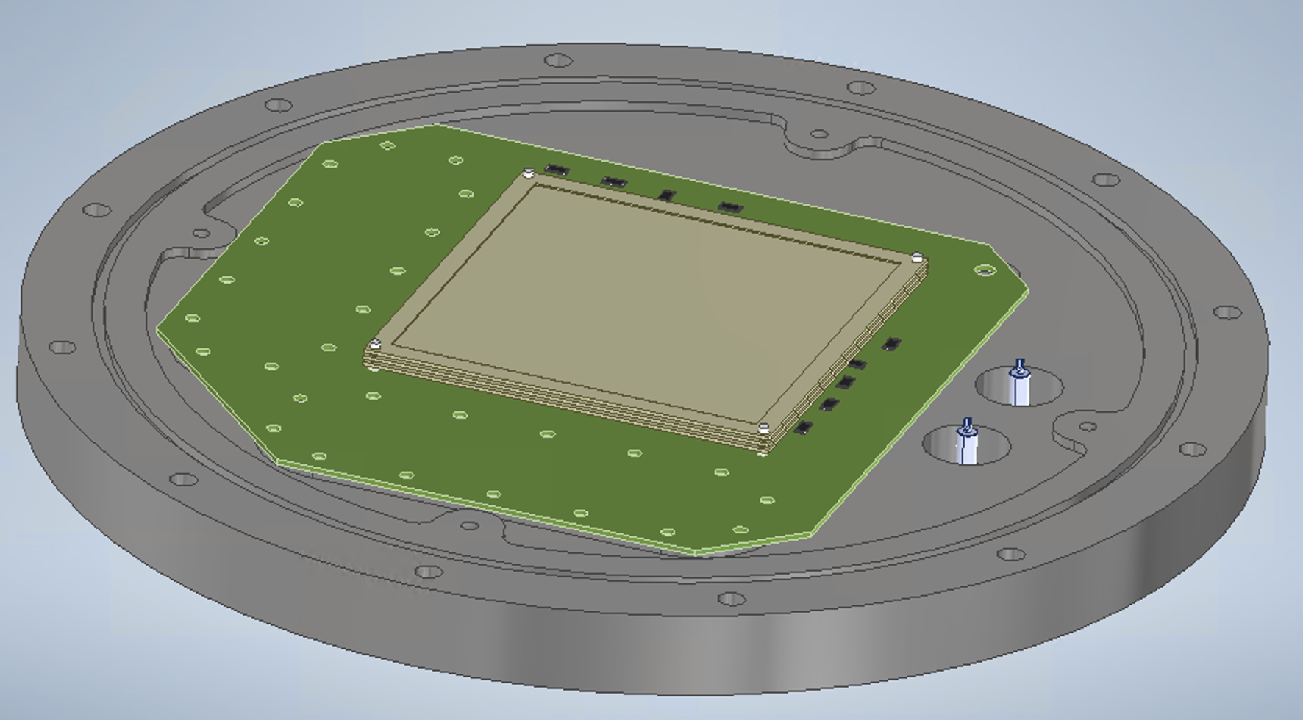
100 cm² active area
10 x 10 cm² double or triple GEM stack
Strip readout:
256 strips per coordinate
400 um pitch between strips
To be used with 512 channel DAQ.

Slide 6
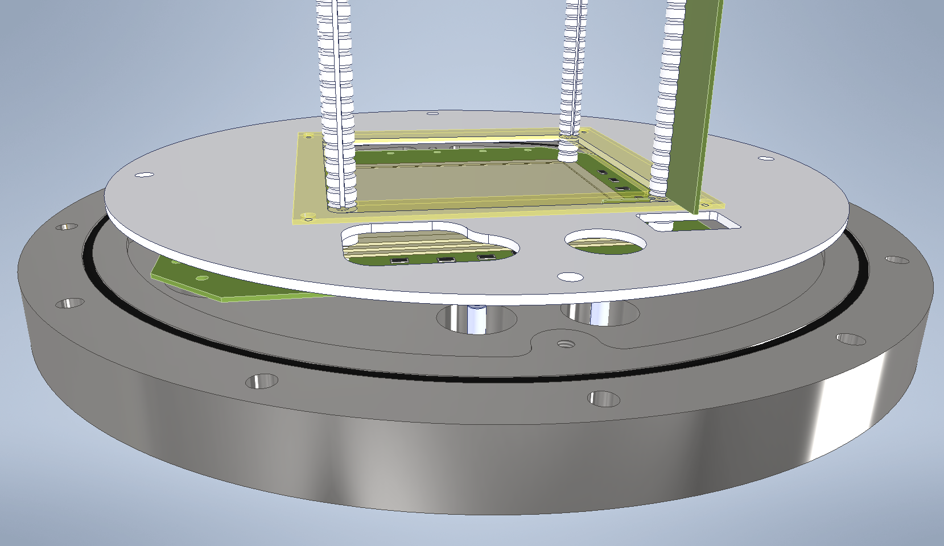
Height ~17 cm
Teflon pillars
Tungsten wires (gold coated?)
Voltage divider in PCB attached to the pillars w/ SMD resistors

Slide 7
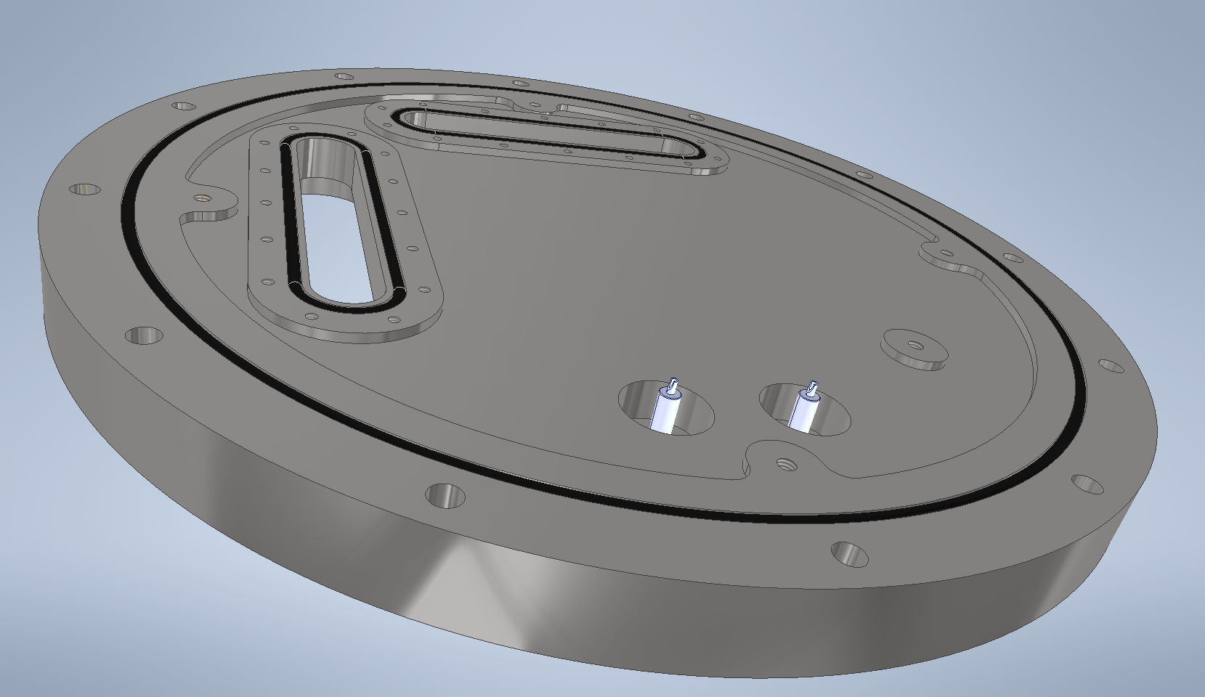
Working pressure >1.3 bar
Hard back with slots for access to the readout.
Each slot has an area of 11 cm2.

Slide 8
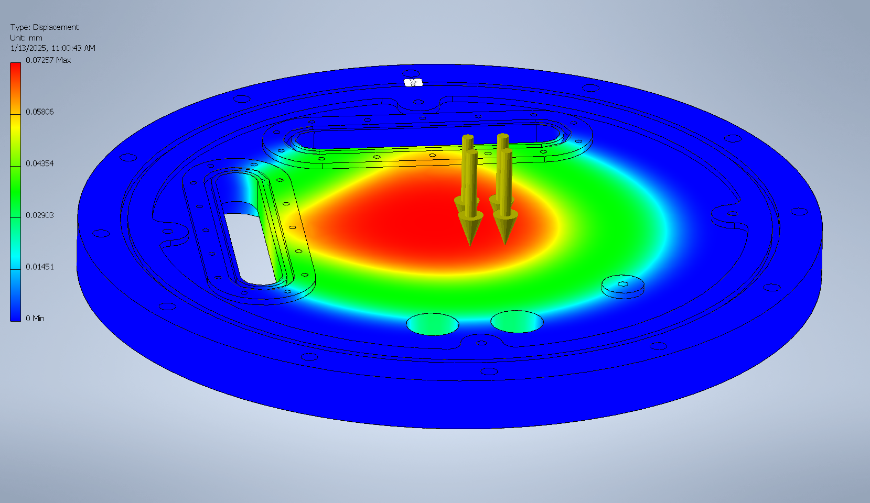
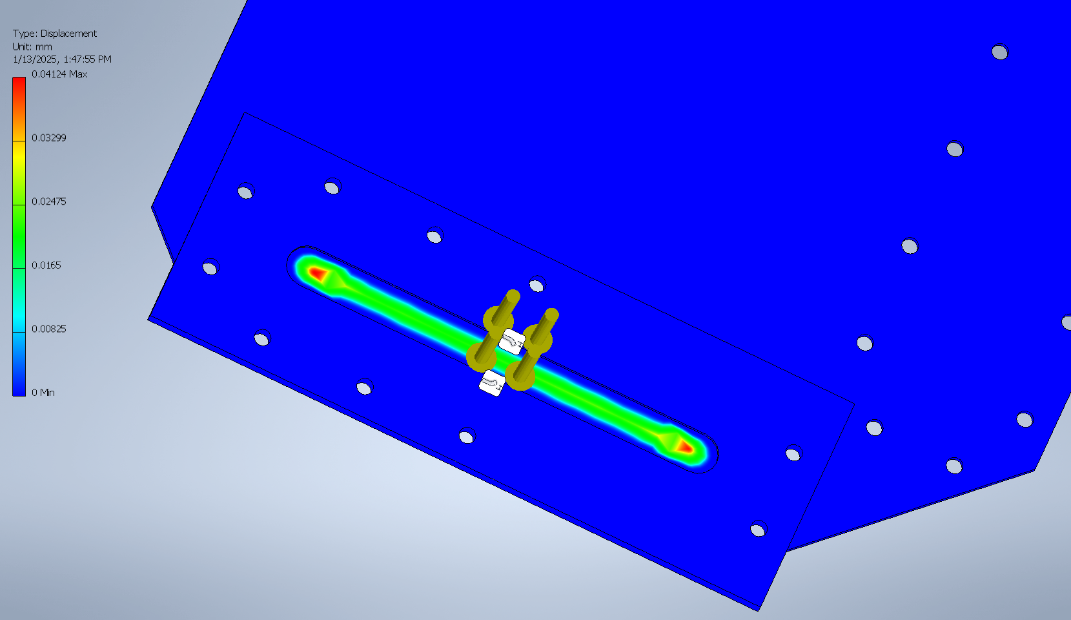
Working pressure >1.3 bar – stress simulations for 10 bar
Flange (steel 22mm) – displacement @10 bar ~70 µm
Readout PCB (FR4 1.6mm) – displacement @10 bar ~40 µm
Stress tests suggest that this setup can hold 10 bar (a maximum pressure will be suggested after testing).
Both thicknesses can be increased if necessary.

Slide 9
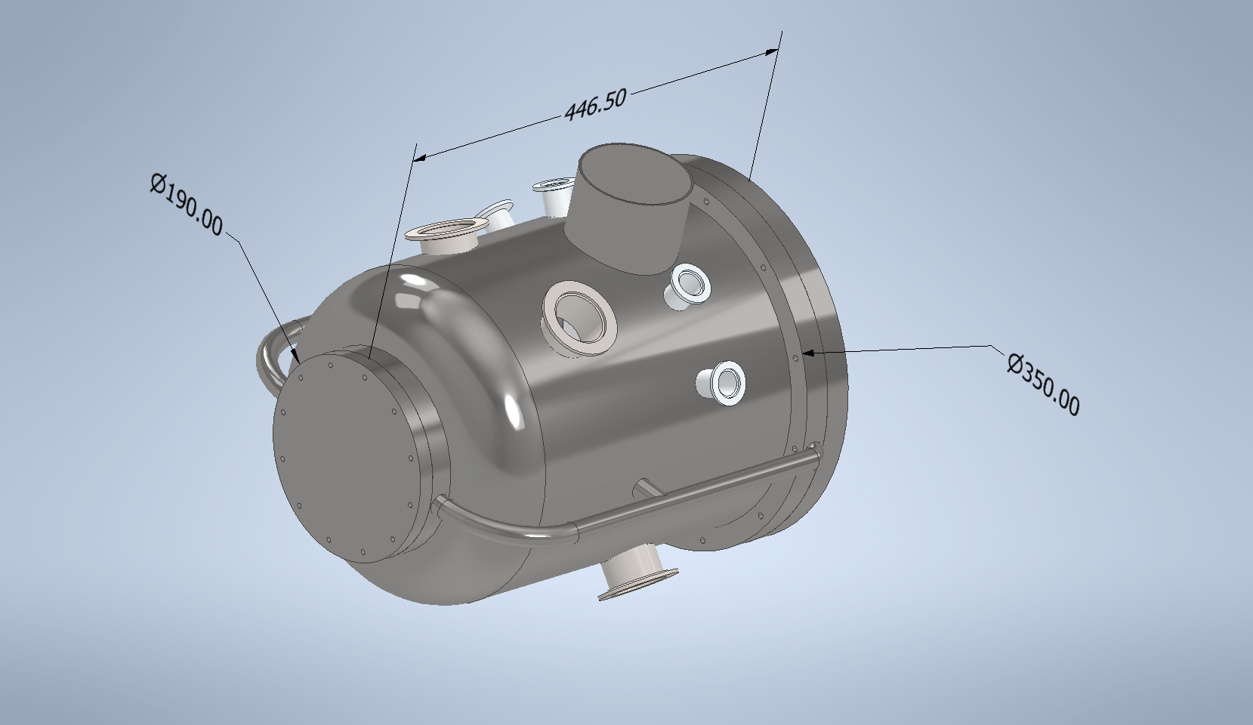
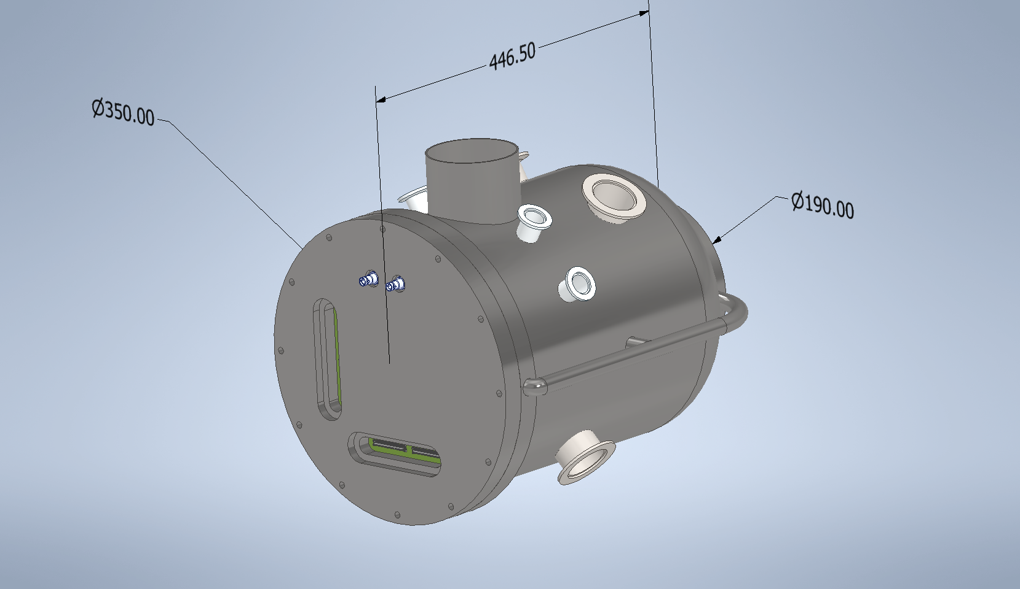
The vessel
We have a budget, but it can be agreed with the French company that build the existing one…
These dimensions are approximate to what was possible to infer from the pictures.
Main difference: no HV feedthroughs in the vessel. Everything in the bottom flange. Bottom and vessel can be totally separated without hanging wires.

Slide 10
Other aspects
Thermal neutron sensitivity
Usage of ¹⁰B cathode.
Absolute z-position
Cannot be done with this budget.
Requires expertise that cannot be guaranteed within the timing of this project.
Data acquisition and data reconstruction (to discuss)
Assuming the use of the currently existing tools.
Development of a new solution is feasible but needs dedicated project, out of the scope of this one, and in collaboration with other institutions.

Slide 11
To discuss
Deliverables
1 TPC detector
1 year support after the 1.5 development
1 progress report (middle of the term)
1 performance (final) report.
timeline,
Servicing and operation components (pumps, vacuum/pressure gauges, sensors),
Data Acquisition and event reconstruction,
Vessel,
Upgrades,
Joint publications resulting from the development period.

Slide 12
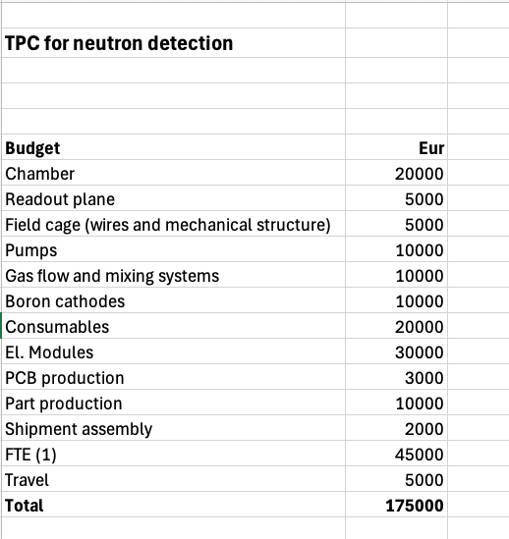
Budget

