Slide 1


Non-destructive nuclear measurements, from R&D to applications
Bertrand PEROT, Nuclear Measurement Laboratory
CEA DES IRESNE / DTN SMTA LMN

Slide 2
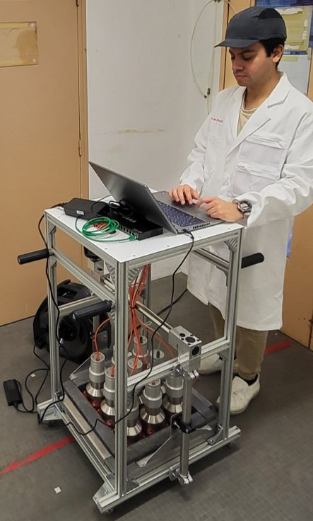
Summary
The Nuclear Measurement Laboratory
Photon imaging
Gamma spectroscopy
Passive & active neutron measurements
Neutron and photon activation analysis

Slide 3
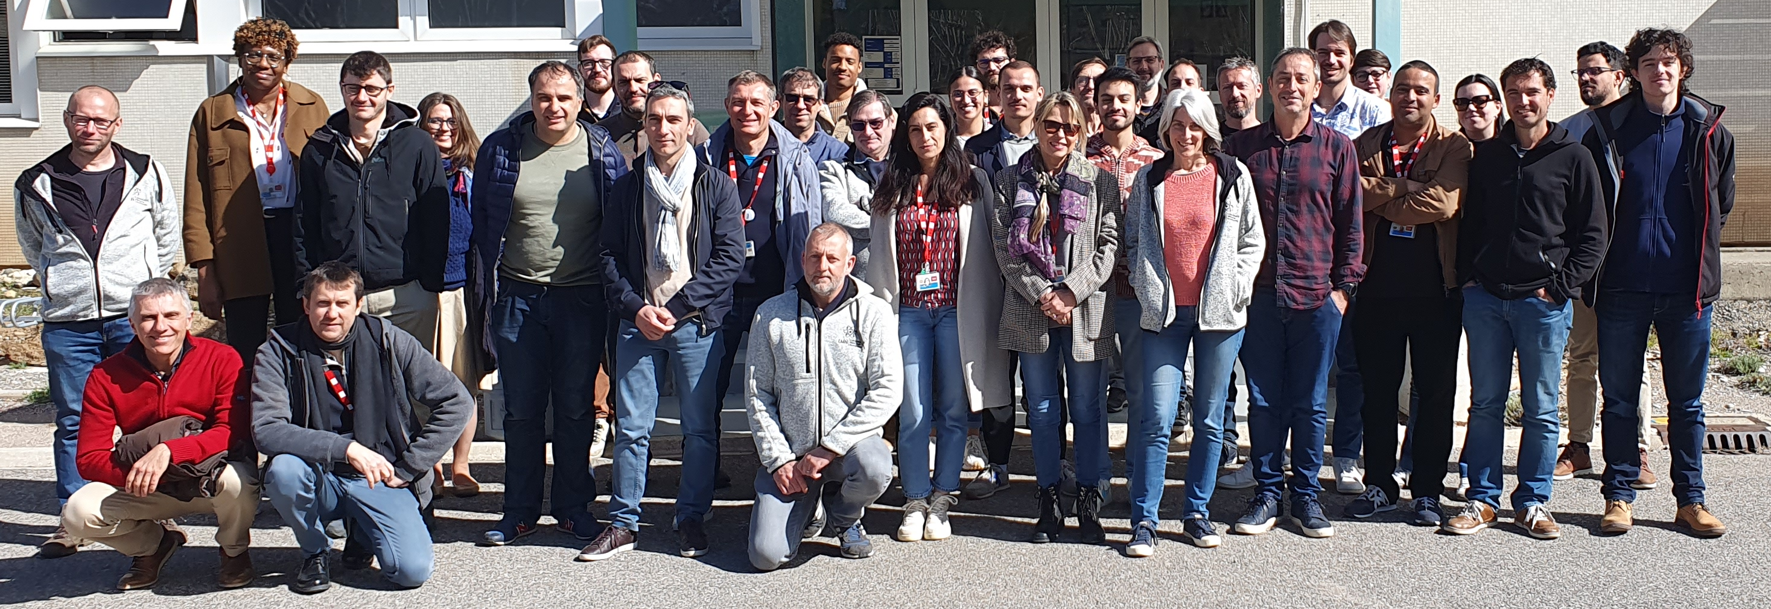
The Nuclear Measurement Laboratory
25-30 permanent staff
5-10 PhD, internships,
temporary researchers
> 50 projects or collaborations on both R&D and applications
Radiological characterization
        Gamma-ray spectroscopy
        Passive and active neutron measurements
        Photofission
Physical characterization
        Photon radiography and tomography
        Neutron radiography
Elemental characterization
        Thermal neutron activation analysis
        Fast neutron activation analysis
Nuclear fuel cycle
        Uranium mining, fuel fabrication & reprocessing
        Radioactive waste characterization
        Dismantling and decommissioning
Reactors
        Non-Destructive Exams for Jules Horowitz Reactor
        Nuclear accident studies and monitoring
Other applications
        CBRNE threats detection, nuclear material controls
        Waste recycling for the circular economy
3

Slide 4
X-ray Imaging
1

Slide 5
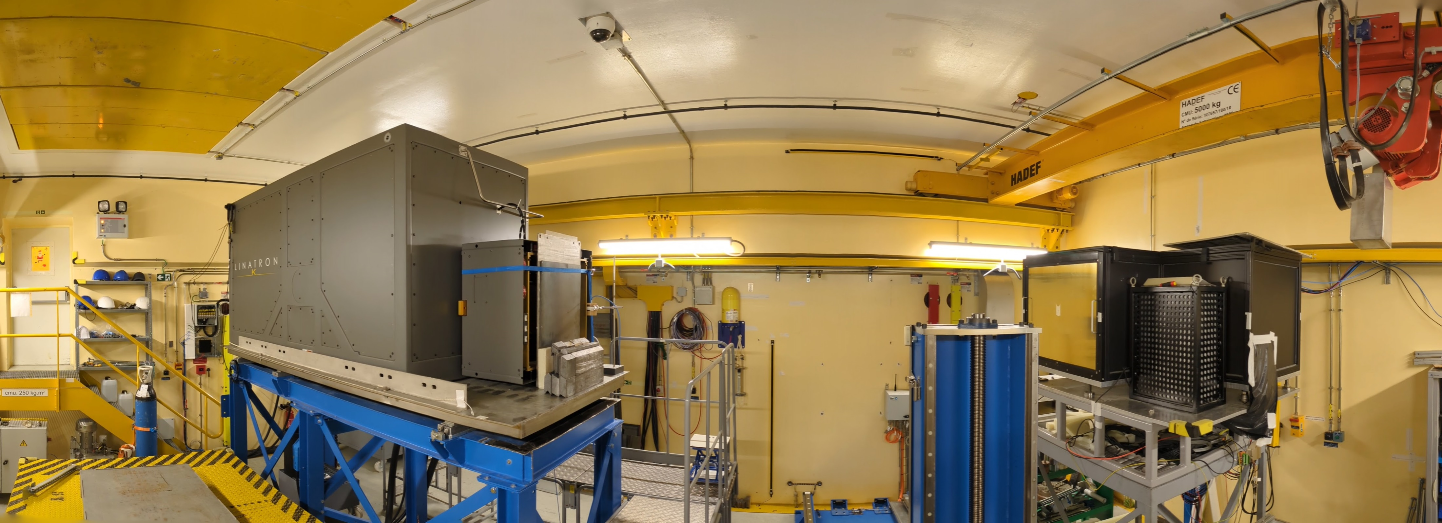
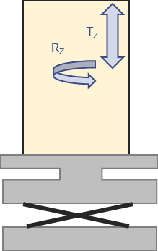
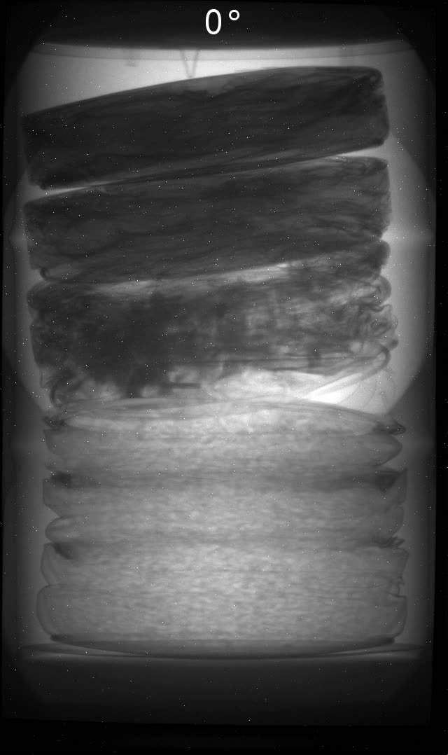
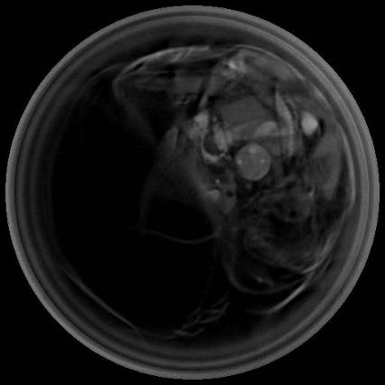
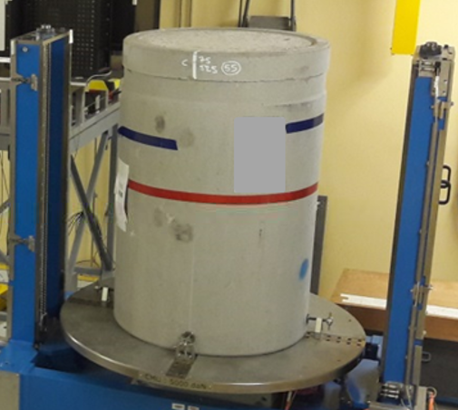
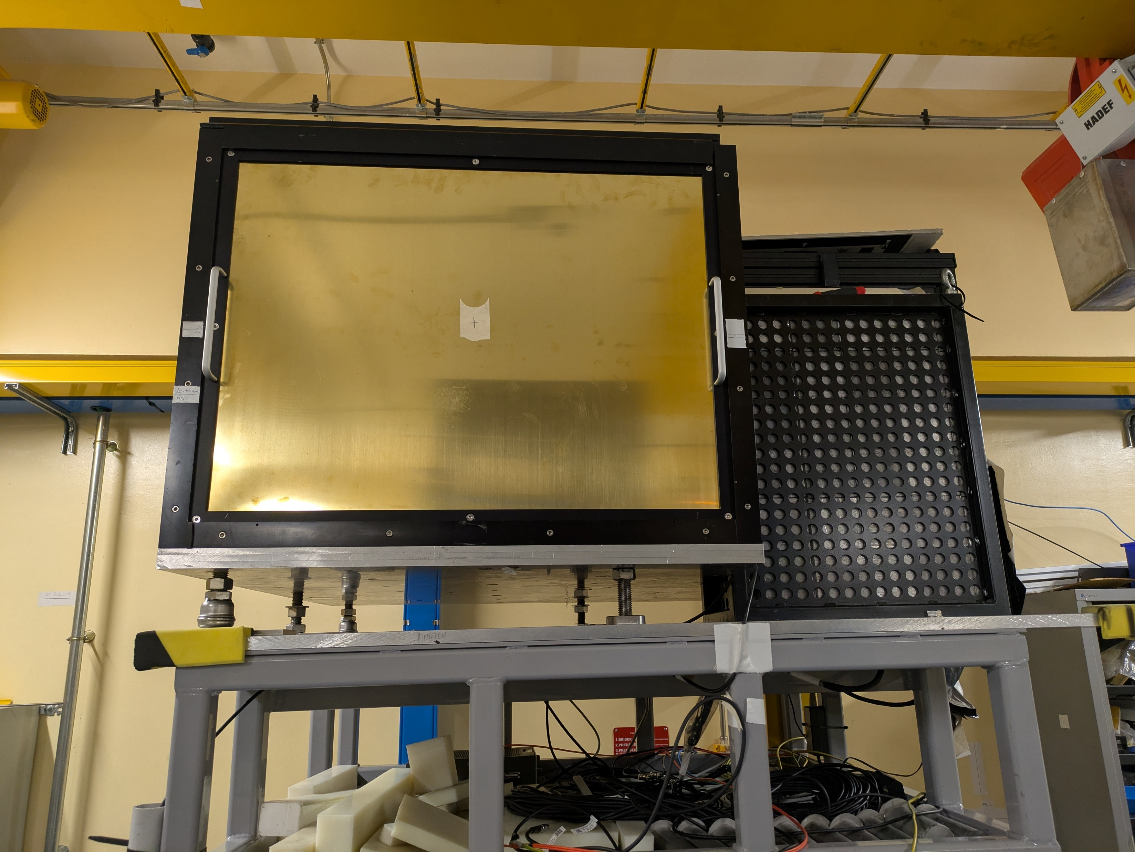
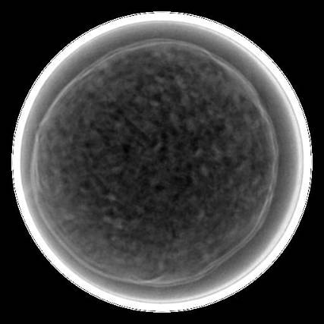

High energy X-ray imaging
X-ray source (electron LINAC)
CINPHONIE casemate in CHICADE facility
45° mirror
Lead
collimator
Bremsstrahlung
X-ray beam
Benoit Geslot
#04-117
Lead
shield
Phosphor screen
Camera
Radiography
Tomography
Varex K15: 9 MV or 15 MV LINAC
(70 or 130 Gy/min at 1 m)
Rotation/elevation bench
(up to 5 tons)
Scintillation plate 800 x 600 mm²
(Gadox Gd₂O₂S - 400 µm)
N. Estre, D. Eck, J-L. Pettier, E. Payan, et al. High-Energy X-Ray Imaging Applied to Non Destructive Characterization of Large Nuclear Waste Drums, DOI:10.1109/ANIMMA.2013.6727987
5

Slide 6
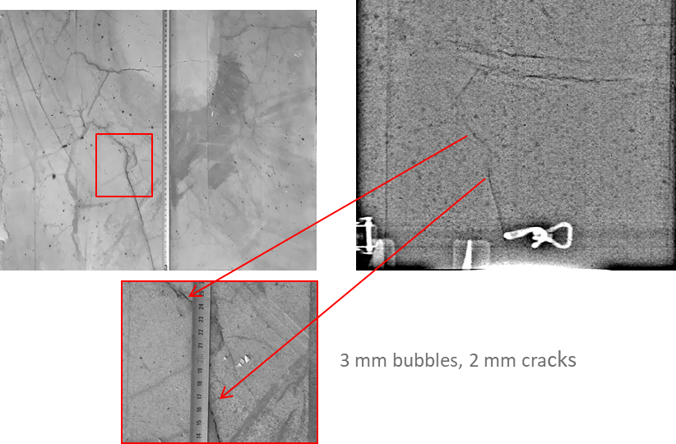
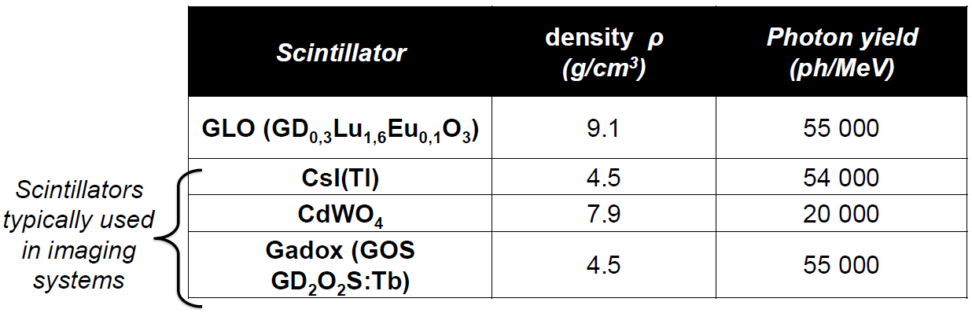
R&D on high resolution imaging
Objective: high resolution imaging 200 µm
Analysis of small objects and defects (bubbles, cracks…)
Comparative studies of linear detectors
Blur reduction using CNN (convolutional neural network)
  trained with ≈ 50 000 pictures with / without blur
  pictures simulated with MODHERATO (LMN code)
New (LLNL)
Old GSO (1800 µm)
Resolution ≈ 800 µm
New GSO (140 µm)
+ CNN ≈ 200 µm
M. Maulin et al., Design of a High-Energy and High-Resolution detector for X-ray computed tomography, EPJ Web of Conferences, ANIMMA2021
M. Maulin PhD thesis, CEA, 2022

Slide 7
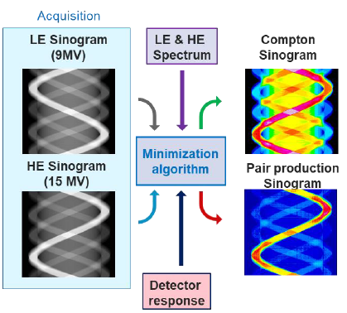
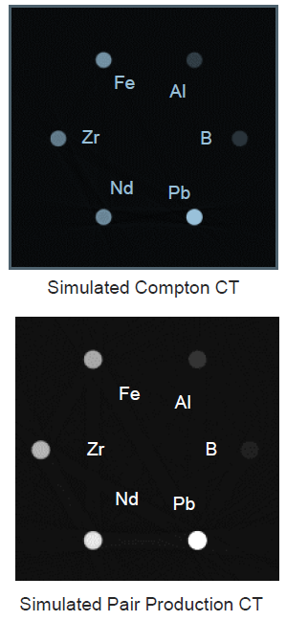
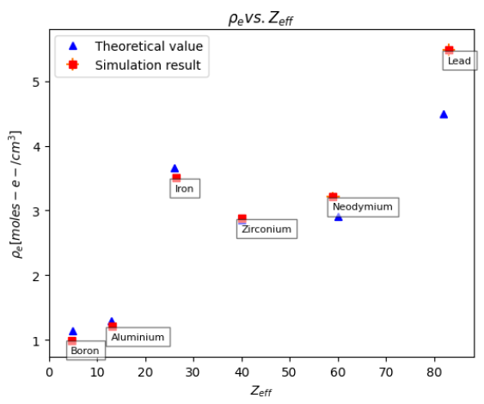
R&D on dual-energy imaging (1st simulation steps)
Goal: ρ_{e} Vs. Z_{eff} to improve material identification (electronic density vs. effective atomic number)
Means: imaging at 9 MeV vs. 15 MeV (“low energy” LE vs. “high energy” HE)
ρ_{e} Vs. Z_{eff}
Filtered back-projection
Using elemental and matrix calibration
A. Sardet et al., High-energy dual-energy computed tomography for the characterization of large and thick objects, iCT2025, 14th Conf. on Indus. Computed Tomography, Antwerp, Belgium

Slide 8

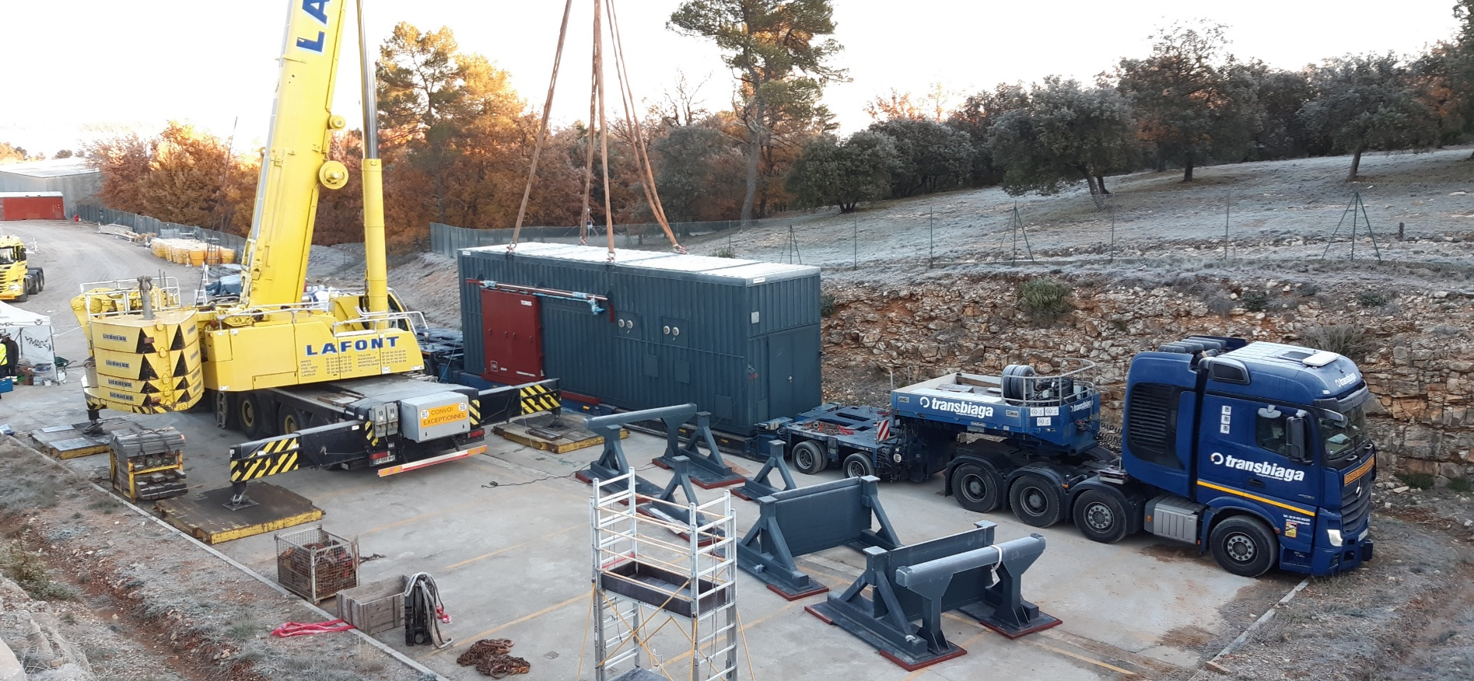
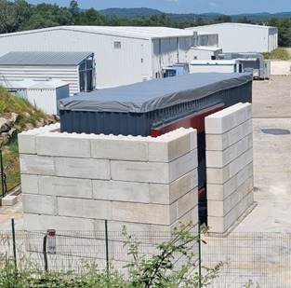
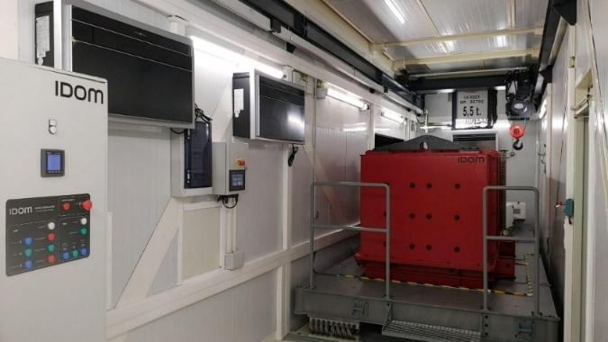
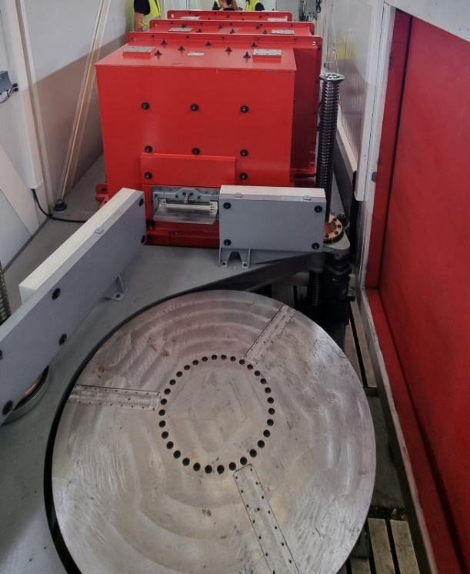
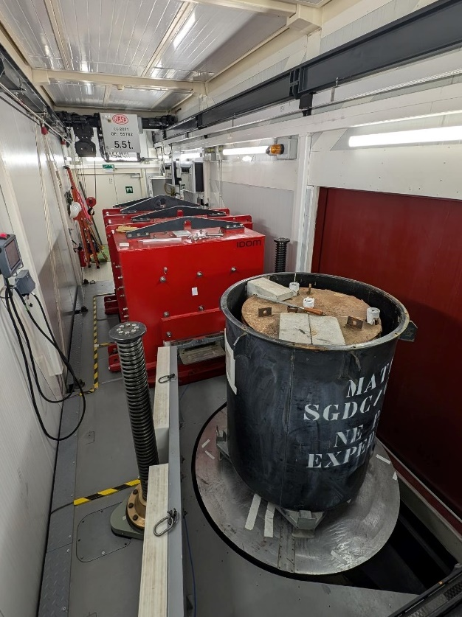
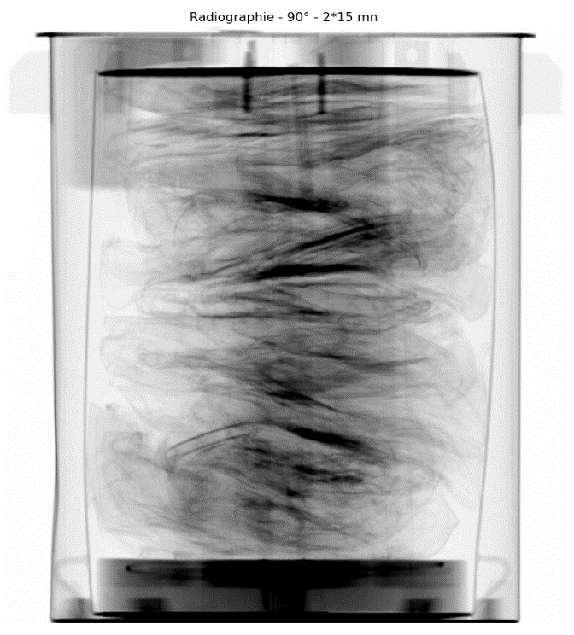
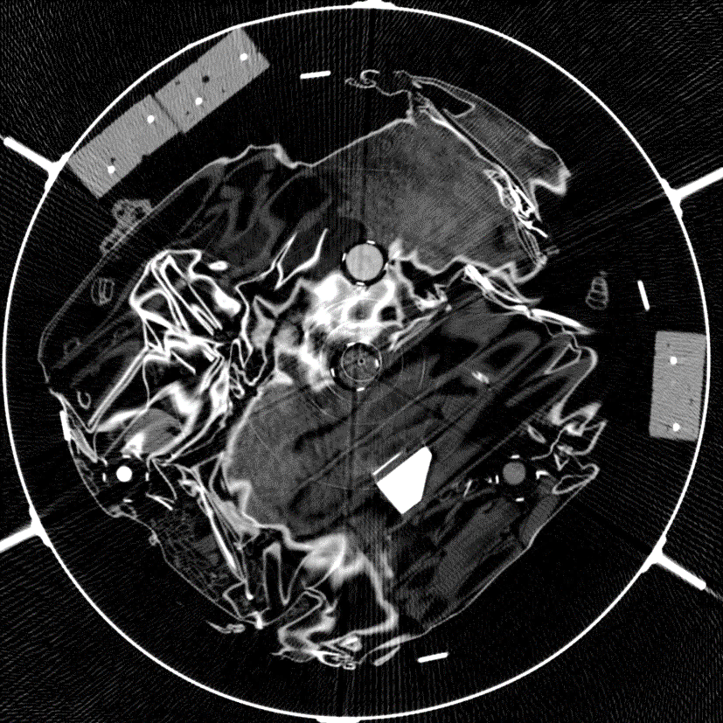

TOMIS mobile high-energy tomography
M9 LINAC 30 Gy/min @ 1 m
Linear CdWO₄ detector
10 mm thick – 1500 mm wide
Beam aperture
Drum
rotating
platform
up to 5T
LINAC shield
M9 LINAC

Slide 9
Gamma-Ray Spectroscopy
2

Slide 10
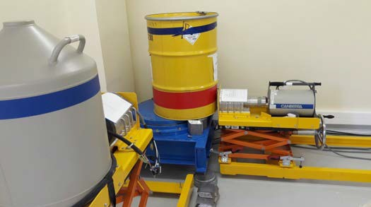
Gamma-ray spectroscopy
High purity
germanium
detectors
Cs-137
Net surface extraction
S_{n}(E)
Compton background
Sn
(
E
)
Radionuclide activities:
=
A
(
E
)
ε
(
E
)
×
I
(
E
)
×
T
Measurement time
Detection efficiency
Gamma-ray intensity

Slide 11
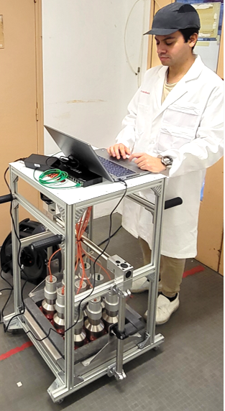
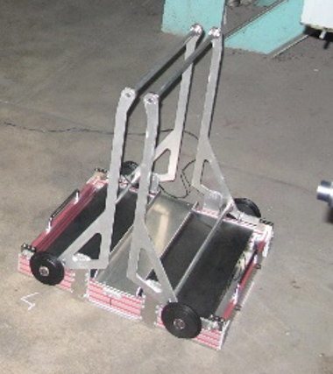
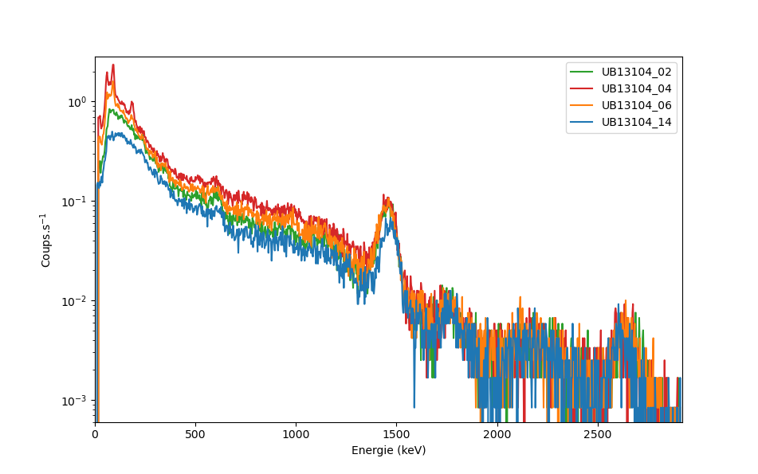
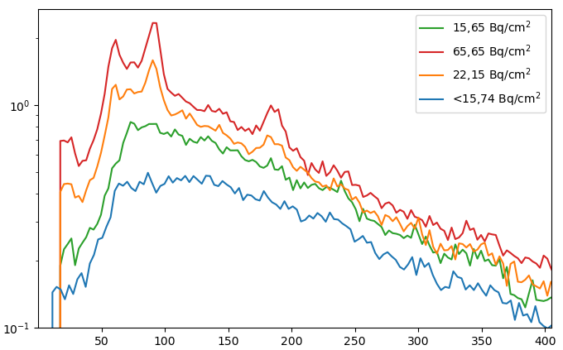
Cleaning and dismantling operations
Fast detection of low-level contamination
for instance < 1 Bq.cm⁻² of uranium on concrete soils
Large ZnS(Ag) and plastic PVT scintillators
⇨ Fast alpha and beta detection (within a few min)
Large NaI(Tl) scintillators
⇨ More precise activity confirmation (within ≈ 15 min)
63 + 92 keV, ²³⁴Th (²³⁸U chain)
U contamination on a concrete soil
(natural U, K, Th background in blue)
185 keV, ²³⁵U
U contamination
Background
Francisco Salvador #07-130
NaI(Tl)
gamma
spectra

Slide 12
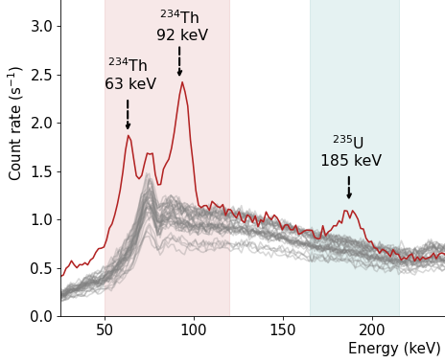

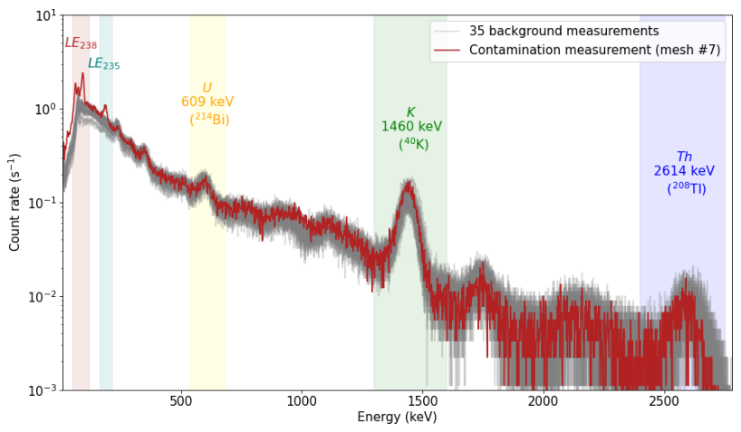
NaI(Tl) spectrum analysis based on energy bands
Large natural background
with significant fluctuations
⇨ estimation by multi-linear regression with U, K, Th bands
Two main U bands
²³⁵U with 185 keV γ ray
²³⁸U with 63+92 keV γ rays (²³⁴Th)
Uranium activity (Bq/cm²)
U enrichment (²³⁵U %wgt)
Patent FR2210553
Francisco
Salvador #07-130
NaI vs. HPGe | HPGe | NaI(Tl)
Acquisition time | 64 h | 15 min
U surface activity | (8.0 ± 0.6) Bq.cm⁻² | (8.5 ± 1.2) Bq.cm⁻²
U enrichment | (0.8 ± 0.1) % | (0.8 ± 0.2) %
F. Salvador et al., Low and high resolution gamma-ray spectroscopy for the characterization of uranium contamination, NIM A 1065 (2024) 169549

Slide 13

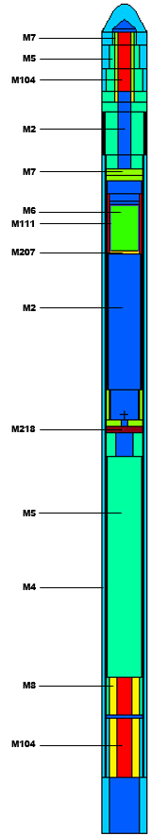
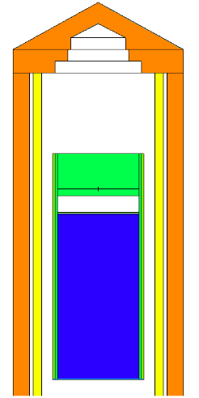
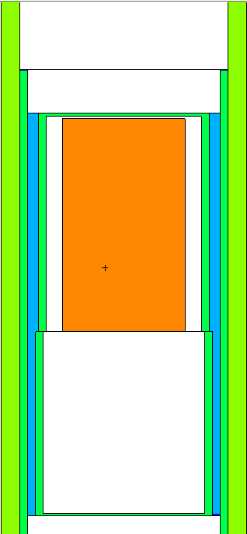
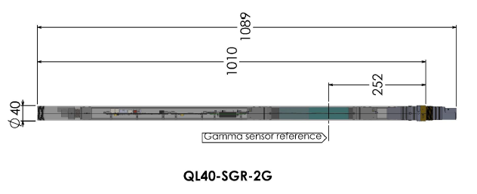
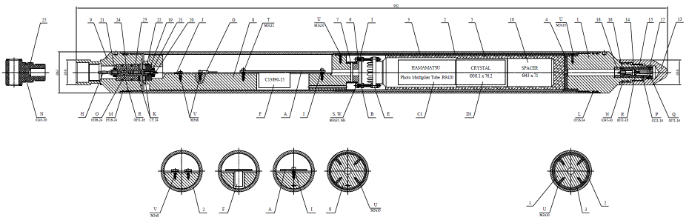
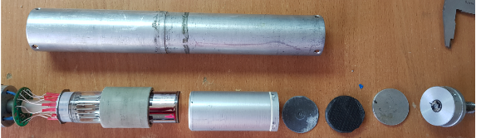
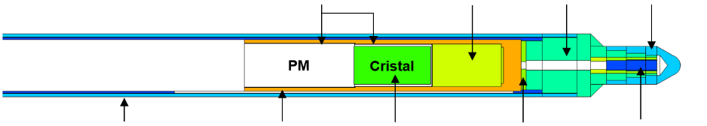

Gamma logging probes for uranium mining
NGRS Probe
Total couting
KSP Probe
Total couting
LaBr₃(Ce) Probe
Spectrometric probe
CeBr₃ Probe
Spectrometric probe
KOBRA
NaI(Tl) 2.4 cm x 3.9 cm
NaI(Tl) 3.0 cm x 7.0 cm
LaBr₃(Ce) 3.81 cm x 7.62 cm
CeBr₃ 2.0 cm x 9.6 cm
m1
m5
m2
NaI
m6
m1
PM
m3
m2
m1
m7
Crystal
L = 697 mm

m2
m3
m3
m4
m4
m5
m8
m6
PM
m4
m7
Arthur Pellet-Rostaing
#10-139
m8
Thomas Marchais #05-34
m9
⌀ 38 mm
Patents for spectroscopic probes WO2021/122772 A1 + WO2023/031465 A1

Slide 14
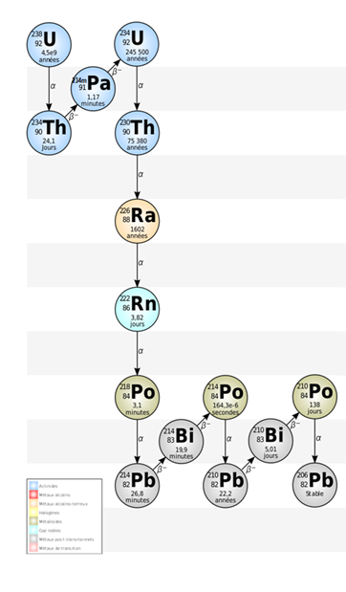
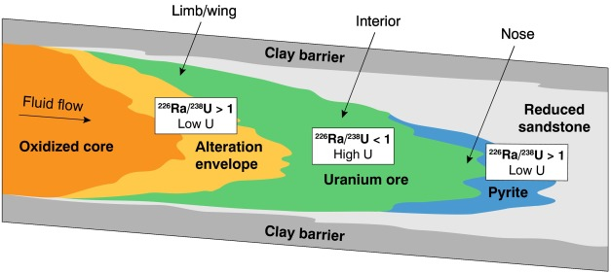
In Situ Leaching Mines ⇨ imbalances in ²³⁸U_{nat} chain
Roll front deposits
92 keV (4.2%)
1001 keV (0.8%)
Origin of
gamma rays
186 keV (3%)
609 keV (45%)
1764 keV (15%)
1120 keV (15%)
352 keV (36%)
295 keV (18%)
242 keV (7%)
Secular equilibrium in U chain is broken
  U / Ra ≠ 1 due to differential leaching in roll fronts
  Ra / Rn ≠ 1 due to radon escape after drilling
U grade over- or underestimation
in total gamma counting probes

Slide 15
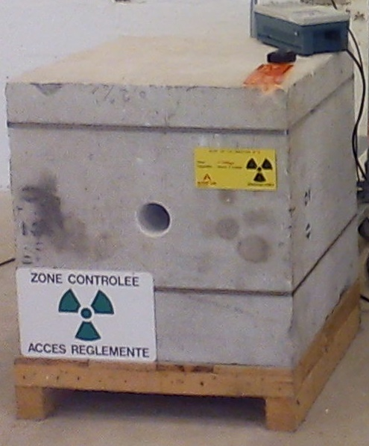
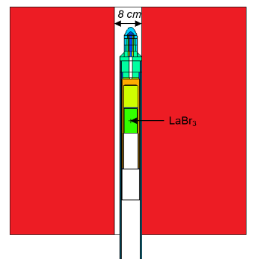
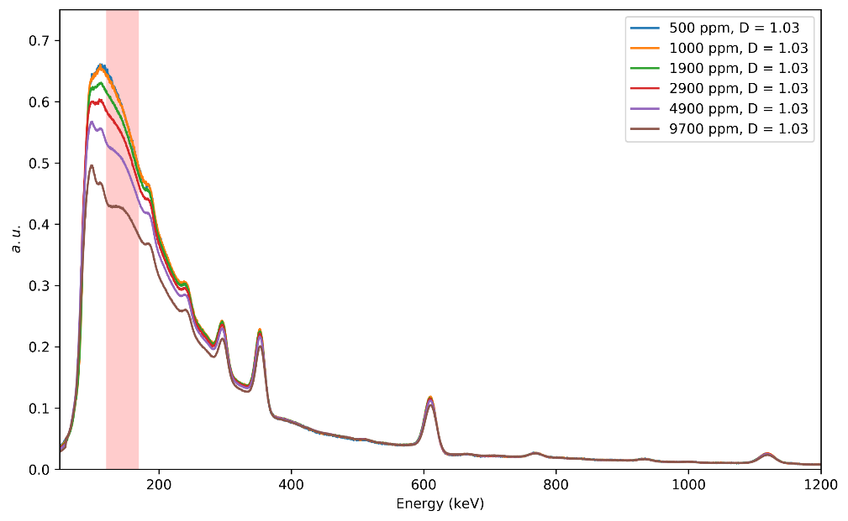
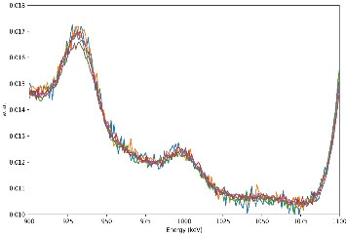
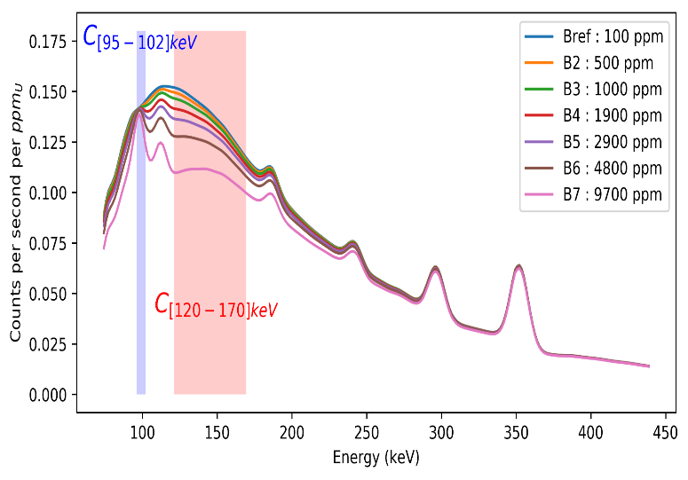
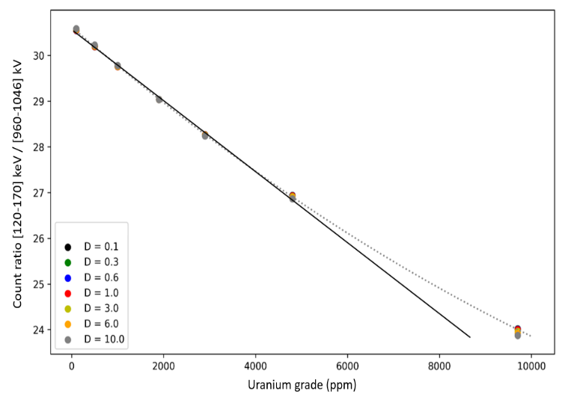
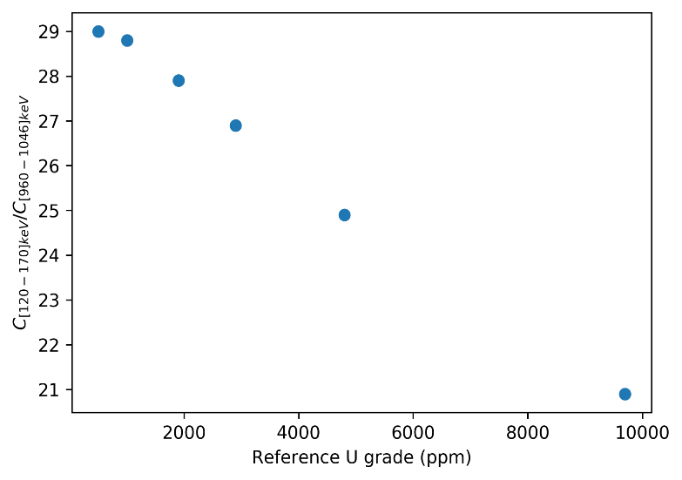
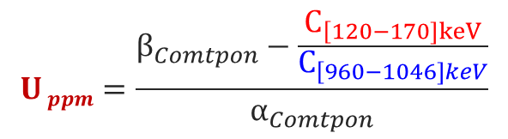
New spectroscopic probes and analysis
MCNP simulations
  Compton counts vs. uranium grade (calibration)
  Uncertainties (disequilibrium, density, mineralogy…)
EXP: ORANO CIME calibration station
  Concrete blocks with U grades up to 10 000 ppm
C_{[960-1046]keV}
$$U ppm=\frac{β_{Comtpon}−\frac{C_{\left[120−170]keV\right.}}{C_{\left[960−1046]keV\right.}}}{α_{Comtpon}}$$
EXP
1001 keV
C_{[120-170]keV}
MCNP
MCNP
EXP
Patent WO2023/031465 A1
Thomas Marchais #05-34
B. Pérot, T. Marchais, P.-G. Allinei, H. Toubon, Y. Bensedik, R. Goupillou, A. Berland, Development of Gamma Spectroscopic Tools for Uranium Ore Samples and Borehole Exploration, 2022 IEEE Nuclear Science Symposium, 5 – 12 November 2022, Milano, Italy

Slide 16
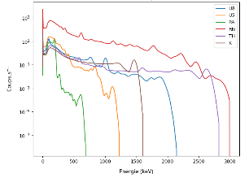
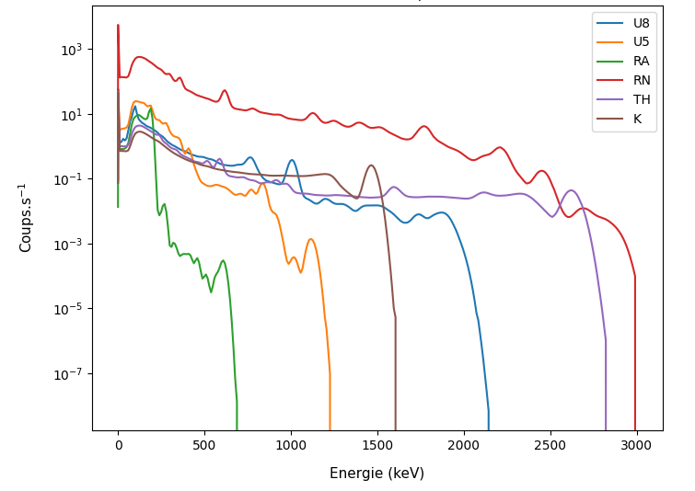
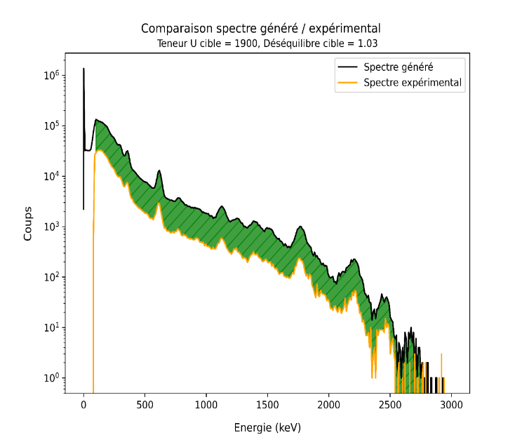
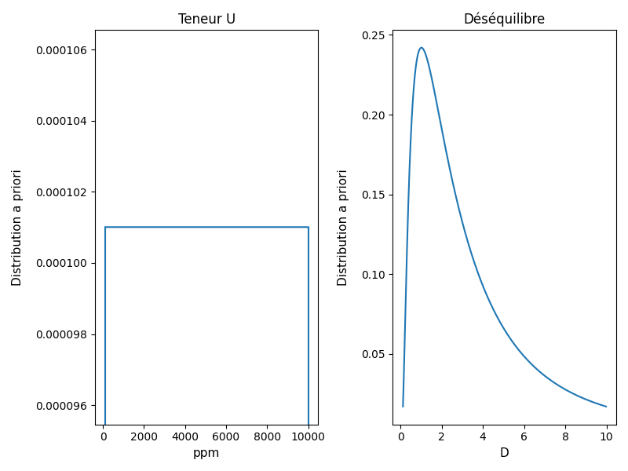
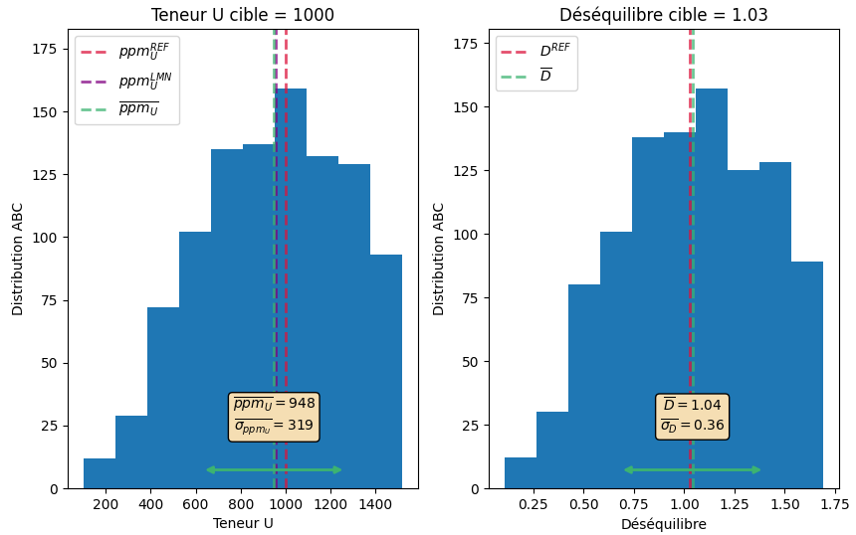

New approaches in logging analysis
Arthur Pellet -Rostaing
#10-139
Bayesian approach (below)
Machine Learning
(under progress)
Prior
distributions
U
grade
U/Ra
$distance =$ $\sum_{i}{({canal}_{i}^{EXP} − {canal}_{i}^{GEN})²}$
i$f distance< ε$
U
U/Ra
Posterior
distributions

Slide 17
Neutron Measurements
3

Slide 18

Main neutron detectors
Cheap but sensitive to gamma rays and no PSD
³He gas detectors : golden standard
in radioactive waste characterization, process monitoring, security, SANS and other physics experiments, etc.
But ³He is expensive
Passive Non Destructive Assay of Nuclear Materials, Los Alamos National Laboratory, NUREG/CR-5550, 1991

Slide 19





Matrix correction: experimental design with MCNP
Experimental design with 104 MCNP simulations
(Taguchi L72 & L32)
Correlation between Pu signals and matrix indicators
(internal monitors & transmission measurements)
Pu passive + active signals
Internal monitors
AmBe transmission
Cyrille Eleon & Quentin Ducasse
#07-42
Quentin Ducasse, Cyrille Eleon, Bertrand Perot, Nadia Perot, and Pierre-Guy Allinei, Application of Machine Learning to MICADO Passive and Active Neutron Measurement System for the Characterization of Radioactive Waste Drums, IEEE TRANSACTIONS ON NUCLEAR SCIENCE, VOL. 71, NO. 5, MAY 2024

Slide 20



Matrix effect correction: predictive models
Passive coincidence counting
Training dataset based
on MCNP simulations
Matrices PE, PVC, Fe…
Densities 0.1 to 0.7 g/cm³
Filling heights 50 to 100%
Regression models
Ordinary Least Squares
Random Forest
Multi-layer Perceptron
Results
#2
#4
Active neutron interrogation
#3
Cyrille Eleon & Quentin Ducasse
#07-42
Achment CHALIL #7-51 (Bayesian)
#1
+
Q. Ducasse, C. Eleon, B. Perot, N. Perot, P.-G. Allinei, Application of Machine Learning to MICADO Passive and Active Neutron Measurement System for the Characterization of Radioactive Waste Drums, IEEE TRANSACTIONS ON NUCLEAR SCIENCE, VOL. 71, NO. 5, MAY 2024

Slide 21





Plastic scintillators as an alternative to ³He counters
Wood
Iron
16 PVT scintillators 10 cm ×10 cm ×100 cm
With or without 5 cm lead shield
Metallic and organic matrices in 118 L drums
¹³⁷Cs, ⁶⁰Co, ²⁵²Cf, AmBe sources, Pu samples
“FASTER” electronics (CNRS)
⇨ ns scale (instead of µs with ³He)
⇨ low accidental level (wrt. ³He)
γ-γ coincidences
Rossi-alpha histogram (times of next pulses after a 1st detection)
Vincent Bottau #5-70
γ-n (and n-n) coincidences
Accidental coincidences
Time (ns)

Slide 22



Coincidence Multiplicity analysis
Vincent Bottau #5-70
Shift register method to unfold real from accidental coincidences
At least 3 pulses in coincidence
to separate spontaneous fissions (Pu or ²⁵²Cf) from parasitic coincidences of (α,n) reactions, gamma cascades…
$\frac{\text{S}\text{pontaneous} \text{fission} \text{neutrons} \text{of}\text{ 252}\text{Cf}}{\begin{aligned}\text{(}\text{α,}\text{n}\text{)} \text{neutron}\text{s} \text{of} \text{AmBe} \\ \end{aligned}}$ ≈ 0.16
 | ²⁵²Cf (3.6x10⁴ n/s) |  | AmBe (2.3x10⁵ n/s) |  | ⁶⁰Co (882 kBq)
 | R+A | A | R+A | A | R+A | A
M0 | 3379137 | 4479459 | 15577017 | 16671802 | 53638186 | 57771864
M1 | 857974 | 8310 | 1141198 | 102194 | 4947762 | 989025
M2 | 209237 | 1296 | 59474 | 5790 | 251249 | 81991
M3 | 38098 | 257 | 2312 | 253 | 9079 | 3516
M4 | 4806 | 42 | 67 | 14 | 239 | 97
M5 | 401 | 5 | -9 | 0 | -11 | 2
M6 | 18 | 1 | -3 | 0 | -7 | 0
M7 | -1 | 0 | -2 | 1 | -2 | 0
S | 14 965.6 s⁻¹ |  | 55 933.5 s⁻¹ |  | 196 155.0 s⁻¹
D | 4 667.6 s⁻¹ |  | 3 842.5 s⁻¹ |  | 14 381.3 s⁻¹
T | 1 174.8 s⁻¹ |  | 174.9 s⁻¹ |  | 342.2 s⁻¹
V. Bottau, et al, Sorting fission from parasitic coincidences of neutron and gamma rays in plastic scintillators using particle times of flight, ANIMMA 2021 International Conference, Prague, Czech Republic, EPJ Web of Conferences 253, 07014 (2021)
Triples $\frac{\text{T}\text{(252}\text{Cf}\text{)}}{\begin{aligned}\text{T}\text{(}\text{AmBe}\text{)} \\ \end{aligned}}$ ≈ 6.7
S, D, T = singles, doubles, triples
after real vs. accidental
coincidence unfolding

Slide 23


Improving S/N ratio using inter-pulse delays
Patents
FR1914402A
(this slide)
FR2406476
(Pu vs. Cm
discrimination)
^{(γ n n) region of interest}
Vincent Bottau #5-70
Radioactive source | Counts in ROI
²⁵²Cf (3.6×10⁴ n.s⁻¹) | 10894
AmBe (2.3×10⁵ n.s⁻¹) | 761
⁶⁰Co (882 kBq) | 522
SNR (²⁵²Cf/AmBe) | 14.3*
V. Bottau, C. Carasco, B. Perot, C. Eleon, R. De Stefano, L. Isnel, I. Tsekhanovich, Sorting fission from parasitic coincidences of neutron and gamma rays in plastic scintillators using particle times of flight, ANIMMA 2021 International Conference, June 2021, Prague, Czech Republic, EPJ Web of Conferences 253, 07014 (2021)
* After neutron and gamma scattering cross talk rejection
(see next slide)

Slide 24






Neutron logging probe for U grade and H porosity
Patent FR2110722
Count rate (s⁻¹)
SODERN DT
neutron generator
H porosity (%)
³He detection block (PE + Cd)
Backscattered
neutrons ⇨ H
Valentin Fondement
#5-143
Fission prompt
neutrons ⇨ U
V. Fondement et al., Development of a neutron probe to perform a combined measurement of uranium concentration and hydrogen porosity for mining applications, NIM A 1059 (2024) 168888

Slide 25
Neutron & photon activation analysis
4

Slide 26




Pulsed Neutron Activation Analysis
Borehole logging (mining, oil..)
Radioactive waste (toxic chemicals, matrix…)
Industry (online analysis, recycling)
Environment (water, soils…)
…
HPGe gamma spectra
Neutron
flux
Basalt
Time
A few 10 µs
Up to few ms
Fast neutrons during pulses ⇨ (n,n’γ)
Thermal neutrons between pulses ⇨ (n,γ)
(+ delayed gamma rays of activation)
A. Parsons et al., "Subsurface In situ elemental composition measurements with PING," 2013 IEEE Aerospace Conference, Big Sky, MT, USA, 2013

Slide 27




PGNAA with gamma coincidences
New R&D topics in critical raw material recycling (e.g. detection of dysprosium in permanent magnets)
New approach ⇨ (n,γ) coincidences with large NaI(Tl) scintillators
⇨ Low energy resolution of NaI(Tl) compared to HPGe but high efficiency
⇨ Fast gamma coincidences (ns) to reduce the background and separate gamma rays (see next slide)
PE moderating
cell with a
graphite core
5’’x5’’x10’’
NaI(Tl) detectors
+ Pb and B shield
One 30 % HPGe
replacing a NaI for comparative tests
J. Roult et al. Prompt Gamma Neutron Activation Analysis with Gamma-Gamma Coincidences for Recycling Waste Characterization, 2022 IEEE Nuclear Science Symposium, Milano, Italy
Jeremy Roult dit Rouaux PhD Thesis, Prompt gamma neutron activation analysis for the detection of strategic metals in conventional waste, 2024

Slide 28




Diagonal projections on 2D spectra
Sulphur sample
Improved signal-to-noise ratio
1D Gaussian fit
Patent WO2025/026740 A1
gamma pairs whose sum of energies is equal to a specific value : E1 + E2 = 8642 keV
gamma pairs whose sum of energies is equal to a specific value : E1 + E2 = 6262 keV
Jeremy Roult dit Rouaux et al, Journal of Radioanalytical and Nuclear Chemistry (2024) 333:6577–6592 https://doi.org/10.1007/s10967-024-09822-x

Slide 29




The associated particle technique
Fast neutron interrogation with a DT neutron generator embedding an alpha detector
Alpha detector
(position sensitive)
Neutron TOF
(alpha-gamma coincidence)
Tagged neutrons
Volume of interest
Built-in segmented alpha detector
Volume of interest
Gamma spectrum (of the selected volume)
Unfolding (with a calibration database)

Slide 30

























Tagged Neutron Inspection System, calibration
Database of neutron-induced elemental spectra
Al
C
Ca
Cl
Cr
Al
C
Cu
F
Fe
K
Mg
Mn
N
Na
Ni
O
P
Pb
S
Si
Zn
C. de Sainte Foy et al., "Optimization of the ENTRANCE Rapidly Relocatable Tagged Neutron Inspection System," 2022 IEEE Nuclear Science Symposium and Medical Imaging Conference (NSS/MIC), Italy, 2022

Slide 31



Field tests in Rotterdam seaport
40 kg of C4 explosive simulant in a cigarettes cargo, 10 min
To be watched in
presentation mode

Slide 32



Photofission with delayed particle detection
R&D program for U and Pu characterization in large concrete radioactive waste packages
Delayed neutron counting between LINAC pulses (historical method) but high attenuation in concrete
Delayed gamma spectroscopy after irradiation (HPGe) or between pulses (scintillators LaBr, BGO… )
Prompt
γ rays
Delayed γ rays
High-E photons
(> 6 MeV)
Photofission
cross
sections
Delayed neutrons
Prompt
γ rays
Delayed γ rays
U or Pu
nucleus
Prompt neutrons
Delayed neutrons
Waste package
LINAC
Brems-
strahlung
photon
spectrum
LINAC
Gamma
detector
Photofission delayed γ rays
High-E
photons
U or Pu photofission

Slide 33



HPGe detection tests of U samples in concrete
LINAC head with its neutron shield
Irradiation 2h
HPGe acquisition 2h
Transfer to HPGe
and cooling delay
(< 1 min)
Benoit Geslot
#04-117
Highly shielded HPGe
Counts
With U sample (17 cm depth)
Active background
Manon Delarue, PhD Thesis, 2020 https://theses.fr/2022GRALY060
M. Delarue et al., New measurements of cumulative photofission yields of ²³⁹Pu, ²³⁵U and ²³⁸U with a 17.5 MeV
Bremsstrahlung photon beam and progress toward actinide differentiation, NIM A 1040 (2022) 167259
Energy (keV)

Slide 34




U detection with scintillators in pulsed irradiation
LaBr₃(Ce) scintillator
Photofission delayed gamma-ray spectra
in 10 min acquisitions
(200 cycles of 3 s)
Concrete matrix
Benoit Geslot
#04-117
U sample
positions
LaBr
LINAC
32°
Energy threshold | Net counts from ²³⁸U | Background counts | Net counts / background
2 | 544017$±$ 826 | 69371 | 8
2.5 | 308041$±$599 | 25434 | 12
3 | 171349$±$429 | 6496 | 26
3.5 | 92585$±$310 | 1824 | 51
4 | 48954 $±$226 | 1184 | 41
4.5 | 24960$±$164 | 1004 | 25
5 | 12357$±$118 | 866 | 14
1 s of
irradiation
1 s of
cooling
1 s of
counting
C. Carasco et al. Photofission delayed gamma-ray measurements in a large cemented radioactive waste drum during LINAC irradiation, NIM A 1053 (2023) 168360

Slide 35
Conclusion and Prospects
8

Slide 36
Conclusion
Nondestructive nuclear measurements
      Fast, cost effective, global assessment of large objects, no secondary waste…
      Radiological, physical and elemental characterization
      Wide range of laboratory or in situ applications
Innovation driven by technology, computing power, AI and data sciences …
    Detectors ⇨ CdTe/CZT, LaBr₃(Ce), CeBr₃… ³He alternatives, gamma and neutron cameras…
    Electronics ⇨ digital pulse processing, pulse dating, on board data processing, compact, fast, high dynamic range and resolution…
    Radiation sources ⇨ high intensity, low noise, compact, transportable, self-shielded, high energy and spatial resolution (small spot LINAC for imaging), new laser sources (X-ray + neutron) …
    High performance computing ⇨ realistic numerical simulations (Monte Carlo neutron and photon transport codes, X-ray imaging…), data processing of both simulation and experimental results (imaging, pulse-by-pulse analysis of list mode data…)
    Data sciences and AI ⇨ Sensitivity Analysis, Machine Learning, Bayesian methods…

Slide 37
Prospects
  Nuclear industry
      Nuclear fuel cycle: uranium mining and enrichment, fuel fabrication, spent fuel reprocessing and recycling
      Reactors: fission (in/ex core), fusion (diagnostics), severe accident monitoring…
      Radioactive waste characterization + Cleaning and Dismantling nuclear facilities
  Non nuclear applications
      Non-destructive testing: online process monitoring, infrastructure inspection, petrol and mining exploration/exploitation, recycling / circular economy …
      Non industrial applications: environment, biology, medicine, physics, archeology …
  Defense, Homeland Security, Safeguards
      Illicit trafficking and CBRNE threats detection: explosives, narcotics, chemical warfare, nuclear materials, contraband goods …
      Safeguards: transportable systems to characterize nuclear materials

Slide 38





CEA Cadarache
bertrand.perot@cea.fr
Thank you!

