Slide 1
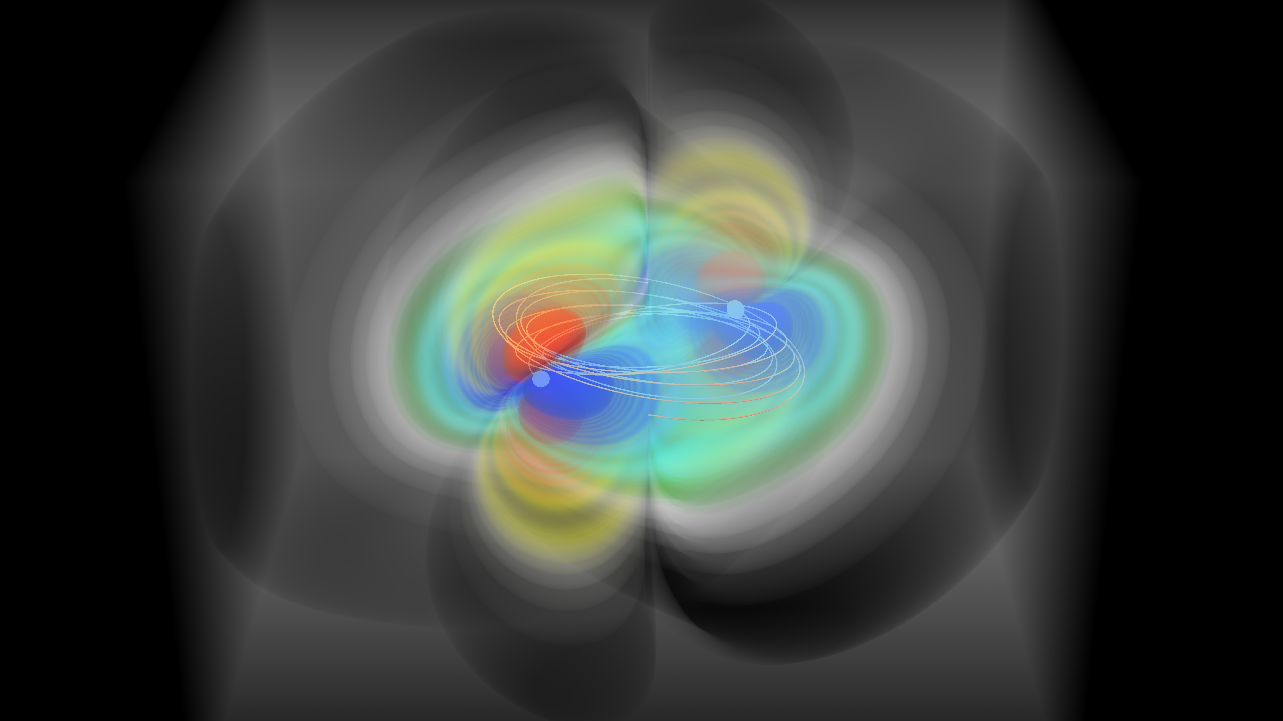


Gravitational waves with ground-based detectors
Alicia M Sintes
The 9th International Conference on
Advancements in Nuclear Instrumentation Measurement Methods and their Applications
ANIMMA 2025 Conference, June 10th 2025
Hotel Meliá Valencia, Valencia, Spain

Slide 2
Laser Interferometer Gravitational-Wave Observatories
GW150914: the first detection
2

Slide 3
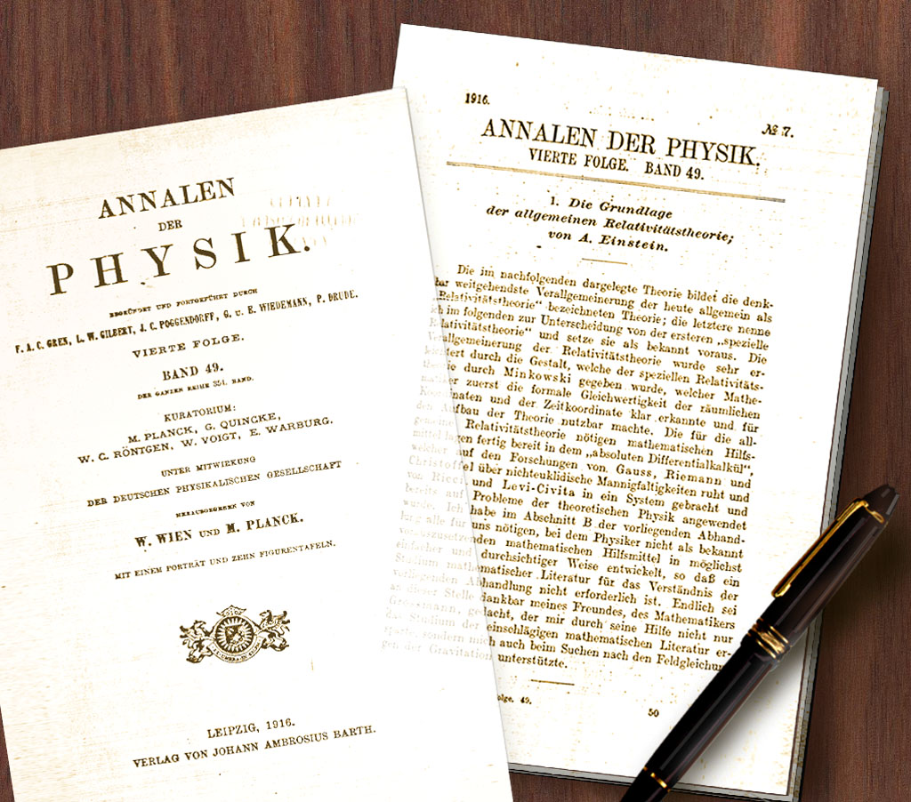
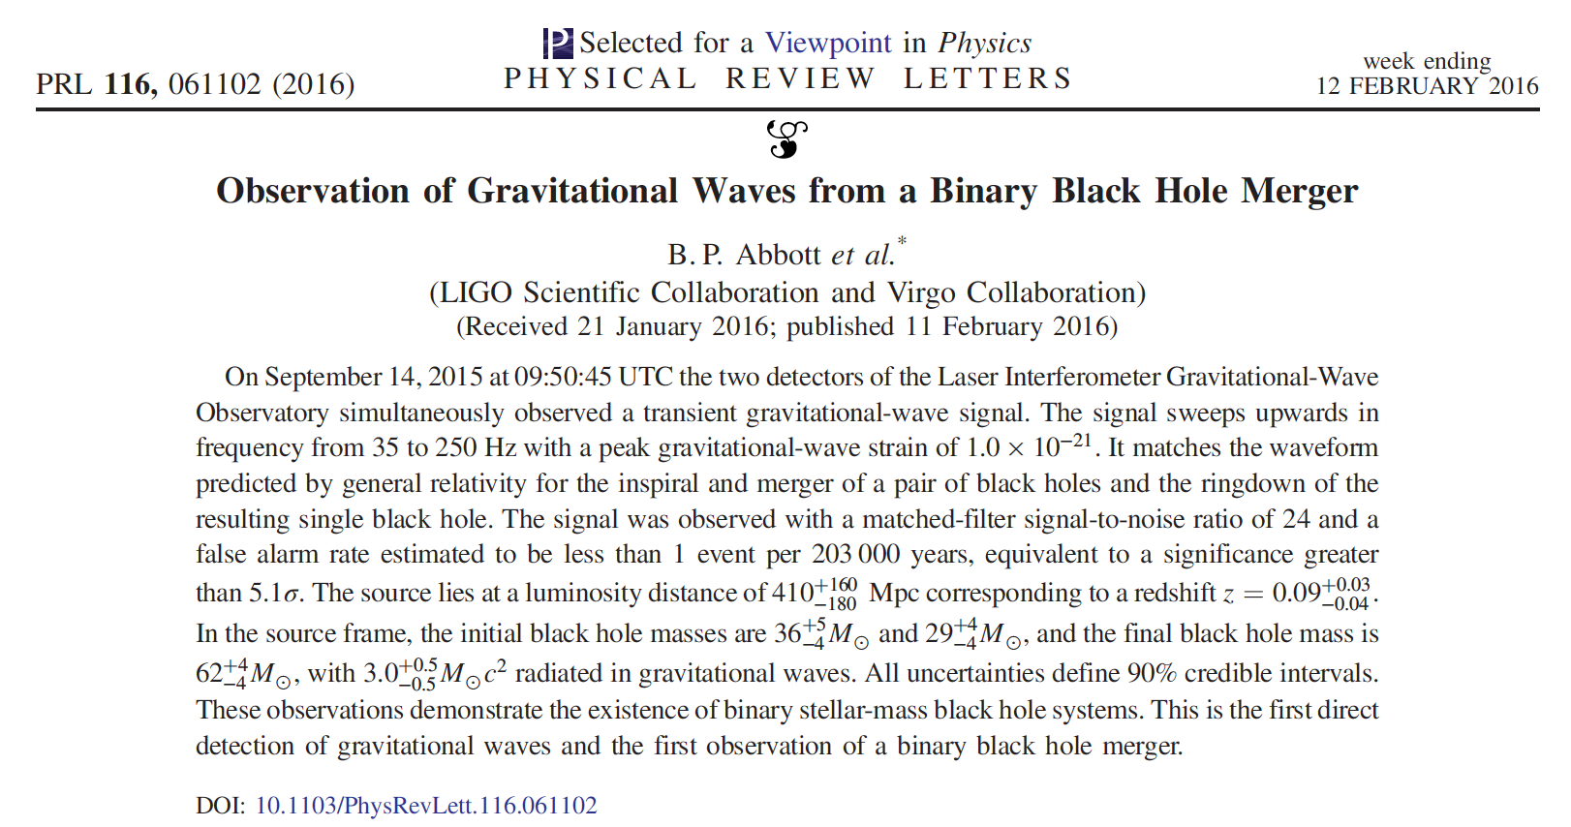
A century of General Relativity
3

Slide 4
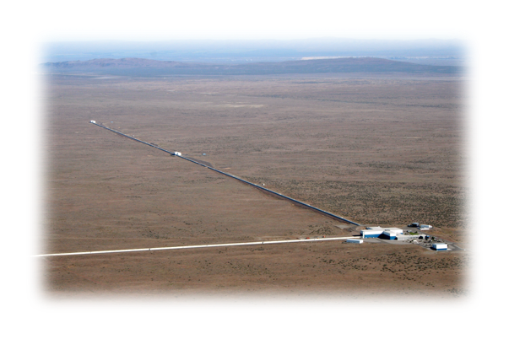
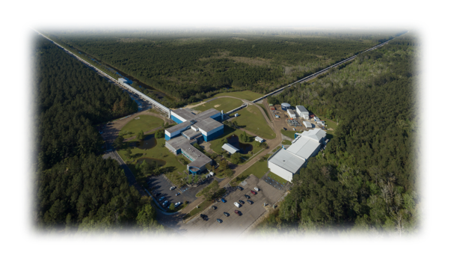
Observation of Gravitational Waves from a Binary Black Hole Merger
(September 2015) - GW150914
Abbott, et al., LIGO Scientific Collaboration and Virgo Collaboration, “Observation of Gravitational Waves from a Binary Black Hole Merger” Phys. Rev. Lett. 116, 061102 (2016)

Slide 5
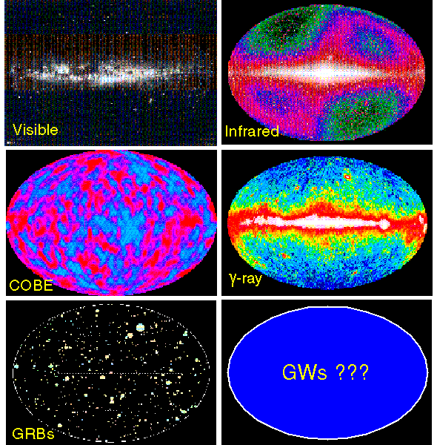
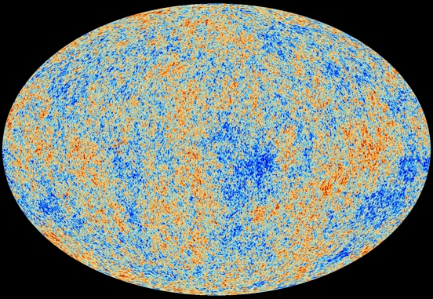
A new window onto the Universe
The history of Astronomy: new bands of the EM spectrum opened --> major discoveries!
GWs aren’t just a new band, they’re a new spectrum, with very different and complementary properties to EM waves.
Distortions of space-time (not in space-time), propagating at the speed of gravity (light)
Generated by accelerating mass/energy, e.g., coherent motion of huge masses; not vibrations of electrons in atoms
GWs are ~immune to scattering / obscuration / absorption… not immune to gravitational lensing
Detectors are rulers as opposed to buckets.
Sensitive to amplitude instead of power— signal falls off as 1/r.
Direct measure of Luminosity Distance
Planck
Gravitational waves offer a unique probe into some of the most extreme systems in the Universe. They originate from merging black holes; from binary stars orbiting at close to the speed of light; from supernovae, and from the Big Bang itself.

Slide 6
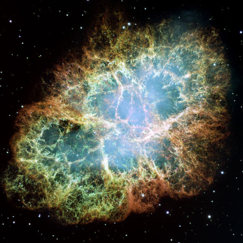
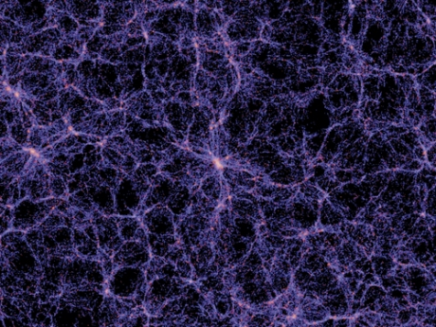
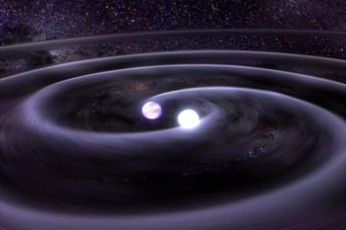
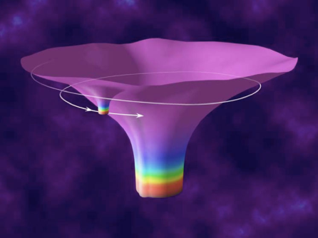
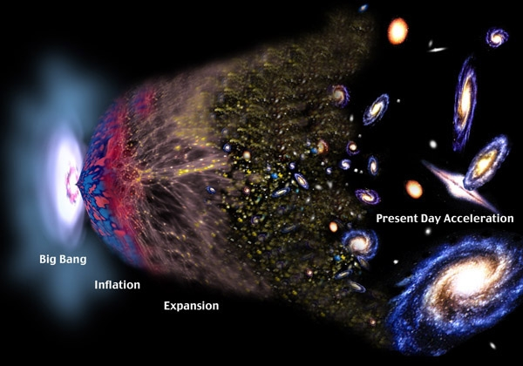
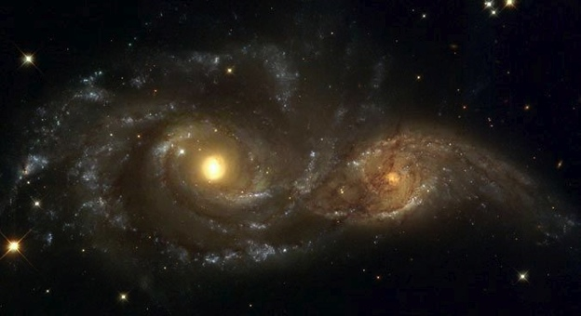
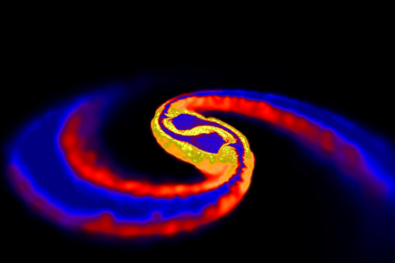
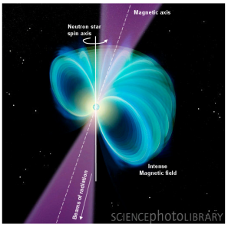
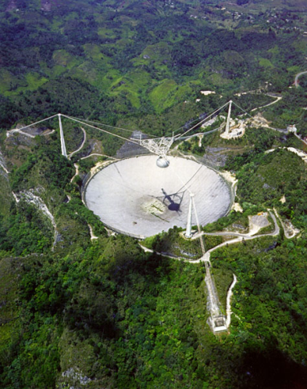
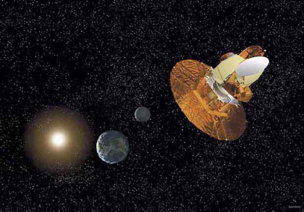
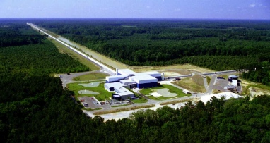
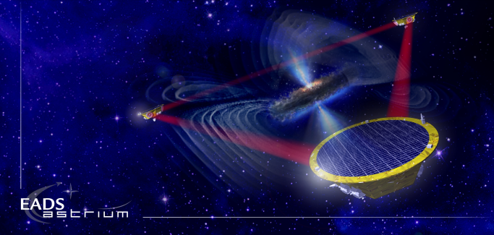
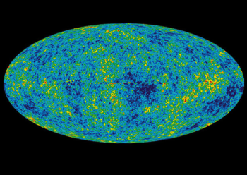
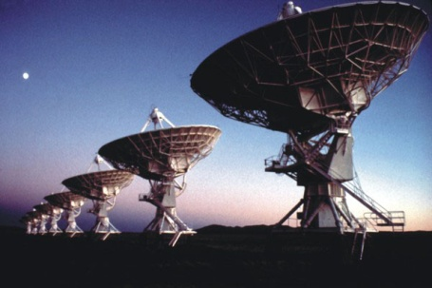
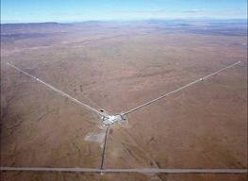
Gravitational Wave Spectrum
BH and NS Binaries
Supernovae
Cosmic Strings
Relic radiation
Extreme Mass Ratio
Inspirals
Supermassive BH Binaries
Binaries coalescences
Spinning NS
10⁻¹⁶ Hz
10⁻⁹ Hz
10⁻⁴ Hz
10⁰ Hz
10³ Hz
Inflation Probe
Pulsar timing
Space detectors
Ground interferometers
6

Slide 7
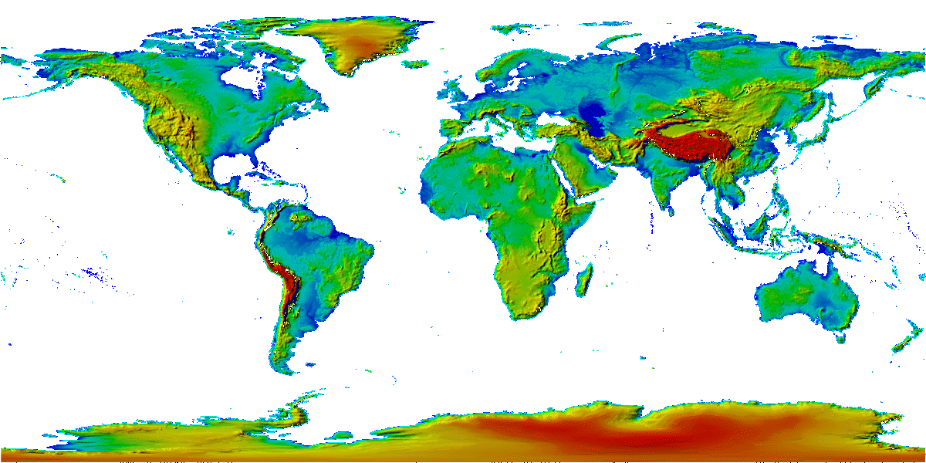
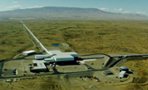
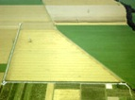

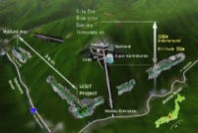
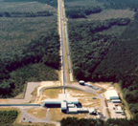
The growing network of advanced GW detectors
GEO600 (HF)
2011
Advanced LIGO
Hanford,
Livingston
2015
Advanced
Virgo
2017
KAGRA
2019
LIGO-India
2030+
(Approved)
3 separate collaborations working together
7

Slide 8
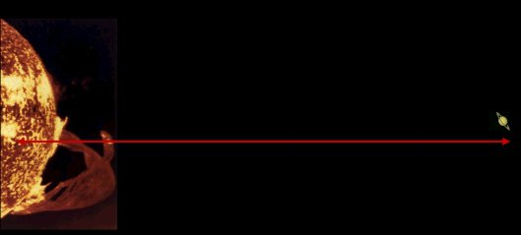
How Small is the Stretching and Squeezing?
The detection of gravitational radiation is technologically staggering.
The effect of a gravitational wave is to change the distance between freely falling test masses.
The amount of stretching and squeezing of space which is predicted to occur near the Earth due to events such as the coalescence of a pair of neutron stars within about 100 million light-years from Earth is about one part in 10²².
“+”
polarization
Time
“x”
polarization
Observing this fantastically tiny effect is equivalent to detecting the motion of Saturn if it were to move closer to the sun by the diameter of a single hydrogen atom!
Detectors should measure displacements of a thousand of a proton.
8

Slide 9
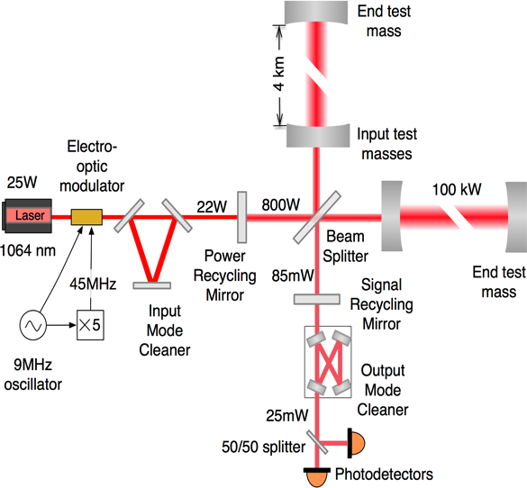
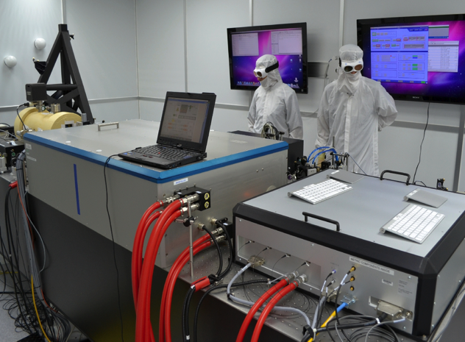
Advanced LIGO: How Does It Really Work?
An Interferometer is a Gravitational- Wave Transducer
200W , 1064 nm
stabilized laser
Δφ
Squeezer

Slide 10
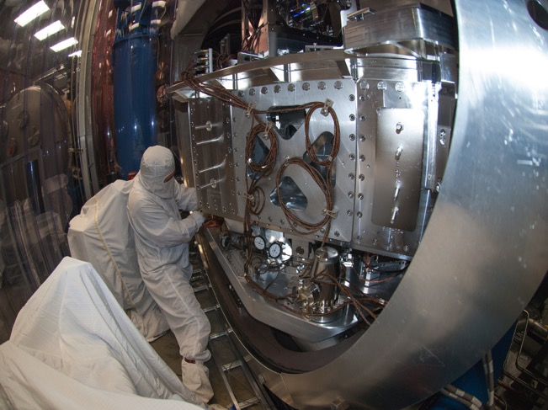
Advanced LIGO: How Does It Really Work?
An Interferometer is a Gravitational- Wave Transducer
Δφ
Actively Controlled
Seismic Isolation
Actively Controlled
Seismic Isolation
Squeezer

Slide 11
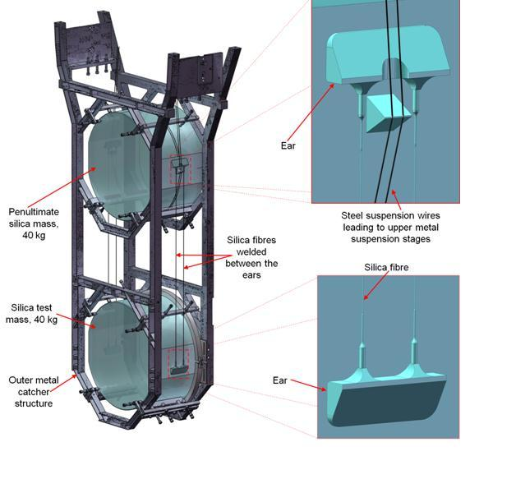
Advanced LIGO: How Does It Really Work?
An Interferometer is a Gravitational- Wave Transducer
Quadruple Mirror Suspension
Δφ
Squeezer
11

Slide 12
Advanced LIGO: How Does It Really Work?
An Interferometer is a Gravitational- Wave Transducer
LIGO Test Mass Mirror
Δφ
Squeezer

Slide 13
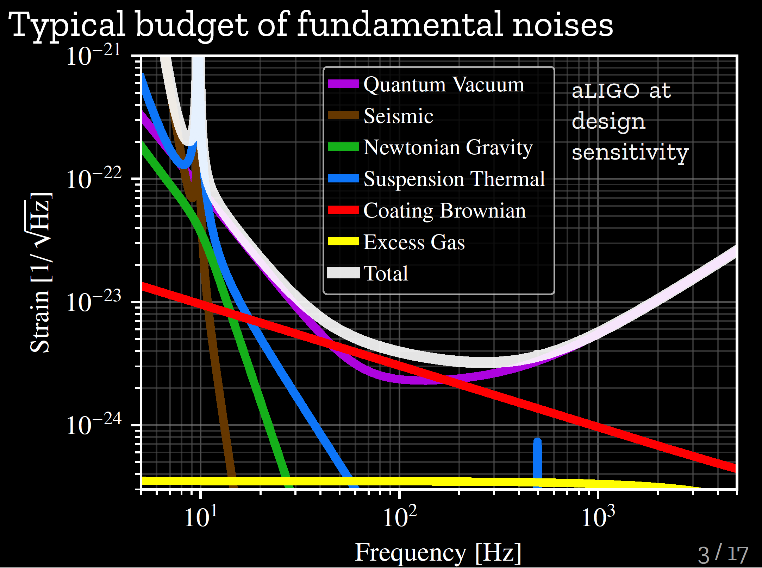
What Limits LIGO-Virgo-KAGRA Sensitivity?
As designed….
Quantum noise – statistical nature of light – dominates at most frequencies
Thermal noise – Brownian noise – dominates in a middle region
Seismic noise, direct and via changing gravitational attraction – at low frequencies
These noise sources don’t grow with the arm length, but the signal does: Length Matters
Technical issues - alignment, electronics, acoustics, etc limit us before we reach these design goals
13
Notes:
This figure shows what limits the sensitivity. Note the shaded area is where detections are possible and more sensitivity is down on the plot. We are limited by seismic effects at the lowest frequencies, by thermal effects in the middle and by shot noise or photo-statistics at the highest frequencies.

Slide 14
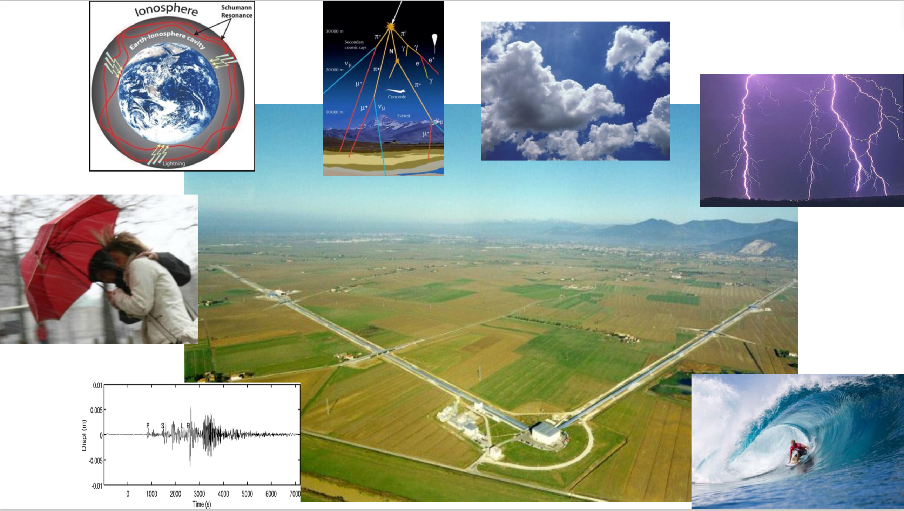
wind,
earthquakes,
storms,
geomagnetic fields,
cosmics rays,
density fluctuations in the ground and the atmosphere.
14

Slide 15
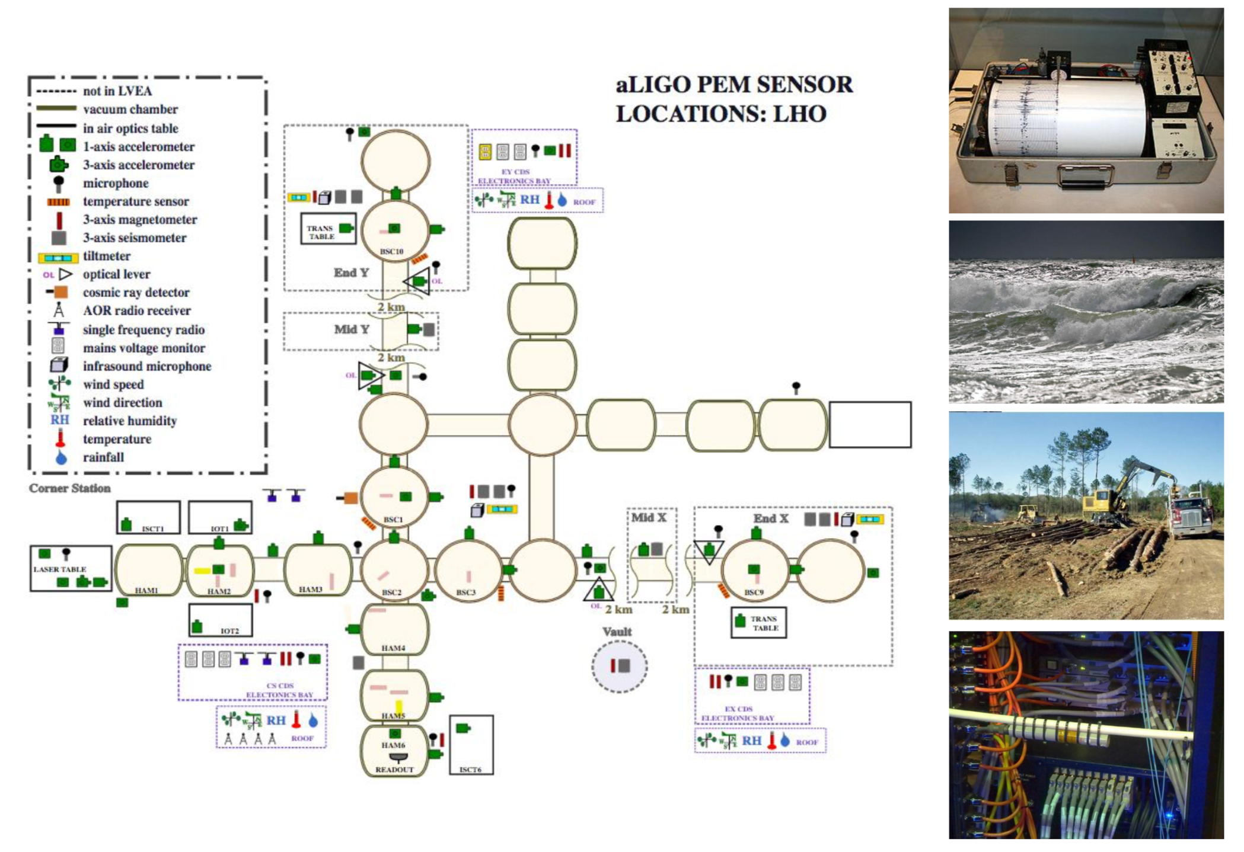
Environmental Monitoring
15

Slide 16
The Gravitational-Wave Science Ecosystem
Gravitational Waves Science is
Big Science!
Gravitational-wave
Science
Gravitational-wave Interferometer
Vacuum System
Interferometer Control Systems
Data Collection, Computing, and Archiving
High Speed Data I/O
Data Analysis
Long Term Data Curation
Future Detector R&D
Lasers and Optics
Detector Performance and Stability
Matched Filter Search Algorithm Development
Unmodelled Source Search Algorithm Development
Statistical Confidence Assessment
Model Waveform Development
High Power Stabilized Lasers
Precision Optics and Optical Metrology
Precision interferometry
Quantum Optics: Squeezed Light
Seismic characterization
Seismic isolation
Low Noise Analog Electronics
Low Noise Digital Electronics
High Efficiency Light Sensing
Ultrahigh Vacuum System Design
Low Contamination Requirements
Environmental Control
Multi-Petabyte Storage
Mirror Suspensions
Data and Cybersecurity
Collaboration Infrastructure/Services
Detector Calibration
Physics and Astrophysics Interpretation
Data Quality/ Certification
High Throughput Computing
Low Latency Computing
Source Physical Parameter Estimation
Astrophysical Interpretation
Fundamental Tests of General Relativity
Multi-messenger Astronomy
Communications
Governance
Meetings
Novel Stabilized Lasers
Silicon Optics
Cryogenic Mirrors
Novel Vacuum Systems
Open Science Center
Quantum-engineered Interferometry
Gravitational-wave Science Output
Notes:
POINT OUT THAT THIS IS A SIMPLIFIED VIEW OF THE GW SCIENCE ECOSYSTEM. WALK THROUGH LEVEL TWO BOXES (DET OPS, DATA COLL, ….) AND GIVE A FEW EXAMPLES TO HIGHLIGHT THE VAST SET OF DISCIPLINES THAT SPAN GW SCIENCE

Slide 17

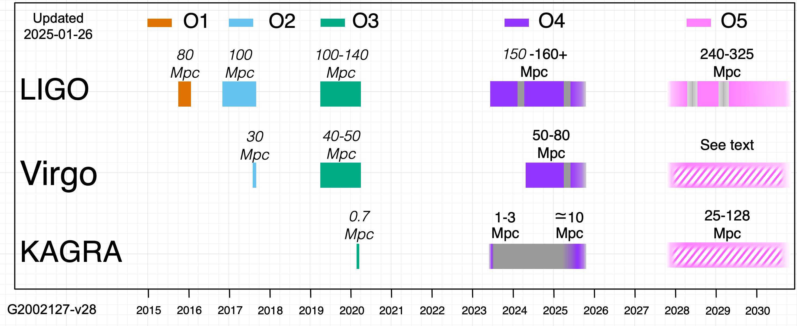
LVK current and future observing runs:
Important detector improvements between O3 and O4
Higher laser power
Frequency-dependent squeezing
Noise reduction & duty cycle improvements
+ Improvements to processing of data for use by searches
    Not comprehensive! These are just some highlights.
O4 observing run:
O4a: May 24th 2023- January 16th 2024
O4b: April 10th 2024- January 23rd 2025
O4c: January 24th 2025- November 18th 2025
O4 break for maintenance and enhancement work + Engineering Run 16 (ER16) was from Jan 16 to April 10, 2024.
2nd Maintenance break from 1 April 2025 to 11 June 2025
KAGRA delayed due to 7.6 magnitude earthquake on Jan 1, 2024
The GW network will continue improving in sensitivity…
….and thanks to that 1/r thing, make substantial improvements in sensitive volume…
• …which means more opportunity for multi-messenger events
https://observing.docs.ligo.org/plan/

Slide 18
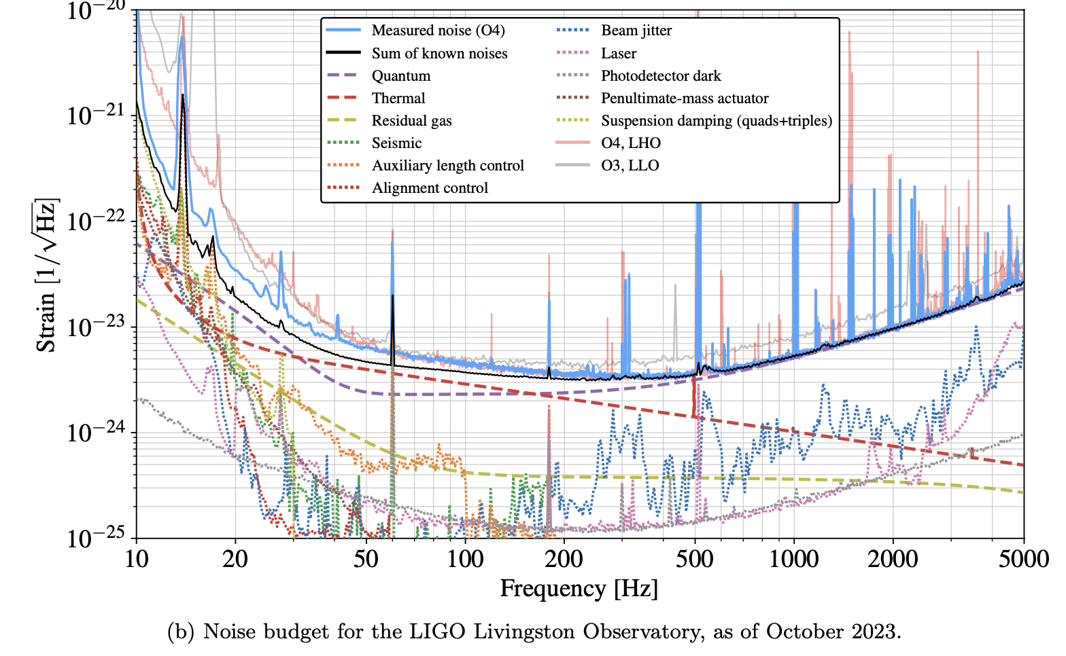
O4a Noise budget
E. Capote, et.al. Phys. Rev. D 111, 062002
Low frequency
  Auxiliary control noise
  Suspension damping
  Unknown technical noise
Mid frequency
  Coating thermal noise
  Unknown technical noise
High frequency
  Quantum noise
    Frequency dependent squeezing (5-6dB)
  Laser noise
    Input beam jitter and frequency noise
18

Slide 19
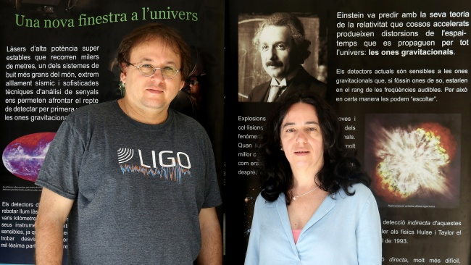
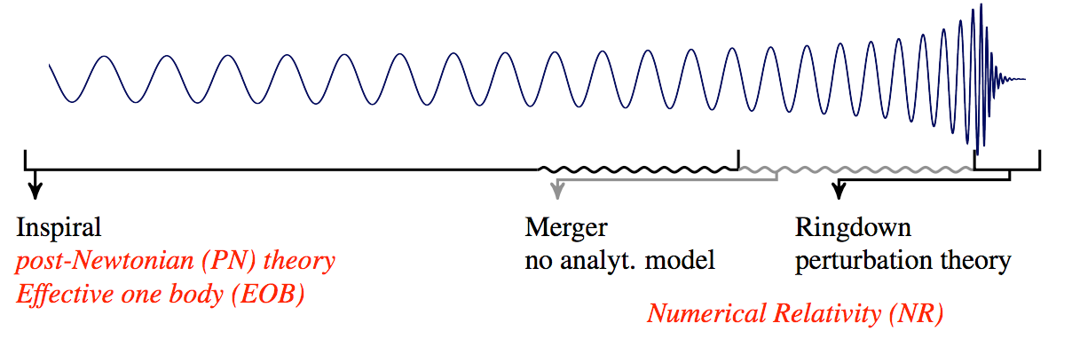
How do we identify the sources?
Compare with theoretical models of waveforms, calibrated to numerical solutions of the Einstein equations.
The GRAVITY group at UIB currently ranks among the leading national users of the BSC, the largest node of the RES. We have been using it since 2009 for numerical relativity simulations, and more recently for Bayesian parameter estimation in CBC signals, as well as for the search for CW signals generated by neutron stars in binary systems, employing a GPU-based implementation.
19

Slide 20
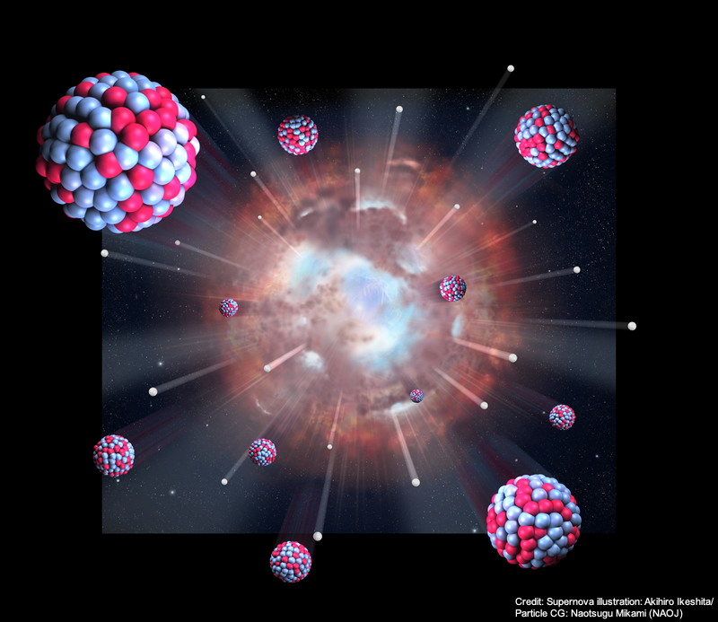
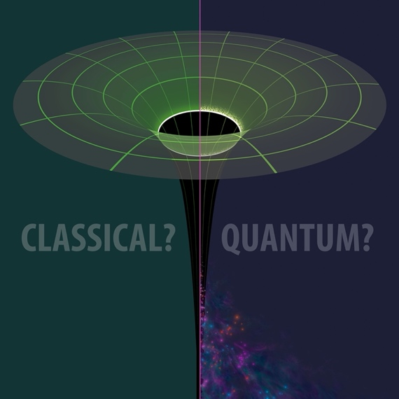
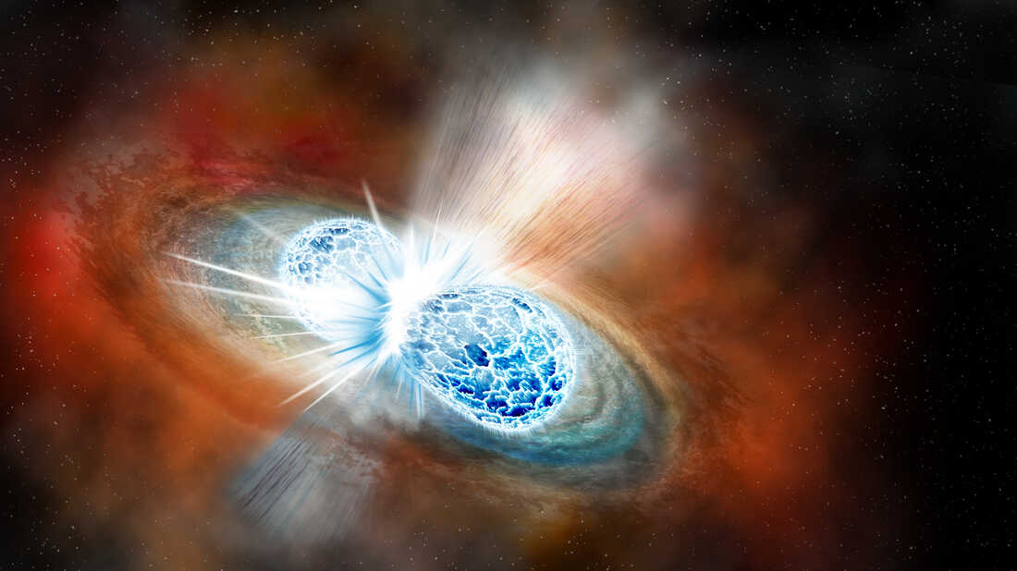
Impact of Gravitational Wave Detections On Our Understanding Of…
The Nature of Black Holes
The Origin of Heavy Elements
How Matter Behaves Under the
Most Extreme Conditions in Nature
EINSTEINIAN?
Image Credit: Robert Hurt, IPAC, Caltech
Image Credit: Robin Dienel/Carnegie Institution for Science
Image Credit: Akihiro Ikeshita/Naotsugu Mikami NAOJ
Credit: LIGO Scientific Collaboration
Notes:
Walk through slide

Slide 21
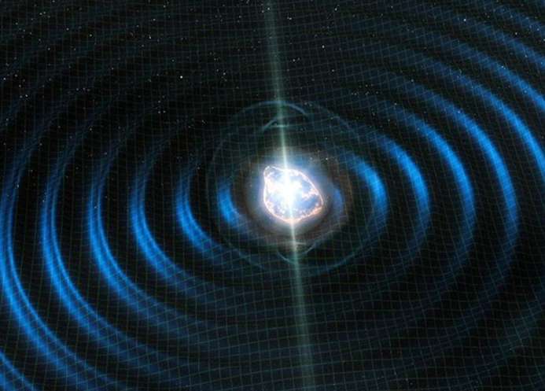
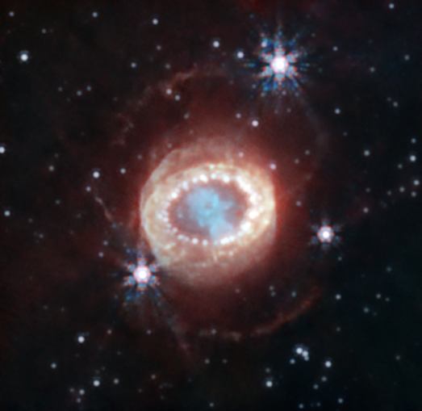
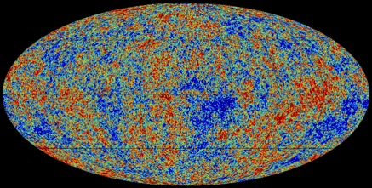
LIGO and Virgo (and KAGRA!) Haven’t Yet Changed Our Thinking About …
Continuously Emitting Neutron Stars
How Supernovae Explode
SN1987a
Astrophysical Stochastic Background
Image Credit: ScienceBlog
Credit: Planck Collaboration
Image Credit: JWST NIRcam/NASA,ESA,CSA

Slide 22
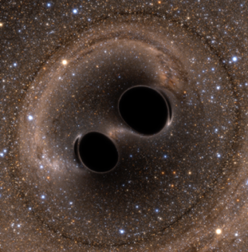
LIGO-Virgo Greatest Hits 2015-2021: What Ground-
Based Gravitational Wave Detections Have Taught Us
GW150914
O1: Gravitational waves from astrophysical sources can be measured.
O1: Binary black hole (BBH) systems exist.
O2: Binary neutron stars (BNS) are progenitors of short gamma ray bursts.
O2: BNS mergers produce kilonovae, which produce heavy elements.
O2: The speed of gravitational waves equals the speed of light.
O2: The Hubble-Lemaître constant can be measured using EM-bright GW ‘sirens’.
O2 – O3: The Hubble-Lemaître constant can be measured using dark GW ‘sirens’.
O3: Black holes with masses in the (pulsational) pair instability gap exist.
O3: Black hole – neutron star systems exist.
O3: Compact objects exist in the 2 – 3 M⦿ mass range.
O1-O3: Astrophysical black holes are Kerr black holes
O1 – O3: General relativity is valid in the high curvature, high field regime.
O1 – O3: Intermediate black holes and stellar mass black holes with mass > 20 M⦿ exist.
GW170817/
GRB170817A
SSS17A

Slide 23
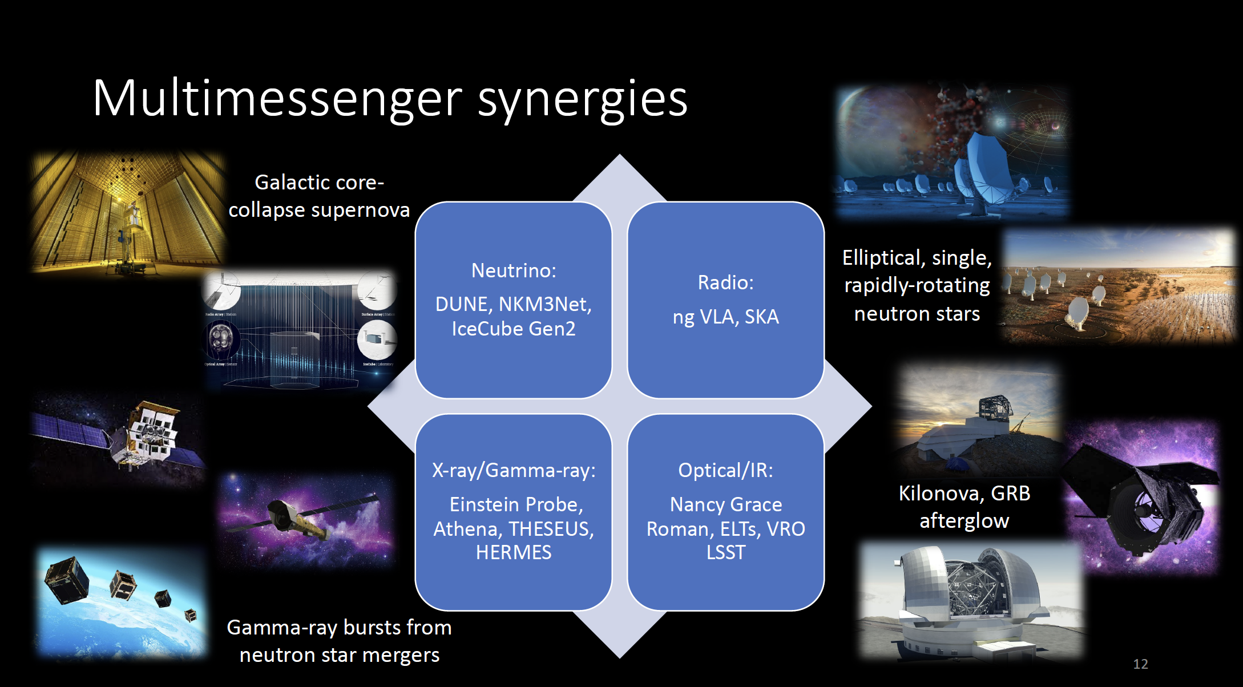
23

Slide 24
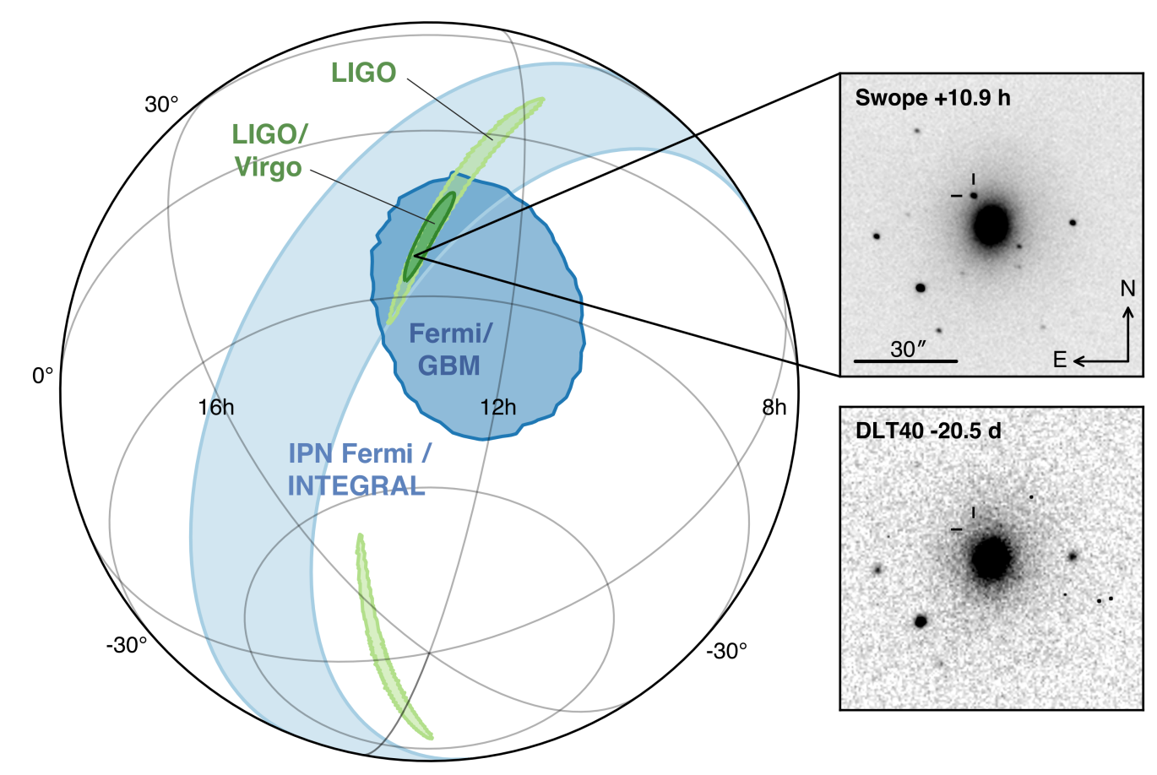
GW170917/GRB170817A :
“Multi-Messenger Observations of a Binary Neutron Star Merger”
B. Abbott et al., ApJL 848 (2017) L12
59-page “letter” (!). More than 3000 authors,~70 collaborations
First unambiguous EM counterpart to a GW source
Gamma Ray transient classified as sGRB detected by Fermi-GBM 2s after inferred GW merger time.
Host galaxy discovered by dedicated optical follow-up.
“Whole of astronomy” broadband analysis of kilonova and host galaxy.
Vivid demonstration that joint observations are > sum of their parts.
24

Slide 25
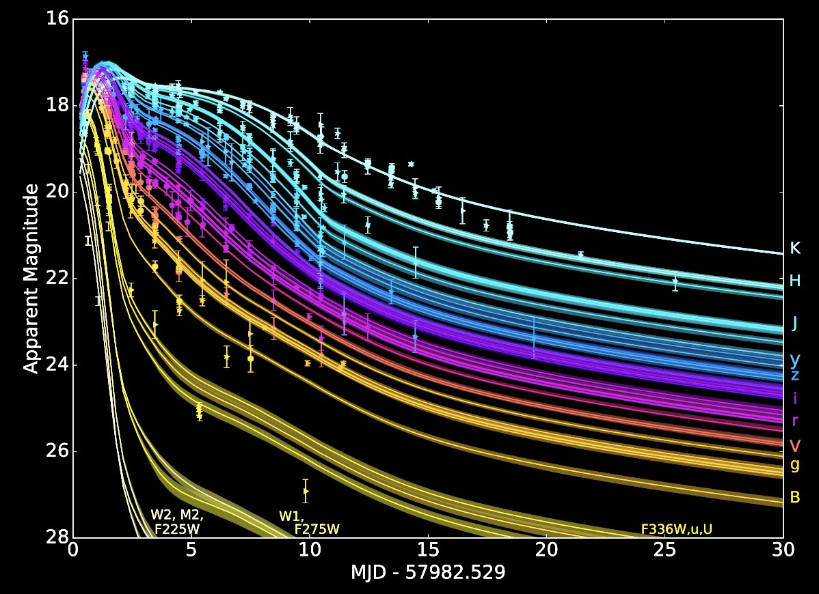
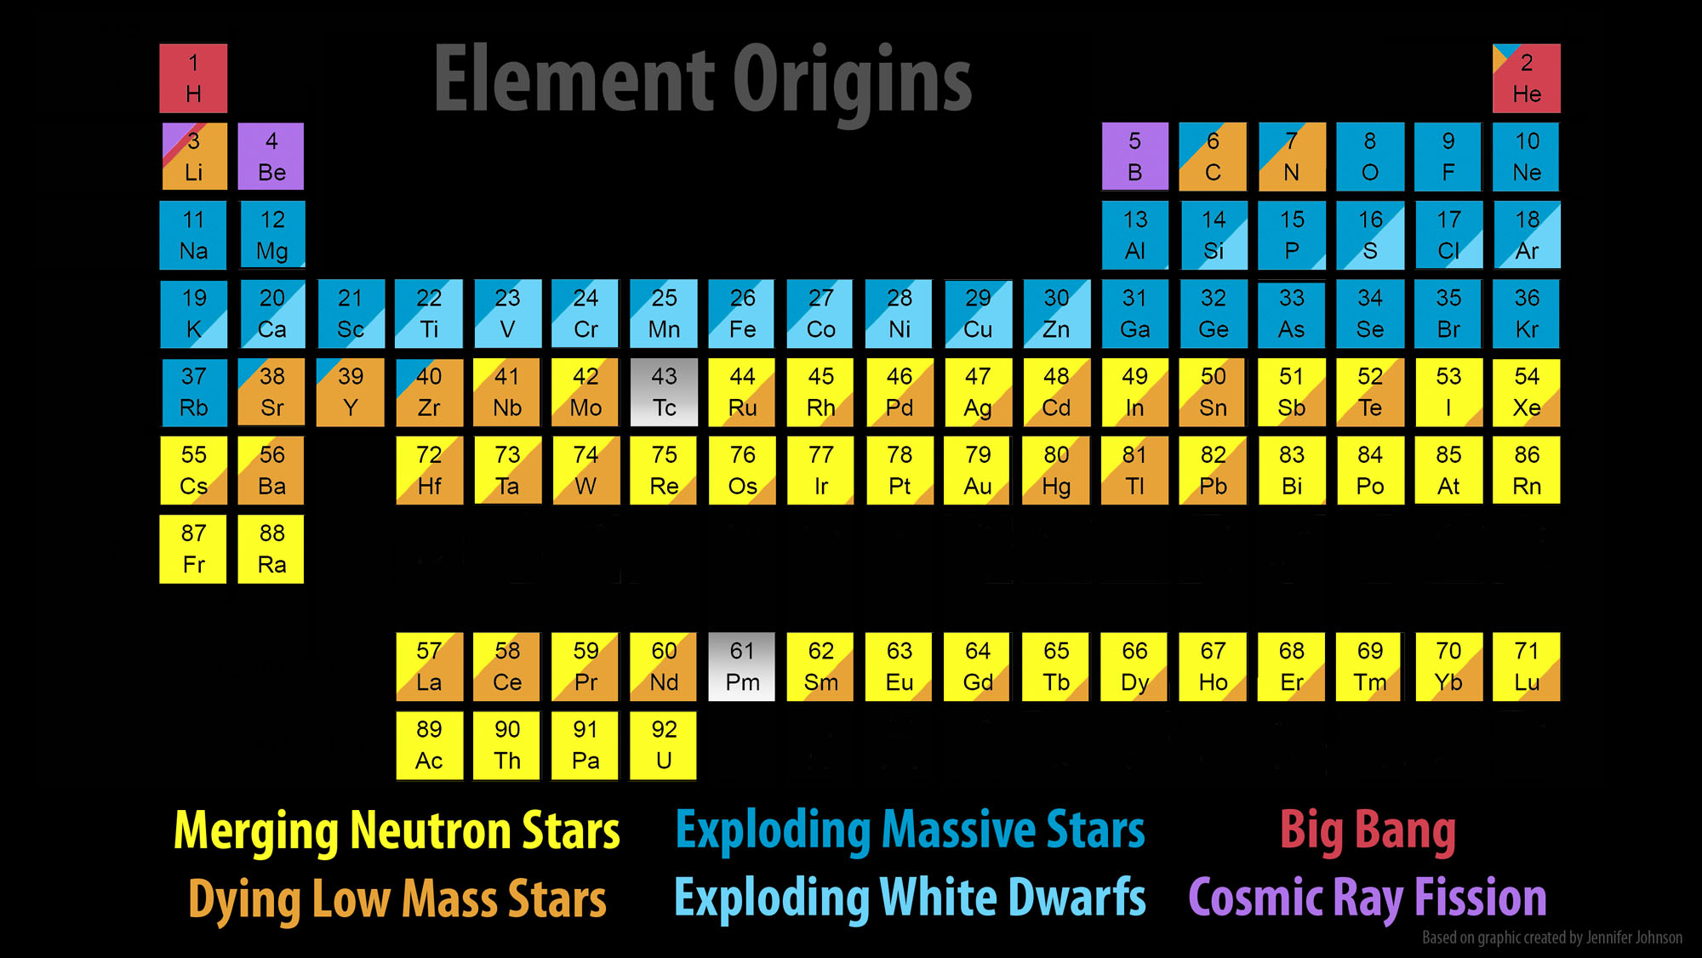


What we learned from GW170817
Villar+ ApJL 2017
BNS mergers are the progenitors of some short gamma-ray burst –the most energetic electromagnetic explosions in the universe
BNS mergers are the sites of heavy element nucleosynthesis, where most of the heavy elements are produced
Kilonova – the radioactive glow of freshly synthesized heavy elements
Constraints on the neutron star mass-radius relation, nuclear equation of state
LVC Nature 551,85 (2017)
LVC PRL 2018
25
Notes:
What does the data tell us?
Explain nucleosynthesis

Slide 26






LIGO Livingston L1
LIGO Hanford H1
O3 campaign and beyond
O3 marked a phase change in GW astronomy, with public GW alerts in low latency and a lot of GW candidates!
Wide range of masses
most events: binary black holes
redshifts up to ~0.8
Spins:
  Key signatures to discriminate BH populations: shed light on formation mechanism
  Some events with clear indication of a net positive X_{eff}
No counterparts found in low latency
But low mass candidates were poorly localized and/or poorly located on the sky
Virgo V1

Slide 27

LVK- O4:
​Observing Run #4 (O4) started on May 24, 2023.
O4a: May 24th 2023- January 16th 2024
O4b: April 10th 2024- January 23rd 2025
O4c: January 24th 2025- November 18th 2025
O4 break for maintenance and enhancement work + Engineering Run 16 (ER16) was from Jan 16 to April 10, 2024.
2nd Maintenance break from 1 April 2025 to 11 June 2025
You can always follow along with O4 Public Alerts here: https://gracedb.ligo.org/superevents/public/O4/
As of April 1st 2025, there have been 203 O4 Significant Detection Candidates: 203 (228 Total - 25 Retracted)
O4 Low Significance Detection Candidates: 3781 (Total)
Our first exceptional O4 gravitational wave detection (GW230529) was announced on April 5, 2024 (more info here: https://www.ligo.org/detections/GW230529.php).
O5 is currently planned to start in 2028

Slide 28



First Results from O4 Observing Run
Credit: Shandika Galaudage
28

Slide 29


Next Generation Observatories
O5 will be “LIGO A+”, significant further upgrades for Virgo and KAGRA too.
LIGO India is coming!
Next upgrade plan “LIGO A♯” [LIGO-T2200287]
3G detectors:
Triangle configuration underground for Einstein Telescope.
Two widely separated, L-shaped surface facilities in the US CE40 and CE20 for Cosmic Explorer
Gain of a factor of 10 and lower frequency bound
New challenges (long-waveforms, overlapping signals, strong foreground, correlated noise)
3G observatories will detect thousands of signals every day
  weak signals, loud mergers
  BNS, NSBH, BBH, SN bursts, CW, …
3G detectors enable a ~complete census of BNS and BBH mergers
29

Slide 30



LIGO and Virgo (+ KAGRA + LIGO-India + Cosmic Explorer + Einstein Telescope) Will Change Our Thinking in the Future
LIGO-India: 2030+
Einstein Telescope (Europe): 2035+
Cosmic Explorer (USA): 2035+

Slide 31


The next generation
ET/CE will be a new discovery machine:
ET/CE will explore almost the entire Universe listening the gravitational waves emitted by black hole, back to the dark ages after the Big Bang
Years after the Big Bang
400 thousand
0.1 billion
1 billion
4 billion
8 billion
13.8 billion
Remote Universe
ET/CE will be a precision measurement observatory:
ET/CE will detect, with high SNR, hundreds of thousands coalescences of binary systems of Neutron Stars per year, revealing the most intimate structure of the nuclear matter in their nuclei
Robust statistics on GRB+BNS merger association, and how that correlates with orientation & distance
BNS signals will be in band and detectable for O(100s) of seconds to several hours
Advanced warning for EM follow-up (though localization will be rough)
Cosmological redshift z
SNR
Nearby Universe
31
Credit: M.Branchesi
Notes:
Marica

Slide 32
ET/CE Science Case in a nutshell
ASTROPHYSICS
Black hole properties
  origin (stellar vs. primordial)
  evolution, demography
Neutron star properties
  interior structure (QCD at ultra-high densities,
  exotic states of matter)
  demography
Multi-band and -messenger astronomy
  joint GW/EM observations (GRB, kilonova,...)
  multiband GW detection (LISA)
  neutrinos
Detection of new astrophysical sources
  core collapse supernovae
  isolated neutron stars
  stochastic background of astrophysical origin
FUNDAMENTAL PHYSICS AND COSMOLOGY
The nature of compact objects
  near-horizon physics
  tests of no-hair theorem
  exotic compact objects
Tests of General Relativity
  post-Newtonian expansion
  strong field regime
Dark matter
  primordial BHs
  axion clouds, dark matter accreting on compact objects
Dark energy and modifications of gravity on cosmological scales
  dark energy equation of state
  modified GW propagation
Stochastic backgrounds of cosmological origin
  inflation, phase transitions, cosmic strings
32

Slide 33







Acknowledgments
This work was supported by the Universitat de les Illes Balears (UIB); the Spanish Agencia Estatal de Investigación grants PID2022-138626NB-I00, RED2022-134204-E, RED2022-134411-T, funded by MICIU/AEI/10.13039/501100011033 and ERDF/EU; the MICIU with funding from the European Union NextGenerationEU/PRTR (PRTR-C17.I1); the Comunitat Autonòma de les Illes Balears through the Direcció General de Recerca, Innovació I Transformació Digital with funds from the Tourist Stay Tax Law (PDR2020/11 - ITS2017-006), the Conselleria d’Economia, Hisenda i Innovació grant numbers SINCO2022/18146 and SINCO2022/6719, co-financed by the European Union and FEDER Operational Program 2021-2027 of the Balearic Islands.

