Slide 1
Shell model neutrinoless double-beta decay NME of ¹³⁶Xe within a statistical approach
Andrei Neacsu (CIFRA & IFIN-HH)
Sabin Stoica (CIFRA)
Mihai Horoi (Central Michigan University)

Slide 2
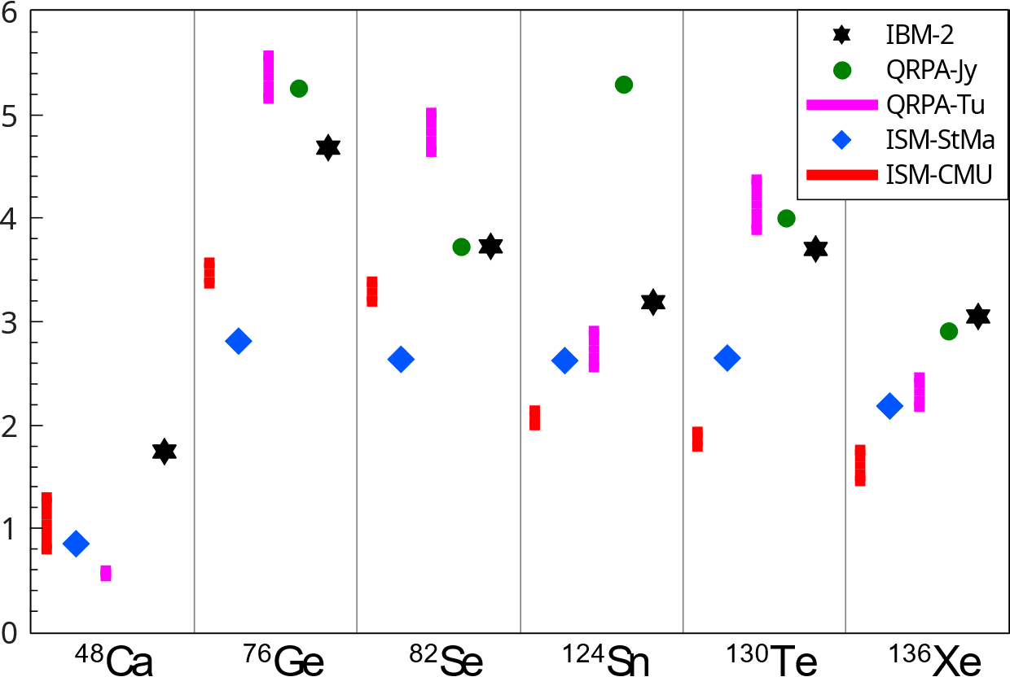
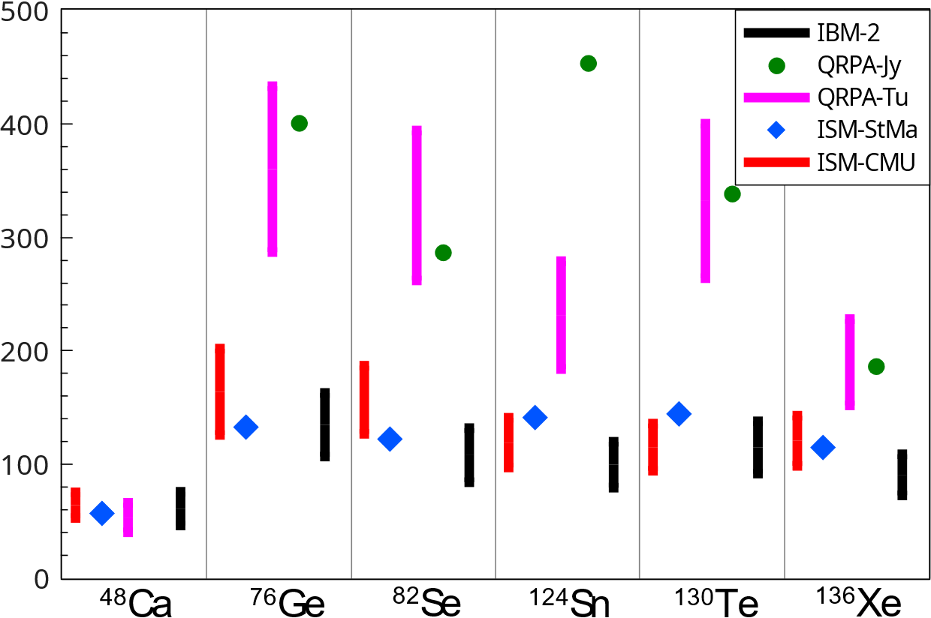
The NME problem:
https://link.aps.org/doi/10.1103/PhysRevC.93.024308
light neutrino-exchange 0νββ NME
heavy neutrino-exchange 0νββ NME
Andrei Neacsu – MEDEX ‘23 – Prague, September 4-8 2023

Slide 3
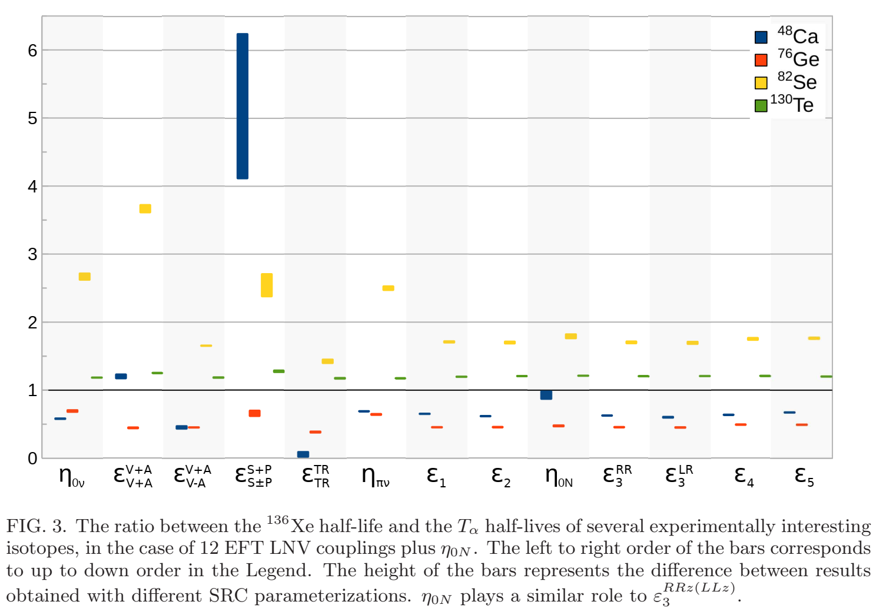
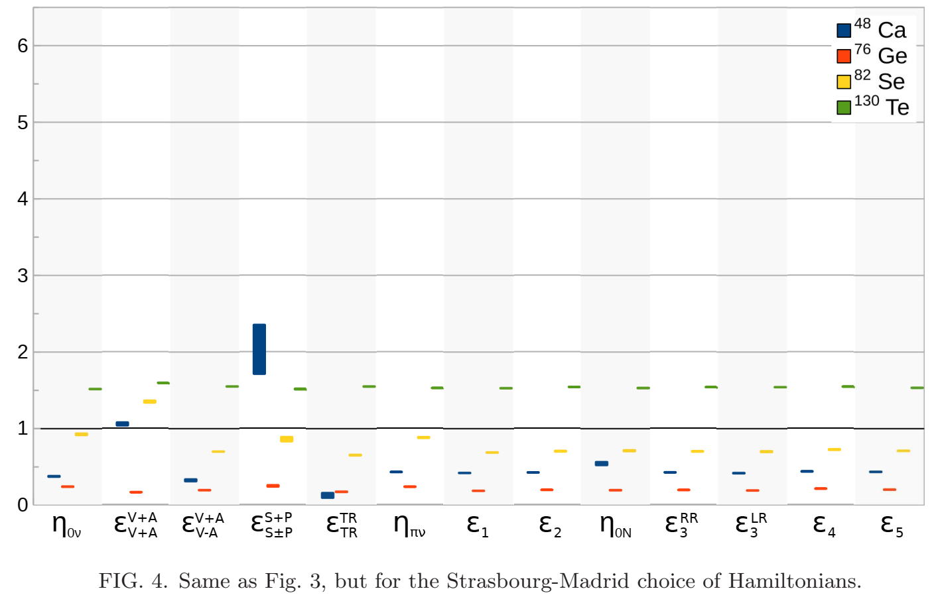
BSM predictions with different Hamiltonians
Looking for the dominant BSM mechanism through ratios of half-lives
Andrei Neacsu – MEDEX ‘23 – Prague, September 4-8 2023

Slide 4
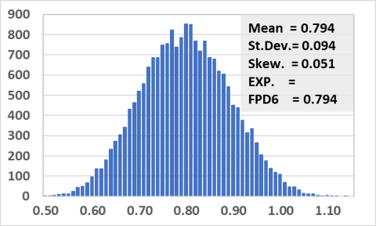
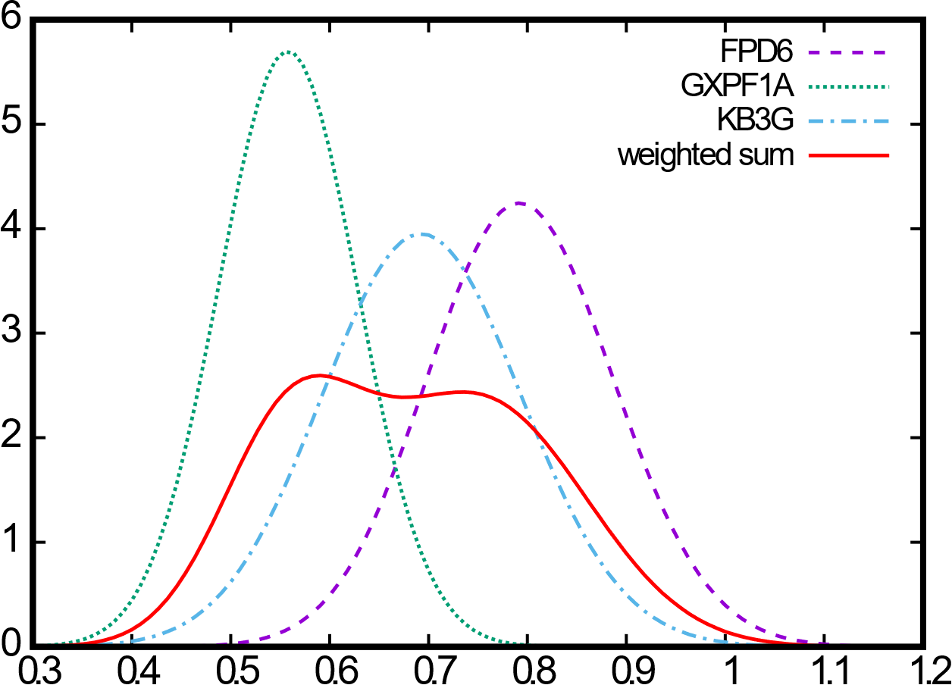
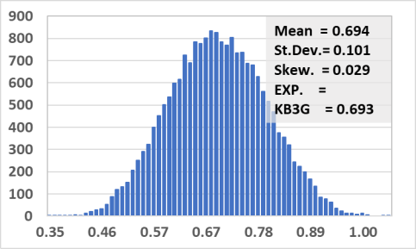
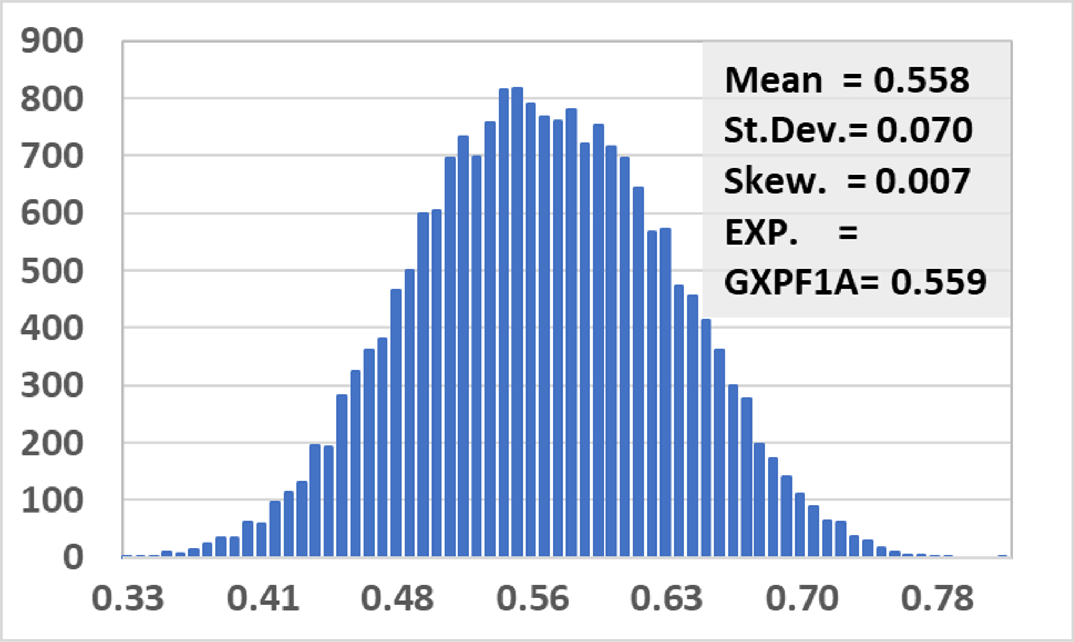
The Solution
Andrei Neacsu – MEDEX ‘23 – Prague, September 4-8 2023

Slide 5
This year
Andrei Neacsu – MEDEX ‘23 – Prague, September 4-8 2023

Slide 6
The culprits
1) SVD - C. Qi and Z. X. Xu, Phys. Rev. C 86, 044323 (2012). 2) jj55t - M. Horoi and B. A. Brown, Phys. Rev. Lett. 110, 222502 (2013). 3) GCN5082 - E. Caurier, F. Nowacki, A. Poves, and K. Sieja, Phys. Rev. C 82, 064304 (2010).
3x1000 effective Hamiltonians from random perturbations within the range of ±10% to their two-body matrix elements (TBME) – the single-particle energies are kept untouched.
Andrei Neacsu – MEDEX ‘23 – Prague, September 4-8 2023

Slide 7
The observables
2νββ NME, the energies of the first 2⁺, 4⁺, and 6⁺ states in the parent (¹³⁶Xe) and daughter (¹³⁶Ba) nuclei,
B(E2) ↑ transition probabilities for ¹³⁶Xe and ¹³⁶Ba to the first 2⁺ states,
Gamow-Teller transition probability for the transition from ¹³⁶Xe and from ¹³⁶Ba to the 1⁺ excited state in ¹³⁶Cs,
the neutron and proton occupancies for ¹³⁶Xe and ¹³⁶Ba above the ¹⁰⁰Sn core in the jj55 model space shells.
The number of observables that we calculate for each sample is 24, including the 0νββ NME.
Andrei Neacsu – MEDEX ‘23 – Prague, September 4-8 2023

Slide 8
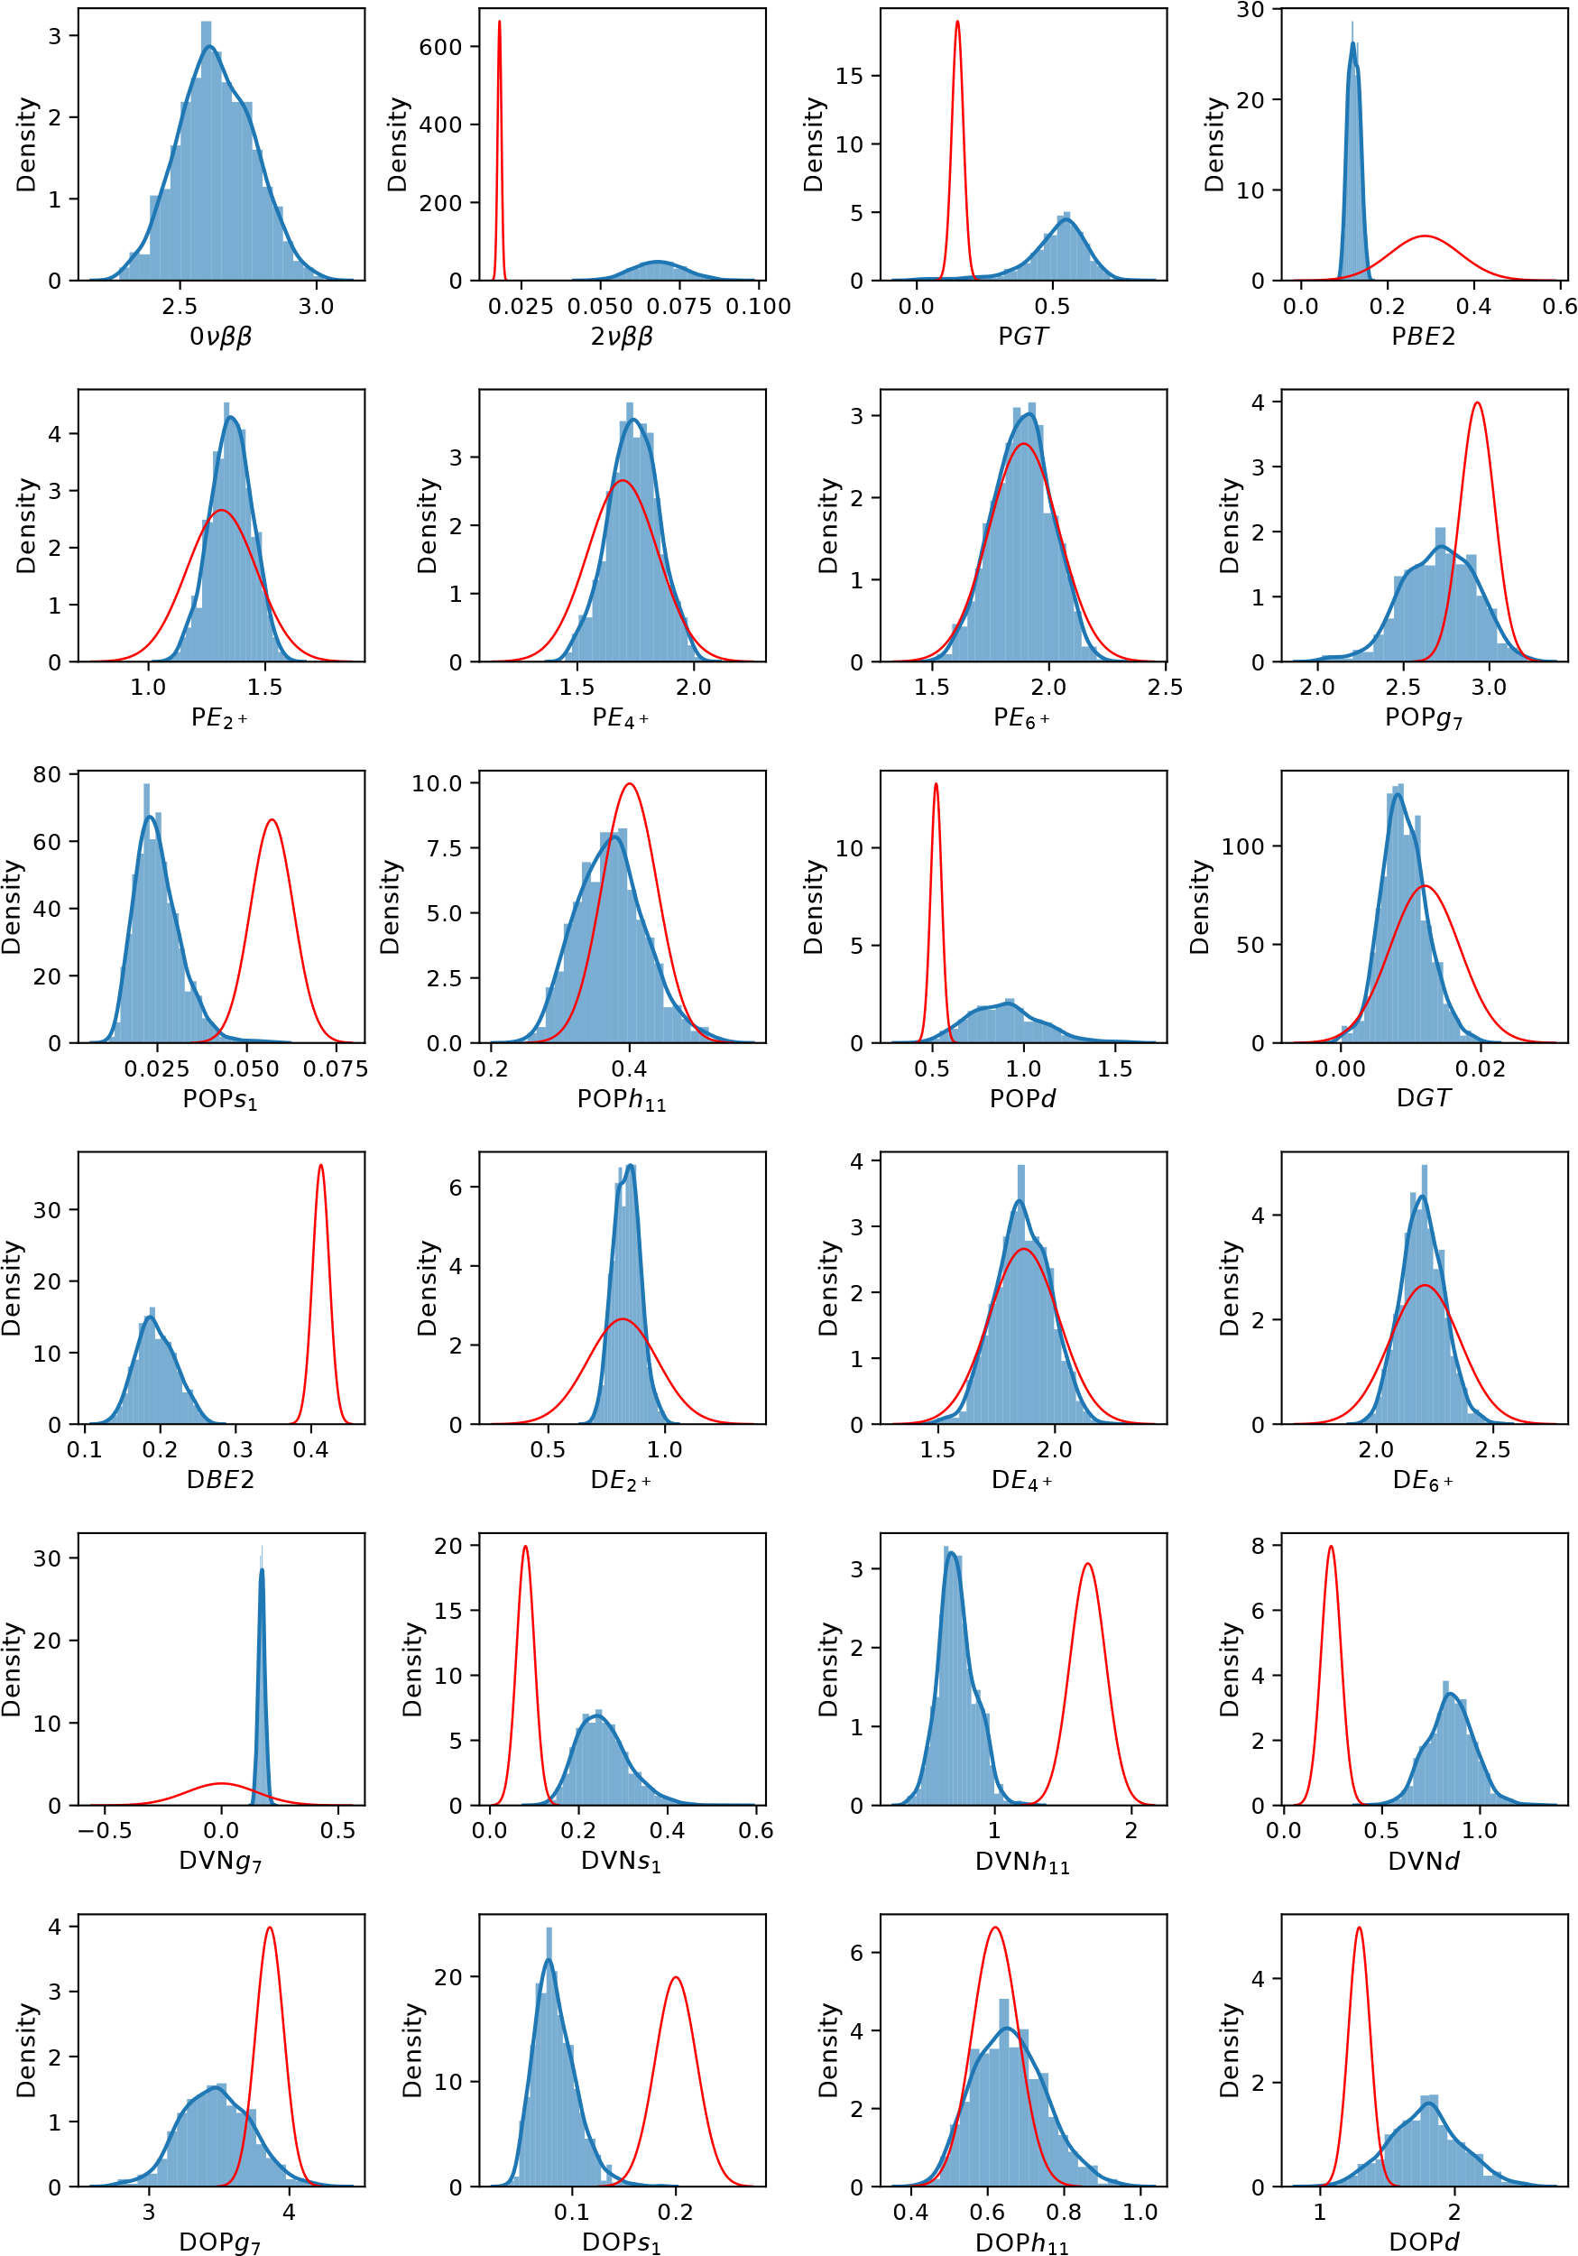
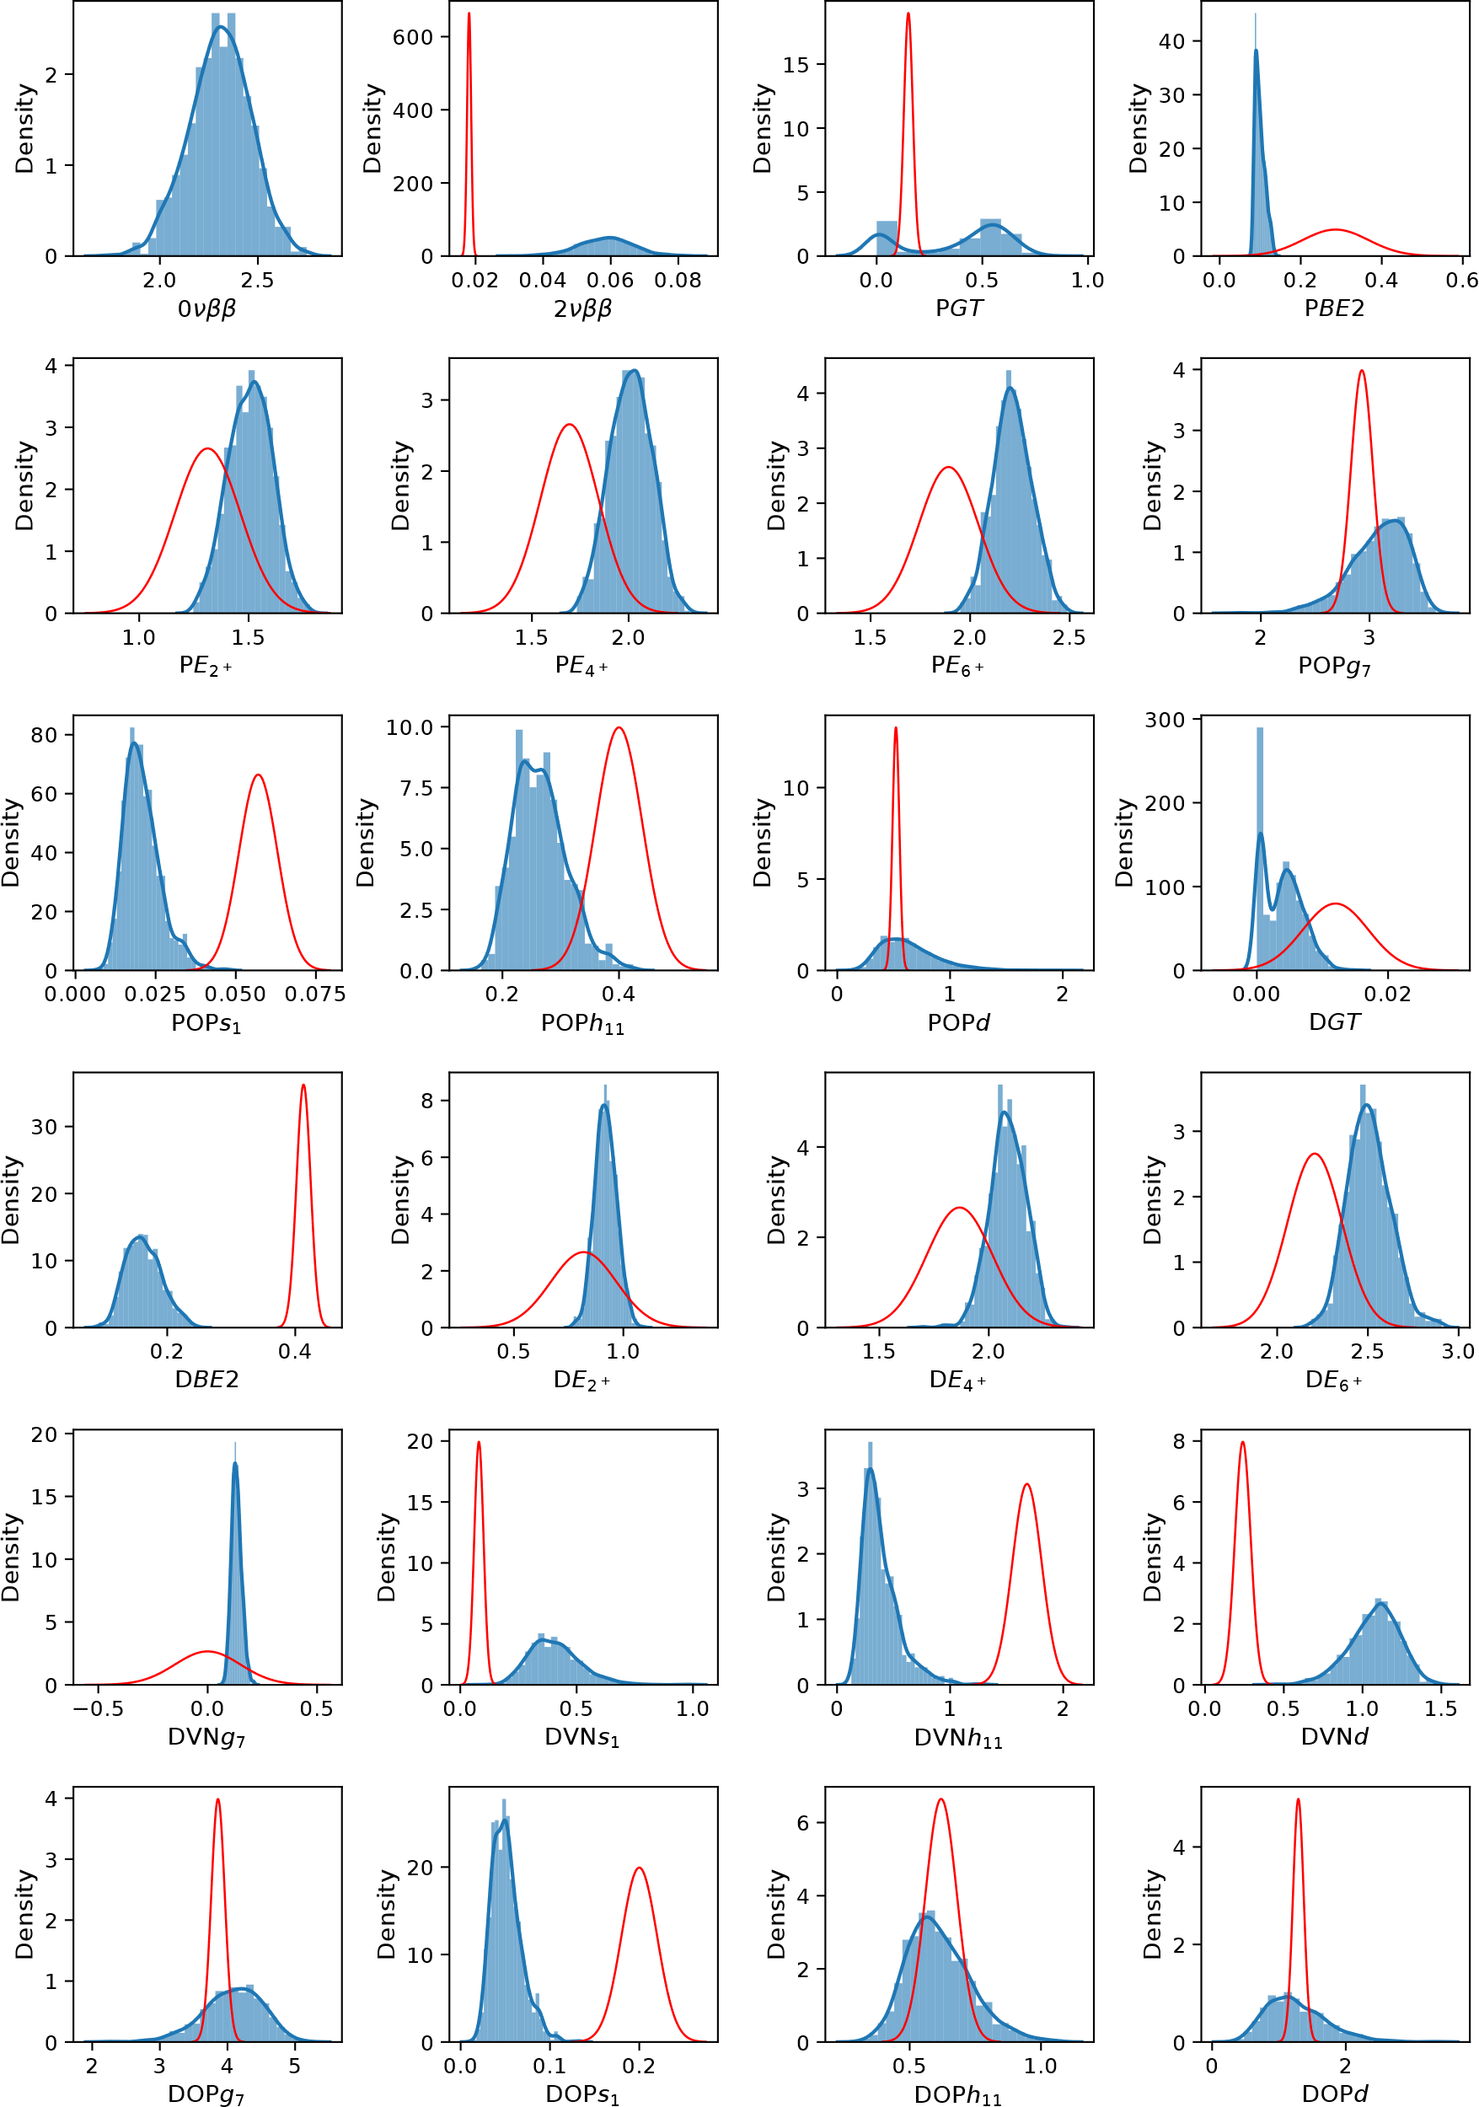
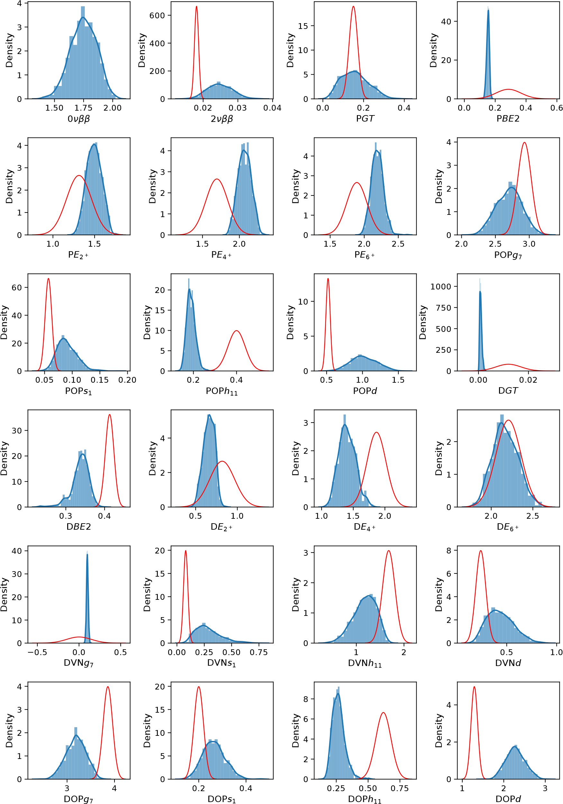
GCN-52:80
jj55t
SVD
Andrei Neacsu – MEDEX ‘23 – Prague, September 4-8 2023

Slide 9
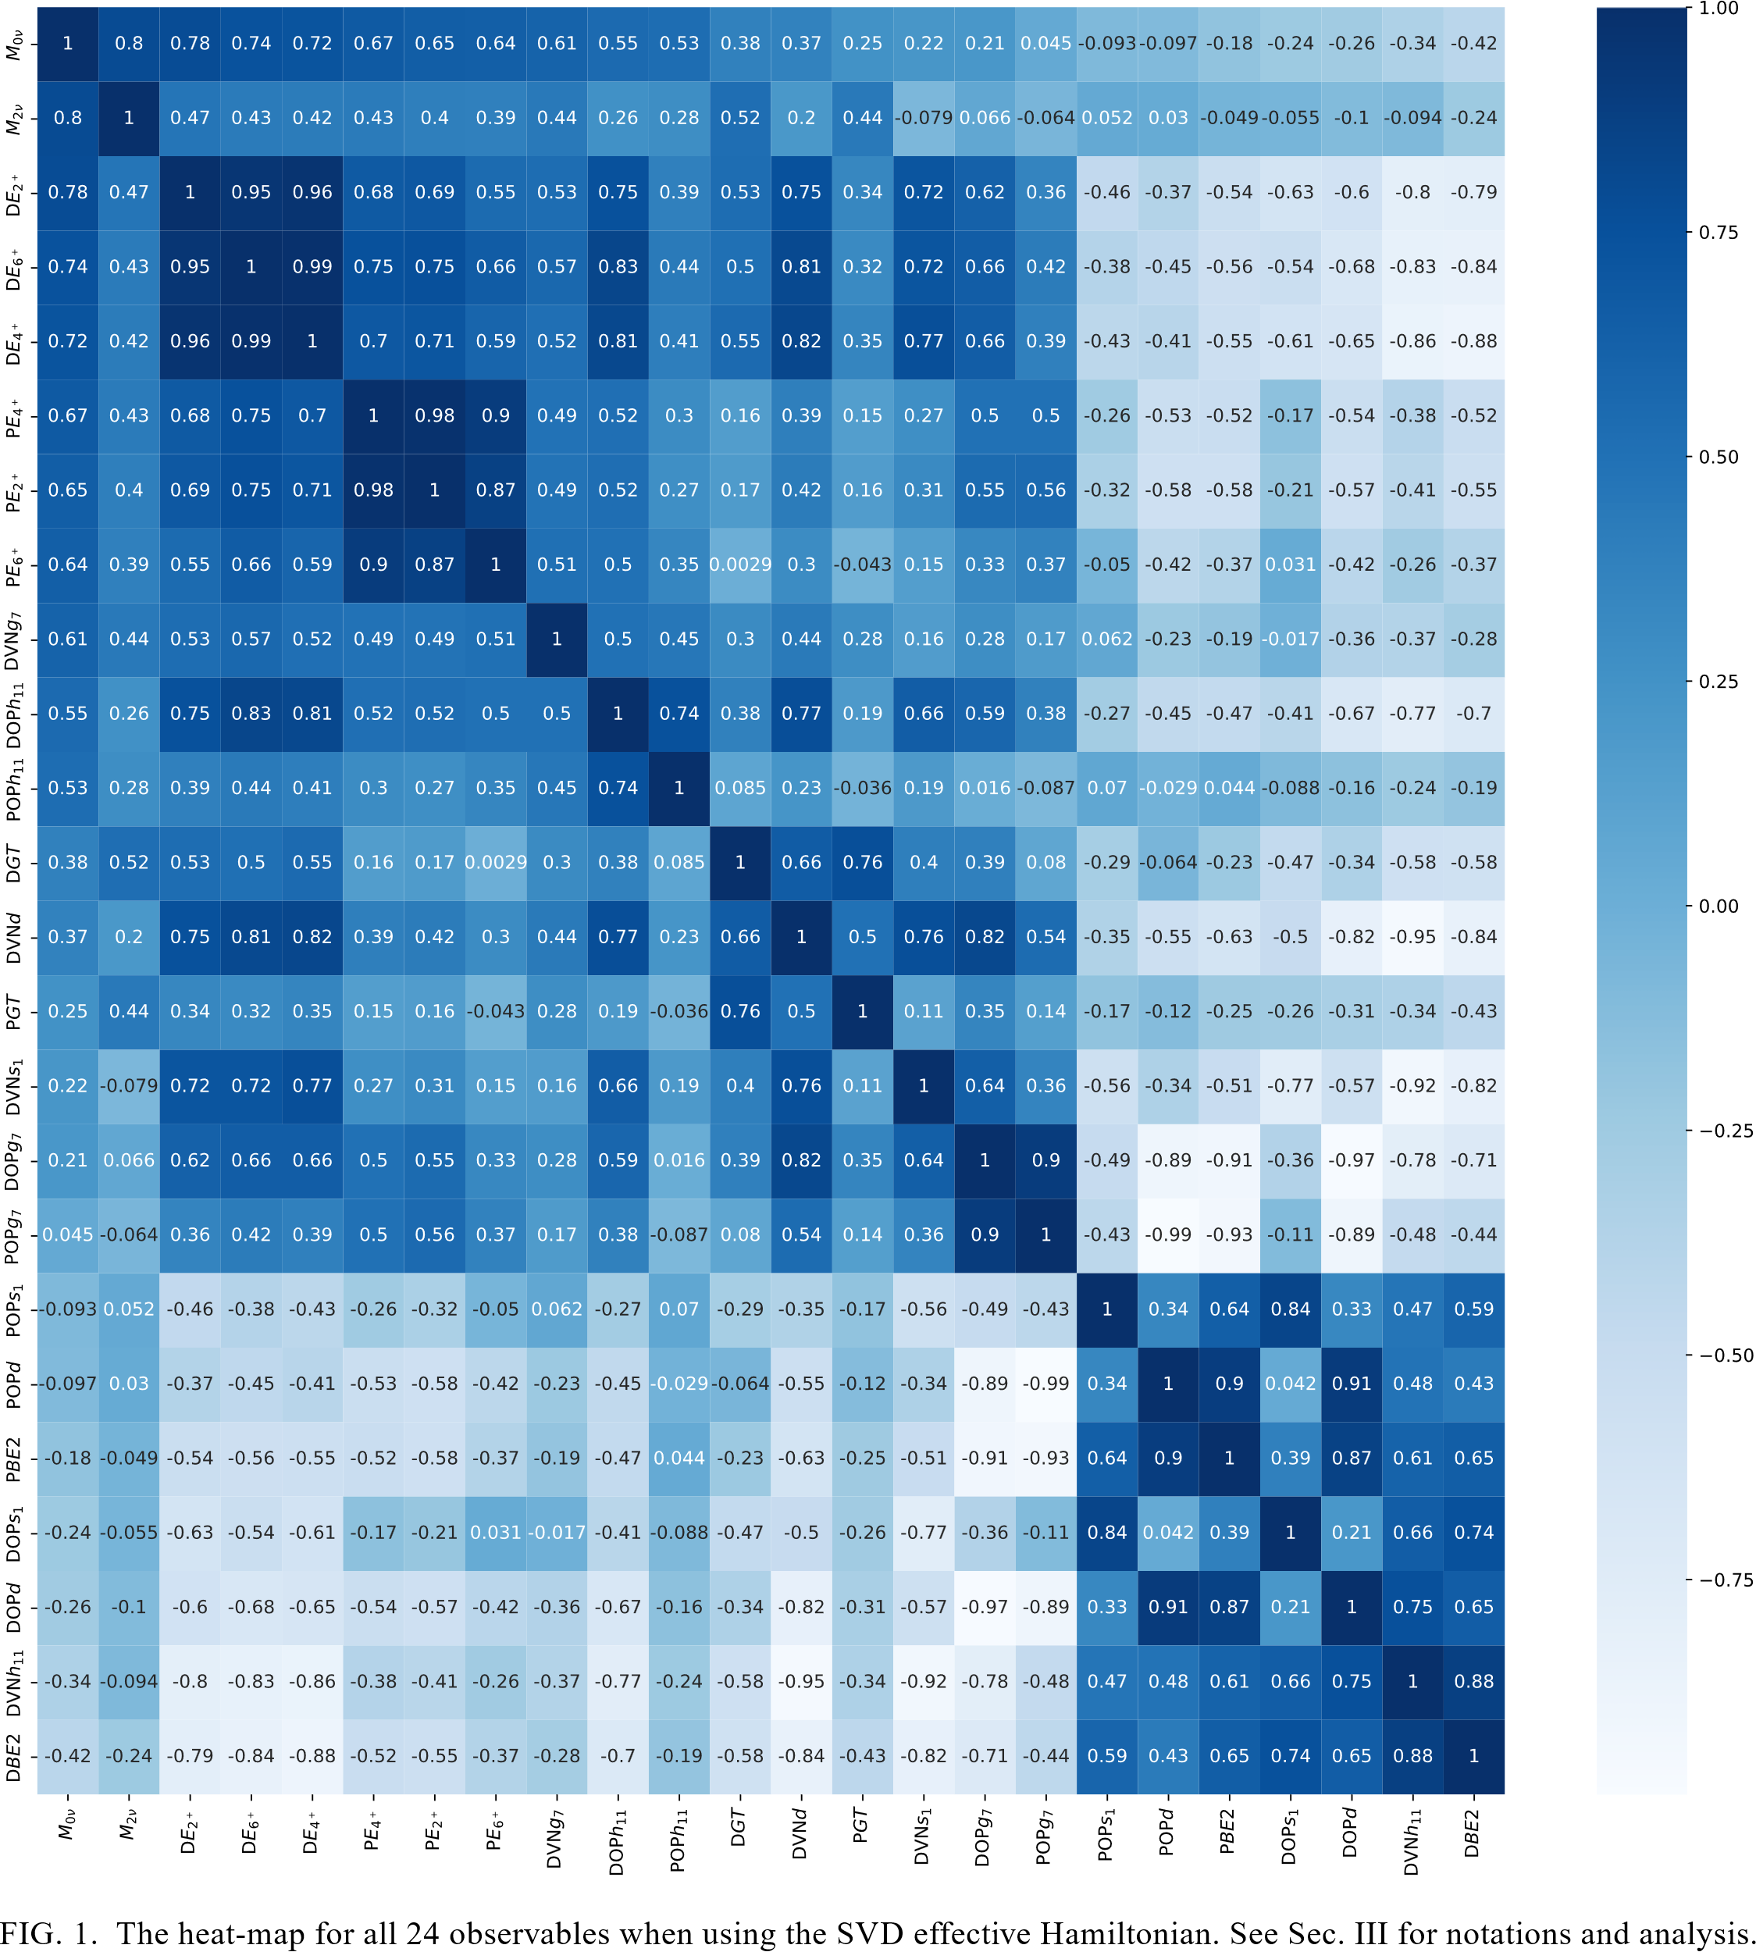
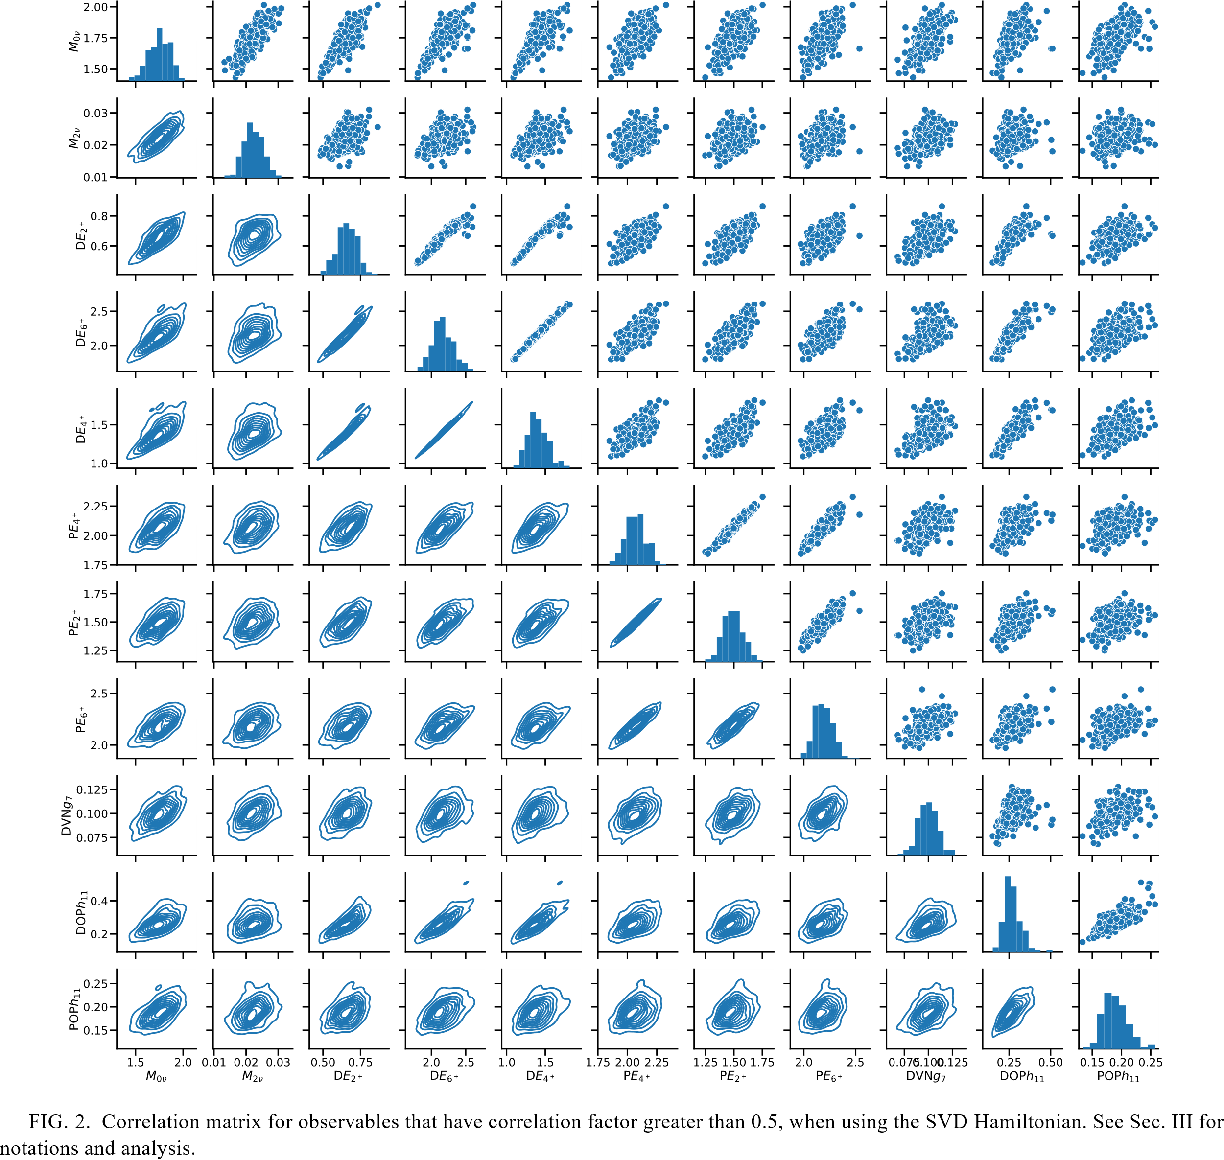
Andrei Neacsu – MEDEX ‘23 – Prague, September 4-8 2023

Slide 10
Highlights
energy levels that correlate with each other and, significantly for this study, the 0νββ NME and the 2νββ NME with R = 0.8 in the case of the SVD Hamiltonian; this is inherited by the BE(2) ↑-s that depend on the 2+ states;
correlations between the 0νββ NME and the strengths of the parent and daughter Gamow-Teller transitions to the first 1⁺ state in ¹³⁶Cs are significantly reduced, while the correlation with the 2νββ NME is very strong (maybe, the product of the GT matrix elements describing transitions to the first 1⁺ state in ¹³⁶Cs does not significantly contribute to the total sum of all excited 1⁺ states in the intermediate nucleus);
other observables that have relatively high correlations with the 0νββ NME are the energies of the 2⁺, 4⁺, and 6⁺ states in both ¹³⁶Xe and ¹³⁶Ba with the correlators R between 0.64 and 0.78;
g_{7/2} neutron vacancies in ¹³⁶Ba correlate with the 0νββ NME at R = 0.61;
proton occupancies of the h_{11/2} orbital in ¹³⁶Ba correlate with the 0νββ NME at R = 0.55, while the proton occupancies of the h_{11/2} orbital in ¹³⁶Xe correlate with the 0νββ NME at R = 0.53;
B(E2)↑ of the ¹³⁶Xe and ¹³⁶Ba cases (R = 0.65); PBE2 correlates very strongly with POPd (R = 0.9) and DOPd (R = 0.91), while it anticorrelates significantly with DOPg7 (R = −0.91) and POPg7 (R = −0.93);
PBE2 correlations with DOPs1 (R = 0.74) and DVNh11 (R = 0.88), anticorrelating with DVNd (R = −0.84), DVNs1 (R = −0.82) and the energy levels DE2+ (R = −0.79), DE4+ (R = −0.88), DE6+ (R = −0.84);
Andrei Neacsu – MEDEX ‘23 – Prague, September 4-8 2023

Slide 11
Statistical Inference based on the Bayesian model averaging
Optimal values and a potential range of error for the 0νββ NME
x is the random value of the 0νββ NME. The normalized weights W_{k} can be inferred using the statistical distributions of the evidence observables and their correlations with the calculated M0ν NME.
In our case, using a standard quenching factor of 0.7 for all GT matrix elements one gets a clearly dominant contribution of the SVD model.
However, we take W_{svd} = 4/6, W_{gcn} = W_{j5t} = 1/6.
Andrei Neacsu – MEDEX ‘23 – Prague, September 4-8 2023

Slide 12
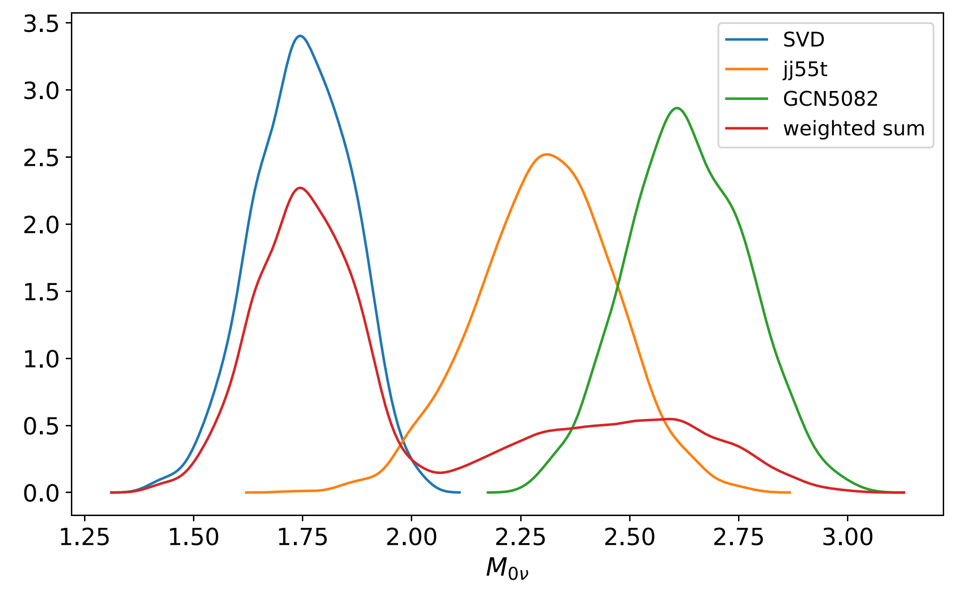
The final 0νββ NME result
PDFs of the 0νββ NME distributions
At 90% confidence, the 0νββ NME lies in the range between 1.55 and 2.65, with a mean value of about 1.99 and a standard deviation of 0.37
Andrei Neacsu – MEDEX ‘23 – Prague, September 4-8 2023

Slide 13
Thank you!
Andrei Neacsu – MEDEX ‘23 – Prague, September 4-8 2023

