Slide 2
42 registrants
26 in person
16 fully online
12 invited speakers
7 in person
5 fully online
2 weeks
50 contributions
27 invited contributions
20 participant presentations
3 guest talks
6 discussion sessions
2 social dinners

Slide 4
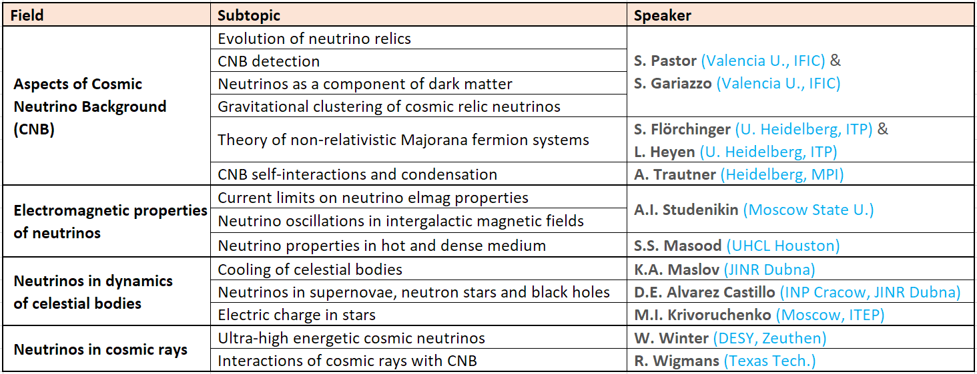

Slide 5
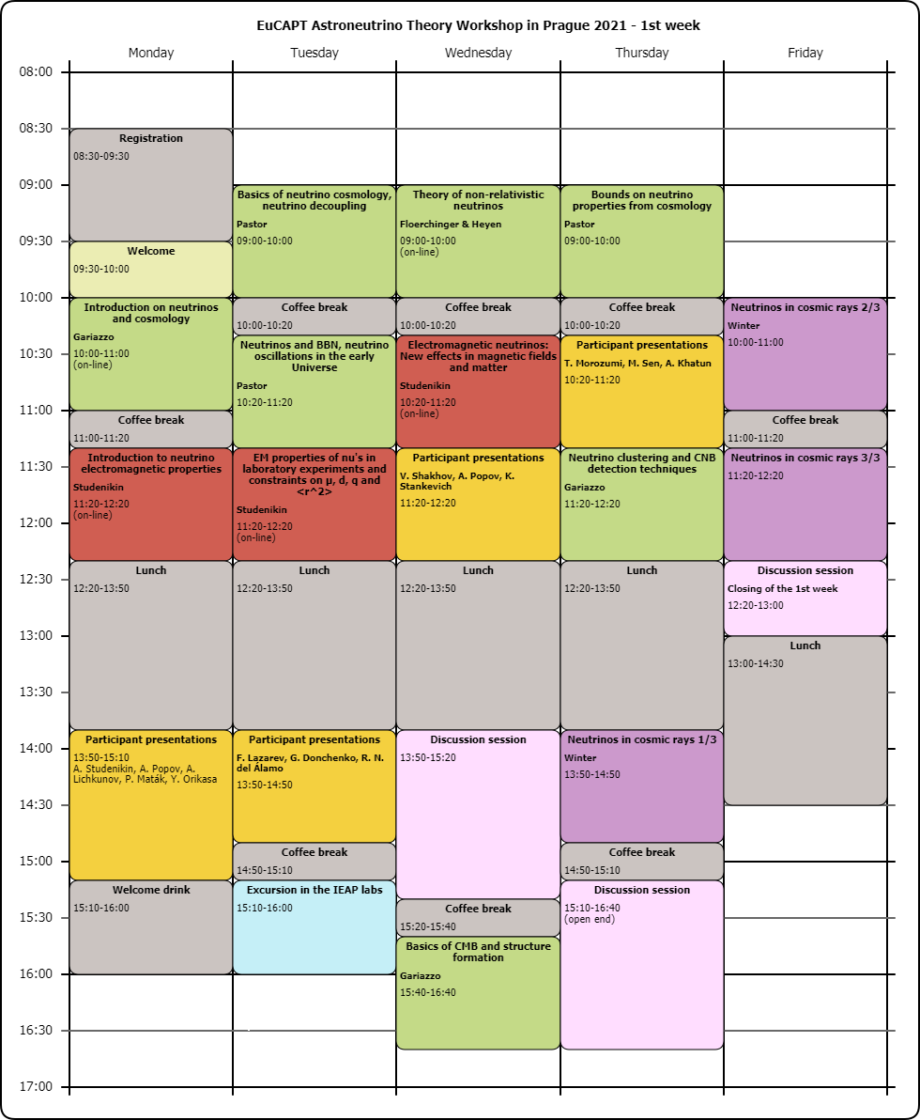
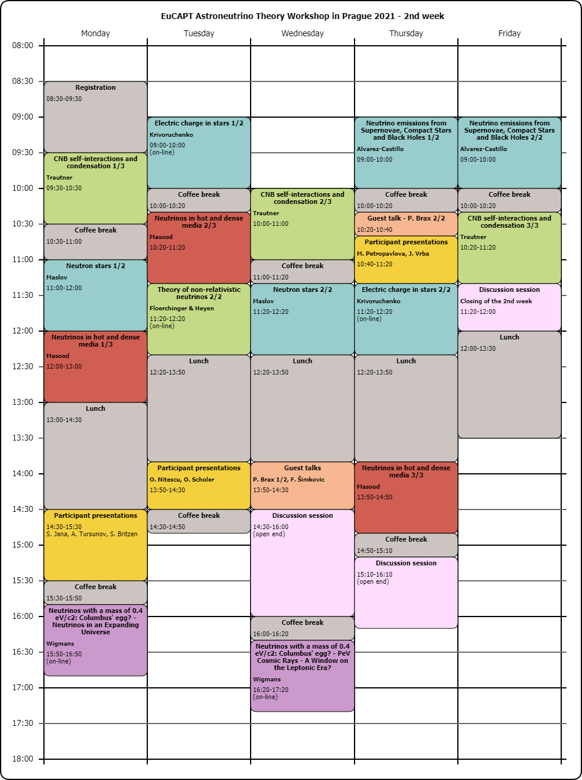

Slide 6
We would like to bring together representatives of the selected areas, from whom the participants (experts and students) can learn, and build up a creative environment and hopefully to end up with new ideas and collaborations.

