Slide 1


X-Ray Imaging Calibration for Fuel-Coolant Interaction Experimental Facilities
M. Johnson¹, C. Journeau, S. Singh², F. Payot (CEA), K. Matsuba, Y. Emura, K. Kamiyama (JAEA)
June 21-25, 2021
¹ currently with SCALIAN
² currently at ESRF

Slide 2
Outline
Context – Objectives
Geometric Calibration of X-ray imaging
Assessment of imaging system capabilities
Conclusions

Slide 3

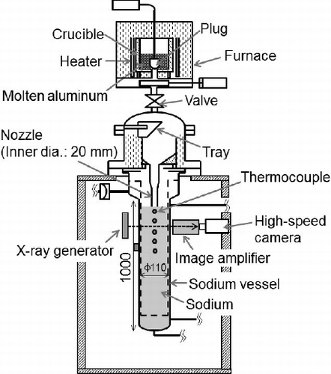


Context – Fuel Coolant Interaction
Postulated severe accident of a Sodium-cooled Fast Reactor
Core material meltdown (U,Pu)O₂, Steel, B₄C
Relocation of the melt
Interaction of melt with liquid sodium
  Melt jet fragmentation
  Intense sodium boiling
  Possibility of vapor explosions
Numerical simulation and experimental research are underway
X-ray imaging is a useful tool to study this interaction.
Molten fuel-vapor interface
Liquid coolant
Molten fuel
Vapor film
MELT facility, Matsuba et al. 2016

Slide 4
Need for X-ray image calibration
  Visualization of fuel-coolant interactions within an optically opaque test section, and for an optically opaque coolant, requires high-speed, high-resolution X-ray imaging.
  Fan beam X-ray imaging inevitably entails certain imaging artefacts, not limited to vignetting, radial distortion and noise.
  From qualitative image analysis to quantitative data thanks to image processing of X-ray images.
  Necessity for calibration to achieve quantitative results.
    Two main calibration objectives:
      Geometric calibration
      Assessment of imaging system capabilities e.g. detection thresholds
    Use of physical « phantoms » providing stable and known geometries/properties representative of the objects to be analyzed.
  Presented examples arise from different facilities in which calibrations have been carried out

Slide 5
Geometric Calibration of X-ray imaging

Slide 6
Design of phantoms
Materials must be chosen to mimic those of materials used in experiments
  Thermoplastics [polyoxymethylene (POM) and polyethylene (PE)] attenuation behaviour comparable to liquid Na at photon energies >100 keV, while offering sufficient versatility for the construction of complex phantom geometries.
  Melt can be represented by steel (metallic melt) or hafnia (density ~UO₂).
  Vapor represented by air
1
2

Slide 7
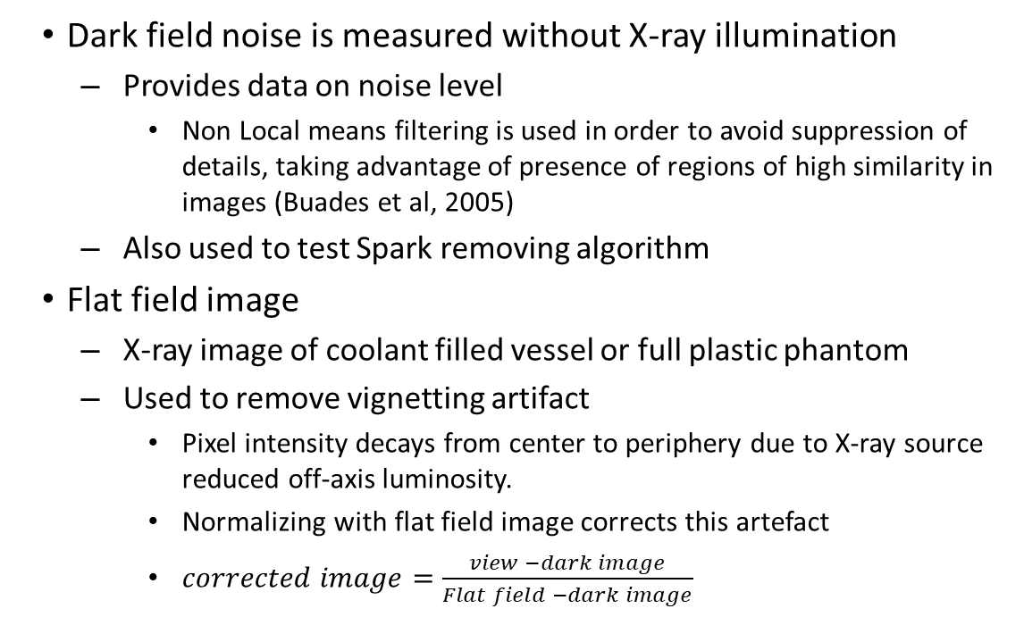
Dark current and flat field images
Dark field noise is measured without X-ray illumination
  Provides data on noise level
    Non Local means filtering is used in order to avoid suppression of details, taking advantage of presence of regions of high similarity in images (Buades et al, 2005)
  Also used to test Spark removing algorithm
Flat field image
  X-ray image of coolant filled vessel or full plastic phantom
  Used to remove vignetting artifact
    Pixel intensity decays from center to periphery due to X-ray source reduced off-axis luminosity.
    Normalizing with flat field image corrects this artefact
    $corrected image=\frac{view −dark image}{Flat field −dark image}$

Slide 8
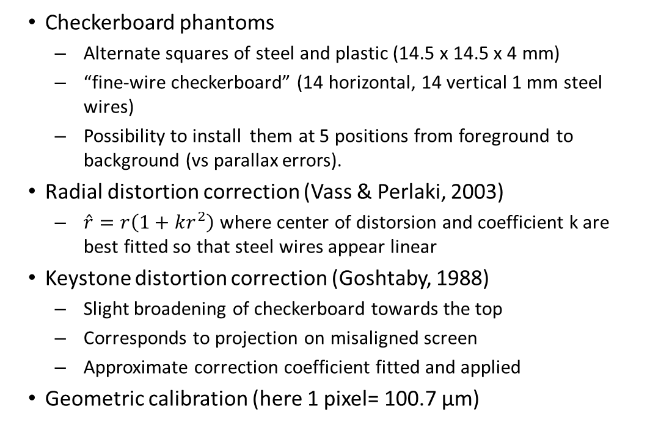
Correction of distorsion artefacts
Checkerboard phantoms
  Alternate squares of steel and plastic (14.5 x 14.5 x 4 mm)
  “fine-wire checkerboard” (14 horizontal, 14 vertical 1 mm steel wires)
  Possibility to install them at 5 positions from foreground to background (vs parallax errors).
Radial distortion correction (Vass & Perlaki, 2003)
  $\hat{r}=r\left(1+kr^{2}\right)$ where center of distorsion and coefficient k are best fitted so that steel wires appear linear
Keystone distortion correction (Goshtaby, 1988)
  Slight broadening of checkerboard towards the top
  Corresponds to projection on misaligned screen
  Approximate correction coefficient fitted and applied
Geometric calibration (here 1 pixel= 100.7 µm)

Slide 9
Assessment of imaging system capabilities

Slide 10
Limits of detection : modelling
  Use of MODERHATO code (Berge et al. 2018) to simulate the radiographic system (source, vessel, objects, scintillator, camera)
  Provides simulated images, including noise
  If a conservative threshold of 5σ is used, detection limit is set to steel balls of 5 mm in the presented calculation (Singh, 2019).
  Nevertheless, it is preferred to complement the simulations by representative phantoms.

Slide 11
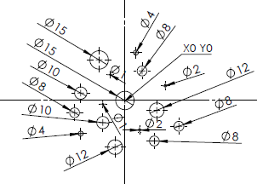
Limit of detection: steel balls in plastic phantom
16 SS balls (∅1 to 15 mm) embedded in POM insert
10 round objects clearly visible + 1 faintly visible
Detection limit corresponds to ∅4mm balls in this configuration.
Raw image
Post-processed image
Contour plot of
detected objects

Slide 12
Detection of clouds of small particles (1/2)
FCI fragments the jet
  Formation of a cloud of drops
Phantom to represent these configurations
  Steel rod ≡ metallic/UO₂ jet
  Series of rings filled with
    ∅ 4 mm Steel balls
    Hafnia powder (median ∅ 0.16µm; 77% void fraction)
    Different filling procedures used (empty rings ≡ gas bubbles)

Slide 13
Detection of clouds of small particles (2/2)
Images of phantom with 0, 1, 3 and 4 rings filled with steel balls
Images of phantom with 0, 1, 3 and 4 rings filled with hafnia powder

Slide 14
Gas film detection threshold
Dedicated phantom for gas film around a jet
  Conical steel rod in cylindrical hole
  Cylindrical rod in conical hole
Gas gap is detectable in the image upper part where it is smaller
Gas gap
Separation between
pieces of plastic

Slide 15
Conclusion
  Calibration is needed to provide quantitative data (including uncertainties) from image analyses of X-ray radioscopy
  Use of dedicated phantoms
    Plastic (PPE, POM) representing sodium
    Steel/hafnia representing fuel
    Air gaps representing vapor
  Geometrical calibration
    Correction of vignetting, distortion
    Pixel calibration
    Need to be performed after each change of geometry
  Detection limits
    Individual objects (balls)
    Clouds of objects
    Films

Slide 16
Thank you for your attention !
This work was carried out within the arrangement between CEA, FRAMATOME, JAEA, MHI and MFBR entered into force January 1, 2020

