Slide 1



Design of an acoustic sensor for fission gas release characterization devoted to JHR environment measurements
F. Baudry^{1,2}, E. Rosenkrantz^{1,2}, P. Combette^{1,2}, D. Fourmentel³ , C. Destouches³ , J.Y. Ferrandis^{1,2}
^{1.} University Montpellier, IES, UMR 5214, F-34000, Montpellier, France
^{2.} CNRS, IES, UMR 5214, F-34000, Montpellier, France
^{3.} CEA, DES, IRESNE, DER, SPESI, LDCI Cadarache F-13108 Saint-Paul-Lez-Durance, France
Notes:
Ladies and gentlemen, M. Chairman, it is my great pleasure to be here for this new edition of Animma conference, I really thanks the organizer … ….
My name is Florian Baudry
So my talk will focuse on « Design of an acoustic sensor for fission gas release characterization devoted to JHR environment measurements”

Slide 2
Presentation of the group of partners and the project
Chronology of the work on the gas composition devices
Operating principle of the device
Device design
Device characterization
Notes:
First of all…

Slide 3





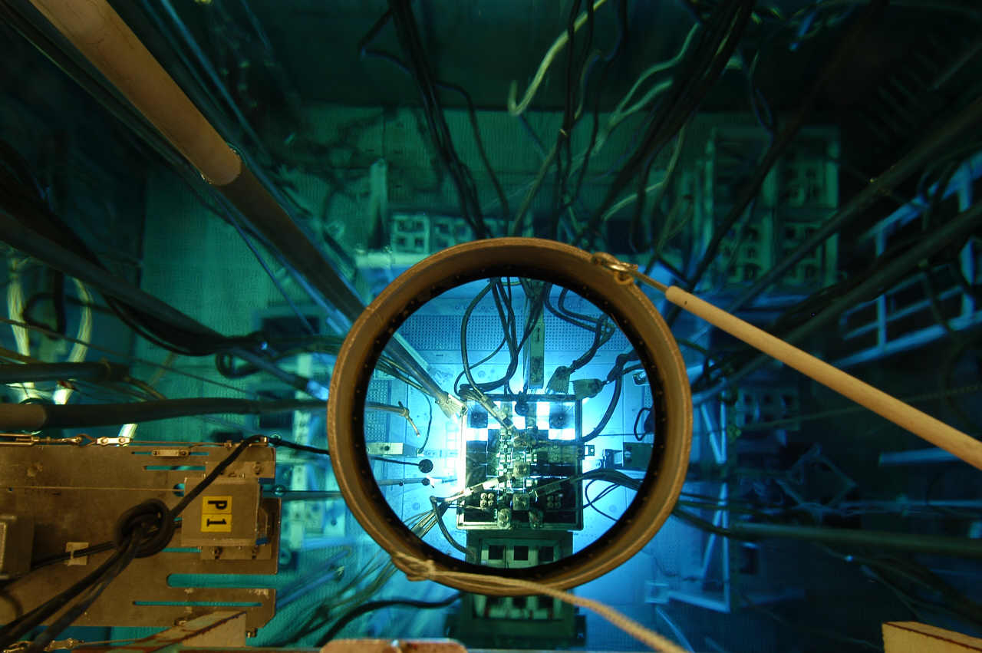
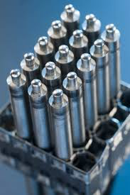
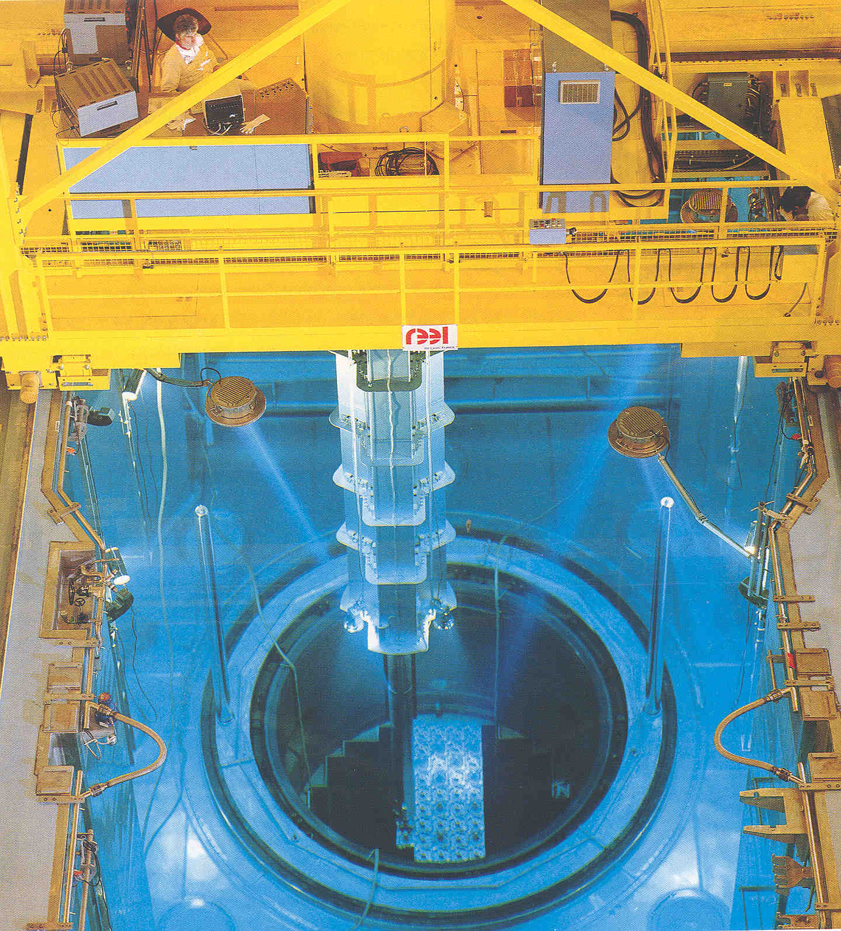
IES Acoustic team has R&D skills to develop innovative instrumentation in nuclear domain
    Measurement of the PCI (Pellet Cladding Interface) by acoustic imaging
    Mechanical characterization of irradiated fuel
    Estimation of the pressure and composition of a gas confined in PWR tube
    Measurement of fission gas composition in experimental reactors
Notes:
First we developpe new acoustic NDT technique in order to control the composition and the inner pressure of the fuel rod tube ( from the outside)
With the acoustic imaging check the interface between the pellet fuel and the tube
Finf the young modulus porosity rate etc etc
Our projext namely control the molar fraction of a gaz in fuel rod PWR tube

Slide 4

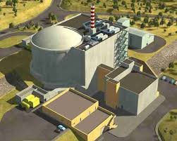
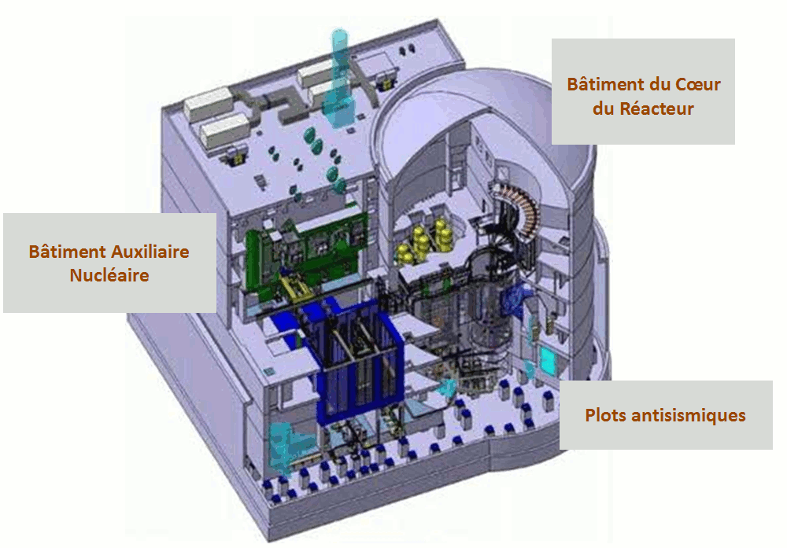


Context : developement and fabrication of a new expérimental reactor Jules Horowitz (RJH)
  An experimental reactor is a nuclear installation in which we produce and maintain a chain reaction in order to obtain a flow of neutrons to be used during experimentation.
  Some are used to study and qualify the behaviour under irradiation of structural materials and fuel.
  Generally speaking, an experimental reactor requires instrumentation (temperature, inner pressure, chemical properties, structural evolution…)
Artist views of the new JHR
the aim of the partnership between CEA and IES (Institute of electronic and systems) is to develop a means of measuring the gas composition in a fuel rod for an experimental reactor
Notes:
But what is the context of developpement of our this new composition devices ?
This device have to be integred in a new RJH reactor in order to be use as apanel of instrumentation such as for instance ( pressure gauge and thermocouple)
The main goal of this type of facility is to produce a neutron and or gamma flux strictly controlled in order to do experimentations
That is the reason why this kind of instrumentation so as to monitoring the physical constant dring irradaiation such as (temperature with thermocouple, pressure by ns controlling the deformation of the fuel rod)

Slide 5
Presentation of the group of partners and the project
Chronology of the work on the gas composition devices
Operating principle of the device
Device design
Device characterization

Slide 6
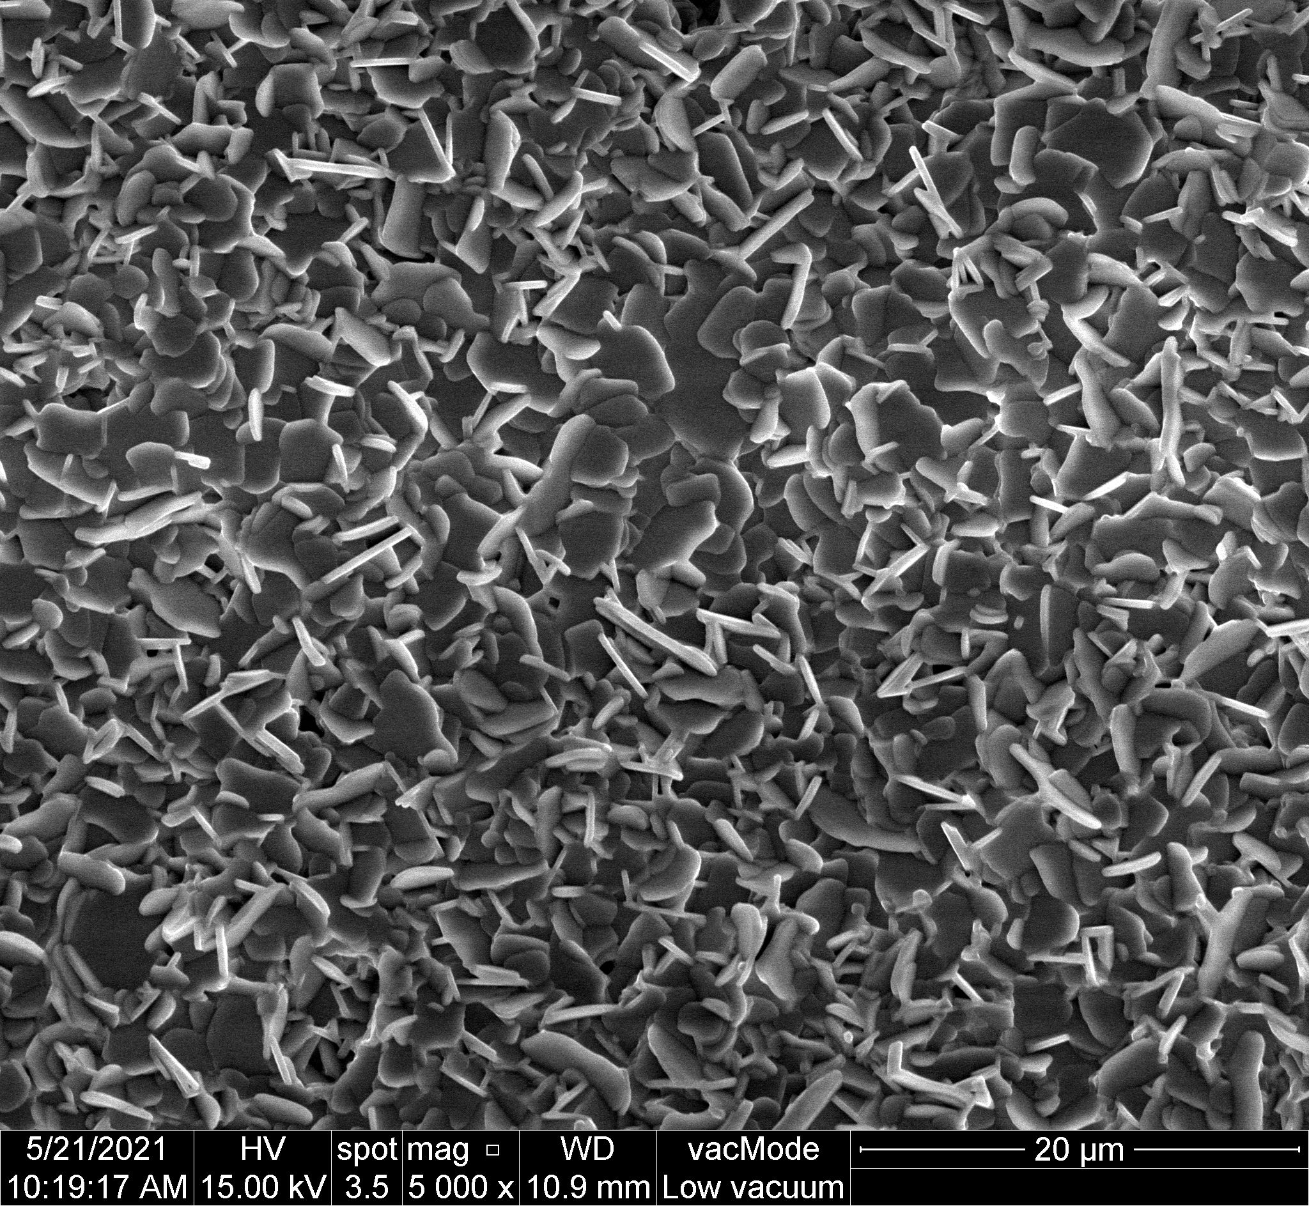
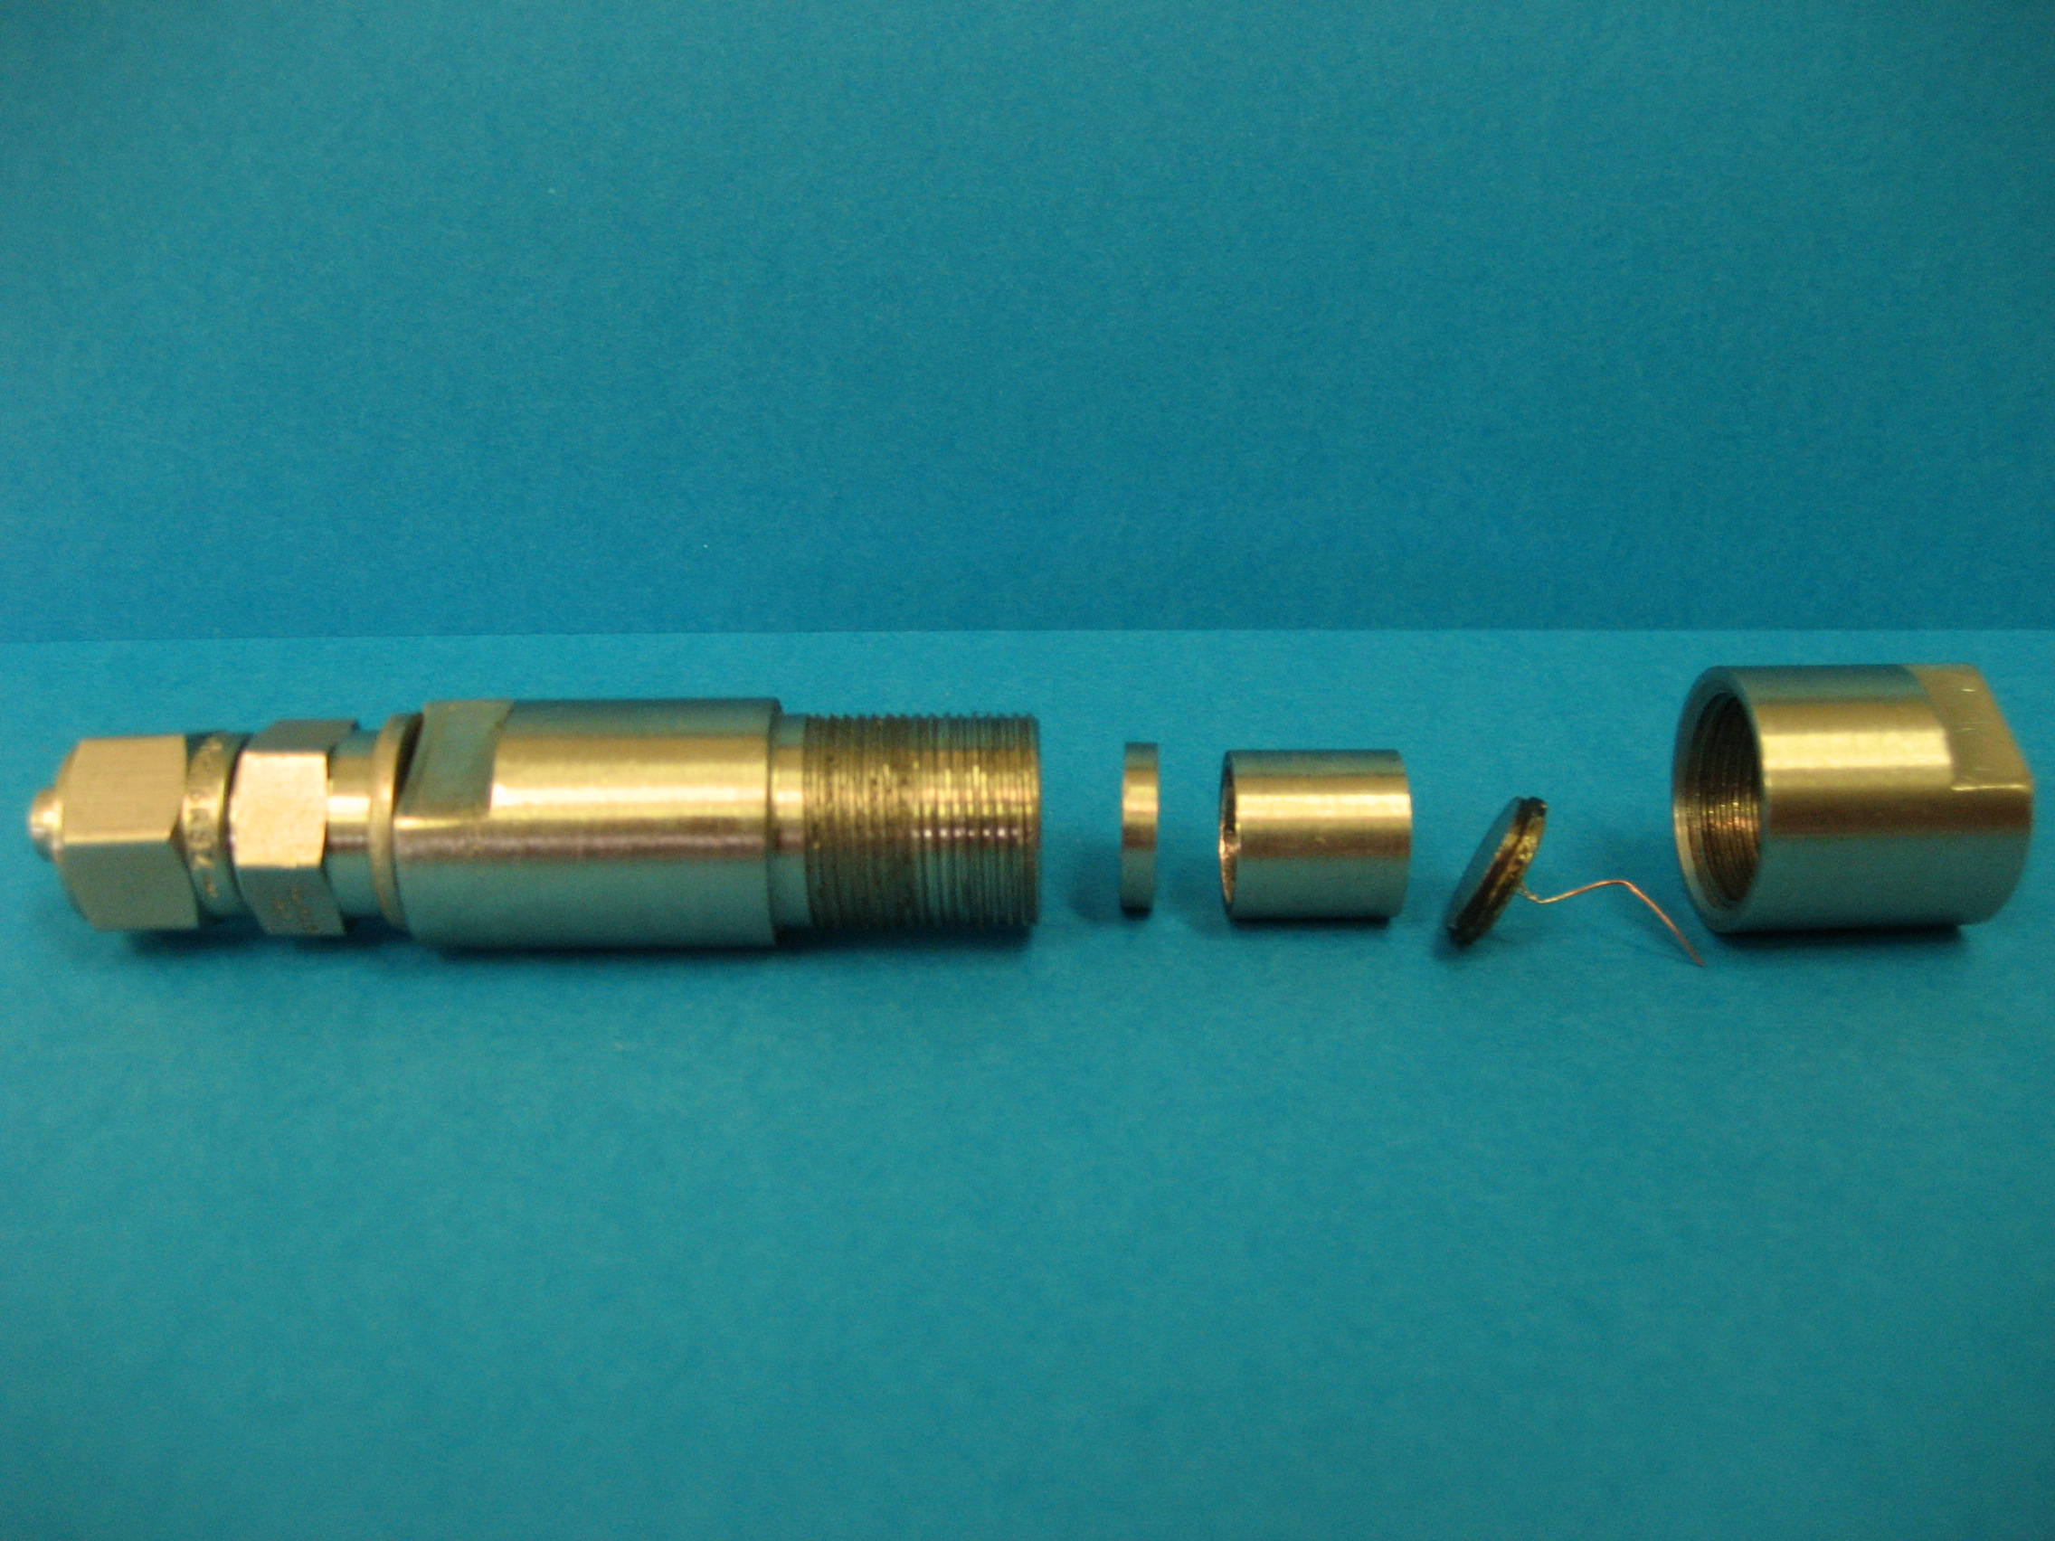
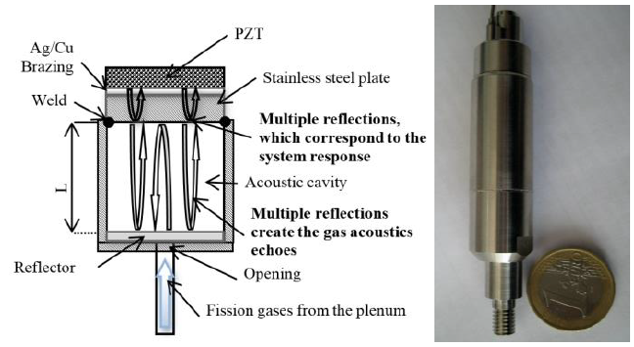
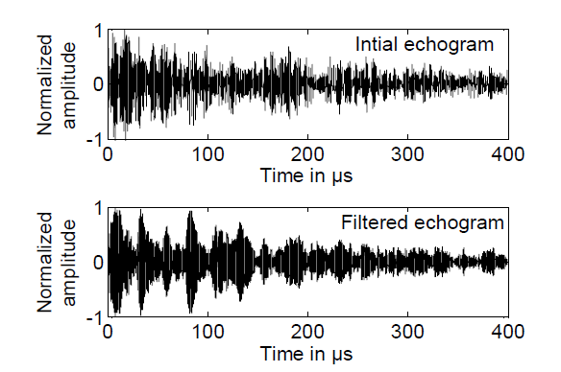
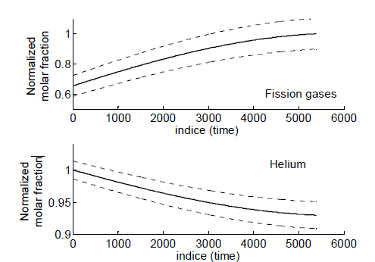
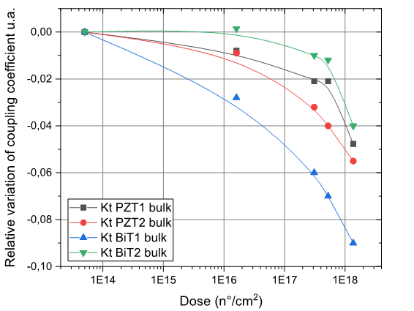
Timeline of the project
2000-2010 : Proof of concepts of a gas composition monitoring device in fuel rod [1]
2010 : Testing the gas composition sensor (CACP-1 REMORA 3) in OSIRIS [2]
2011-20XX : Study of a new gas composition sensor with high temperature ( < 300°C )
Acoustic sensor overview of CACP-1 2010 tested in OSIRIS [1]
NDT sensor for measurement of gaz composition [5]
SEM picture ×5000 of high Curie temperature piezoelectric material PHD of F.Very and O.Gatsa
Raw signal in 90 Bar of helium and filtred signal by FFT[2]
Variation of gas composition during maximal irradiation phase [2]
Irradiation study of piezoelectric elements at high Curie temperature (Animma 2019) [3]
Notes:
In order to understand the behavior of the sensor we have to describe the timeline of the project :
The tube act as resonator which is permitted to investigates the composition of the gaz fission.
The devices achieved a measure of pressure with a precision around 0,3%
In 2010, this sensor is not plated on the fuel rod, but canalisation convoy gaz from the fuel rod to a hermetic acoustic cavity. the first studies of the sensor have been done the performance of the initial sensor CACP-1 is limited for a temp of 200°C due to the use of PZT as piezo material (PZ27) on INOX (limitation of the coupling factor and limited temperature)
But permitted to follow the gaz composition evolution of the device by mesuring the time of flight of acoustics signal
Expliquer le graph
Given the fact the limited operationnnal temperature is an handicap for measurement in BWR and PWR CONDITION REACTOR at least 350°C
The work of F.Very et O.Gatsa have permitted to show the possibility of elaborate the high temp piezoelectric elements (350°C) but reliable to dose rate (sum rate (thremal, ast and epthimal ) to 1E10^17 n)cm²

Slide 7
Presentation of the group of partners and the project
Chronology of the work on the gas composition devices
Operating principle of the device
Device design
Device characterization

Slide 8
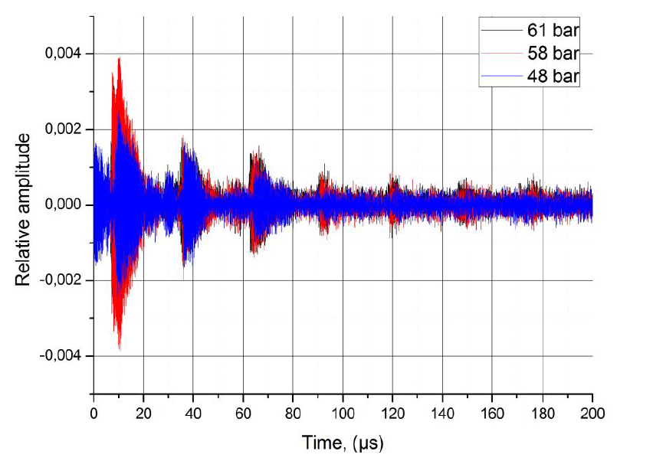
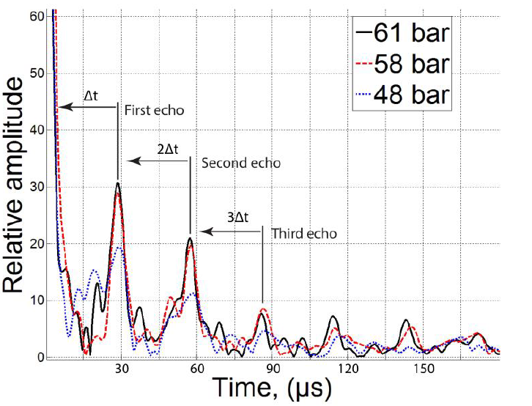
Acoustic sensor for gas composition measurement (REMORA3 generation)
Brazing
PZT OR NBT
Stainless steel plate
Airtight weld seam
Acoustic cavity
Deflector
Fission gases from the plenum
schematic sectional view of the CACP 1 device
Echogram in Helium under pressure
Filtered signal by FFT and RFFT
Notes:
So how work the sensor ?
Here we have a cross section of the CACP-1 stated before.
Here we have the cavity filled of pressurised gaz .
The fuel tube is filled of helium and this helium is collected from the fuel rod and is injected in a tube, the speed of sound depend of the pressure the temp and teh composition. The acoustic signal is generatd y piezoelectric part present on the top.
During the experiment the pressure and temp remain constantonly the gaz composition is modified Kr/Xe
then after a signal processing which consists in a FFT of the signal which allows to select only the frequency ranges of low frequencies and insi clean the signal and remove a good part of the noise

Slide 9
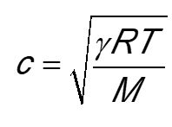
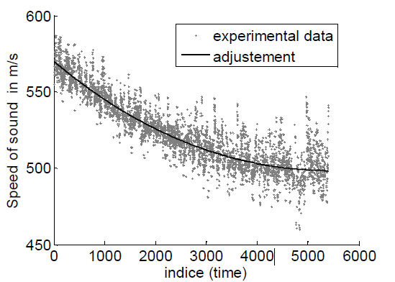

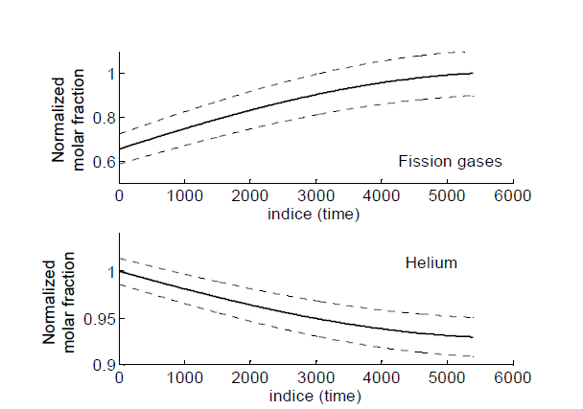


Then how pass from Δt to a gas composition measurement ?
Dependency of acoustic celerity and the molar mass of the gaz
equation of statistical physics linking the velocity of acoustic waves to a gas composition
equation of statistical physics linking the velocity of acoustic waves to a gas composition
Perfect gas = use the first order Viriel equation
With $c=\frac{2d}{∆t}$
/Kr
real gas = use either the Viriel or Redlich-Wong equation
Decrease of the Speed of sound for a real mixture
The ratio $\frac{x_{Xe}}{x_{kr}}$ is known (12 for UO₂ and 17 for MOX)
We have to know the initial gaz mixture (100% He for instance for t=0)
Standard Acoustic measurements from gas cavity
Estimation by equations of the ratio x between He and Xe/Kr
Notes:
But what is the math model to pass from a delta t to a gas composition?
like i said before the speed of sound depend of temp, and the molar mass of the gaz by measuring delta T we measure the speed of acoustic wave.
For perfect gas
Then with a fraction gas equation it is possible to apprximate a molar into a mix of two gas for a case helium gaz and a couple of Xe/Kr produe during the nuclear fission for U02 it’s 12 and 17for Mox then we have 1 equation with 1 unknow such as Mxe/Kr
A second condition of course is to exactly know the initial composition of the gaz…
Then it’s possible to reduce a problem of trinary gaz (3 differents gaz in the medium) in binary gaz

Slide 10
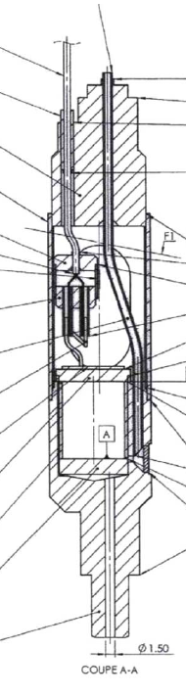
why up to date the gas composition monitoring device ?
Two thesis (2015 - F. VERY & 2018 - O. GATSA) allowed us to propose two solutions :
  Direct screen printing of an active element onto alumina substrate to reduce the imperfection and non-parallelism influence
  Active element with a working temperature about 400 °C
  Both of these solutions have been validated under nuclear radiations [3]
My work consists to design, manufacture the new Acoustic instrumentation and GEN2- sensor
Now we have to study the structure of the device…
Because the GEN1- REMORA3 sensor presents some limitations :
Mechanical coupling imperfection between the active element and substrate
Parallelism issue due to fabrication technique
Temperature limitation of an active element (PZT) at 200 °C → The NBT have an higher temperature limitations
Notes:
Previously we have described the princple of the first Remora 3 sensore name cacp-1, but this sensor have limitations and these limitation justifies to make an up tio date .
Mechanical couplied have imperfections because due to an important pression (200 Bar) in the gaz cavity the inox plate have to be thick few millimeters and this thkness limitate the performance of the sensor (acoustic limitation)
Use of PZT have a temp of Curie around 200°C, this limitation doesn’t permit to be use in 350°C reactor fr instance
Fvery and Ogatsa have permitted to responds for these differents questions
Fvery for use of alumina→ abandon of INOX
And OG for a new generations of piezoelectrics elements NBT → With a higher Curie temp…

Slide 11
Presentation of the group of partners and the project
Chronology of the work on the gas composition devices
Operating principle of the device
Device design
Device characterization

Slide 12
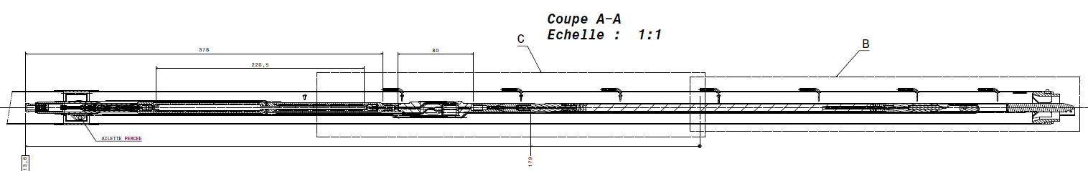
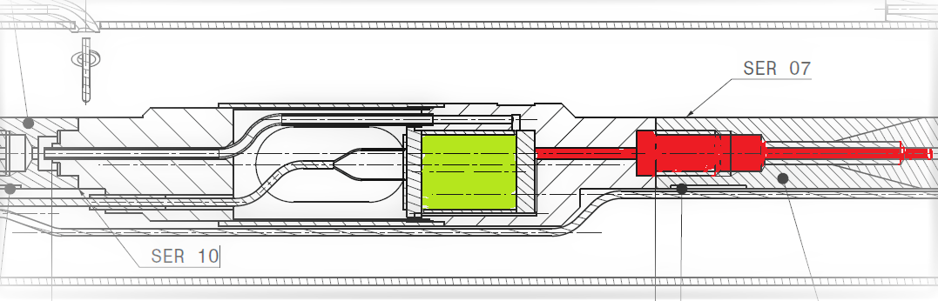
Device specifications
Resist to a temperature of at least 350 °C for Gen2-sensor → Use of ceramics and refractory cement for the manufacturing of the devices
Radiation constraints → Experiments have been done so as to test the NBT under harsh environment (Neutron flux, temperature…) (ANIMMA 2019 : TRIGA MK2 Slovenia)
Dimensional constraints → must be able to fit in a cylinder of 15 mm diameter
U0₂ or MOX PELLETS
Global Cut view of the new instrumented fuel rod for JHR
7 m
Cavity filled by HP gas
Canalisation between fuel pellets and cavity
Our sensor have to be integrated in this cavity…
Cut view C
Notes:
Rester sur le conditionnel
Each part of the device have to be resilient and a low TCE for 350°C → Choose of Ceramic and NBT
manipulation have been done in 2018 in an experimental nuclear facility in order to test the NBT secreen printed on alumina in radiation environments
Why we have size contraint ?

Slide 13
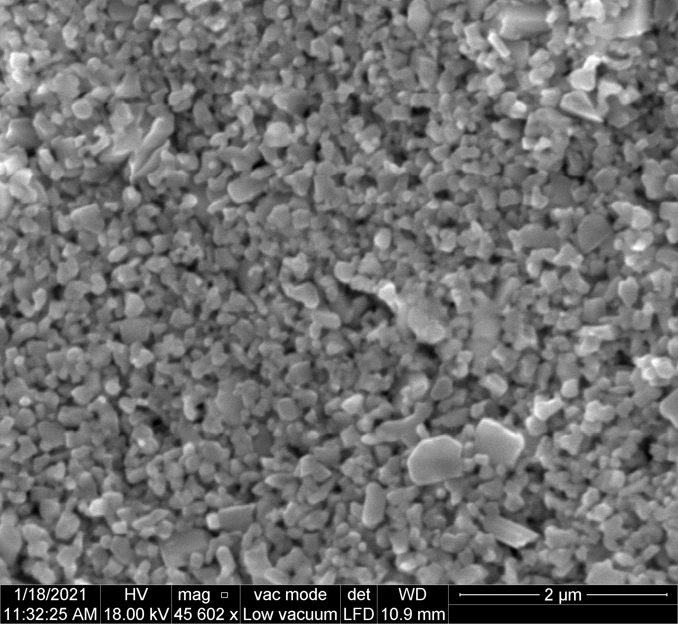
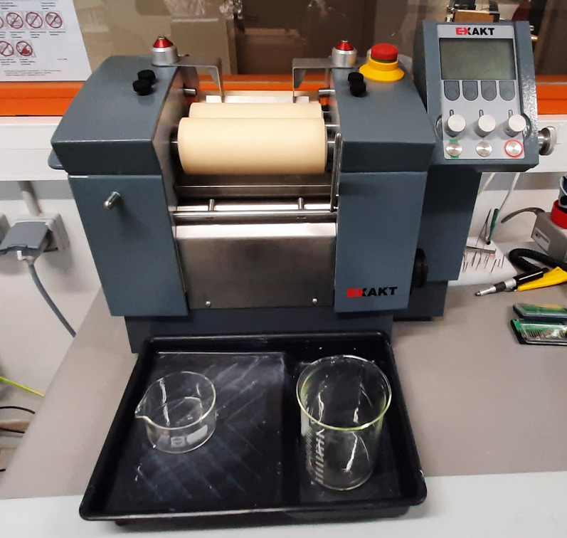
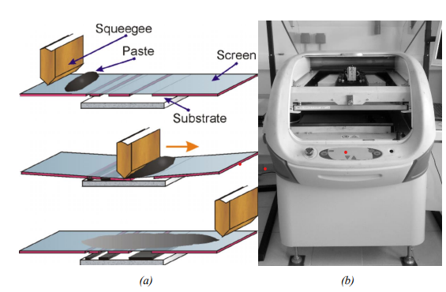
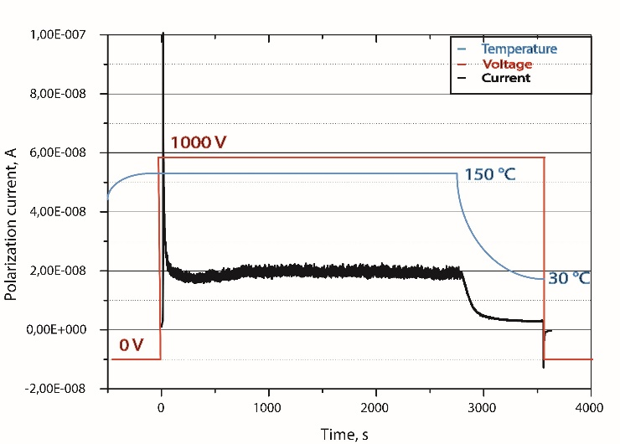
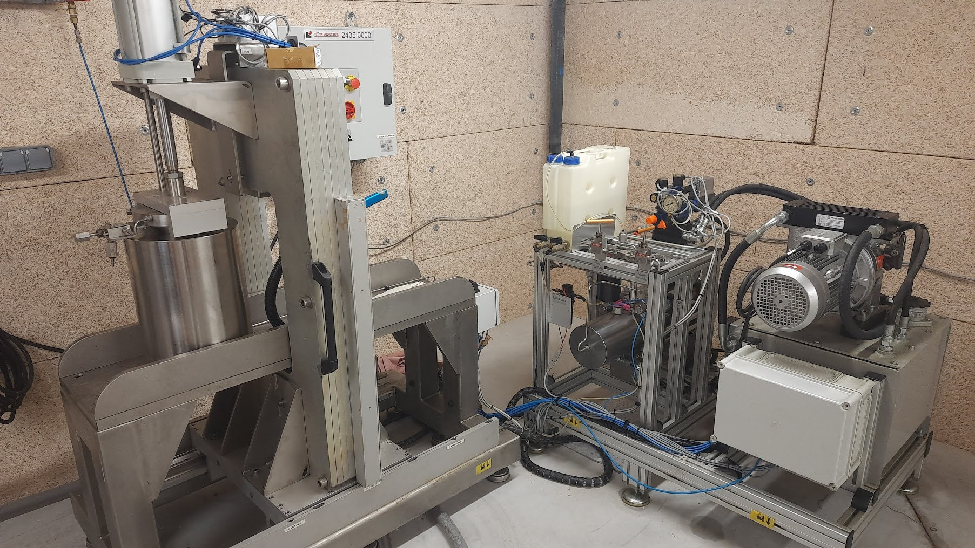
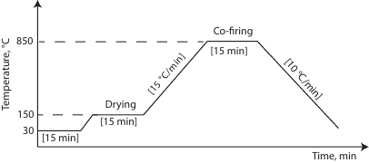
Fabrication of the piezoelectric part
1
2
Powder of NBT
Mixed powder + binding agent
Screen printing deposition
3
5
4
Polling step
Firing
isostatic pressing
Notes:
Poling permitted to give piezo perfs.

Slide 14
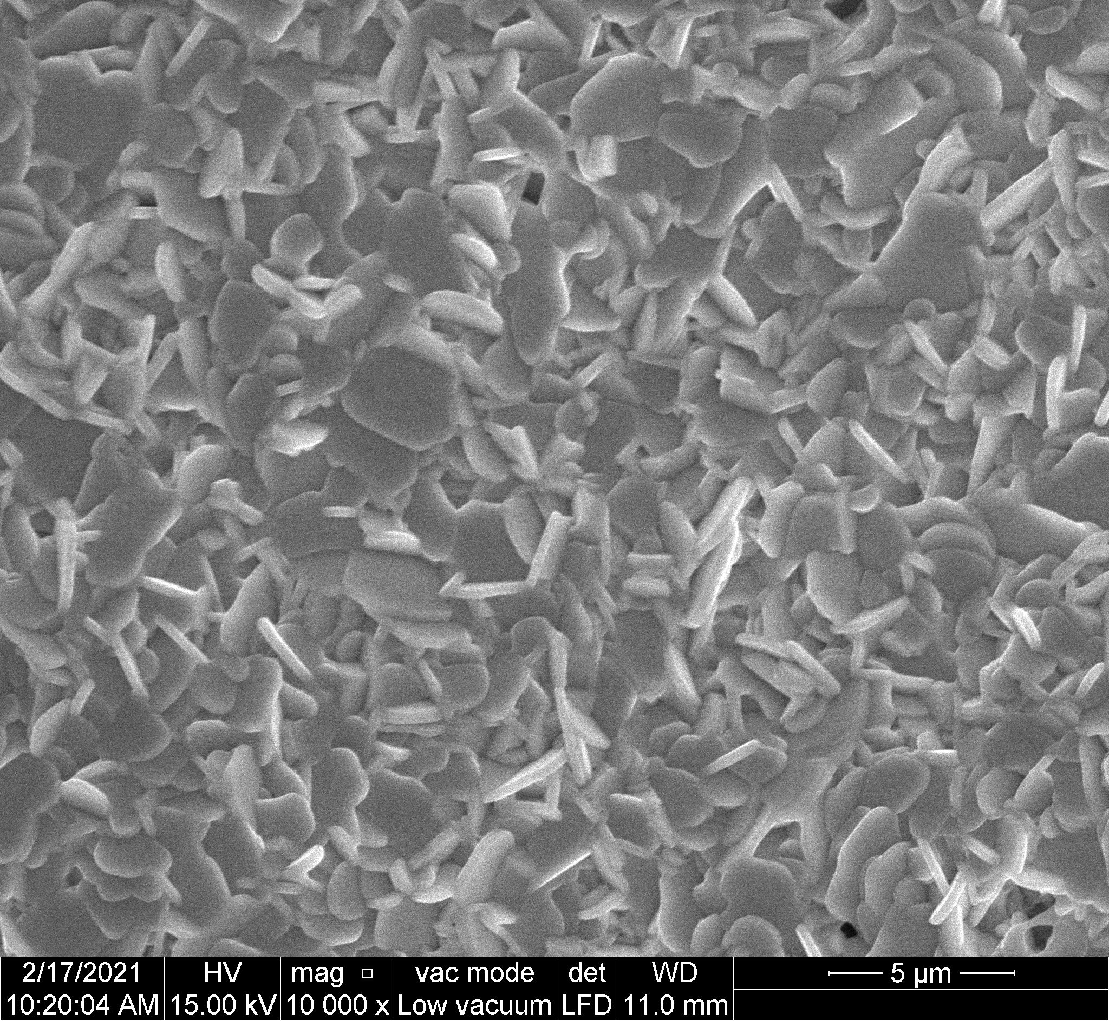

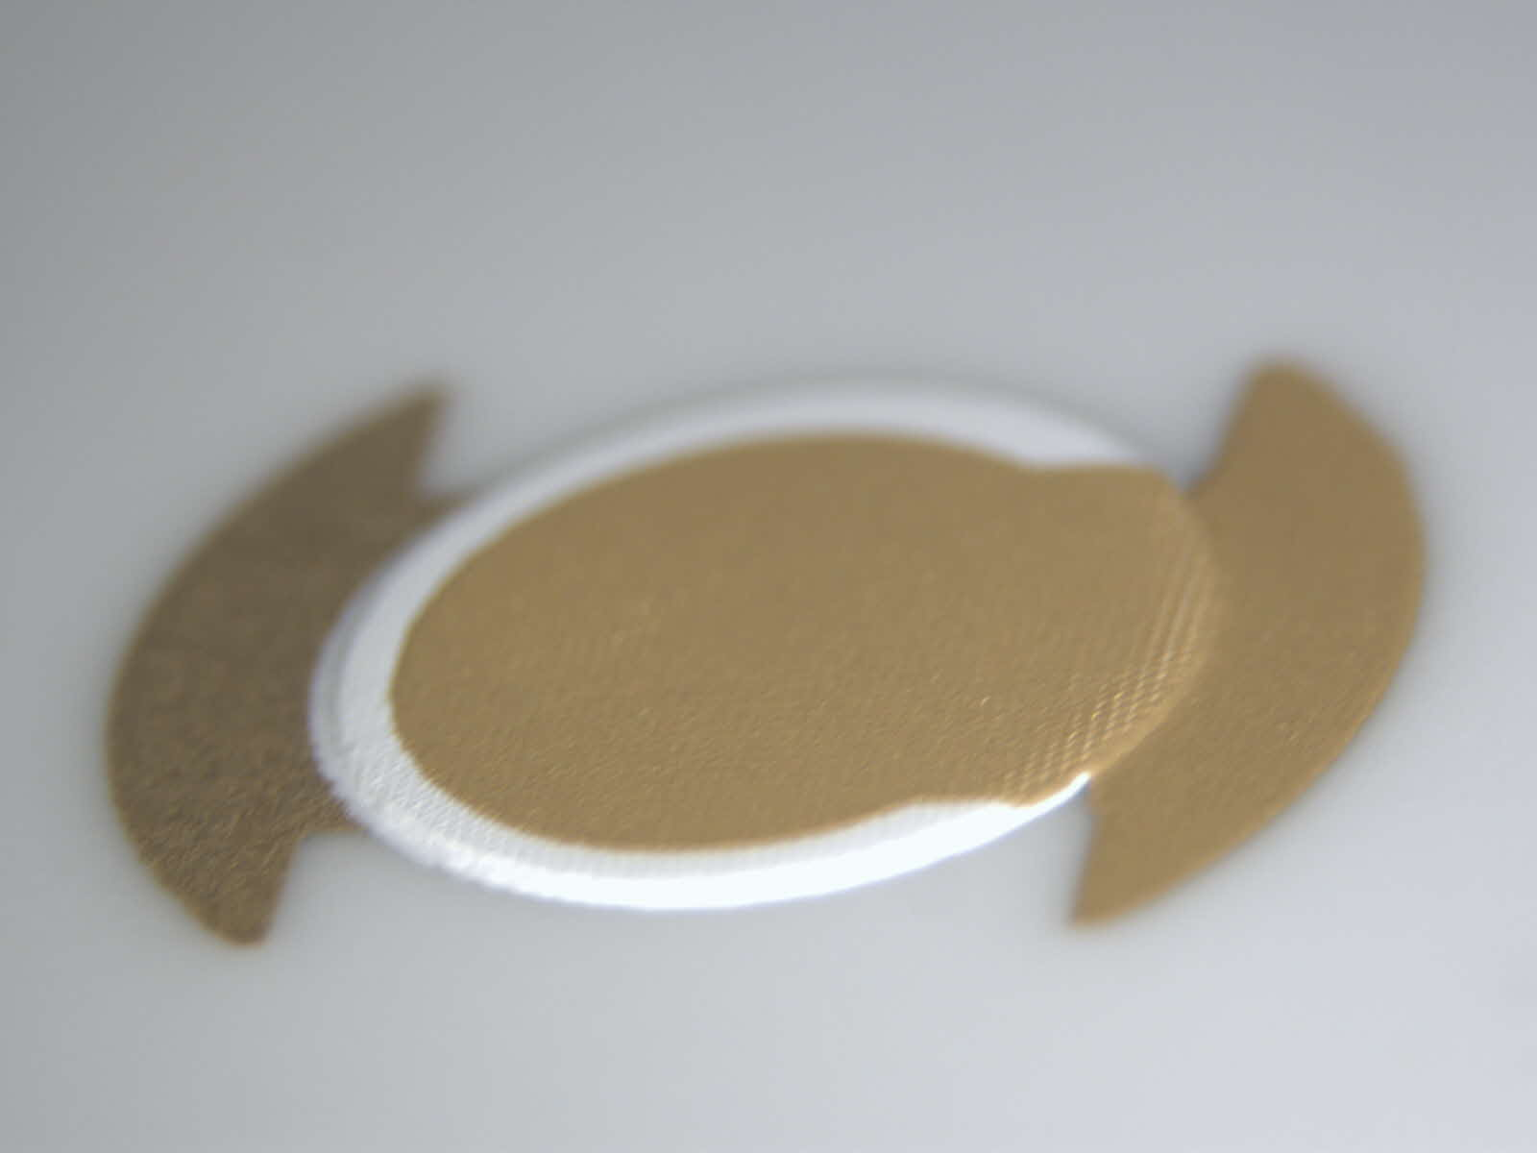
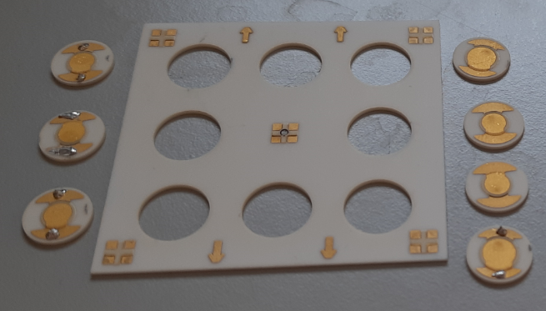
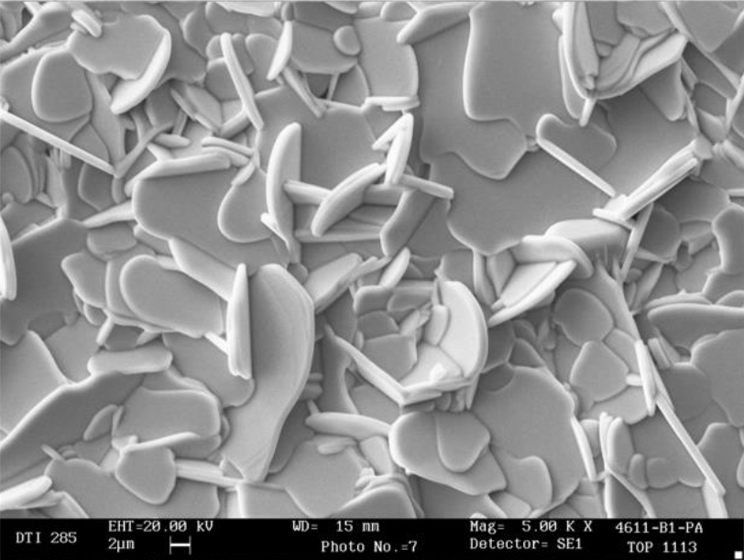
Piezoelectric parts
- Use of NBT (Sodium Bismuth Titanate) similar to PZ46 marketed by MEGGIT® (no longer commercialize) → Has a high Curie temperature and a sufficient S/N ratio for our applications (at least 350°C)
5 mm
screen printing on MACOR and Alumina (Al₂O₃)
use of Pt and Au electrodes that can reach temperatures of at least 1000°C
SEM pictures of our NBT
Ceramic disk with piezoelectrics parts
Fabrication of matrix plates 8 piezoelectrics elements by screen printing
SEM pictures of marketed PZ46® from MEGGIT®
Notes:
4slides qui correspondent aux pages de 17 à 20 pour remplacer celle là slide générique p 21

Slide 15
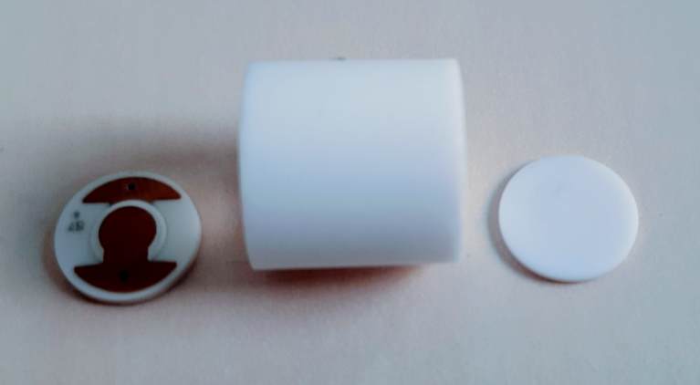
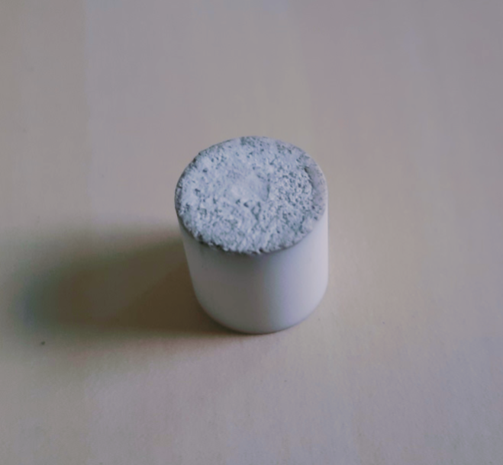
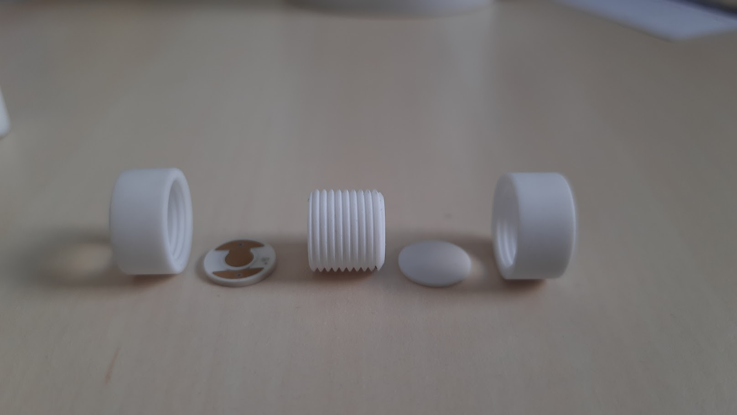
Sensor body
The sensor Body is made of vitroceramic MACOR for two reasons :
  Low dismatch of TCE between elements of the sensor (α_{Al2O3}= 8,6×10⁻⁶ K⁻¹ VS α_{NBT} = 7×10⁻⁶ K⁻¹ VS α_{MACOR} = 9×10⁻⁶ K⁻¹ )
  Each parts can be bounded by alumina cement (resilient until T_{max}=1400°C)
Design n°2
Design n°1
Piezoelectric disk
Leak hole
Reflector
Alumina cement
Integration of the sensor directly in the pressurized cavity
Designs 1 & 2 of acoustics devices
Notes:
The sensor body have to be realize with ceramics, use of MACOR have been preferized due to the fact that it’s easy to machining, low dismatch of TCE and easy to bounded differents parts with alumina cement

Slide 16
Presentation of the group of partners and the project
Chronology of the work on the gas composition devices
Operating principle of the device
Device design
Device characterization and results

Slide 17
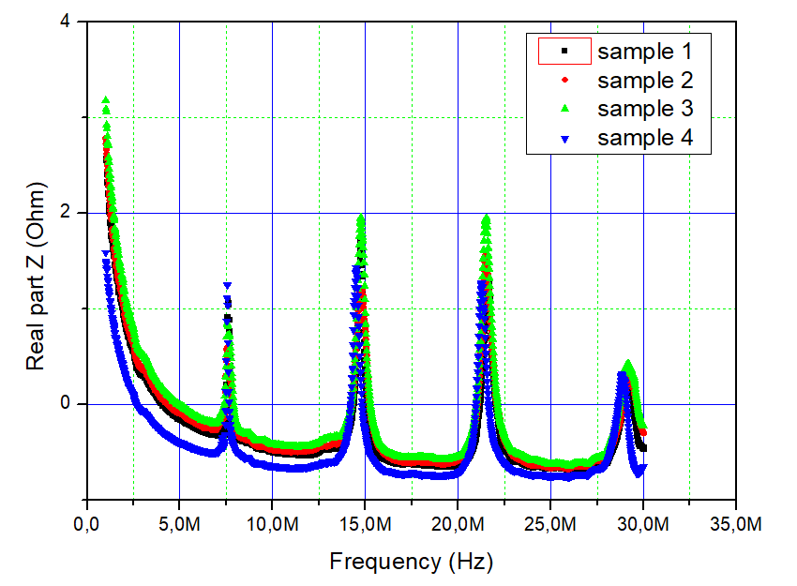
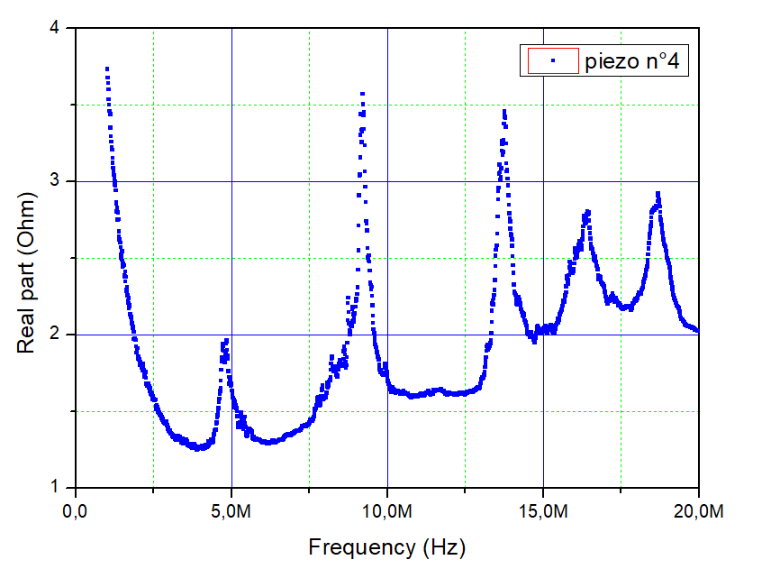
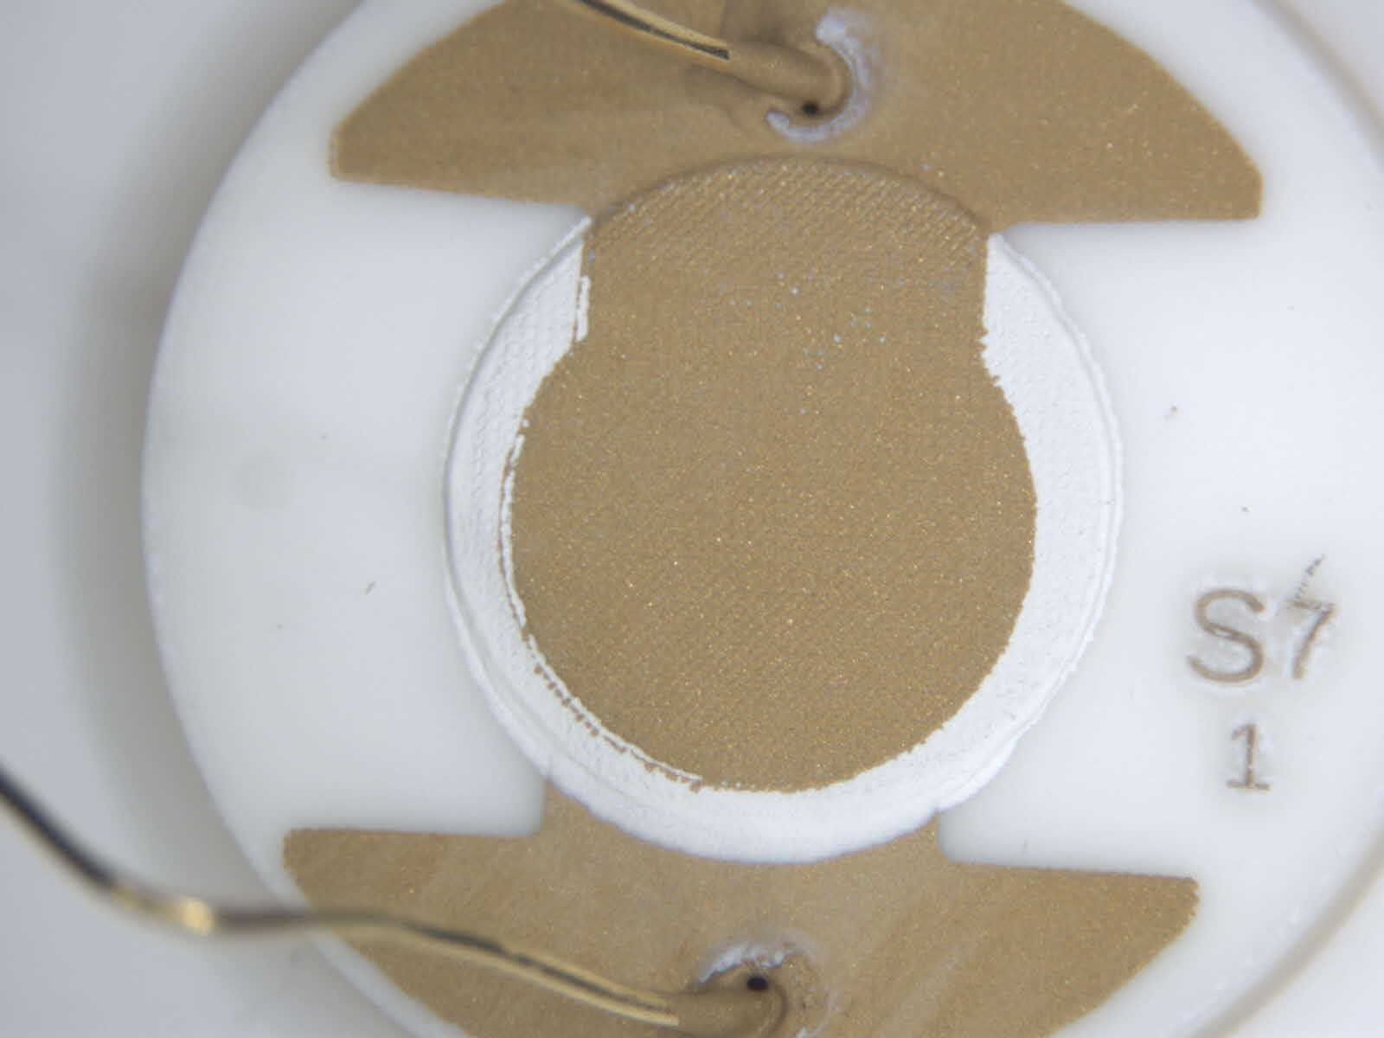
Impedance characterization
First of all, for characterization in a viscoelastic medium like gas, the resonance must be around 5 MHz :
  With a numeric model (KLM), we have estimated optimals dimensions and thickness for the sensor
  For a 700 µm thickness alumina substrate and 90 µm NBT element the fundamental should be around 5 MHz
Fundamental 7,5 MHz
Example of NBT sample impedance for 50 µm thickness
Fundamental 5 MHz
NBT devices with Au electrodes and Bounded Au wires
Keysight 4990A
Example of NBT sample impedance for 90 µm thickness

Slide 18
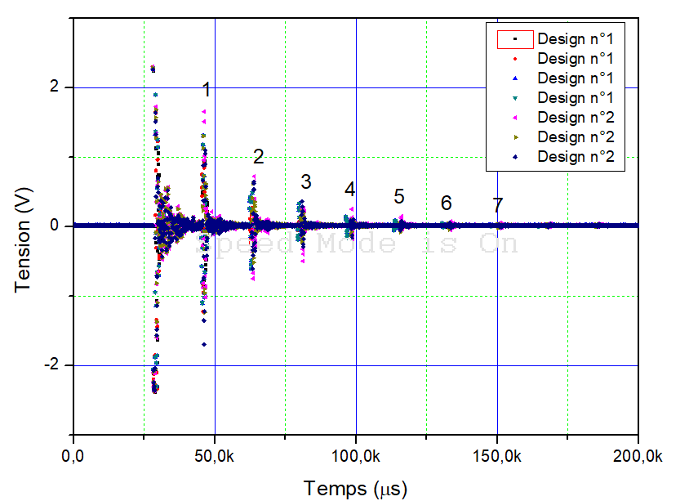
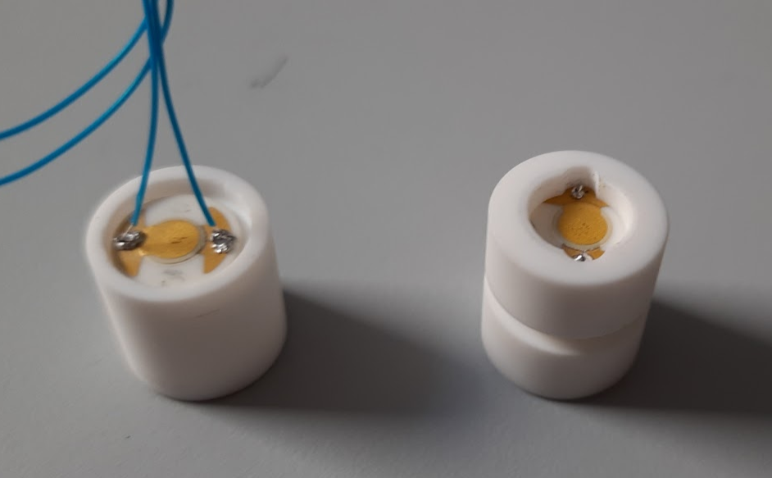
Tests with ethanol as acoustic medium
The preliminary tests consist in filling the device with ethanol in order to use it as propagation medium :
  Decrease of echoes → Good parallelism
  Good S/N ratio for liquid medium
Piezoelectric disk
Filling with ethanol
Alumina cement
Filling the resonant cavity with ethanol
Design n°1 and n°2
7 acoustic reflexions in ethanol medium and the next measurements in pressurized He

Slide 19
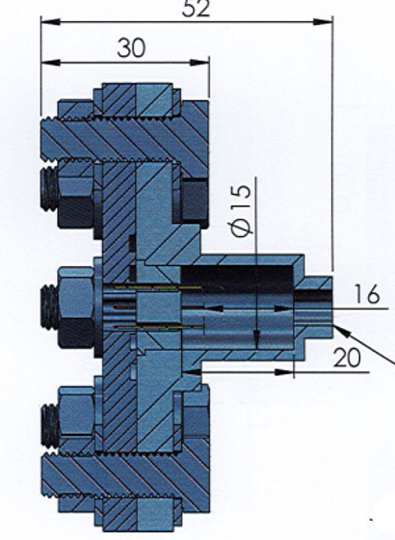
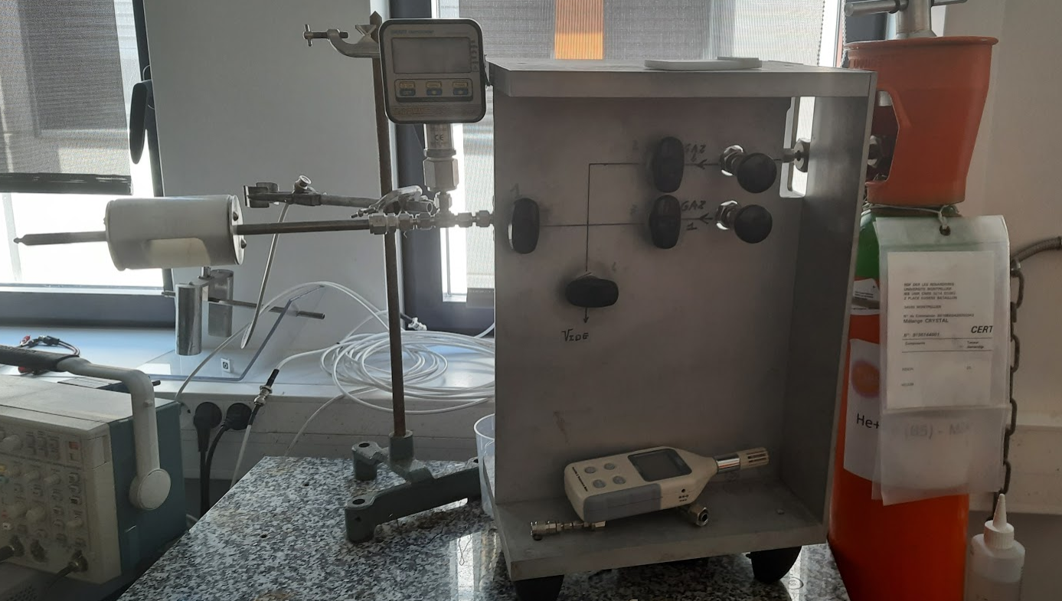
Pressure test bench
The acoustic team of IES and TMI Orion have developped a specific pressurized test bench for our laboratory :
  Possibility to be use up to 200 Bar for T=200 °C
  4 sealed contacts permitted to connect 1 thermocouple and 1 acoustic sensor
To pressure chamber
pressure gauge
Sensor
He gas from pressure rig
He reserve
Pressure chamber made of INOX 316L
pressure rig with reserve of Helium
The first experiment under gas pressure are planned for this summer

Slide 20
Conclusions
NBT seems to be a suitable material for the realization of this new device
the new sensor will have a 100% ceramic composition
Preliminary tests with ethanol have been successful and are promising for the future of the project

Slide 21
Bibliographie
[1] D. Fourmentel, J. F. Villard, J. Y. Ferrandis, F. Augereau, E. Rosenkrantz, and M. Dierckx « Acoustic Sensor for In-Pile Fuel Rod Fission Gas Release Measurement »
[2] E. Rosenkrantz, J.Y. Ferrandis, F. Augereau, T. Lambert, D. Fourmentel, X. Tiratay, An innovative acoustic sensor for first in-pile “ fission gas release determination - REMORA3 experiment »
[3] JY. FERRANDIS1, O. GATSA1, P. COMBETTE1, D. FOURMENTEL2, C. DESTOUCHES2, V. RADULOVIC3, L. SNOJ, « Acoustic instrumentation of the new generation of MTR: effect of nuclear radiation on modified Bismuth Titanate piezoelectric elements “
[4] R. Torah, S. P. Beeby, et N. M. White, « An improved thick-film piezoelectric material by powder blending and enhanced processing parameters »
[5] J. Y. Ferrandis, E. Rosenkrantz, G. Lévêque, D. Baron, J. C. Segura, G. Cécilia, and O. Provitina, Full-Scale Hot Cell Test of an Acoustic SensorDedicated to Measurement of the InternalGas Pressure and Composition of aLWR Nuclear Fuel Rod, 2011

