Slide 1
#11-81 Optimization of Scintillator Based Neutron Detector Y. Yehuda-Zada, A. Broide, I. Cohen-Zada, R. Sayef, D. Ginzburg, Y. Kadmon, and A. Osovizky 24 June 2021

Slide 2
Goal
Neutron radiation detectors are essential in various fields, such as the nuclear power industry, nuclear medicine, scientific experimental systems and homeland security.
LiF:ZnS(Ag) scintillator is an optional alternative for these detectors.
The total sensitivity is affected by the probability for neutron capture (Li), high excitation energy transfer (ZnS(Ag)), Light transport in the sensor mixture and the light collection.
This work presents an optimal design configuration based on ZiF:ZnS(Ag) particles spread in a configuration which offers maximal sensitivity and approximation of the neutron energy.

Slide 3
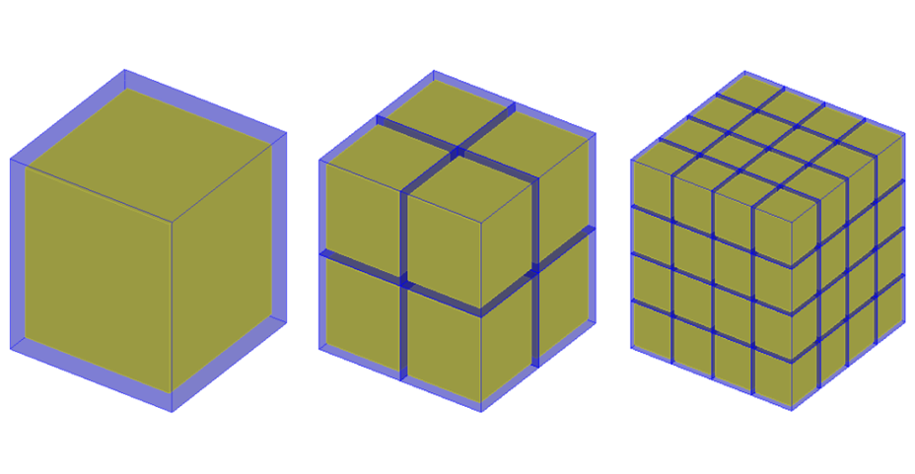
Method - Optimal particle size and grain configuration

Slide 4
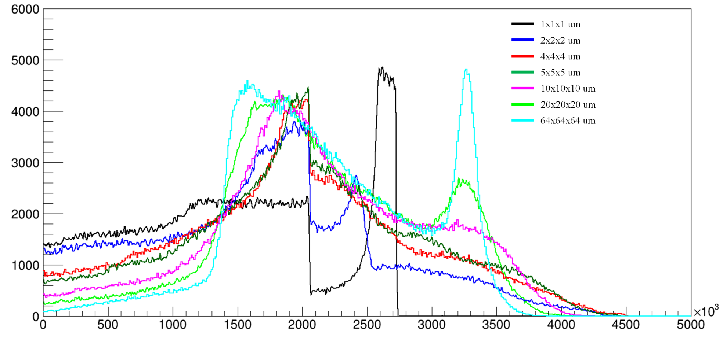
Main Results – Energy Transfer
Distribution
Energy [keV]

Slide 5
Main Results – Sensitivity

Slide 6
Main Results – Spectroscopy

