Slide 1

  June 23rd, 2021
  #04 - Research Reactors and Particle Accelerators
  #75
  3-D thermal and radiation-matter interaction simulations of a SiC solid-state detector for neutron flux measurements in JSI TRIGA Mark II research reactor
V. Valero¹, L. Ottaviani¹, A. Lyoussi², H. Ghninou², V. Radulović³, L. Snoj³, A. Pungerčič ³, A. Volte¹, M. Carette¹, C. Reynard-Carette¹
¹ Aix Marseille Univ, Université de Toulon, CNRS, IM2NP, Marseille, France
² CEA/DES/IRESNE/DER, Section of Experimental Physics, Safety Tests and Instrumentation, Cadarache, F-13108, Saint Paul-lez-Durance, France
³ Reactor Physics Division, Jožef Stefan Institute, Ljubljana, Slovenia

Slide 2
  Summary:
  I – Introduction and issues
  1- Context
  2- Silicon Carbide detectors for neutron detection
  3- Irradiation campaign preparation
  II – Detector 3-D geometry
  III – 3-D numerical thermal simulations
  IV – 3-D numerical radiation/matter interaction simulations
      V – Conclusions and outlooks

Slide 3
  I – Introduction and issues

Slide 4
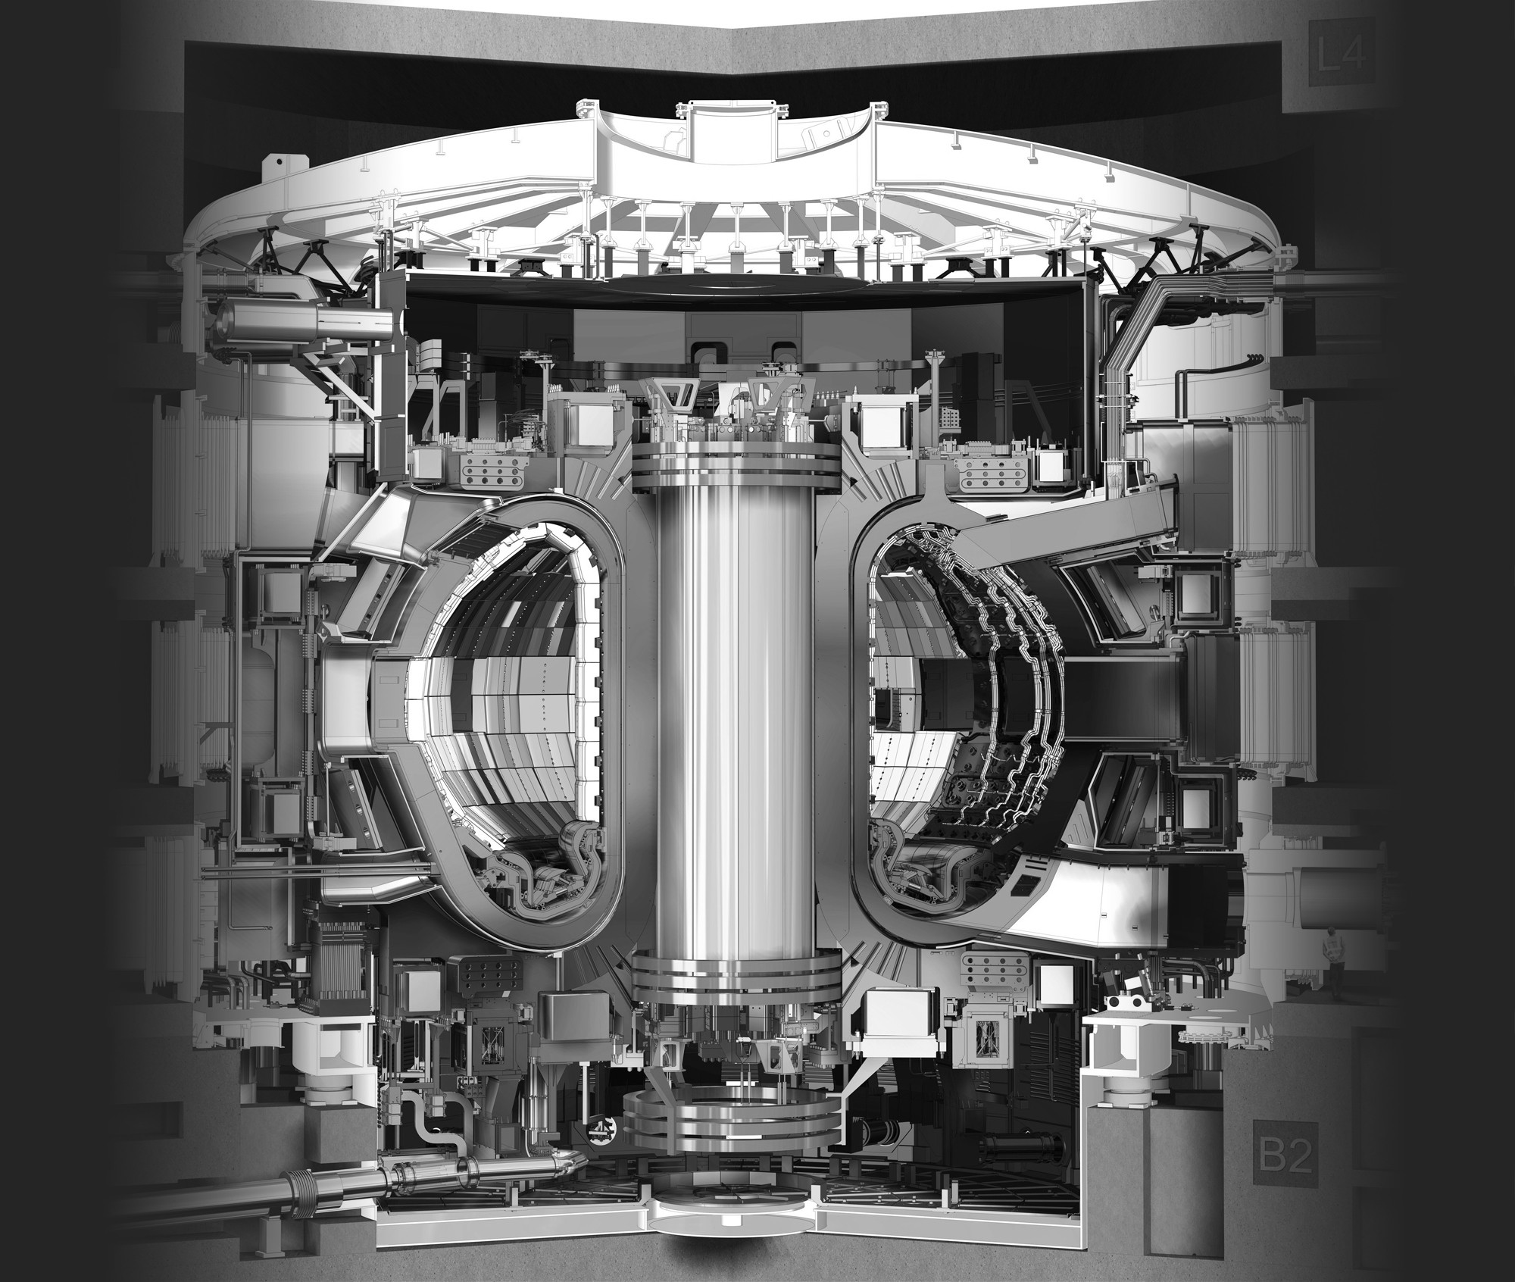
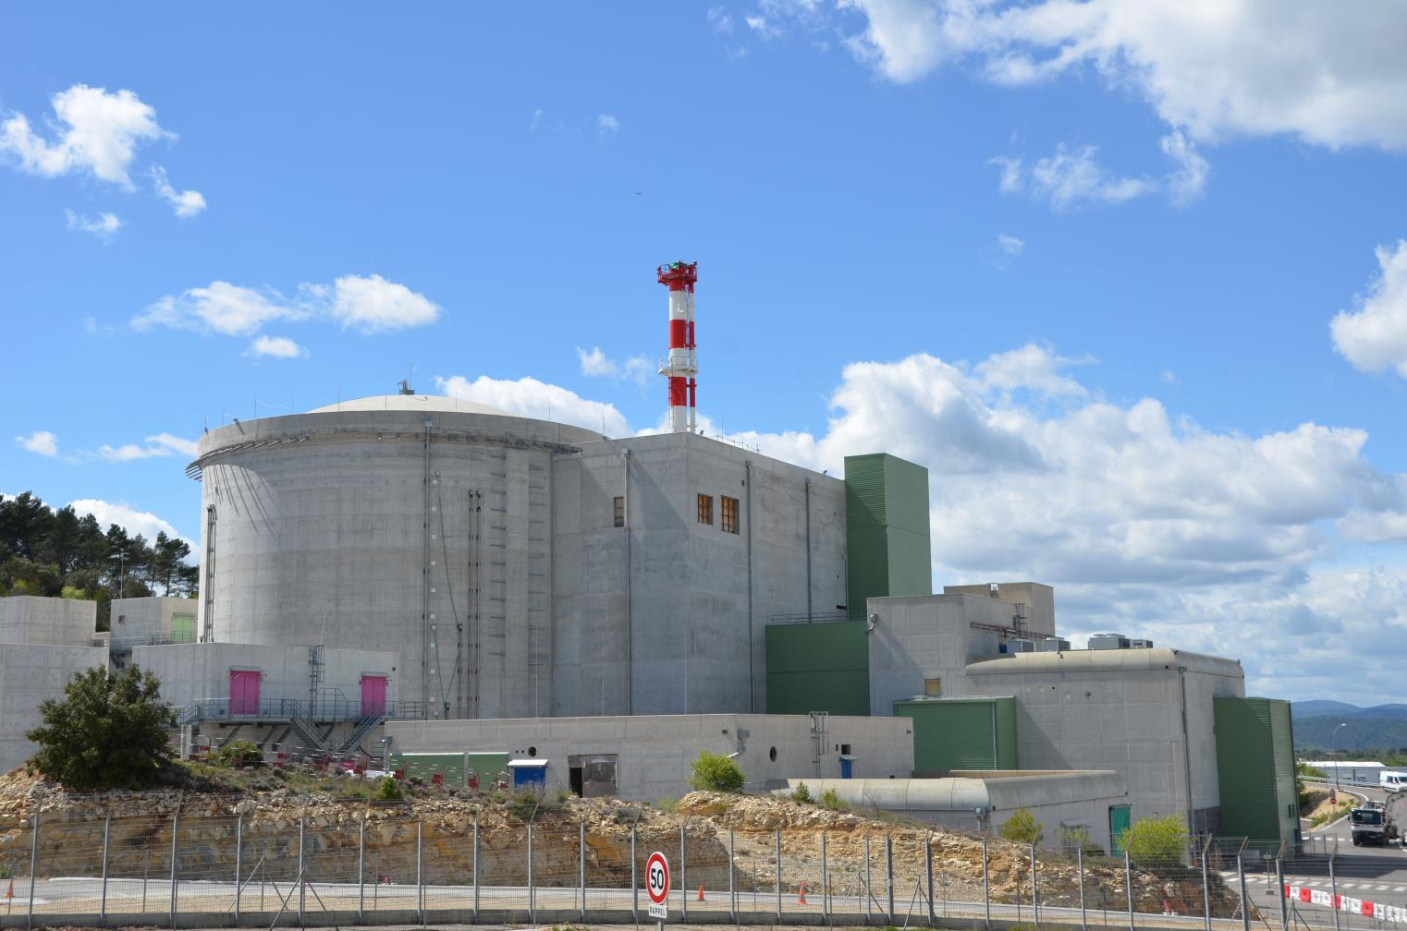
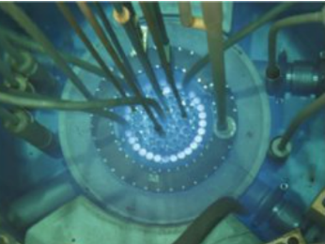
  I – 1 – Context
  Neutron detection: a relevant topic of nuclear instrumentation
  Fusion and fission applications
    In-core and ex-core monitoring in fission research reactor (neutron mapping, safety applications)
    Fusion energy applications (neutron diagnostics, Test Blanket Modules TBM)
  Adaptation for harsh conditions → Jules Horowitz Reactor (JHR) or ITER
    High neutron and γ fluxes ~ 5 ×10¹⁴ n or γ·cm⁻²·s⁻¹
    High nuclear heating rates ~ 20 W·g⁻¹ in Aluminum for JHR
    High temperatures ~ 500 °C for TBM
Characteristics of the required sensors
    High temperature and radiation resistance
    Stability under radiation in a mixed neutron and γ environment
    High energy resolution
    Fast response
    Ability to detect γ, thermal and fast neutrons
    Wide bandgap semiconductors such as Silicon Carbide are good candidates
ITER
JHR
JSI reactor core

Slide 5
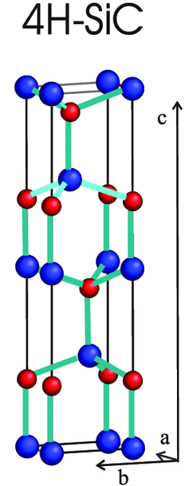
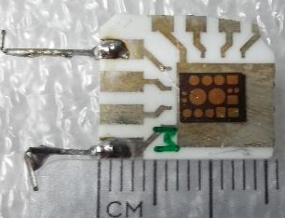
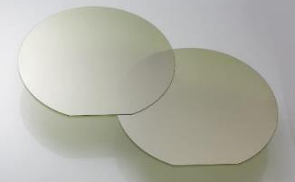
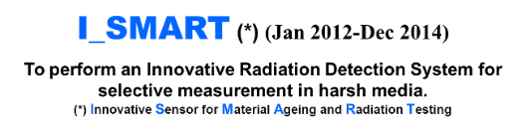
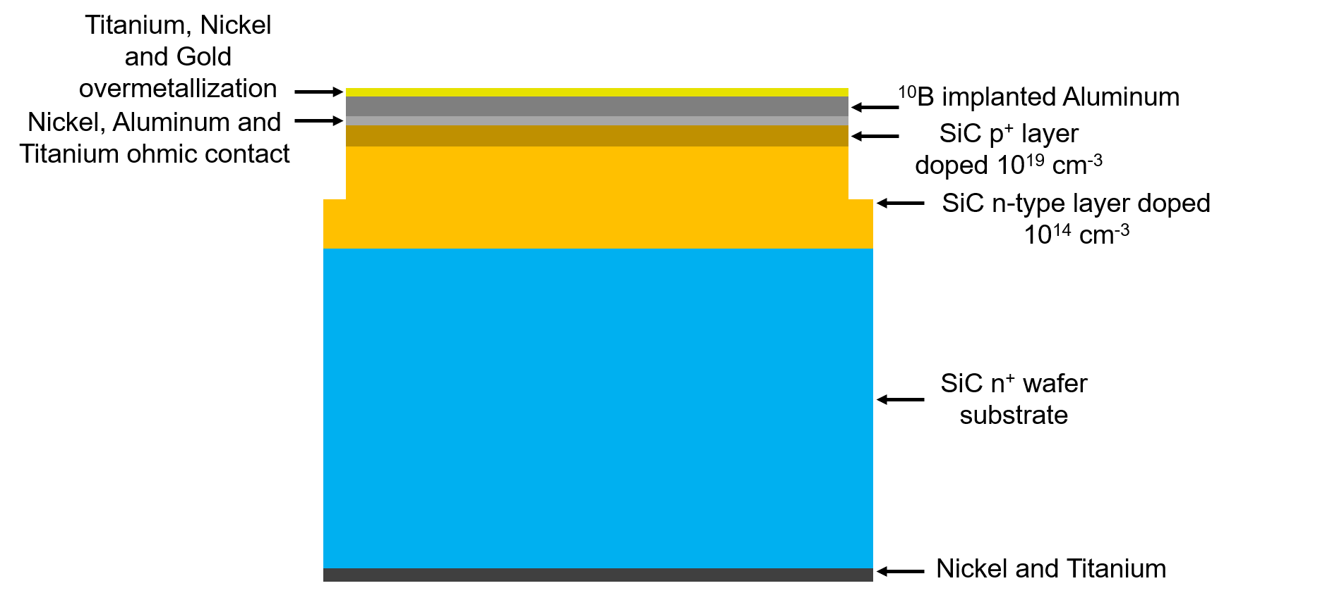
  I – 2 – SiC detectors for neutron detection
  Why choose Silicon Carbide as a neutron detector?
  Main advantages of 4H-SiC-based semiconductor detector
    High breakdown field (3 MV.cm⁻¹) → fast response (ns)
    High energy threshold of defect formation (20-40 eV) → stability versus radiations
    High thermal conductivity due to C (450 W·m⁻¹·K⁻¹) → low temperature gradient & thermal resistance
    Clear discrimination between neutron and γ rays
    Low e-hole creation energy (7.78 eV) → high energy resolution
    Possibility to detect thermal or fast neutrons
    Low defect concentration & 6-inch wafer availability
  Our detector: a P⁺N junction diode (7 mm × 5 mm × 0.371 mm)
    Deposed on an alumina support (16 mm × 14 mm × 1 mm)
    Housing for EMI shielding
    Space Charge Region (SCR) → sensitive part of the diode
      Depends on the applied bias voltage
SCR

Slide 6
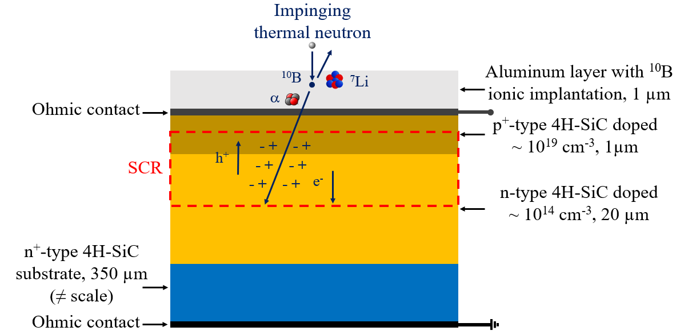
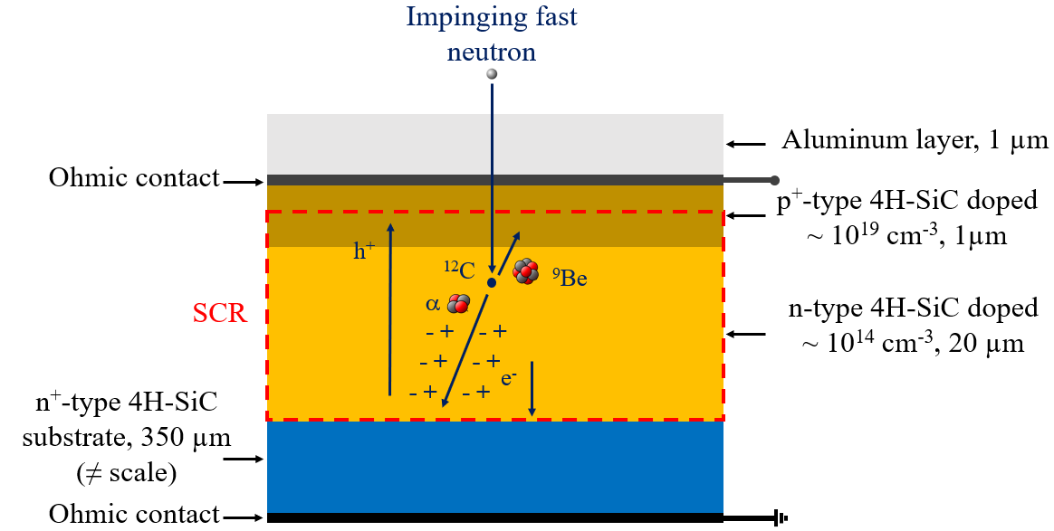
  I – 2 – SiC detectors for neutron detection
  Thermal neutron detection
  Fast neutron detection
  Neutron Converter Layer (NCL)
    Composed of materials with high thermal-neutron absorption cross-section (σ_{10B} = 3840 barns)
    Boron-10 (ionic implantation at 50 keV)
    ¹⁰B+n→⁷Li*(0.84 MeV)+⁴He(1.47 MeV)+γ(0.48 MeV) 94 %
    ¹⁰B+n→⁷Li(1.01 MeV)+⁴He(1.78 MeV) 6 %
  Detection achieved through threshold reactions
    Elastic scattering: ¹²C(n,n)¹²C, ²⁸Si(n,n)²⁸Si
    Inelastic scattering: ¹²C(n,n’)¹²C*, ¹²C(n,n’)3α, ²⁸Si(n,n’)²⁸Si*
    (n,α) reactions: ¹²C(n,α) ⁹Be, ²⁸Si(n,α) ²⁵Mg
  Secondary charged particles or scatterings → ionization of matter → e⁻/h⁺ pairs in the SCR
  → Charge collection through the electrodes and the applied electric field → signal generation (pulses)

Slide 7
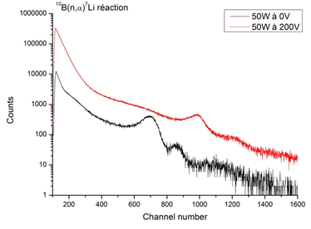
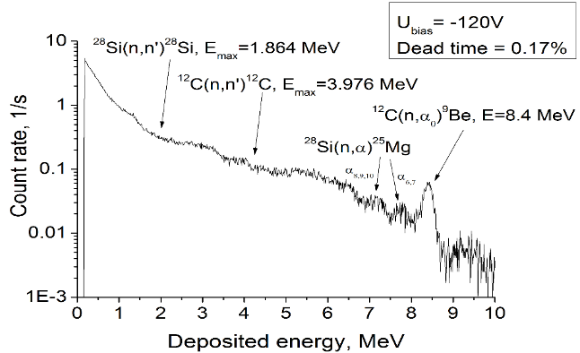
  I – 2 – SiC detectors for neutron detection
  Work status for our SiC detectors
0V
-200 V
  Thermal neutron detection:
    Maximal neutron flux ~ 9.4 ×10⁸ n·cm⁻²·s⁻¹ including 30% of thermal neutrons (MINERVE Zero Power Reactor, Cadarache, France) ^{[1]}
      No signal degradation
      Detection possible without bias voltage
    Stability under irradiation for a maximum fluence ~ 2 ×10¹³ n·cm⁻² (BR1 nuclear research reactor, Moll, Belgium) ^{[2]}
  Fast neutron detection:
    Maximal 14.1 MeV-neutron flux: 3.2 ×10⁷ n·cm⁻²·s⁻¹ (D/T neutron generator of Technical University of Dresden, Germany) ^{[3]}
      Improvement of the energy resolution with the count rate
      Same energy resolution as a conventional s-CVD diamond detector
    Stability under high temperature up to 500 °C for a 14.1 MeV flux of 3.1 ×10⁷ n·cm⁻²·s^{-1 [4]}
Pulse Height Spectrum of thermal neutrons ^{[1]}
[1]: O. Obraztsova, et al., Comparison between Silicon-Carbide and Diamond for Thermal neutron detection at Room Temperature, IEEE Trans. Nucl. Sci., Vol. 67, No. 5, pp. 863-871 (2020).
[2]: F. Issa, et al., Study of the stability of 4H-SiC detectors by thermal neutron irradiation, Materials Science Forum, Vol. 821-823, pp. 875-878 (2015).
[3]: O. Obraztsova, et al., Comparing the response of a SiC and a sCVD Diamond detectors to 14 MeV neutron radiation. IEEE Trans. Nucl. Sci., Vol. 65, No. 9, pp. 2380-2384 (2018).
[4]: D. Szalkai, et al., Fast Neutron Detection With 4H-SiC Based Diode Detector up to 500 °C Ambient Temperature, IEEE Trans. Nucl. Sci., Vol. 63, No. 3, pp. 1491-1498 (2016).
Pulse Height Spectrum of 14.1 MeV neutrons ^{[3]}

Slide 8
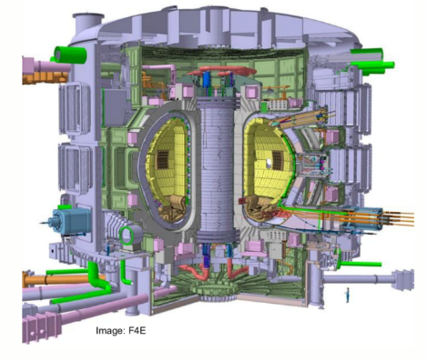
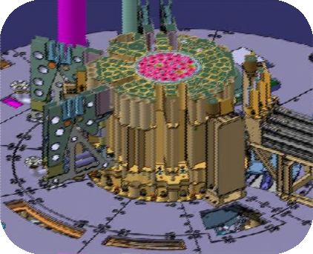
  I – 3 – Irradiation campaign preparation
  Future main objectives for our SiC detectors
  Improvement of the measured total neutron flux
    5.5 ×10¹⁴ n·cm⁻²·s⁻¹ in the JHR core for E_{n} > 1 MeV
    10⁹-10¹⁴ n·cm⁻²·s⁻¹ in the ITER tokamak for E_{n} > 14.1 MeV
  Adaptation of the housing of the detector for in-core measurements in a research reactor
    3-D numerical thermal simulations → maximum temperature & fields
    3-D numerical simulations of radiation/matter interaction → neutron & γ fluxes, nuclear heating rate, activation
Intermediate steps are necessary to reach these aims
    Qualification of our SiC detector for measurements of increased neutron fluxes
      Especially total neutron fluxes > 10¹⁰ n·cm⁻²·s⁻¹
    Test the best acquisition chain
    Realization of nuclear-hardened instrumentation cables
ITER tokamak
JHR core

Slide 9
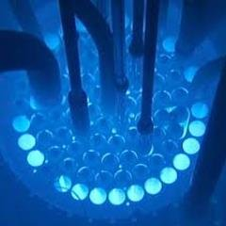
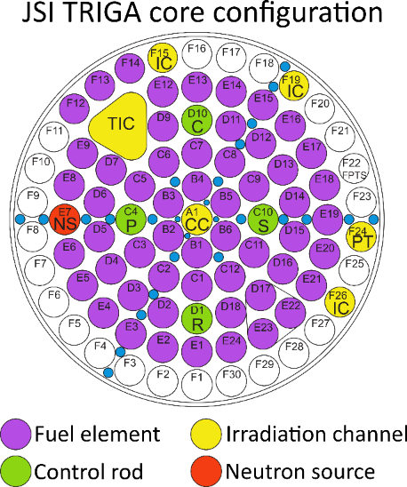
  I – 3 – Irradiation campaign preparation
  Preparation of an irradiation campaign at Jožef Stefan Institute
  JSI TRIGA Mark II Reactor
    Maximum thermal power: 250 kW_{Th}
    Maximum neutron flux (Central Channel): ~ 2 ×10¹³ n·cm⁻²·s⁻¹
    Maximum γ flux (Central Channel): ~ 2 ×10¹³ γ·cm⁻²·s⁻¹
  Measurements will be made in the TIC (Triangular Irradiation Channel)
    Channel diameter of around 6 cm & diagonals of around 7.7 cm
    Dry air channel with an ambient temperature of ~ 40 °C
      Natural convection (low heat transfer coefficient)
    Total neutron flux (thermal and fast): ~ 1.2 ×10¹³ n·cm⁻²·s⁻¹
    Total γ flux: ~ 1.2 ×10¹³ γ·cm⁻²·s⁻¹
    Maximum estimated nuclear heating rate (Si): ~ 0.055 W·g^{-1 [5]}
      Maximum neutron KERMA rate (Si): ~ 4.2 ×10³ Gy·h⁻¹
      Maximum photon KERMA rate (Si): ~ 1.9 ×10⁵ Gy·h⁻¹
[5]: K. Ambrožič, G. Žerovnik, L. Snoj, Computational analysis of the dose rates at JSI TRIGA reactor irradiation facilities, Applied Radiation and Isotopes, Vol. 130, pp. 140–152 (2017).

Slide 10
  II – Detector 3-D geometry

Slide 11
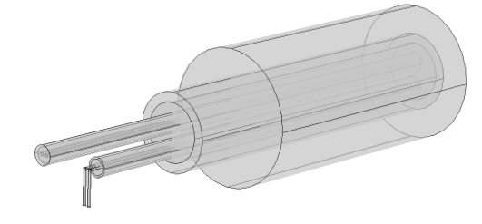
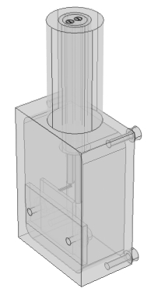
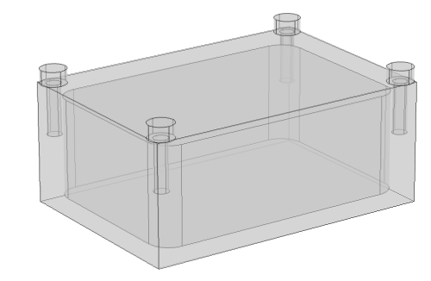
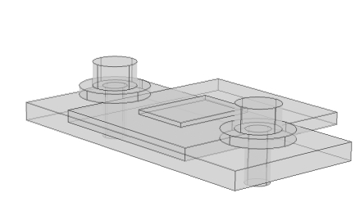
II – Detector 3-D geometry
  Studied SiC detector #1
  Composed of 3 main parts
    Machined housing and screws for hood closing
      Air-gap inside the housing
    SiC diode and its support fixed on a base and maintained by washers and screws
    Connector crimped to the housing, SiC signal wires and their sheaths and k-type thermocouple
K-type thermocouple
14 mm
Connector inner and external parts
SiC signal wires
28 mm
40 mm
13.5 mm
Base
Diode-support
Air-gap
SiC diode
28 mm
Housing
16.5 mm

Slide 12

  III – 3-D numerical thermal simulations

Slide 13
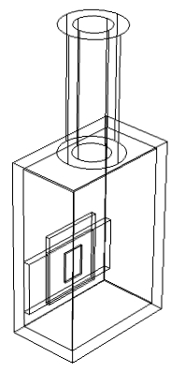
III – 3-D numerical thermal simulations
  Parameters of the study
  COMSOL Multiphysics code used (finite element code & a heat transfer module)
  Considered 3-D thermal model
    Heat equation solved only with conductive heat transfers: λ = f(T)
      Convective and radiative exchanges are neglected inside the detector → low nuclear heating rate
      Only stationary state studied
      1 heat source per material (Q_{i} = ρ_{i}.E_{n})
      Nuclear heating rate E_{n} → from 0 to 0.055 W·g⁻¹ by steps of 0.0025 W·g⁻¹
    Used extra-thin mesh (102 µm < element size < 2380 µm)
    Applied boundary conditions:
      Coolant fluid flow temperature T_{fluid} (dry air) → 35, 40, 45 °C
      Heat transfer coefficient h calculated and imposed by COMSOL code for external natural convection with air by taking the geometry into account
h = 2 W·m⁻²·K⁻¹
h vertical connector cylinder
h upper housing wall
h vertical housing walls
h lower housing wall

Slide 14
III – 3-D numerical thermal simulations
  Results for the SiC detector #1: boundary condition influence
  Nuclear heating rate influence on the heat transfer coefficient
    Increase of the heat transfer coefficient value with the nuclear heating rate
      Increase of the temperature due to the nuclear heating → increase of the thermal exchanges
    Coherent heat transfer coefficient values with those obtained by using correlations of the literature: 5 ≤ h ≤ 25 W·m⁻²·K⁻¹
Tfluid = 40 °C

Slide 15
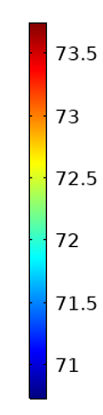
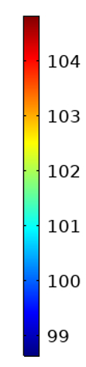
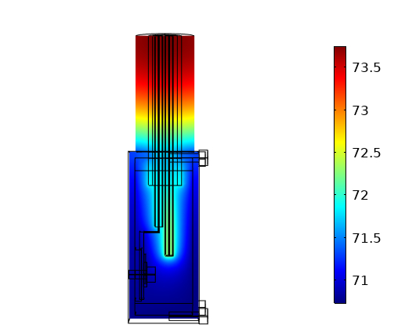
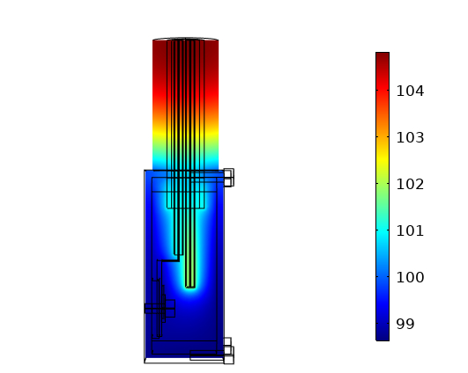
III – 3-D numerical thermal simulations
  Results for the SiC detector #1
  Nuclear heating rate influence on the maximum temperature
    Maximum temperature << Duralumin melting point ~ 660 °C
    Higher temperature in the connector
      Low heat transfer coefficient → connector external direction
      High energy deposition due to a high density material (Stainless Steel 316L) ~ 7850 kg·m⁻³
Vertical cross section of the detector for a nuclear heating rate of 0.025 W·g⁻¹ (left-hand section) and 0.055 W·g⁻¹ (right-hand section) and a fluid temperature of 40 °C

Slide 16

  IV – 3-D numerical radiation/matter interaction simulations

Slide 17
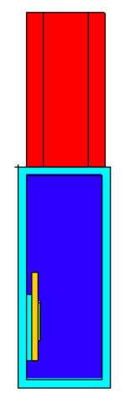
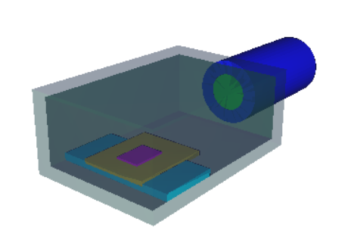
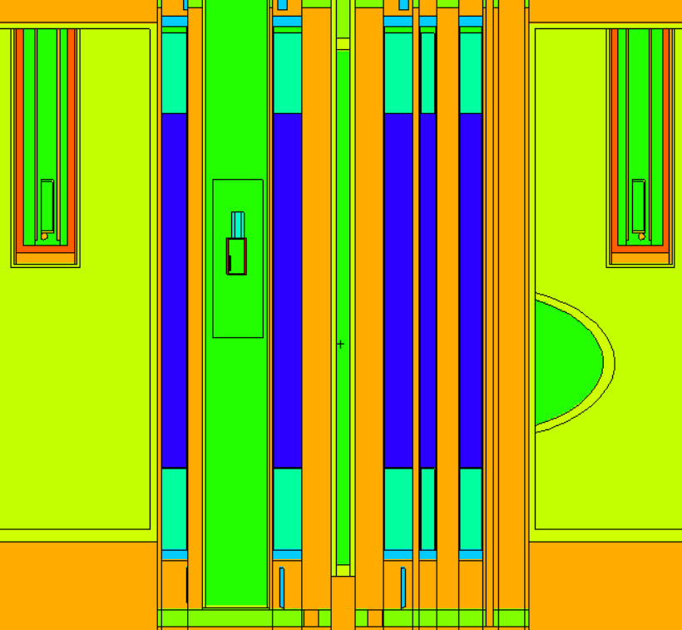
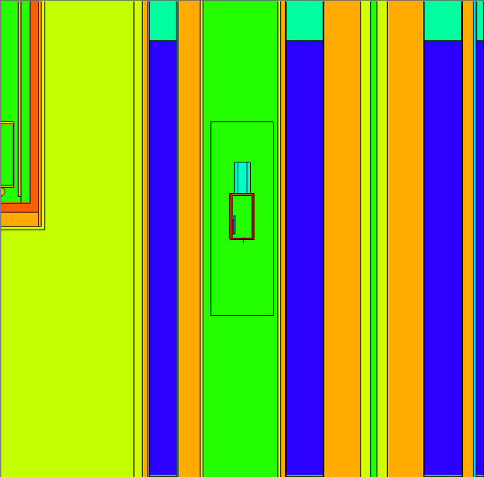
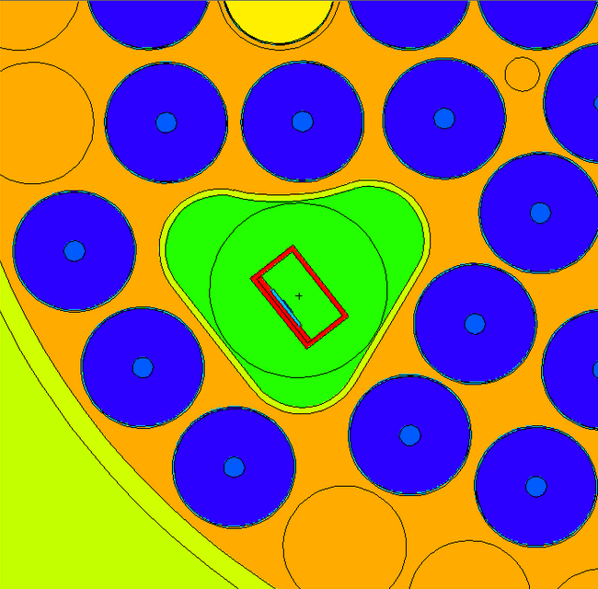
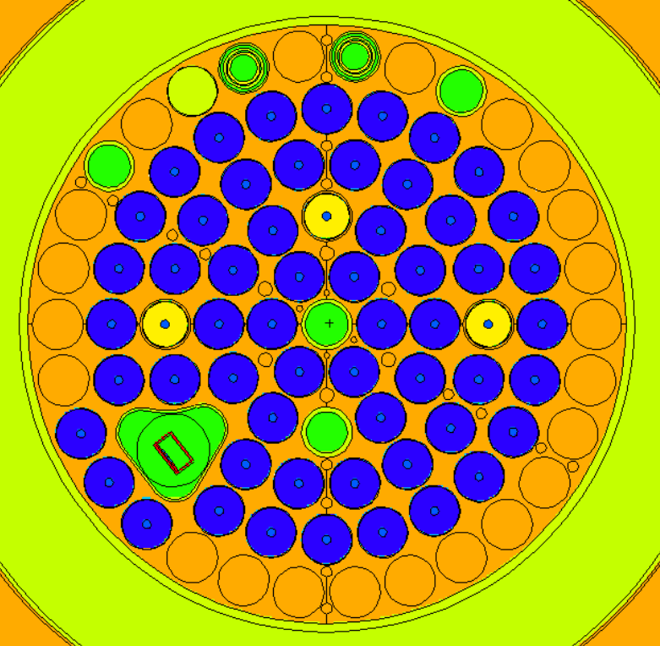
  IV – 3-D numerical r/m interaction simulations
  Studied SiC detector
  Geometry and materials
    Simplified geometry for first results → low calculation time
Housing
Air-gap
SiC diode
Diode-support
Connector
Base
  Tallies
    F4 (1/cm²) → neutron & γ fluxes in the SiC diode
    F6 (MeV/g) → neutron & γ deposited energy estimated with KERMA in all cells
  ENDF/B-VII.0 cross-section nuclear data library at 297.15 K
Side and top view of the detector in the Triangular Irradiation Channel

Slide 18
  IV – 3-D numerical r/m interaction simulations
  Prompt neutron and γ KERMA values and fluxes results at the center of the TIC
  Prompt neutron and γ KERMA values at full reactor thermal power (250 kW_{th})
    Maximum KERMA values coherent with the literature: ~ 0.055 W·g⁻¹ (Si) ^{[5]}
      ~ 0.039 W·g⁻¹ with an uncertainty of 0.07 % in the housing (Duralumin)
      ~ 0.046 W·g⁻¹ with an uncertainty of 0.54 % in the SiC diode (Silicon Carbide)
      ~ 0.048 W·g⁻¹ with an uncertainty of 0.14 % in the connector (Stainless Steel 316L)
  Prompt neutron and γ fluxes
    Maximum fluxes values at full reactor thermal power: 9.94 ×10¹² n·cm⁻²·s⁻¹ and 1.06 ×10¹³ γ·cm⁻²·s⁻¹ (± 0.5 %)

Slide 19
  V – Conclusions and outlooks

Slide 20
  V – Conclusions and outlooks
  Conclusions
  Thermal simulations with COMSOL Multiphysics
    Heat transfer coefficient values calculated by COMSOL are coherent with those estimated by using correlations of the literature: 5 ≤ h ≤ 25 W·m⁻²·K⁻¹
    Maximum temperature ~ 110 °C (E_{n} = 0.055 W·g⁻¹ and T_{fluid} = 45 °C) << Duralumin melting point ~ 660 °C even with a safety margin
      Tin alloy welding for SiC diode connection can be done (melting point between 180 - 220 °C)
    Most part of the heat deposited in the connector
      To reduce the temperature → material change or smaller connector
    Low SiC diode temperature and heat transfer coefficient differences between the two geometries
  MCNP-code simulations
    The first preliminary results confirm the right nuclear heating rate range used for the 3-D thermal simulations
      MCNP KERMA values are slightly lower than those found in literature: 0.055 W·g⁻¹
    These KERMA values → lower temperatures in our detector: ~ 100 °C (E_{n} = 0.045 W·g⁻¹ and T_{fluid} = 45 °C)
    In spite of a short calculation time, the maximum uncertainty is 0.54 % and majority are bellow 0.3 %
    The various neutron fluxes obtained already give us an idea of the different reactor thermal power levels to test with our detector
      ~ 10¹³ n·cm⁻²·s⁻¹ at full reactor thermal power i.e. 250 kW_{th}

Slide 21
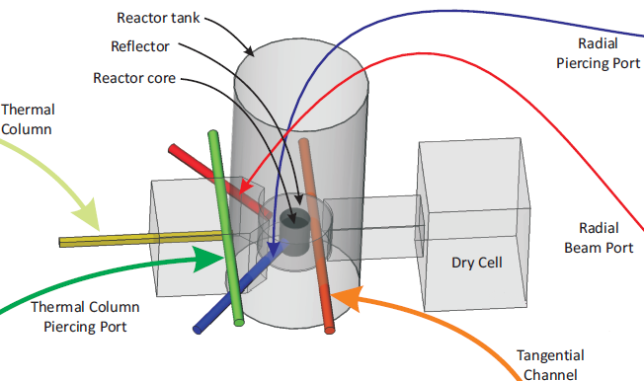
  V – Conclusions and outlooks
  Outlooks
  MCNP-code simulations
    Simulations with other conditions (explicit modelling of the detector in different axial positions inside the TIC, reactor power, other irradiation channel)
    Integration of *F8:E tally for nuclear heating rate calculations with another estimator
    Neutron activation calculation for various materials
    Real detector 3-D geometry and assembly
      Screws, washers, thermocouple, wires
      New kind of connector more suitable
  Thermal simulations with COMSOL Multiphysics
    New sources applied by taking into account MCNP results
    Temperature field comparaison
    Integration of radiative and convective transfers
    Integration of a new connector
  Achievement of the irradiation campaign at the JSI TRIGA Mark II Reactor during the last quarter of 2021

Slide 22
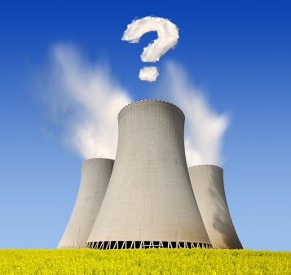
  Thank you for your attention !

Slide 23
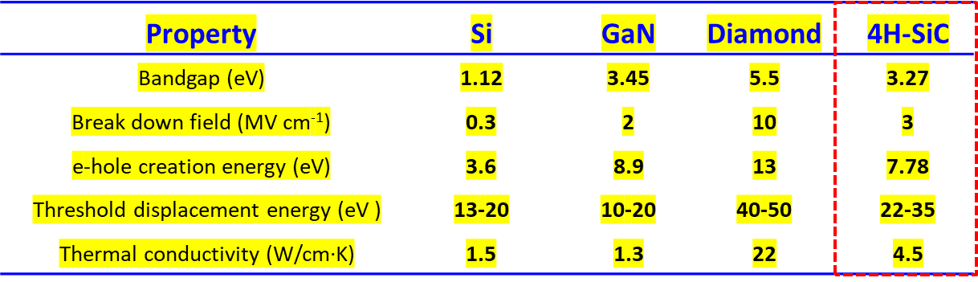
  Back-up
  Why Silicon Carbide for neutron detection?
  Main advantages of 4H-SiC-based semiconductor detector
    Wide bandgap (3.27 eV) → low leakage current
    High breakdown field (3 MV.cm⁻¹) → fast response (ns)
    High energy threshold of defect formation (20-40 eV) → stability versus radiations
    High thermal conductivity due to C (450 W.m⁻¹.K⁻¹) → low temperature gradient & low thermal resistance
    Epitaxial growth control → low defect concentration & 6-inch wafer availability
    e-hole creation energy (7.78 eV) → high energy resolution
    Lower sensitivity to γ rays than other semiconductors
    Clear distinction between neutrons and γ rays for C-based materials
    Technology used : P⁺N (our detector) or Schottky-junction diodes
Si detector :
Small Bandgap (1.12 eV at RT) →
High leakage current above 30°C
Low thermal conductivity → Cooling system required
High displacement energy threshold → low stability vs radiations
Carbon (Low atomic number Z) :
  Direct fast neutron detection through Elastic scattering (with respect to Si)
  Lower sensitivity to photons (gamma rays) than other semiconductors

Slide 24
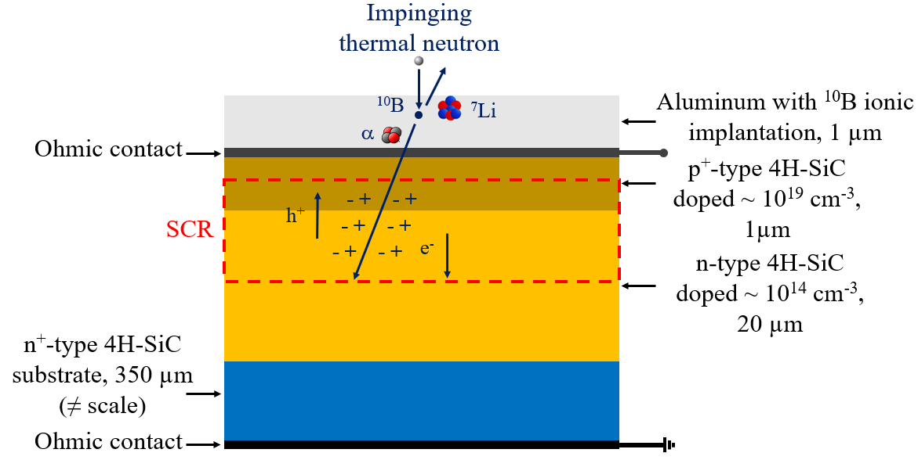
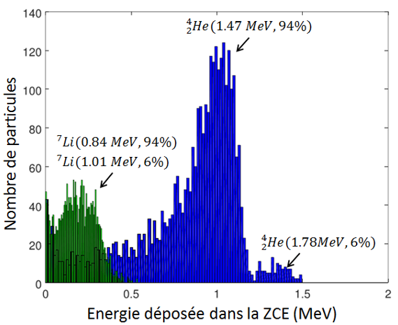
  Back-up
  Thermal neutron detection
  Neutron Converter Layer (NCL)
    Composed of materials with high thermal-neutron absorption
    cross-sections
      σ_{10B} = 3840 barns
      σ_{6Li} = 940 barns
    Boron-10 (our detector with an ionic implantation at 50 keV)
    ¹⁰B + n → ⁷Li* (0.84 MeV) + ⁴He (1.47 MeV) + γ (0.48 MeV) 94 % or
    ¹⁰B + n → ⁷Li (1.01 MeV) + ⁴He (1.78 MeV) 6 % or
  Lithium-6
    ⁶Li + n → ⁴He (2.05 MeV) + ³H (2.73 MeV)
  Secondary charged particles → ionization of matter → e⁻/h⁺ pairs in the SCR
  Charge collection through the electrodes and the applied electric field → signal generation (pulses)
  Acquisition of an energy spectrum (Pulse Height Spectrum) with a Multi Channel Analyzer (MCA)
    Measurement and quantification of thermal neutrons (fission applications)
Number of particles
Deposited energy in SCR (MeV)

Slide 25
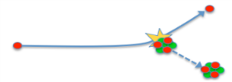

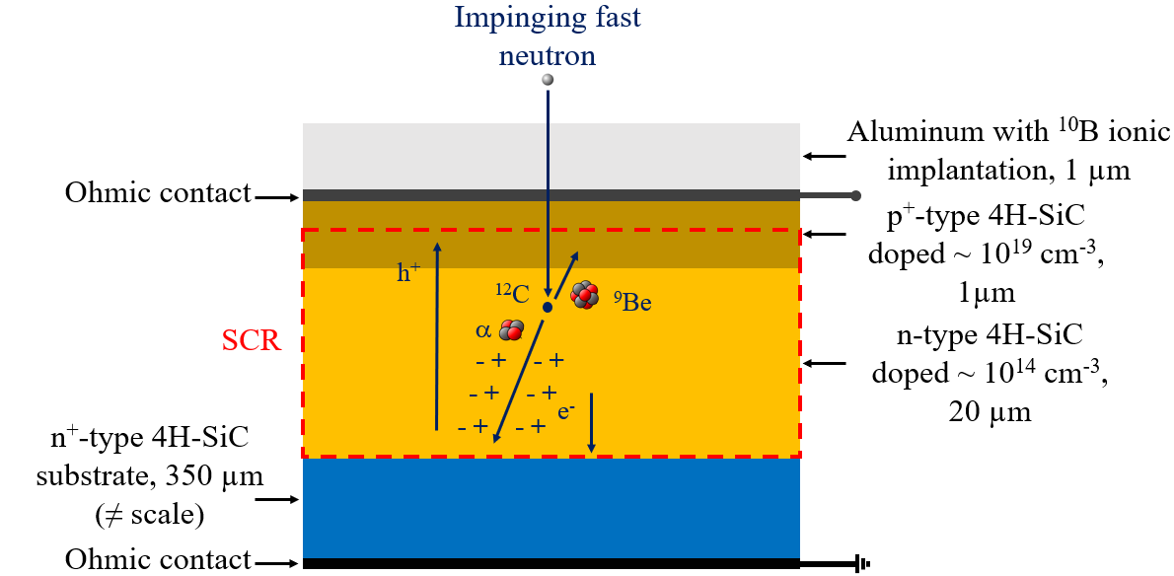
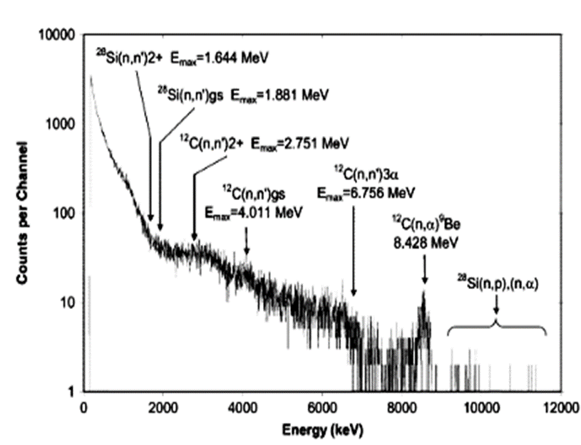
  Back-up
  Fast neutron detection
²⁸Si
n
¹²C
n
n
n
  Detection achieved through threshold reactions ^{[6]}
    Elastic scattering: ¹²C(n,n)¹²C, ²⁸Si(n,n)²⁸Si (E_{n} ≥ 0 MeV)
    Inelastic scattering: ¹²C(n,n’)¹²C* (E_{n} ≥ 4.81 MeV), ¹²C(n,n’)3α (E_{n} ≥ 8.43 MeV),
    ²⁸Si(n,n’)²⁸Si* (E_{n} > 1.85 MeV)
    (n,α) reactions: ¹²C(n,α) ⁹Be (E_{n} ≥ 6.42 MeV), ²⁸Si(n,α) ²⁵Mg (E_{n} ≥ 2.77 MeV)
²⁸Si
¹²C
  Fast neutron detection
    Scatterings of the impinging neutrons → γ deexcitation emission
    Secondary charged particles → ionization of matter → e⁻/h⁺ pairs
  Charge collection through the electrodes and the applied electric field → signal generation (pulses)
  Acquisition of an energy spectrum (Pulse Height Spectrum)
  with a Multi Channel Analyzer (MCA)
    Measurement and quantification of fast neutrons (fission and fusion applications)
[6] Ruddy et al. , « Fast neutron spectrometry using Silicon Carbide detectors », Reactor Dosimetry in the 21st Century, J. Wagemans, Eds London, UK: World Scientific, 2003, pp. 347-355.

Slide 26
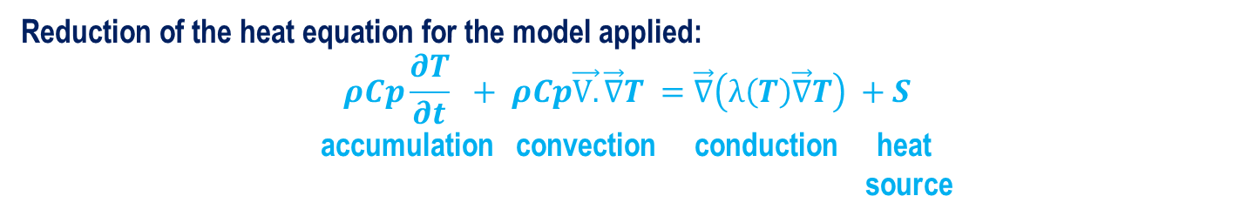
Back-up
  Parameters of the study
  COMSOL Multiphysics code used (finite element code & a heat transfer module)
  Considered 3-D thermal model
    Heat equation solved only with conductive heat transfers: λ = f(T)
      Convective and radiative exchanges are neglected inside the detector → low nuclear heating rate
      Only stationary state studied
      1 heat source per material (Q_{i} = ρ_{i}.E_{n})
      Nuclear heating rate E_{n} → from 0 to 0.055 W·g⁻¹ by steps of 0.0025 W·g⁻¹
    Used extra-thin mesh (102 µm < element size < 2380 µm)
    Applied boundary conditions:
      Coolant fluid flow temperature T_{fluid} (dry air) → 35, 40, 45 °C
      Heat transfer coefficient h calculated and imposed by COMSOL code for external natural convection with air by taking the geometry into account
h = 2 W·m⁻²·K⁻¹
Reduction of the heat equation for the model applied:
$$ρCp\frac{∂T}{∂t} + ρCp\vec{\text{V}.}\vec{\text{∇}}T =\vec{\text{∇}}\left(λ\left(T\right)\vec{\text{∇}}T\right) +S$$
accumulation convection conduction heat source
h vertical connector cylinder
h upper housing wall
h vertical housing walls
h lower housing wall

Slide 27
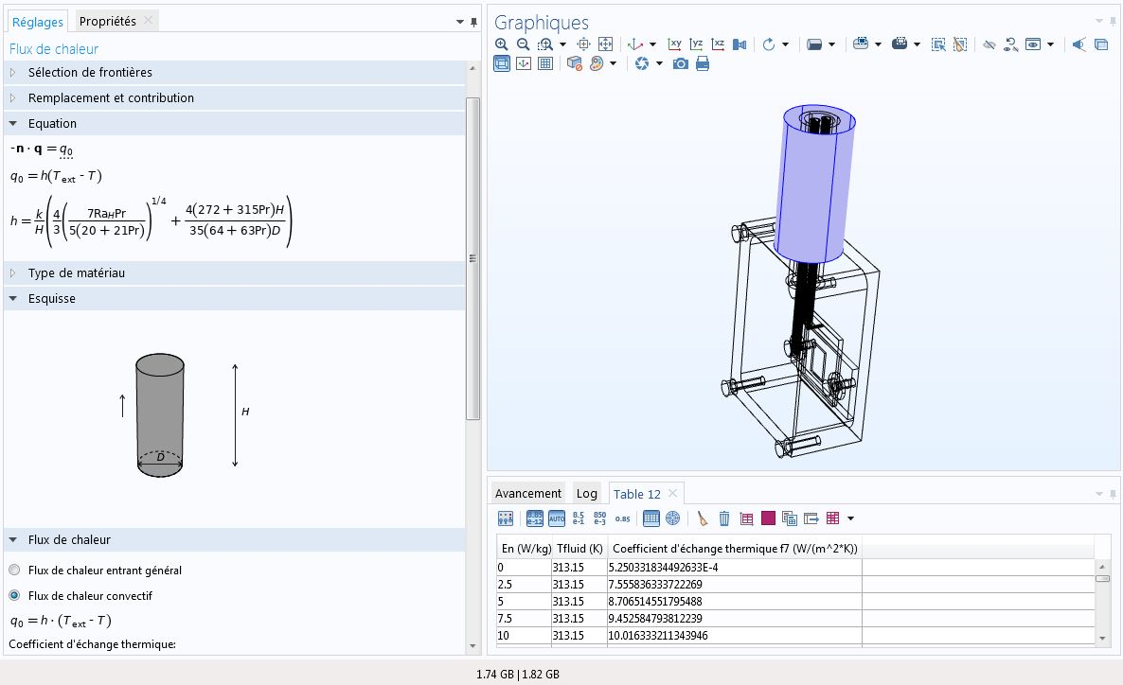
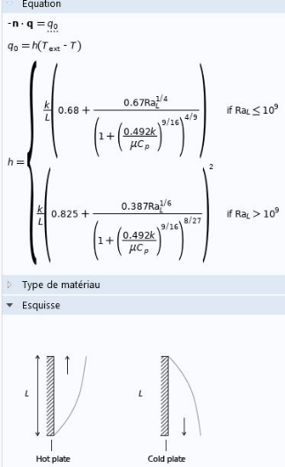
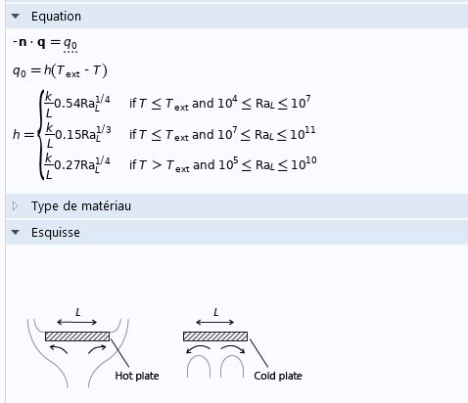
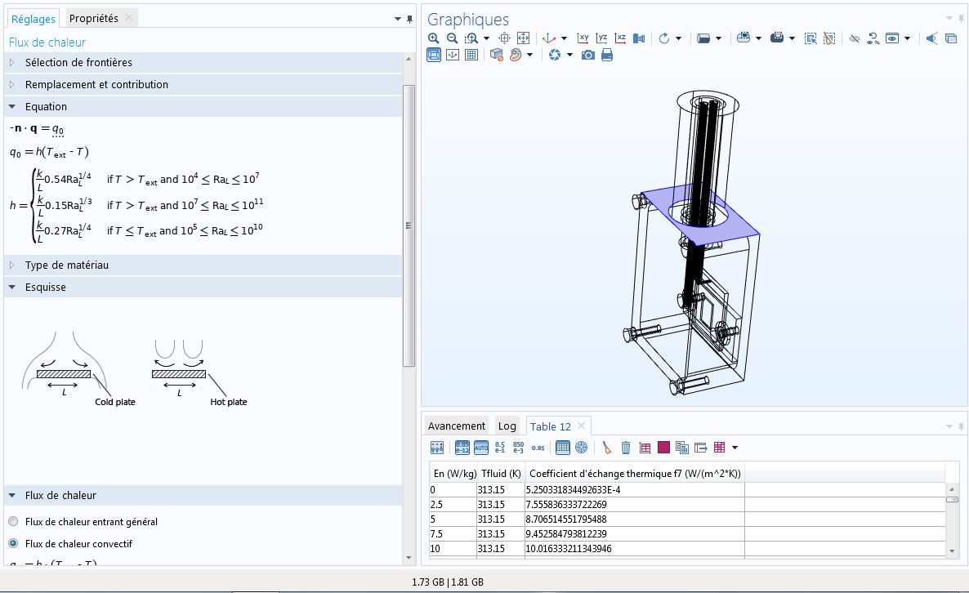
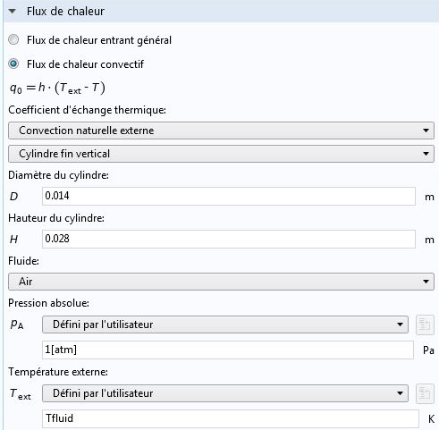
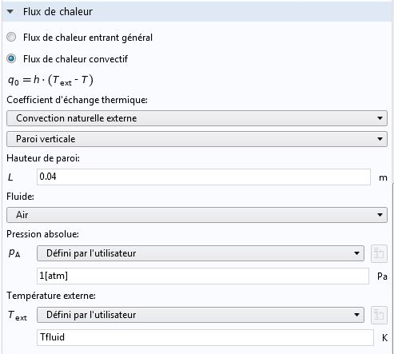
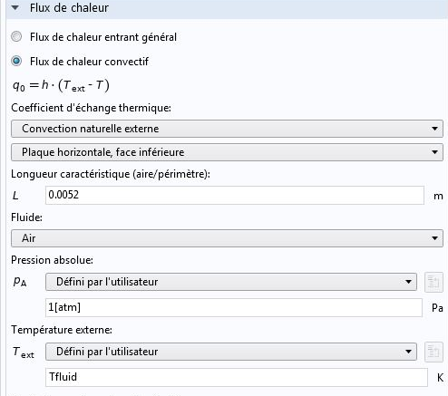
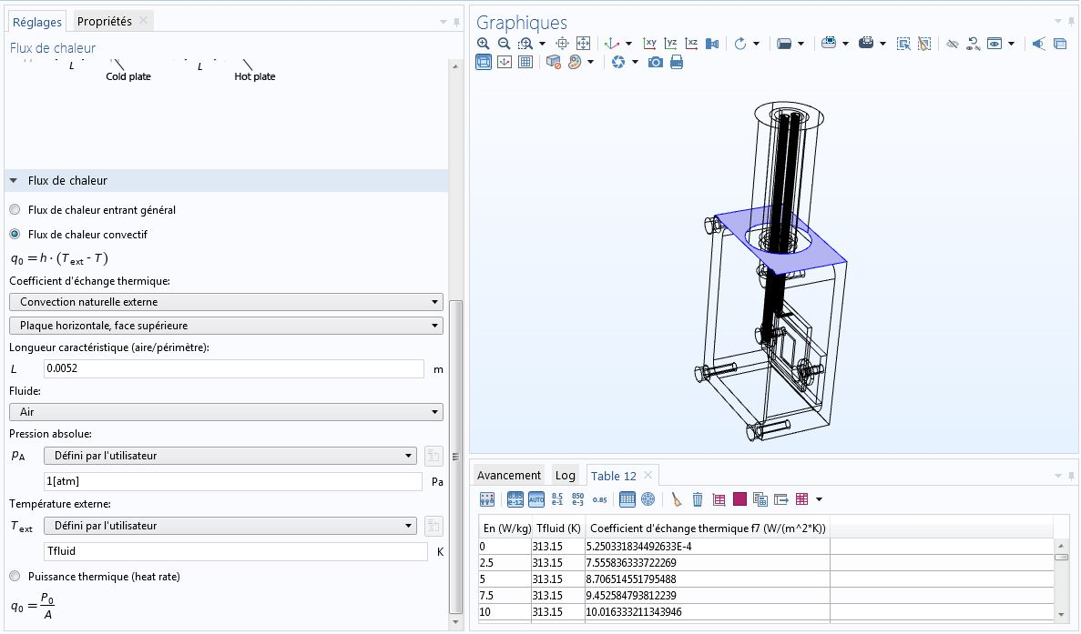
Back-up
  Heat transfer coefficient calculated by COMSOL Multiphysics
h vertical connector cylinder
h vertical housing walls
h lower housing wall
h upper housing all

Slide 28
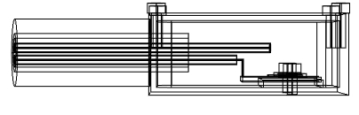
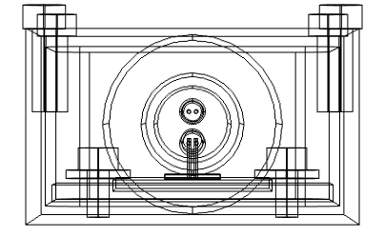




Back-up
  General dimensions of the SiC detector #1
14 mm
16.5 mm
28 mm
40 mm
28 mm
SiC detector side view
SiC detector front view
14 mm
3 mm
13.5 mm
5 mm
37 mm
7 mm
12 mm
16 mm
36 mm
SiC detector air-gap side view
25 mm
2 mm
25 mm
2 mm
Diode, support and base top view
SiC detector air-gap top view
SiC detector connector, thermocouple and wire

Slide 29
Back-up
  Materials and thermal properties
Element | Concerned geometry model | Material | Thermal conductivity λ (W.m⁻¹.K⁻¹) | Density ρ (kg.m⁻³)
Air-gap | 1 & 2 | Air | Function of T, at 293 K = 0.0257 W.m⁻¹.K⁻¹ & at 393 K = 0.0332 W.m⁻¹.K⁻¹ | Function of T
SiC diode | 1 & 2 | Silicon Carbide | 450 | 3200
Diode-support | 1 & 2 | Alumina | 27 | 3900
Washers | 1
Housing | 1 & 2 | Duralumin (AU4G, 2017A) | 160 | 2800
Base
M2 Screws | 1 | Stainless Steel AISI 304 | 16 | 7930
Connector | 1 & 2 | Stainless Steel AISI 316L | Function of T, at 293 K = 14.93 W.m⁻¹.K⁻¹ & at 393 K = 20.07 W.m⁻¹.K⁻¹ | 7850
Thermocouple and SiC wire sheath | 1
Thermocouple and SiC wire sheath insulator | 1 | Magnesium oxyde | 45 | 3580
SiC and thermocouple wires | 1 | Nickel | 90 | 8900

Slide 30



Back-up
  Results for the SiC detector #2
  Nuclear heating rate influence on the maximum temperature
    Maximum temperature << Duralumin melting point ~660 °C
    Most part of the heat deposited in the connector
      Same behavior than the previous geometry
3D thermal view for a nuclear heating rate of 0.055 W·g⁻¹ and fluid temperature of 40 °C
Middle sectional view of the detector for a nuclear heating rate of 0.025 (left-hand section) and 0.055 W·g⁻¹ (right-hand section) and fluid temperature of 40 °C

Slide 31




Back-up
  SiC detector #1 et #2 comparison
  Nuclear heating rate influence on the maximum temperature
    Same behavior for the two detectors
    Most part of the heat deposited in the connector
Middle sectional view of the detector #2 (left-hand section) and the detector #1 (right-hand section) for a nuclear heating rate of 0.025 W·g⁻¹ and fluid temperature of 40 °C
Middle sectional view of the detector #2 (left-hand section) and the detector #1 (right-hand section) for a nuclear heating rate of 0.055 W·g⁻¹ and fluid temperature of 40 °C

Slide 32
Back-up
  SiC detector #1 et #2 comparison
  Nuclear heating rate influence on the heat transfer coefficient and for a fluid temperature of 40 °C
    Low h difference < 0.15 W·m⁻²·K⁻¹ for a maximum nuclear heating rate value
    h difference can be attribute to the temperature difference between the two detector geometries

Slide 33




Back-up
  Simplification of the detector for MCNP heat source calculation
  Simplification of the SiC detector #1
    Component-number reduction
      Same dimensions and position for the encapsulation, base, diode-support and SiC diode
      Housing without fillet radius
      Simplification of the connector (without thermocouples, wires, inner part)
    Gain of time for MCNP modeling
Base
SiC diode
Diode-support
Connector
Housing
Air-gap

Slide 34
Back-up
  Comparison of SiC detectors (#1 and #2)
  Nuclear heating rate influence on the maximum temperature
    Same behavior for the two detectors (maximum difference < 2.5 °C for E_{n} = 0.055 W·g⁻¹)
    Most part of the heat deposited in the connector
    No significant thermal difference between the two detectors → MCNP calculation can be made
Tfluid = 40 °C
Vertical cross section of the detector #2 (left-hand section) and the detector #1 (right-hand section) for a nuclear heating rate of 0.055 W·g⁻¹ and a fluid temperature of 40 °C

Slide 35
  Back-up
  Studied SiC detector
  Geometry and materials
    Simplified geometry for first results → low calculation time (few hours)
  Requested tallies
    F6 → neutrons & photons deposited energy KERMA in all cells
    F4 → neutrons & photons fluxes in the SiC diode
Housing
Air-gap
SiC diode
Diode-support
[7]: R.J. McConn Jr, et al., Compendium of Material Composition Data for Radiation Transport Modeling, RADIATION PORTAL MONITOR PROJECT, Pacific Northwest National Laboratory (2011).
Connector
Base
Middle sectional view of the detector

Slide 36
  Back-up
  Neutron and γ KERMA obtained values
  Neutron and γ fluxes obtained values

Slide 37


  Back-up
  Outlooks
  The first detectors were built and tested in a D/T neutron generator at the LPSC laboratory (GENESIS) in Grenoble, France
  The preparation of the irradiation campaign has already began
    Identification of the best acquisition chain
    Development and test of new instrumentation cables
    Testing and characterization of various diodes
  Comparison of the response a sCVD diamond detector and our detectors for fluxes < 10¹⁰ n·cm⁻²·s⁻¹ in another channel (thermal column or tangential channels)
    New 3D numerical simulations are planned
  Achievement of the irradiation campaign during the last quarter of 2021

