Slide 1
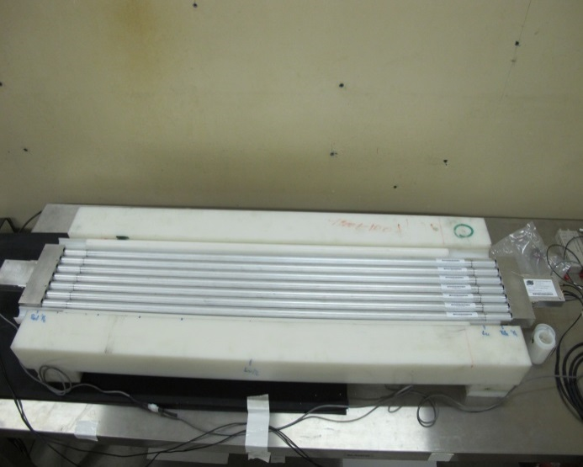
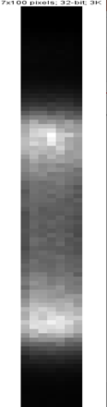
Presentation #07-14
Boron Coated Straws imaging panel capability for neutron emission tomography for source localization inside radioactive drums
M. BEN MOSBAH, C. ELEON, D. TISSEUR, H. BAKHABBA, A. DOGHMANE
24/06/2021

Slide 2
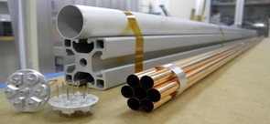
Summary
Background and aims
Short state of art
MCNP Feasibility study
Experimental validation
Conclusion and future work

Slide 3
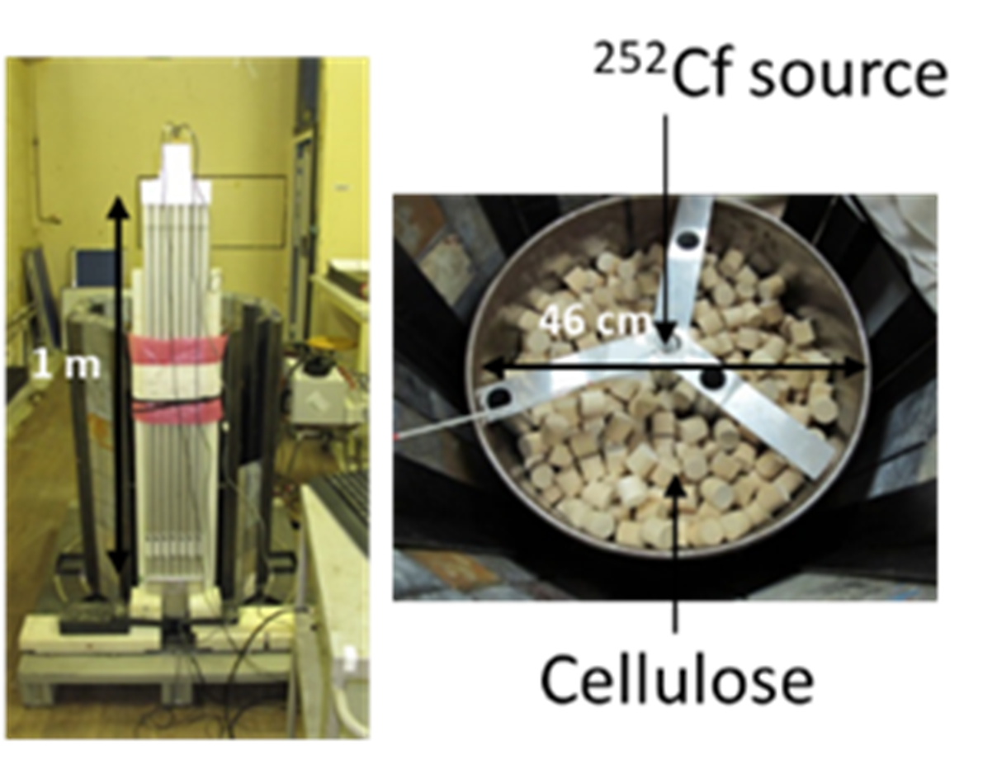

Background and aims
Non destructive neutron measurement of nuclear waste [ref. 1]
Criticality safety risk control, regulation of waste transport
workers’ radiation protection
Waste storage, retrieval of old waste
Radiological characterization of waste drums (50 L to 800 L)
Fissile (Pu-239) and other actinides (Pu-240) mass evaluation
Mass uncertainty reduction
⇒ Better knowledge of the distribution of the nuclear material and the matrix effect
mPu(g) $=\frac{usefull signal (s^{−1})}{calibration coeff.}$
Active and passive measurement system with neutron emission capability
Neutron imaging panel from Proportional Technology
7 boron coated straws (BCS) tubes (1 m height each) : n_{th} +¹⁰B → α+ ⁷Li
Neutron interaction position sensitive (1 cm segmented counts)
Neutron emission tomography technique applied
Objective : neutron term source 3D mapping inside the drum
⇒ reliable and robust estimation of mPu
BCS detectors
Neutron imaging Panel
Mockup drum

Slide 4
A short state of art [ref. 2]
SNM clusters 2D map with
DDT (active measurement with neutron generator)
MCNP design of complete BCS imaging panel measurement system
MCNP model
(empty drum)
Source Z position estimation
using “axial profiles”
Source radial position R_{source}
using substraction between “FWHM” of opposite panels (ΔFWHM(1-5))
One BCS tube
Z axis
Exp. setup
Neutron counts = f(Z)
“Axial profile”
SNM 1
SNM 2
graphite
Calculation versus experimental
Max deviation < 20%
Z_{source} ≈ centroid
“spatial resolution” 20 cm
R_{source} = f(ΔFWHM(1-5))

Slide 5
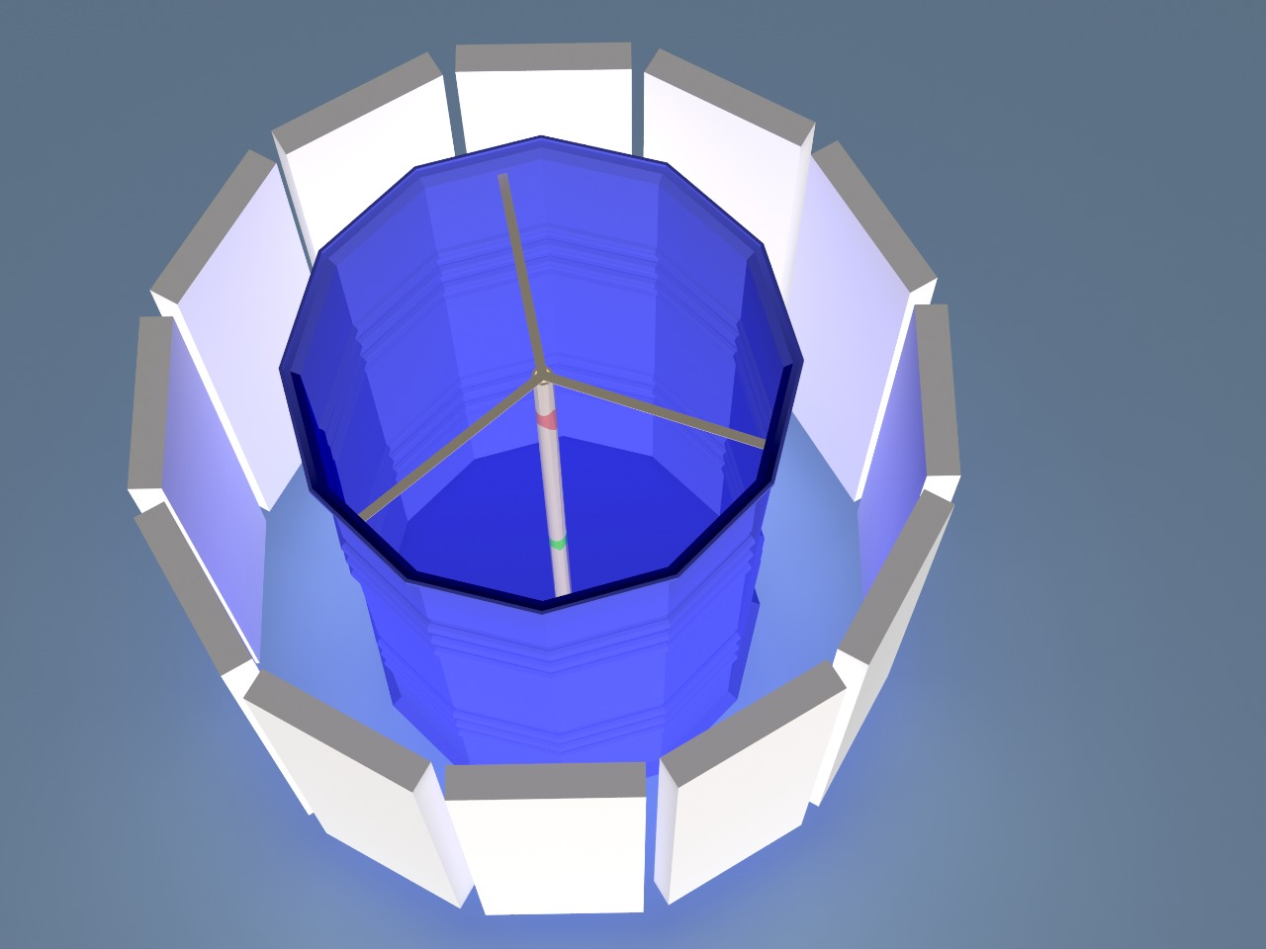
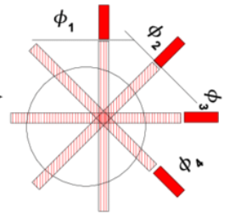
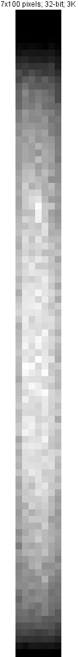
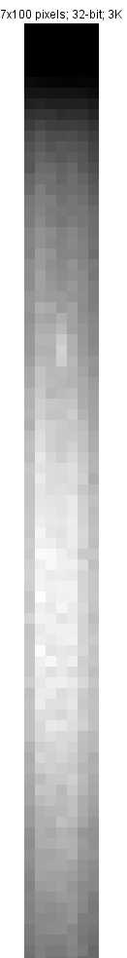
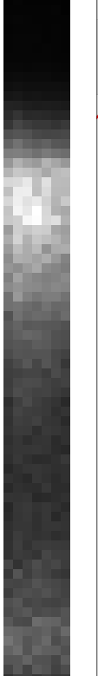
Neutron emission tomography : Deconvolution and 3D reconstruction
Common to numerical and experimental images
Acquisition
Image processing
Deconvolution
kernel image
centred source
Imaging panel
Raw image
7*100 pixels
Rotation
Δθ = 30°
Reconstructed image
One projection
Neutron
source
12 “projections”
Merging
12 proj.
RTK retroprojection
Rotating neutron emission tomography system
Richardson-Lucy
Algorithm*
*Richarson W.H., “Bayesian-Based Iterative Method of Image Restoration “ Journal of the Optical Society of America, Vol. 62, Issue 1, p. 55

Slide 6
MCNP feasibility study : Geometry and setup

Slide 7
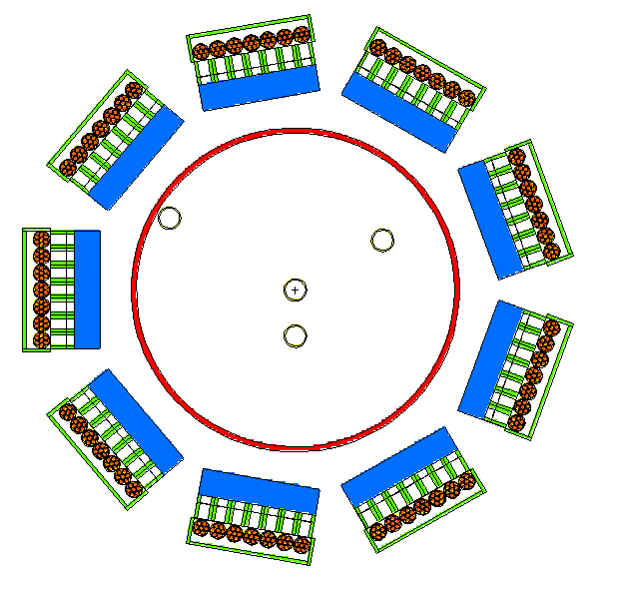
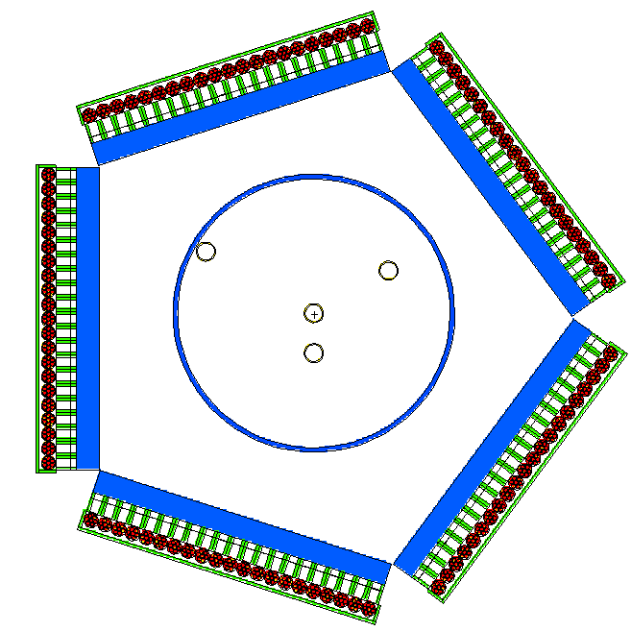

MCNP feasibility study : neutron emission tomography station design
Drum
fully covered by
21-tubes imaging panels
MCNP simulated images
Imaging panel
BCS tube
Imaging panel
Drum
not fully covered
Z axis
Initial MCNP model
9 Imaging panels (7 BCS tubes each)
New MCNP design
5 Imaging panels (21 BCS tubes)
No « shadow zones »
Tubes
21 x 100 pixels

Slide 8
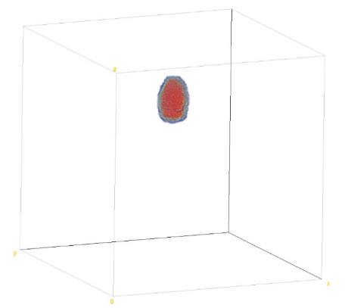
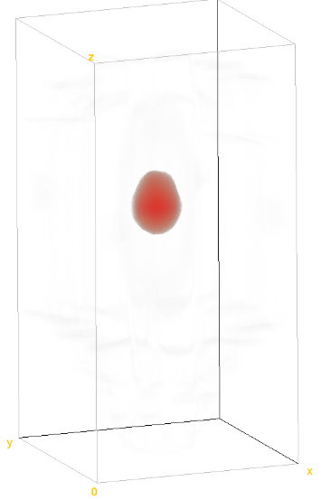
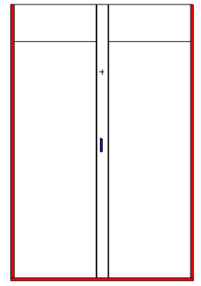
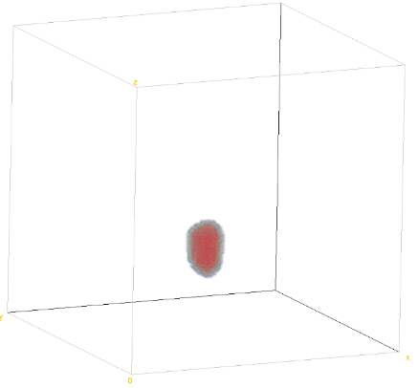
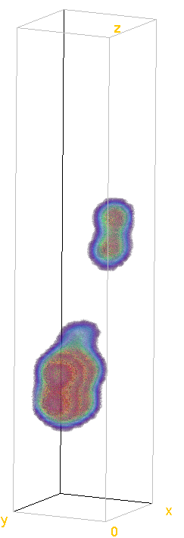
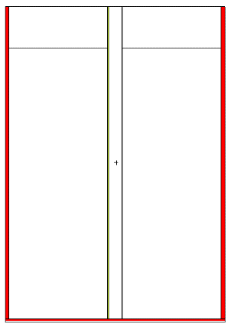
MCNP feasibility study : results for 4 source configurations
“Top”
source
Z
Z centered source
Z
Z
Z
²⁵²Cf
64 cm
9 cm
73 cm
²⁵²Cf
9 cm
59 cm
50 cm
reconstruction
reconstruction
Tube
axis
Tube axis
Feasibility validated !!
“Bottom”
source
Z
Two sources
Z
Z
Z
²⁵²Cf
60 cm
²⁵²Cf
reconstruction
9 cm
60 cm
9 cm
29 cm
20 cm
AmBe
reconstruction
Tube
axis
10 cm
14 cm
22 cm

Slide 9
Experimental validation

Slide 10
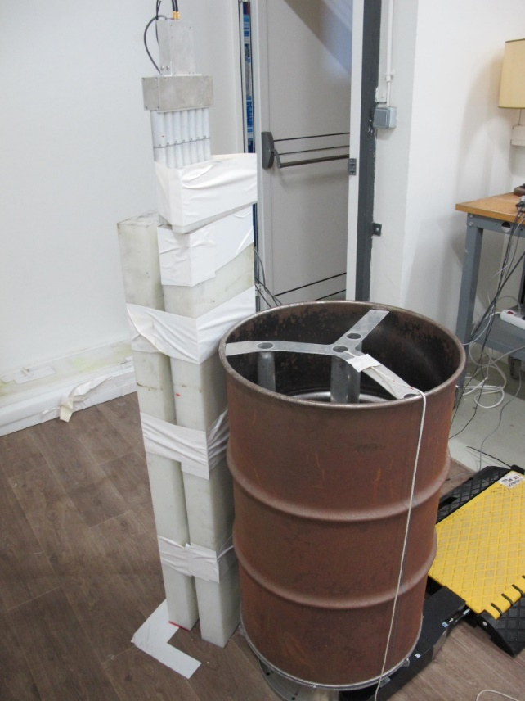
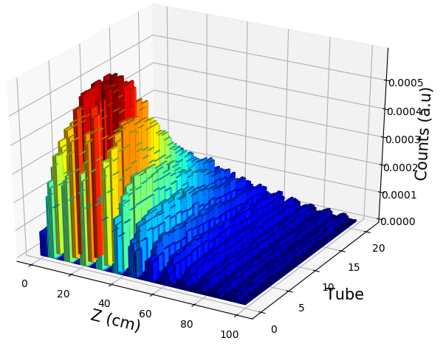
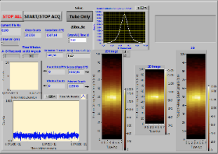
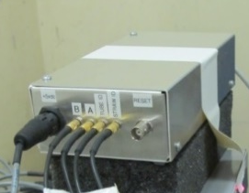


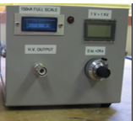
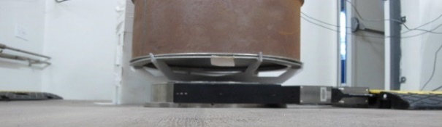
Experimental setup
Material
Spatial profile
(counting rate = f(Z))
Data processing Python
BCS imaging panel
D=25.5 cm
CH₂ 25 cm large
7.5 cm width
Mockup
drum
H=74 cm
DAQ
Neutron counts 2D map
The Reconstruction Toolkit
Rotating plate
Acquisition UI
Image processing
softwares
Power supply

Slide 11

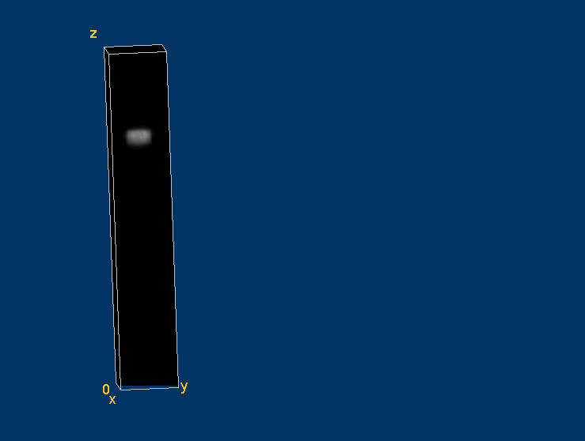
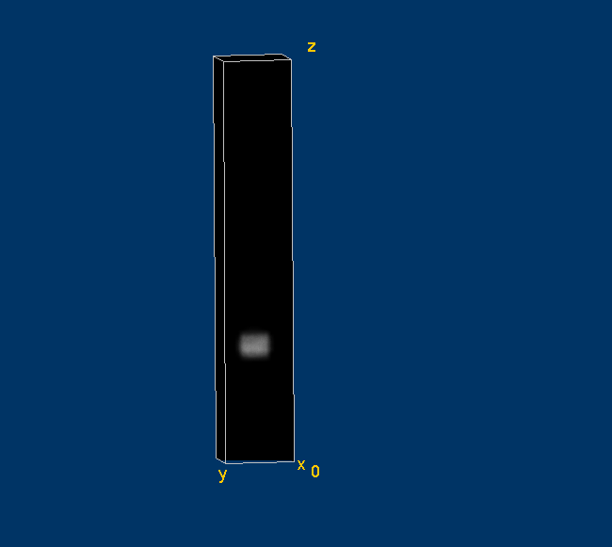
Neutron source imaging : one source configuration
« Top » AmBe source
10⁵ n.s⁻¹
Acquisition time : 12*10 min
« Bottom » source AmBe source
10⁵ n.cm⁻².s⁻¹
20cm
50cm
2D image after Richardson-Lucy Deconvolution
3D reconstruction
3D reconstruction
2D image after Richardson-Lucy Deconvolution

Slide 12

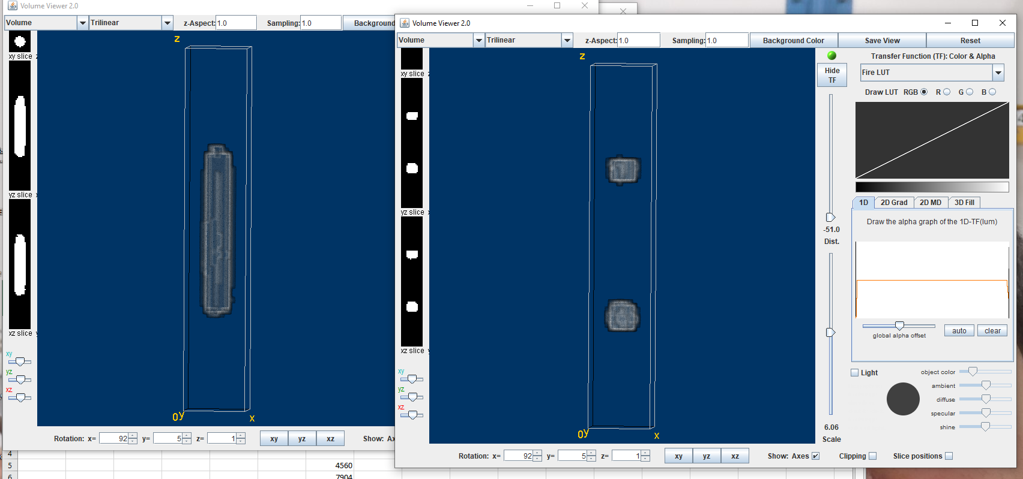
Neutron source imaging : two sources configuration
Axial positions
Source emissions 10⁵ n.s⁻¹
Acquisition time : 12*10 min
BCS imaging panel
CH₂
Mockup drum
e= 7,5cm
30cm
26cm
32.5cm
L= 74 cm
4,5cm
d
25,5cm
6,5cm
²⁵²Cf
Ambe
l= 25cm
2D image after Richardson-Lucy Deconvolution
3D reconstruction

Slide 13
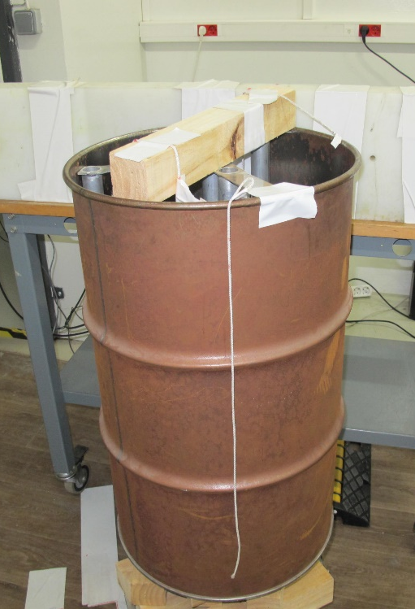
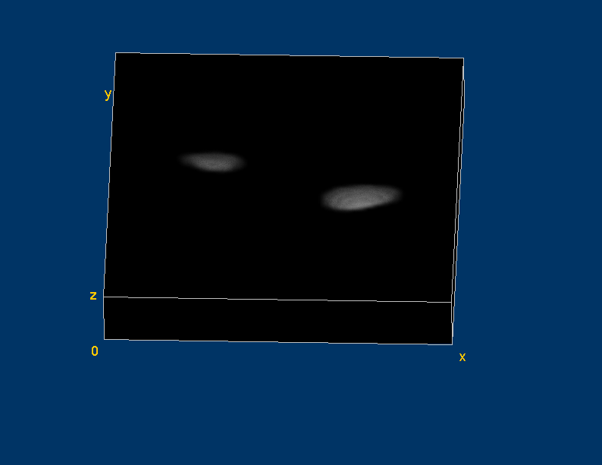
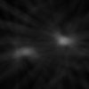
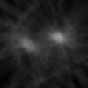
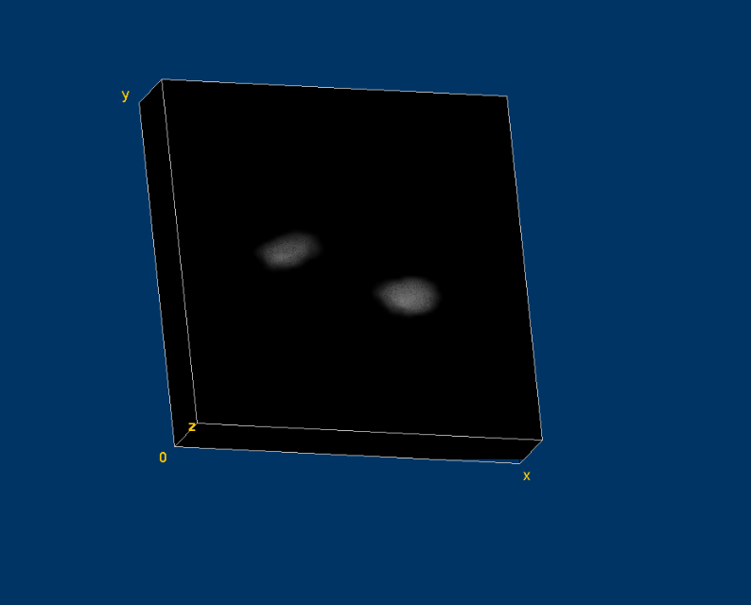
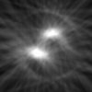
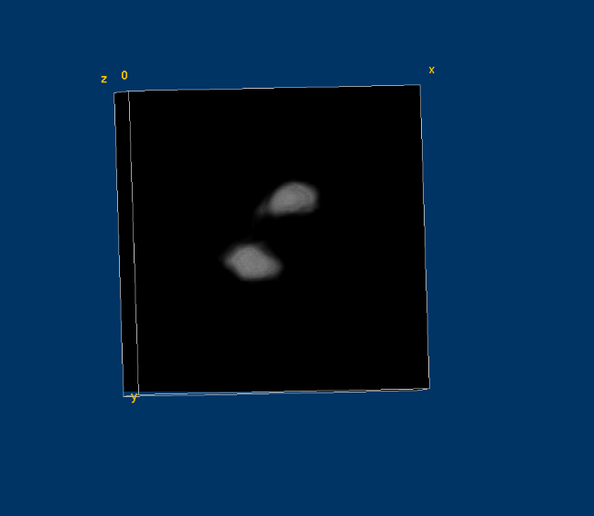
Neutron source imaging : two sources configuration
Radial positions
Acquisition time : 12*10 min
Source emissions 10⁵ n.s⁻¹
40cm
D=20, 30 and 40 cm
D=40 cm
²⁵²Cf
AmBe
34cm
D=30 cm
D=20 cm
22cm
2D images after Richardson-Lucy Deconvolution

Slide 14
Concluding remarks

Slide 15
Conclusion an future work
Demonstration of the Boron-coated Straw (BCS) imaging panel capability for neutron emission tomography :
  State of art : axial and radial source position determination ;
  Neutron emission tomography : MCNP feasibility validated;
  Experimental assay :
    Standard gamma tomography algorithms used
    Neutron sources in Mock-up drum measured with a rotating BCS imaging panel
    Successful neutron emission tomography :
      Single source @ different axial positions
      Two sources @ opposite axial (30 cm) and radial positions (20 cm)
  Prospects :
    Tests with organic, metallic and mixed matrices
    Tests with position sensitive He-3 tubes
    Optimization of Deconvolution and reconstruction processes (specific algorithms for neutrons,
    Machine and Deep Learning approaches)
    Test in active neutron mode (DDT technique)

Slide 16
References
B. Perot et al. The characterization of radioactive waste: a critical review of techniques implemented or under development at CEA, France, EPJ Nuclear Sci. Technol. 4, 3 (2018)
C. Eleon et al. Boron-Coated Straws Imaging Panel Capability for Passive and Active Neutron Measurements of Radioactive Waste Drums, IEEE Transactions on nuclear science, Vol. 67, no. 9, September 2020
M. Cortesi et al. “Concept of a novel fast neutron imaging detector based on THGEM for fan-beam tomography applications ». Journal of Instrumentation, Volume 7, February 2012
D. Tisseur, N. Bhatia, N. Estre, L. Berge, D. Eck, E. Payan, Evaluation of a scattering correction method for high energy tomography, ANIMMA 2017, International Conference on Advancements in Nuclear Instrumentation Measurement Methods and their Applications, 19-23 June, Liège, Belgium.
M. Kistler, N. Estre, E. Merle, Simulated Performances of a Very High Energy Tomograph for Non-destructive Characterization of large objects, ANIMMA 2017, International Conference on Advancements in Nuclear Instrumentation Measurement Methods and their Applications, 19-23 June, Liège, Belgium.

Slide 17
Thank you for your attention

