Slide 1


Ordinary muon capture studies as an opportunity for DBD calculations
M. Shirchenko, JINR, Dubna
MEDEX’19
29.05.2019
Notes:
OMC and it’s implications to nuclear and particle physics
Not only for DBD but for nuclear and particle physics. Egoistic goal.

Slide 2
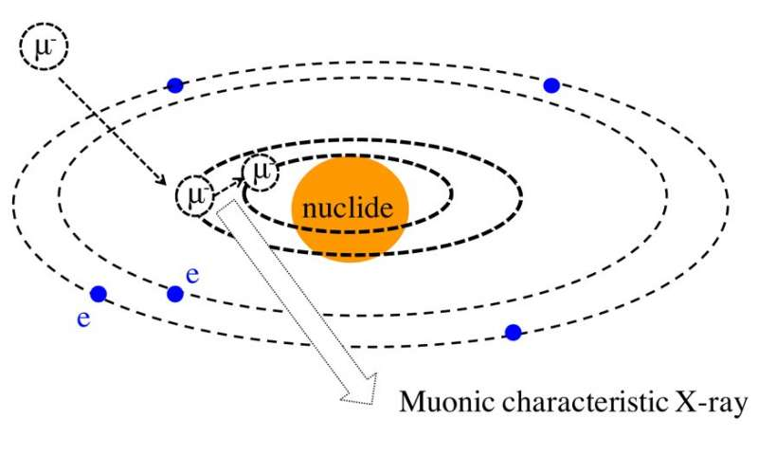
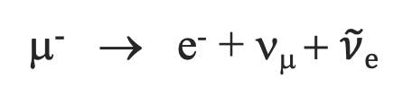
Ordinary Muon Capture (OMC)
μ⁻ → e⁻ + ν_{μ} + $\tilde{ν}e$
Muon decay as a competitive process
μ⁻ + (A, Z) → (A, Z) + μ⁻ + Σγ_{x}
μ⁻ + (A, Z) → (A, Z-1)* + ν_{μ}
(A, Z-1)* → (A, Z-1) + γ
(A, Z-1)* → (A-X, Z-1) + Xn + γ
Notes:
Последняя орбита внутри ядра
Сказать про μx – диплом и Тойоту. Чувствительны к химическому составу мишени.

Slide 3
n
n
γ
A+1, Z+1
A-1, Z+1
A, Z+1
OMC
A, Z
Target:
A, Z+2

Slide 4
OMC advantages
n
γ
n
A+1, Z+1
A-1, Z+1
A, Z+1
A, Z
ββ
Huge momentum transfer (up to 100 MeV)
  High-lying states population
Right leg testing for DBD calculations (coupling to charge exchange reactions)
g_{a} – suppression probing
      via capture rates calculations (+ other methods)
A, Z+2

Slide 5
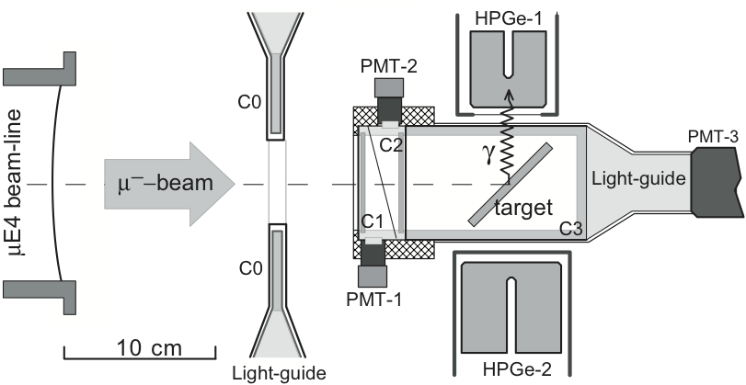
Schematics of set-up
N of μ-stop = (8 – 25) x 10³ with 20 – 30 MeV/c

Slide 6
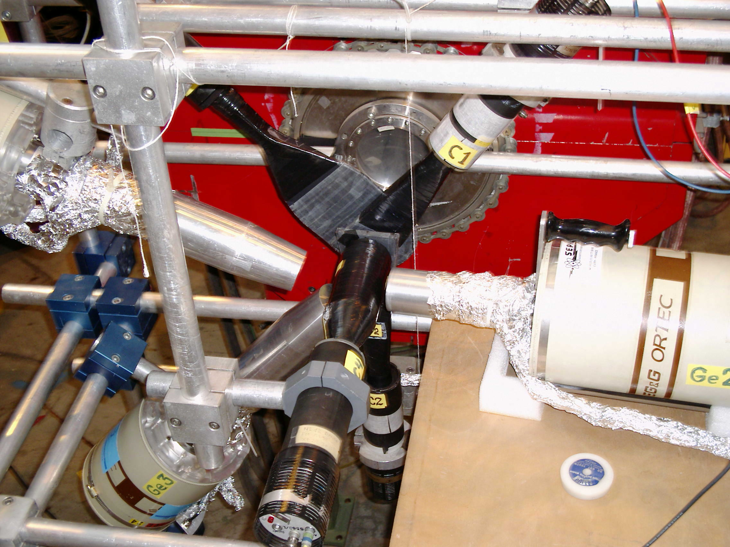
PSI 2002

Slide 7
Key points
Very small amount of the target medium.
Enriched isotopes.
Measurement of gaseous target @ 1 bar
High precision γ-spectroscopy
(eV precision)
№ of μ-stop = (8 – 25) x 10³ with 20 – 30 MeV/c

Slide 8
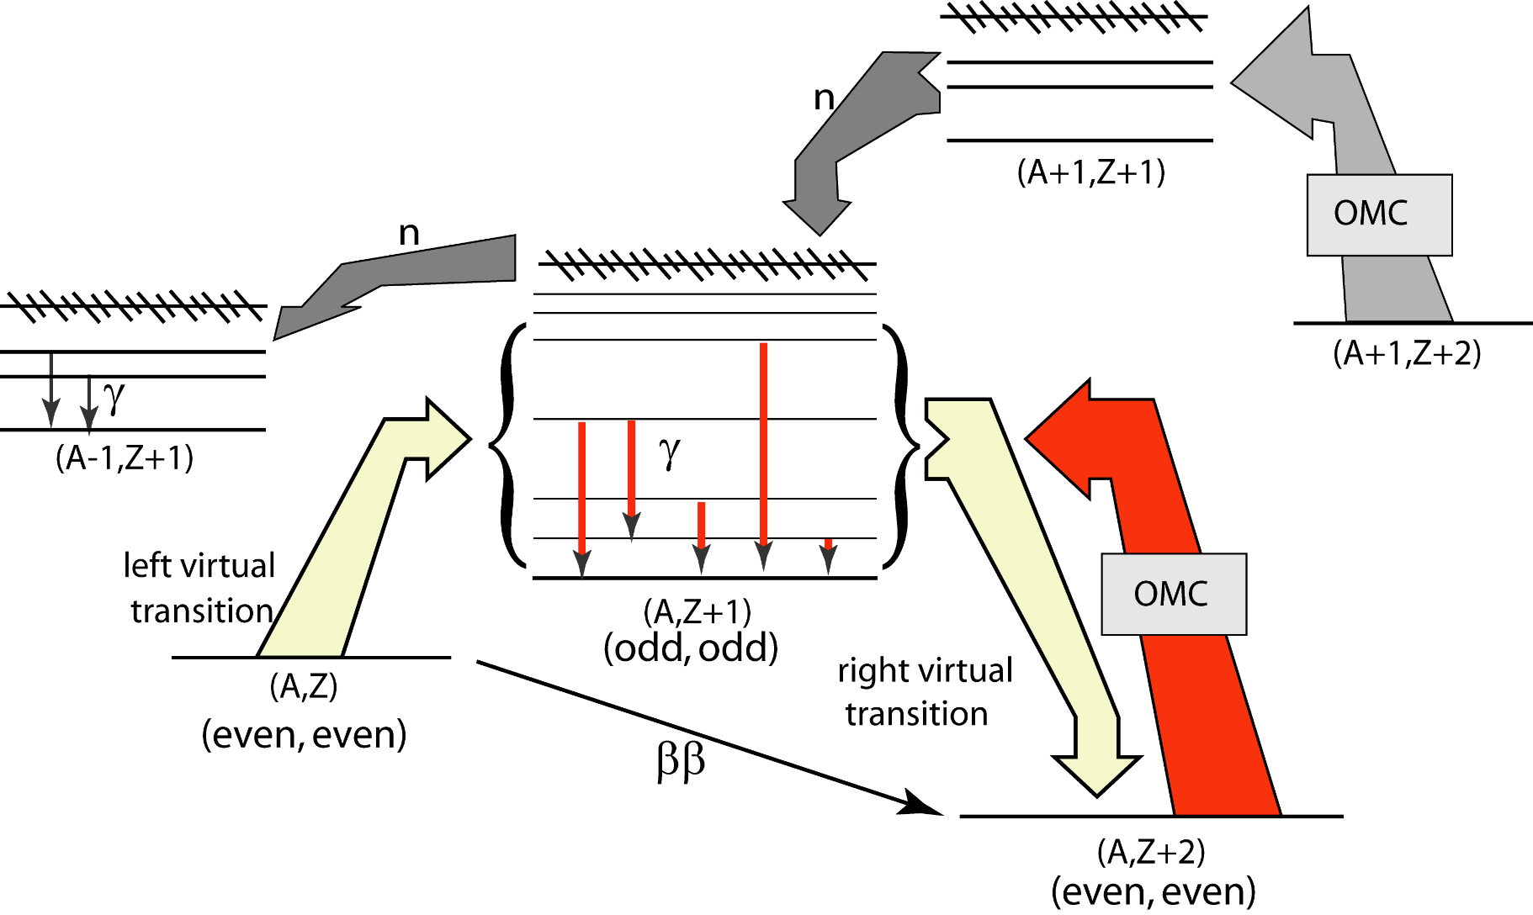
OMC for DBD
μ⁻ + (A, Z) → (A, Z-1)* + ν_{μ} → (A, Z-1) + γ​, m_{μ} ~ 100 MeV

Slide 9
2β-decay | 2β-experiments | OMC target | Status
⁷⁶Ge | GerdaI/II, Majorana Demonstrator | ⁷⁶Se | 2004
⁴⁸Ca | TGV, NEMO3, Candles III | ⁴⁸Ti | 2002
¹⁰⁶Cd | TGV | ¹⁰⁶Cd | 2004
⁸²Se | NEMO3, SuperNEMO, Lucifer(R&D) | ⁸²Kr | 2006
¹⁰⁰Mo | NEMO3, AMoRE(R&D), LUMINEU(R&D) | ¹⁰⁰Ru | 2018, RCNP
¹¹⁶Cd | NEMO3, Cobra | ¹¹⁶Sn | 2002
¹⁵⁰Nd | SuperNEMO, DCBA(R&D) | ¹⁵⁰Sm | 2002, 2006
¹³⁶Xe | EXO200, Kamland-Zen, NEXT | ¹³⁶Ba | −
¹³⁰Te | Cuore 0/Cuore, SNO+ | ¹³⁰Xe | −
Phys. Rev. C 99 (2019) 024327.

Slide 10
Target | Enrichment | Composition | Qt - ty
⁴⁸Ti | 95.8% | TiO₂ powder | 1.0 g
⁷⁶Se | 92.4% | Se granules | 5.0 g
^{nat}Se | -- | Se granules | 5.0 g
¹⁰⁶Cd | 63.0% | Cd metal foil | 5.0 g
^{nat}Cd | -- | Cd metal foil | 5.0 g
⁸²Kr | 99.8% | Kr gas | 0.7 l (1 atm.)
^{nat}Kr | -- | Kr gas | 1.0 l (1 atm.)
¹⁵⁰Sm | 92.6% | Sm₂O₃ powder | 2.0 g
^{nat}Sm | -- | Sm₂O₃ powder | 2.0 g
Phys. Rev. C 99 (2019) 024327.

Slide 11
E,T – distribution
Time, ns
Energy, keV

Slide 12
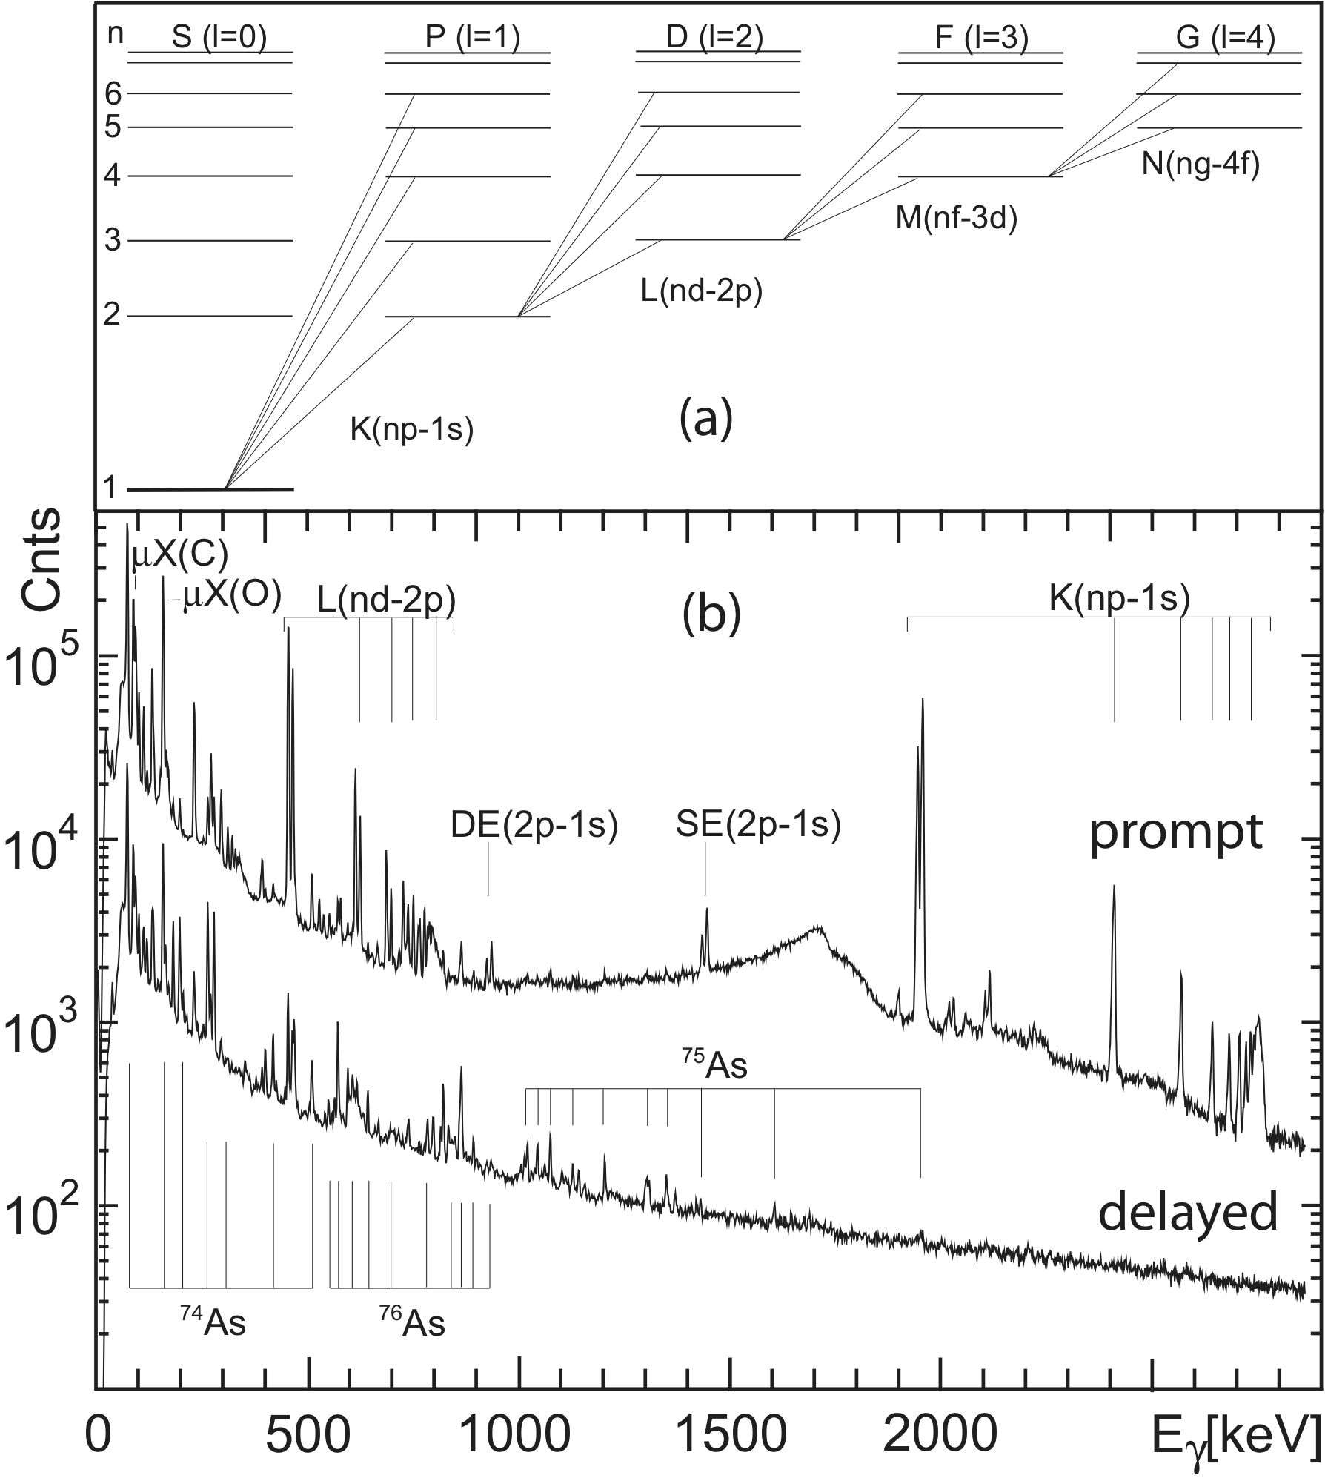
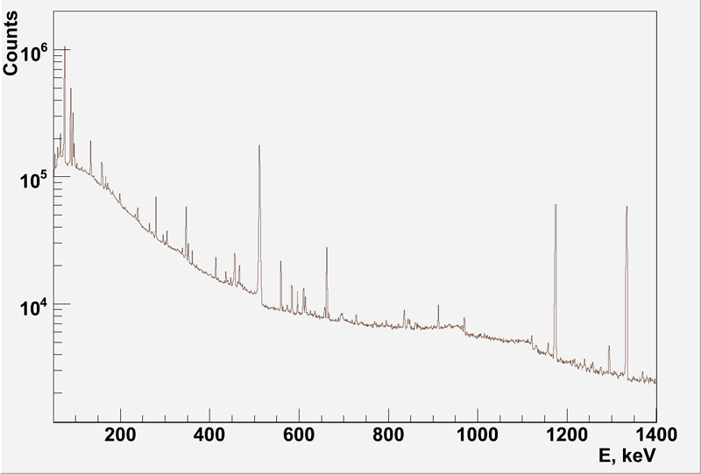
μ-spectra
Uncorrelated
prompt
delayed

Slide 13
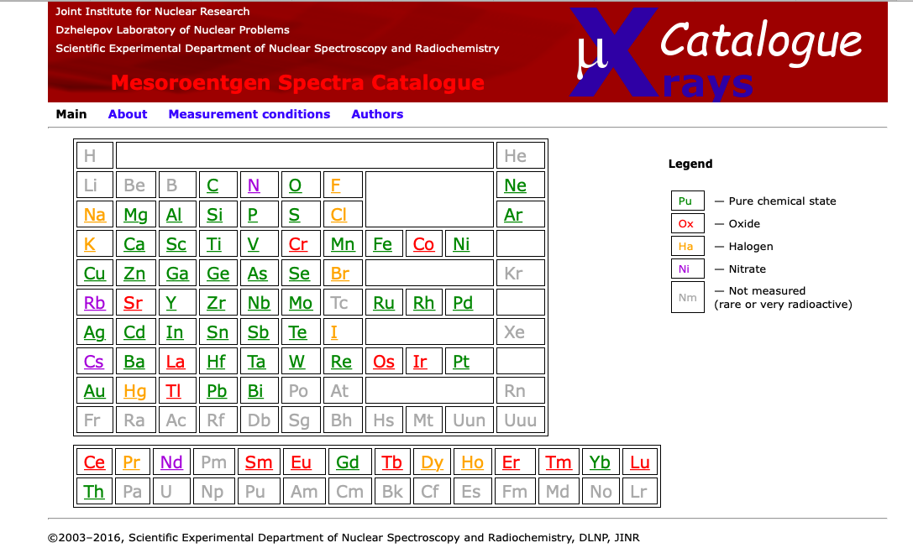
μX-rays catalogue
75 elements measured @ PSI
http://muxrays.jinr.ru
Notes:
Белый порошок на таможне

Slide 14
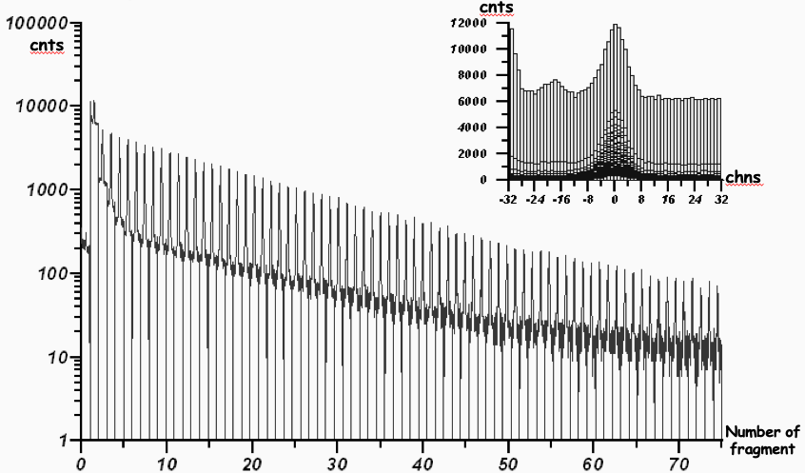
Time evolution method
(Each fragment corresponds to 10 ns time period)
H.O.U. Fynbo et. al.,NPA724(2003)493

Slide 15
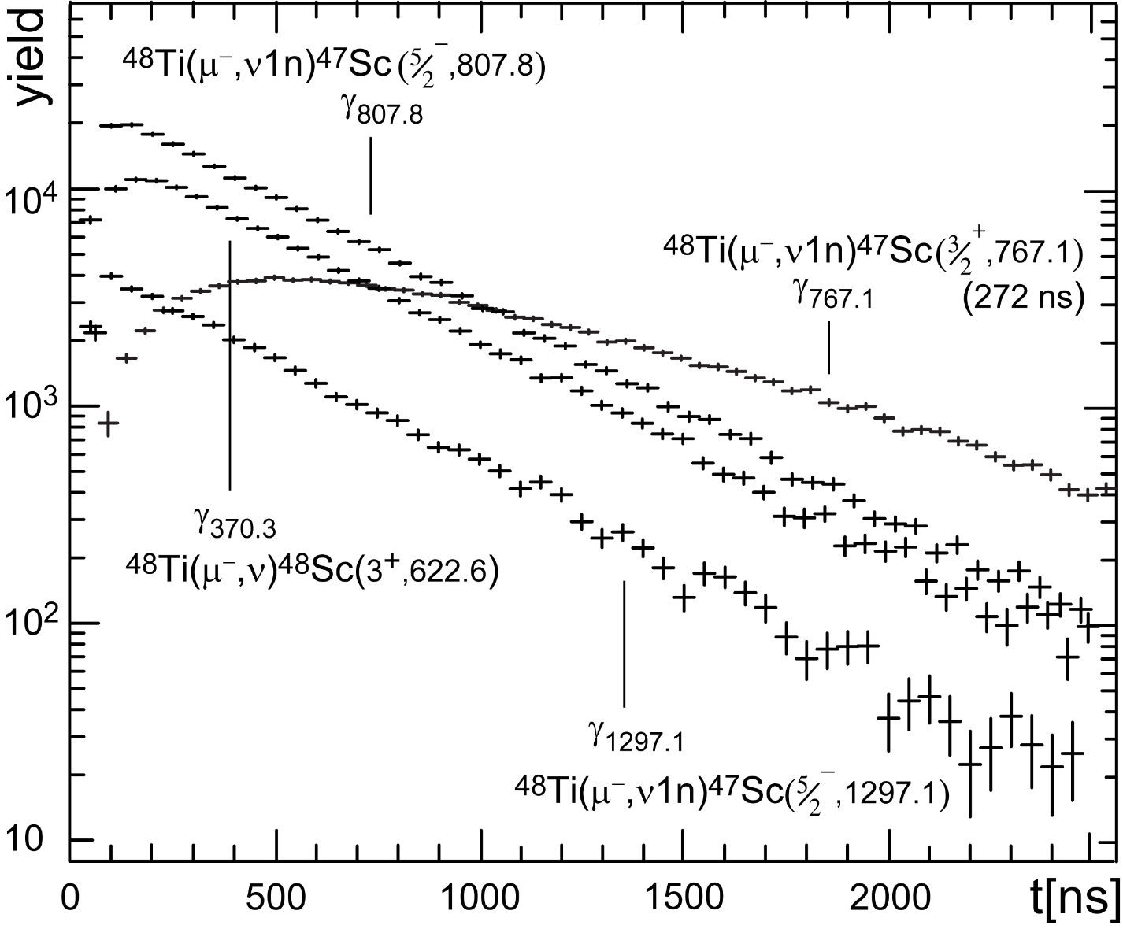
Capture rates for ⁴⁸Ti
τ: 361.1 ns
т.e., λ_{cap} = 2.32 μs⁻¹

Slide 16
Extraction of partial capture rates
feeding
decaying
detailed balance
A
D.Zinatulina PHD thesis
https://arxiv.org/abs/1803.10960
Notes:
I do not have enough patience, only Dana can do this

Slide 17
Partial capture rates for ⁴⁸Sc

Slide 18
Theory comparison
Not that good up to now, but
See Lotta’s talk…

Slide 19
Uncorrelated spectrum measured with ⁷⁶Se target
⁷⁶As
⁷⁵As
⁷⁴As

Slide 20
Yield of different isotopes from β-decay
2n
n
β⁻
γ
β⁻
γ
OMC
β⁻
γ
Target:
A, Z

Slide 21
Isotopes yield for the ⁷⁶Se and ¹⁵⁰Sm

Slide 22
What can we get from the OMC?
Correlated events – energy and time distribution:
  Energy information: Total capture rates;
  Time discrimination (20-50 ns): muonic X-ray cascade (prompt spectra) – normalization, identification, surrounding and target material decomposition, enrichment (by isotopic shifts measurements), beam profiling;
  Time discrimination (50-700 ns): nuclear γ-rays following μ-capture (delayed spectra) – partial capture rates, doppler shape of gamma lines due to angular correlation (γ, ν), GDR state probing;
Induced radiation directly not connected to muons (uncorrelated spectra)
  Yield of different isotopes from β-decay.

Slide 23

And this is not the only possibility…
Angular correlations in OMC
(Doppler shape of γ-lines).
Experiment: JINR, PSI (beamline μ-E4) 1996–2006
Ch. Briançon, J. Deutsch, V. Egorov, , C. Petitjean, Y. Shitov, M. Shirchenko, I. Yutlandov, S. Zaparov

Slide 24
PSI, 1998

Slide 25
Doppler profile of the γ-line

Slide 26
Options
OMC followed by γ-emission.
μ⁻+ (A, Z)_{I}→(A, Z−1)*_{F} + ν_{μ}→(A, Z−1)_{o} + γ_{E,L}
Allowed capture, angular momentum transferred (Δu ≤ 1), (Δπ = +1).
g_{p}/g_{a} (PCAC)
Needs pure GT (1⁺→0⁺) or known multipolarity mixture
https://www.sciencedirect.com/science/article/abs/pii/S0375947499008192
First-forbidden capture (Δu ≤ 2), (Δπ = -1)
C_{S}+g_{S}
https://www.sciencedirect.com/science/article/abs/pii/S0375947401012842
Spin correlations → hyperfine splitting of the lowest K-shell level F₊= I_{i}+ ½ and F₋= I_{i}- ½
λ₊/λ₋=f(g_{p}/_{g}a)
(https://journals.aps.org/prc/abstract/10.1103/PhysRevC.65.025503)
μSR
Cascades
Notes:
5. We were limited by 4 HPGe

Slide 27
μ – capture in ¹⁶O. Level scheme

Slide 28
Gas target (atmospheric pressure)
Entrance window: 150 mg/cm²
Target thickness: - O₂: 20 mg/cm² - Ne: 15 mg/cm²
Beam momentum: 30-40 MeV/C
Intensity: 20 000 µ/s
Gas
inlet
γ
µ
µE4
beam
Recoil
nucleus
ν
Gas
HPGe
Gas
outlet

Slide 29
µ-capture in ¹⁶O. Shape of the 277 keV γ-line

Slide 30
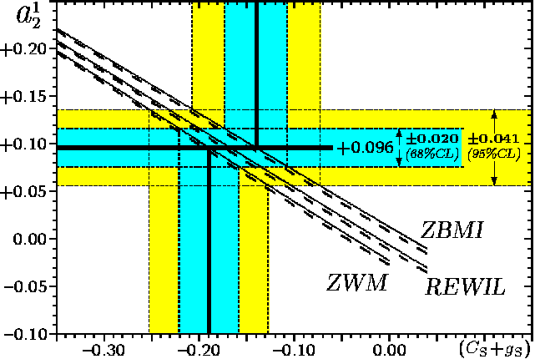
Dependence of the a₂ correlation coefficient on the Scalar form factor

Slide 31
µ-capture in ²⁰Ne. Level scheme.

Slide 32
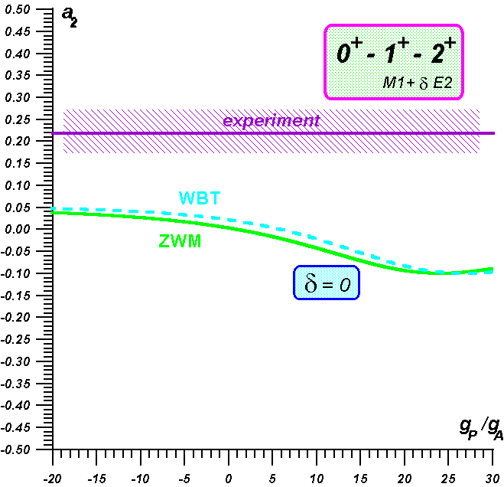
Shape of γ–lines (μ-capture in Ne)
Strange results
Gas target at atmospheric pressure
4 HPGe detectors
400 hours of measurement time

Slide 33
πE1(PSI) and Music(RCNP) comparison
Beam | πΕ1 | MUSIC
Beam current, μА | 1600 | 1.1
Intensity | 10⁷(n x 10⁵) | 3x10⁴ (n x 10³)
Momentum | 280 MeV/c | 50 MeV/c
ΔP/P | 0.8%-3% (FWHM) | 10%
Geometry | 20 mm | ?
Features |  | Moderator is needed
Qualified devoted group on site
Run time available
Notes:
Because of beam–time we need to use any opportunity

Slide 34
What we can …
Muon lifetime for the given isotope
Gamma – yields
Partial capture rates (not that easy)
Gamma-lines shape and angular correlations (A,Z -- ν -- γ )
μX – cascades
GDR energy region
Enriched isotopes
Gases
and what we can not…
Multiplicity
GT-strength
Level scheme
γ-γ coincidences???

Slide 35
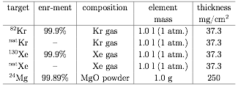





Plans
PSI run (2 weeks)
  October 2019 (gas target)
RCNP run (1 week)
  February 2020 (solid targets)
Targets are still the subject to discussion

Slide 36
Conclusions:
OMC presently seems to be a bit off the main stream of physics
But: it can provide important information about the high-q component of the weak nuclear response, i.e. it is relevant for the neutrinoless double beta decay (and astrophysics)
Several targets (⁴⁸Ti, ⁷⁶Se, ⁸²Kr, ¹⁰⁶Cd, ¹⁵⁰Sm) have been studied by our group for the double beta decay (⁴⁸Ca, ⁷⁶Ge, ⁸²Se ¹⁰⁶Cd, ¹⁵⁰Nd). Partial capture rates were extracted and a substantial strength of the μ-capture was found to reside in the low-energy region -- especially in the case of heavy systems
Further efforts (experimental and theoretical) is be needed
New initiatives are very welcome to advance in the field

Slide 39
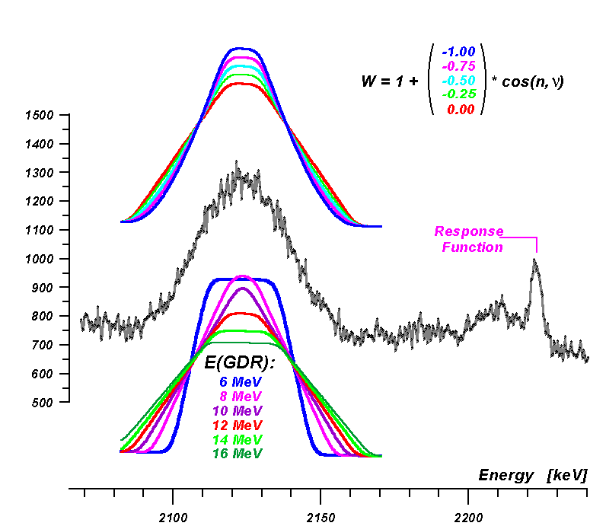
GR – strength
2n
n
β⁻
γ
β⁻
OMC
γ
Energy of
intermediate state
2. Angular correlation
between (n,ν)
β⁻
γ

Slide 40
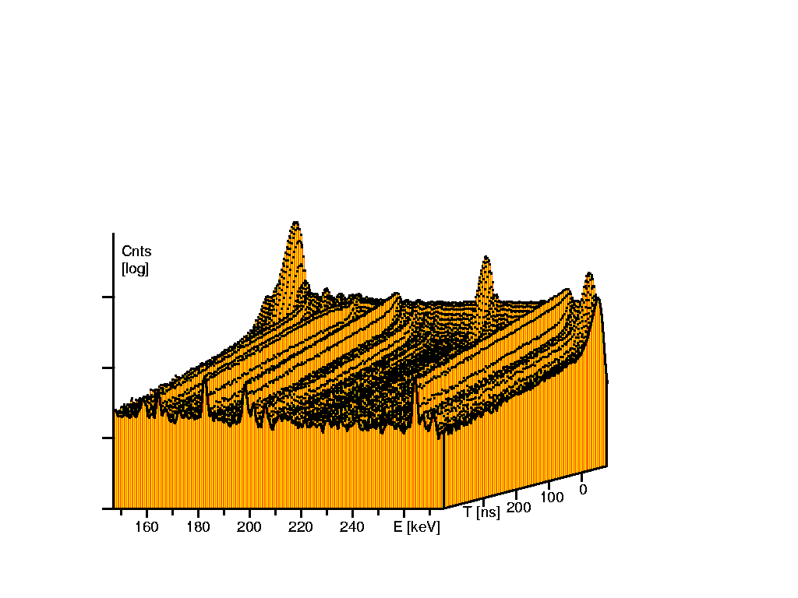
Distribution N(E,T)

Slide 41
Comparison with theory and charge-ex
theory
expmt
Notes:
It’s hard to compare with the theory

Slide 42
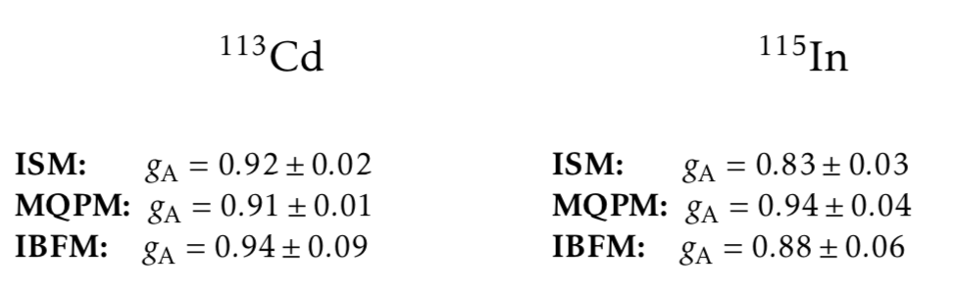
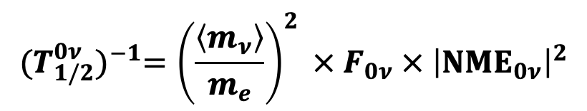

g_{A} suppression in nuclei
$${(T_{1/2}^{0ν})}^{−1}={\left(\frac{\left\langle m_{ν}\right\rangle }{m_{e}}\right)}^{2} × F_{0ν} ×{ \left|{ΝΜΕ}_{0ν}\right|}^{2}$$
$${ \left|{ΝΜΕ}_{0ν}\right|}^{2} ≅{\left|M_{GTGT}^{0ν}\right|}^{2}={\left(g_{a,0v}\right)}^{4}{\left|Σ_{J^{π}}\left(\left\langle 0_{f}^{+} | O_{GTGT}^{0ν} | 0_{i}^{+}\right\rangle \right)\right|}^{2}$$
Joel Kostensalo
NDM-2018
$$g_{a}=0.88⇒g_{a}^{4}<0.6$$

Slide 43
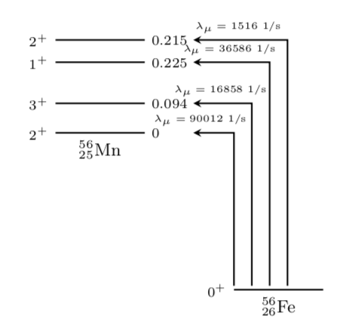
Shell calculations
DBD isotopes
g_{a} suppression check
V,A,P contributions
to the capture rates

Slide 44
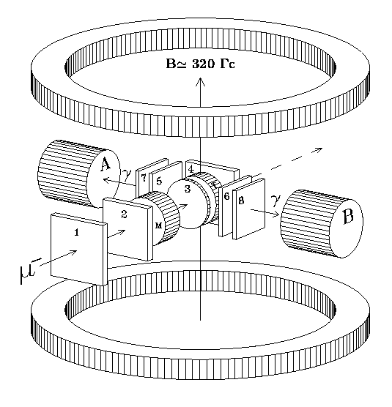
µ-capture in ²⁸Si
JINR 1995
Target: metallic Si
2 γ-detectors: co-axial. HPGe
8 plastic scintillator counters
Measurement of the (σ_{μ}·k_{γ}) angle : µSR-techniques

Slide 45
µ-capture in ²⁸Si. Level scheme.

Slide 46
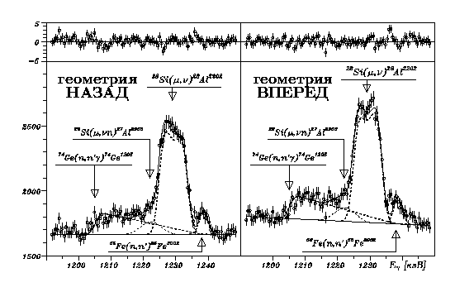
Doppler shape of the 1229 keV γ-line
BACKWARD
geometry
FORWARD
geometry

Slide 47
μCR42β
Total μ-Capture Rates
⁴⁸Ca
599±2 ns
⁴⁰Ca
362±2 ns
⁴⁸Ti
360±1 ns

Slide 48
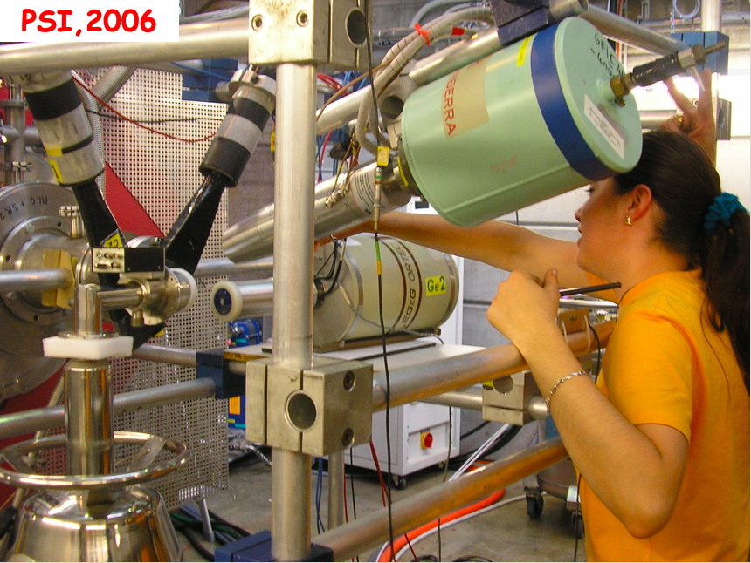
PSI, 2006

Slide 49
