Slide 1
Reliability of QRPA approach to ββ and β decays
J. Terasaki, Czech Technical Univ. in Prague
Y. Iwata, Kansai Univ.
1. Issues of neutrino
2. Our originalities in calculating nuclear matrix
elements of $ββ$ decay
3. Examination of wave functions of QRPA used for
$ββ$ decays ¹³⁶Xe→¹³⁶Ba and ¹³⁰Te→¹³⁰Xe
4. Reduced half-life of 0vββ decay
May 29, 2019
Prague

Slide 2
1. Issues of neutrino
What mass?
―a fundamental problem in physics.
Dirac or Majorana particle?
―if Majorana, 0vββ decay would occur.
Breaking of the lepton number conservation?
―If found, it is the first time.
Lepton CP violation?
How can the right-handed neutrino (sterile neutrino) be experimentally observed?
―Does that neutrino have an interaction? Having a huge mass?

Slide 3
Principle to determine effective neutrino mass
$$\left\langle m_{ν}\right\rangle =\left|\sum_{i=1,2,3}{U_{ei}^{2}m_{i}}\right|$$
$$1/T_{0ν}(0^{+}→0^{+})={\left|M^{\left(0ν\right)}\right|}^{2}G_{01}{\left(\frac{\left\langle m_{ν}\right\rangle }{m_{e}}\right)}^{2}$$
Half-life
Nuclear matrix element
Effective 𝜈 mass
Phase-space factor
Experimental measurement
Theoretical calculation

Slide 4
Our originalities in calculation of nuclear matrix elements of $ββ$ decay
Overlap of two QRPA states expressing inter-mediate states in ββ nuclear matrix element
$$M^{(0ν)}≅\sum_{pp^{′}nn^{′}}{\left\langle \left.pp^{′}\right|V\left(\overline{E}\right)\left|\left.nn^{′}\right\rangle \right.\right.}〈0_{f}^{+}|c_{p^{′}}^{†}c_{n^{′}}^{}c_{p}^{†}c_{n}^{}|0_{i}^{+}〉$$
$$\sum_{d_{f}:pnQRPA}{|d_{f}〉〈d_{f}|}$$
$$\sum_{d_{i}:pnQRPA}{|d_{i}〉〈d_{i}|}$$
Residual interaction little affects.
Overlap of QRPA states
Unnormalized overlap
=
π
(Normalization factors of the QRPA g.s.)
final,
initial
Residual interaction enhances,1‒1.86.
J.T. PRC 87, 024316 (2013)

Slide 5
ii. Two decay paths under closure approx.
$$\sum_{pp^{′}nn^{′}}{\left\langle \left.pp^{′}\right|V\left(\overline{E}\right)\left|\left.nn^{′}\right\rangle \right.\right.}\sum_{d_{f}d_{i}:pnQRPA}{〈0_{f}^{+}|c_{p^{′}}^{†}c_{n^{′}}^{}{|d_{f}〉\left\langle d_{f} | d_{i}\right\rangle 〈d_{i}|c}_{p}^{†}c_{n}^{}|0_{i}^{+}〉}$$
=
$$\sum_{pp^{′}nn^{′}}{\left\langle \left.pp^{′}\right|V\left(\overline{E}\right)\left|\left.nn^{′}\right\rangle \right.\right.}\sum_{b_{f}b_{i}:likeQRPA}{〈0_{f}^{+}|c_{p^{′}}^{†}c_{p}^{†}|b_{f}〉\left\langle b_{f} | b_{i}\right\rangle {〈b_{i}|c}_{n}^{}c_{n^{′}}^{}|0_{i}^{+}〉}$$
Proton-neutron (pn)-pairing interaction is important for β decay.
The like-particle QRPA does not depend on this interaction.
The strength of the T=0 pn-pairing interaction can be determined.
J.T. PRC 93, 024317 (2016)

Slide 6
3. Examination of wave functions of QRPA used
for $ββ$ decays ¹³⁶Xe→¹³⁶Ba and ¹³⁰Te→¹³⁰Xe
i. Self-check of using two sets of QRPA solutions for
intermediate states in nuclear matrix element of the
2νββ decay
$$M^{(2ν)}=\sum_{K=0,±1}{\sum_{\begin{aligned}d_{f}^{K}d_{i}^{K}: \\ pnQRPA\end{aligned}}{\frac{〈0_{f}^{+}|τ^{−}{\left(−\right)}^{K}σ_{−K}|d_{f}^{K}〉\left\langle d_{f}^{K} | d_{i}^{K}\right\rangle 〈d_{i}^{K}|τ^{−}σ_{K}|0_{i}^{+}〉}{(E_{dK}−\overline{M})/m_{e}c^{2}}}}$$
$$+Fermi term similar to the first term$$
If the QRPA is good, $E_{dK}=E_{dk}^{i}$ and $E_{dK}=E_{dk}^{f}$ give
close M ^{(2v)}.
QRPA energy obtained from initial state + origin calibration.

Slide 7
g_{A} is determined so as to reproduce the exp. half-life to 2vββ decay
A.S. Barabash, MEDEX’13.
Initial nucleus | $$E_{dK}$$ | $$M^{(2ν)}$$ | $$g_{A}$$ | Half-life (cal) (${10}^{21}$yr) | Half-life (exp) (${10}^{21}$yr)
¹³⁶Xe | $$E_{dK}^{i}$$ | 0.0748 | 0.49 | 2.164 | 2.20±0.06
 | $$E_{dK}^{f}$$ | 0.0744 | 0.49 | 2.188
¹³⁰Te | $$E_{dK}^{i}$$ | 0.133 | 0.48 | 0.697 | 0.69±0.13
 | $$E_{dK}^{f}$$ | 0.0864 | 0.60 | 0.677
QRPA is good for ¹³⁶Xe→¹³⁶Ba,
not very good for ¹³⁰Te→¹³⁰Xe.

Slide 8
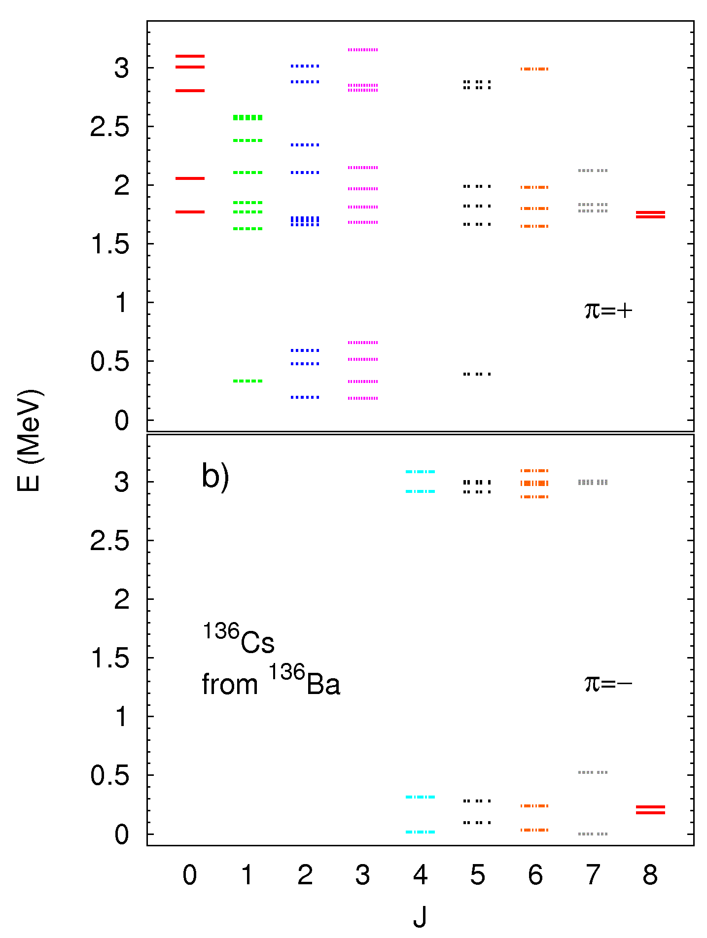
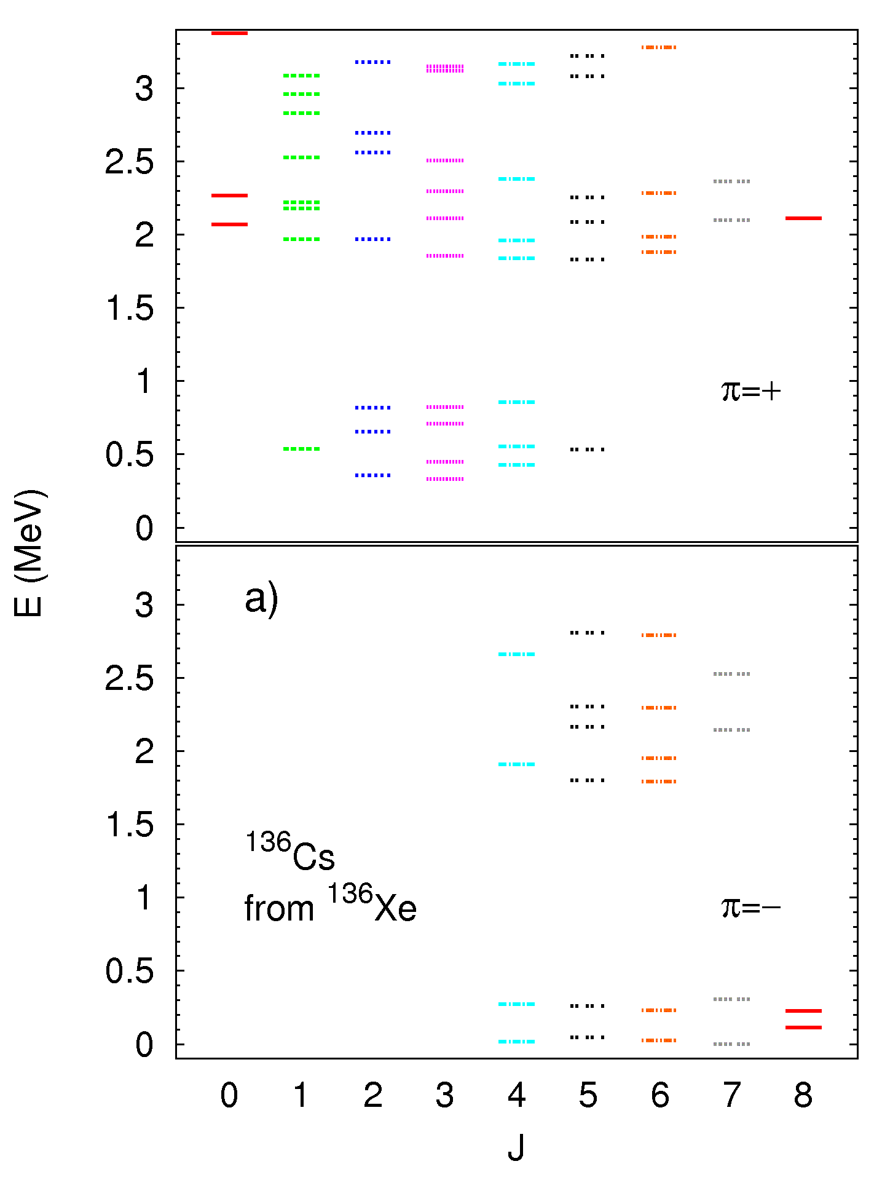
ii. Spectrum of intermediate nucleus
¹³⁶Xe→¹³⁶Cs→¹³⁶Ba

Slide 9
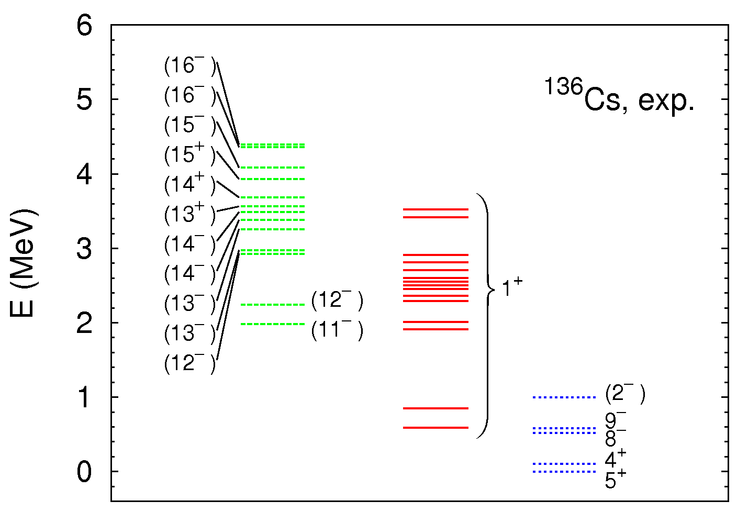
ii. Spectrum of intermediate nucleus
¹³⁶Xe→¹³⁶Cs→¹³⁶Ba
www.nndc.bnl.gov

Slide 10
iii. Gamow-Teller Sum rule
$$\sum_{d}{{\left|\left\langle d | τ^{−}σ | 0^{+}\right\rangle \right|}^{2}}−\sum_{d^{′}}{{\left|\left\langle d^{′} | τ^{+}σ | 0^{+}\right\rangle \right|}^{2}}=3(N−Z)$$
$$\left.\left|0^{+}\right.\right\rangle$$ | Left-hand side | $$3(N−Z)$$
¹³⁶Xe | 85.145 − 1.138 = 84.007 | 84
¹³⁰Te | 79.798 ‒ 1.847= 77.951 | 78

Slide 11
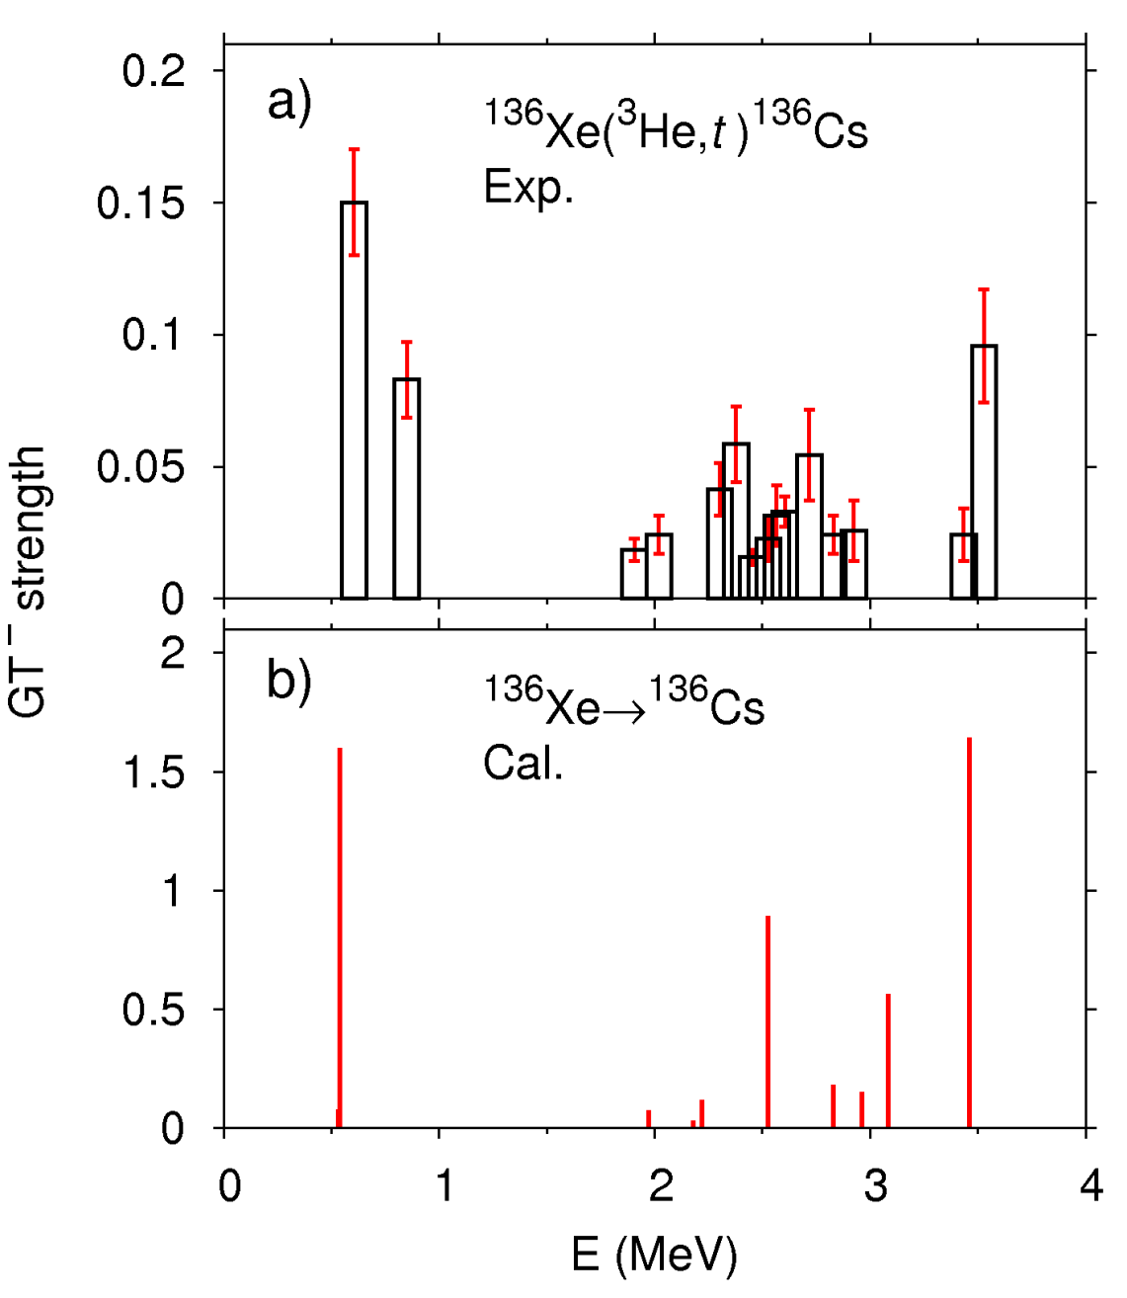
iv. GT transition strength by charge-change reaction
P. Puppe et al., PRC 84, 051305(R) (2011)
The E-dependence is reproduced, but the absolute values are quite different.
There was a similar problem in ⁴⁸Ca. The solution was to include the isovector spin-monopole operator.
The question is whether the exp. data satisfy the GT sum rule.

Slide 12
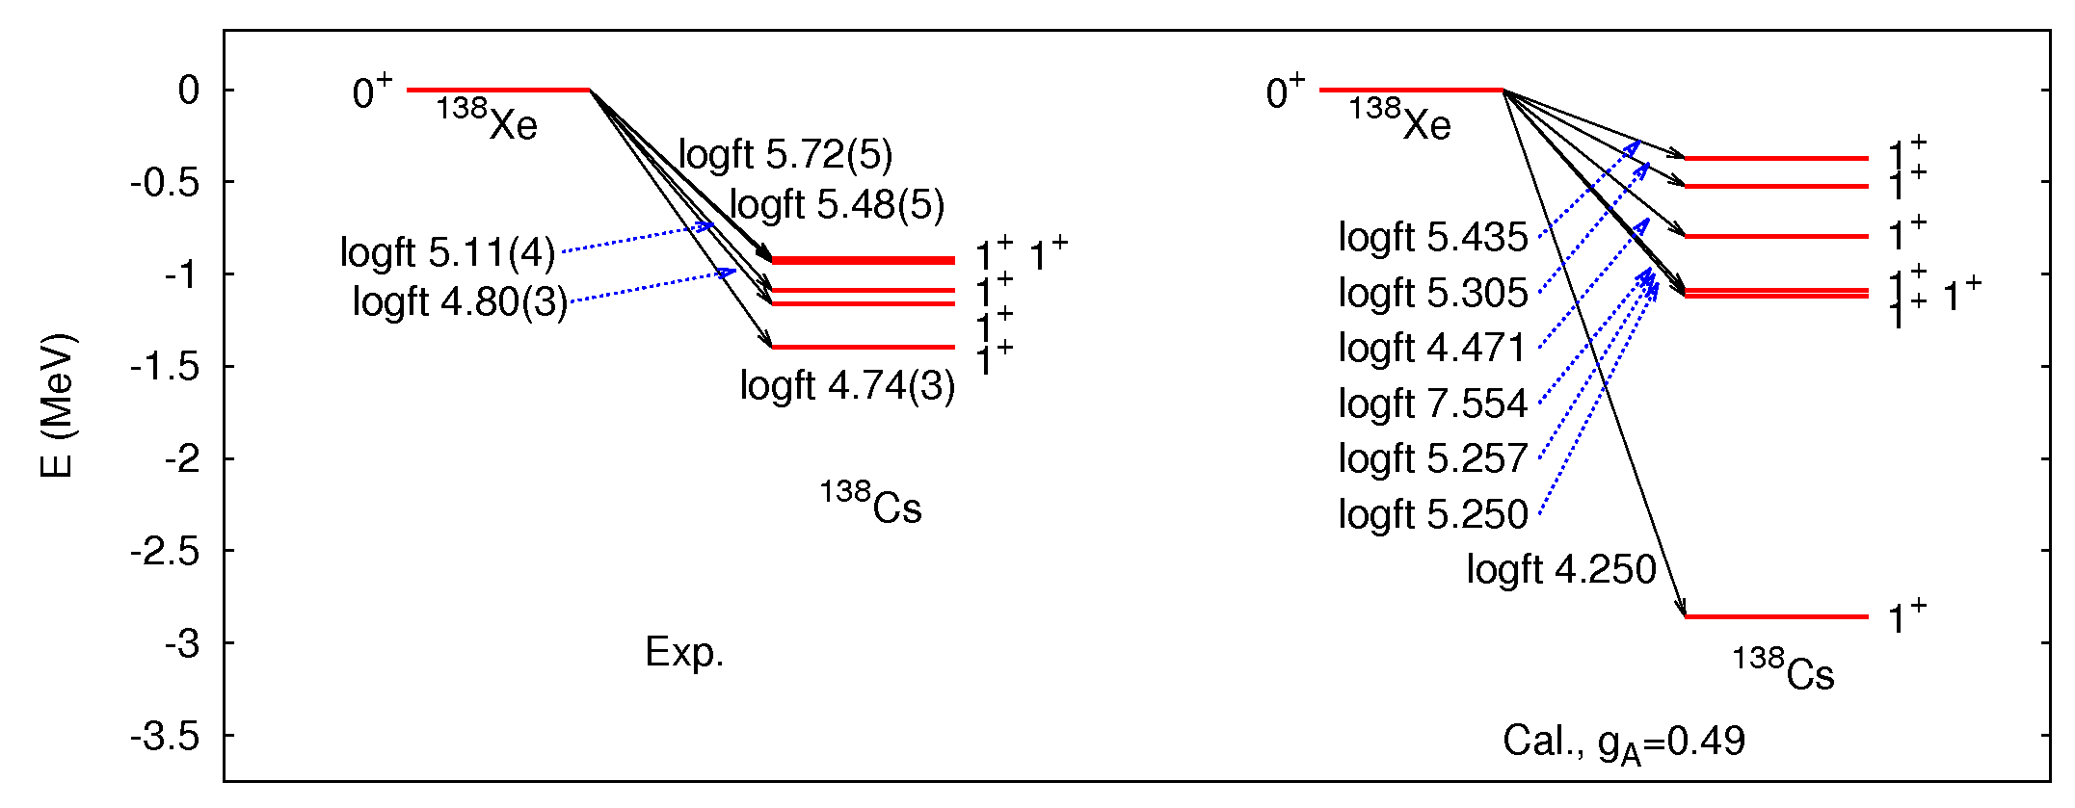
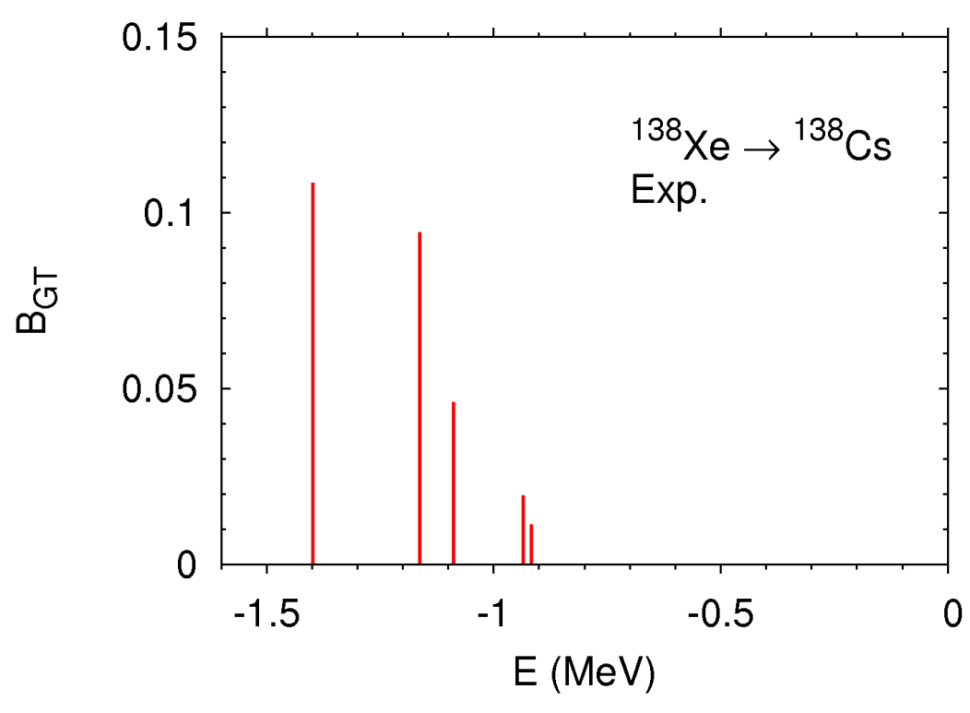
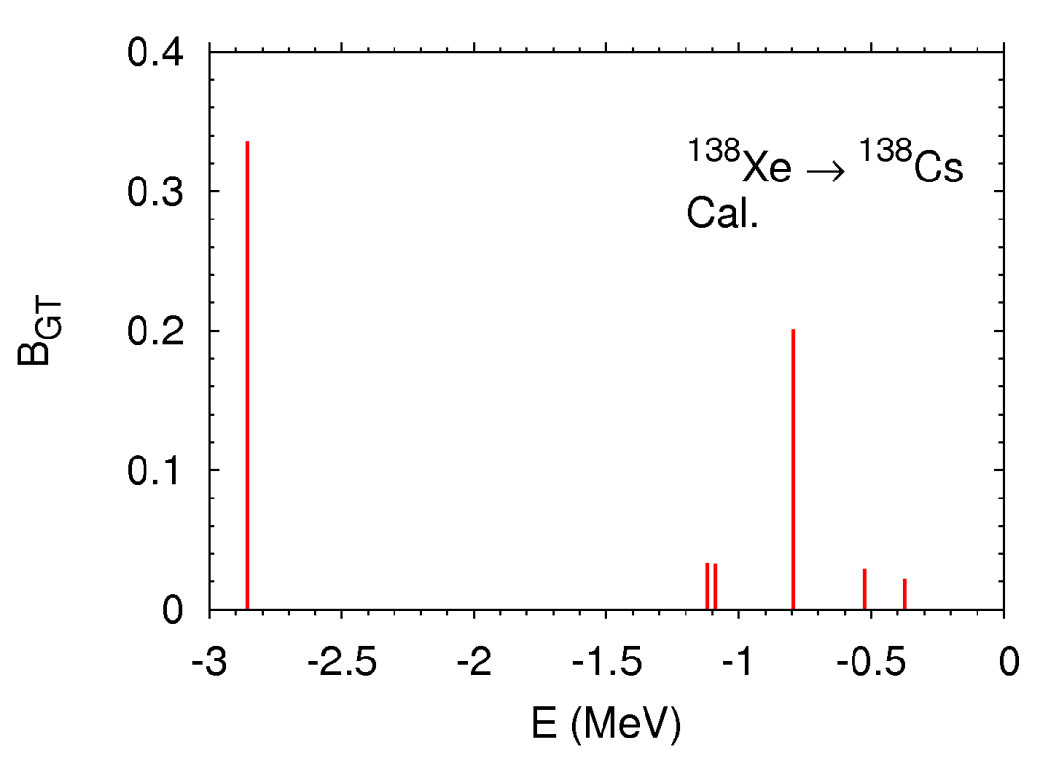
v. β decay of ¹³⁸Xe
Sum of B_{GT}
= 0.281
Sum of B_{GT}
= 0.301

Slide 13
Sum rule
GT strength from charge-change reaction
Independent of g_{A}, test of transition density
$${〈d_{i}|c}_{p}^{†}c_{n}^{}|0_{i}^{+}〉$$
Dependent on g_{A} and transition density
Strength of β decay
Effective g_{A} of 0.49 determined by fitting the half-life of 2vββ is consistent with β decay.
If the absolute values of the exp. GT strength from the charge-change reaction are explained, the conclusion would be that the transition density to 1⁺ states is correct.

Slide 14
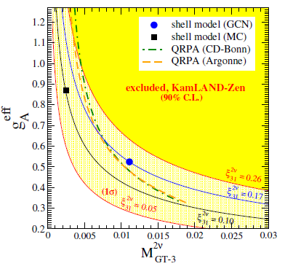
vi. Higher-order term of nuclear matrix element of 2v ββ
decay
$$M_{GT­‐3}^{(2ν)}$$
analogous to $M_{GT­­}^{(2ν)}$ but the exponent of the energy denominator is 3.
F. Šimkovic et al., PRC 97, 034315 (2018)
Statistical analysis with the exp. data of ββ spectrum of ¹³⁶Xe
A. Gando et al., PRL 122, 192501 (2019)

Slide 15
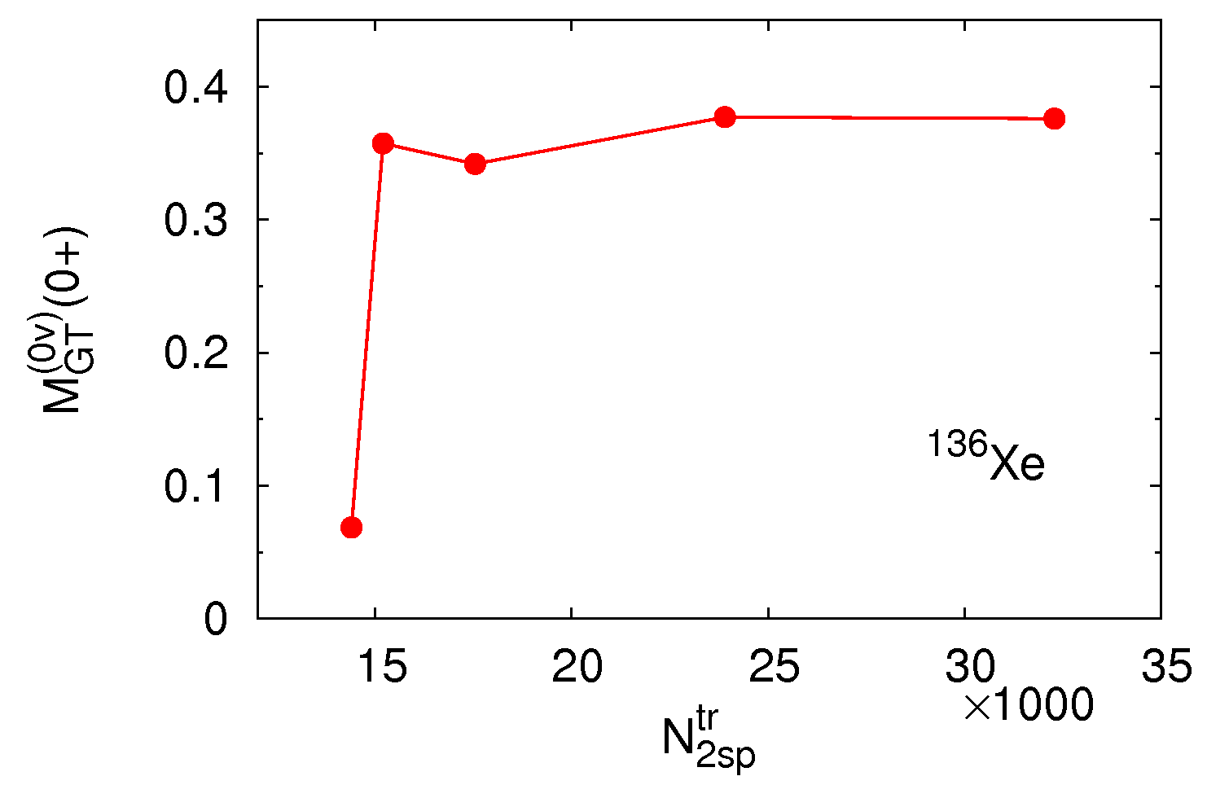
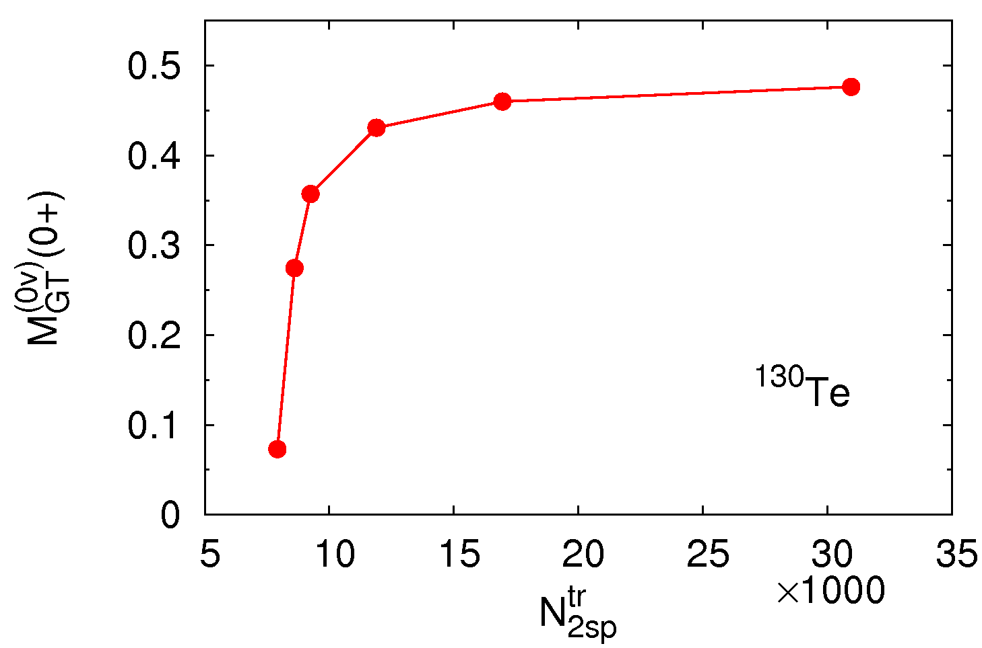
vii. Convergence of calculation with respect to single-
particle space
Summation of numbers of (pn) and (pꞌnꞌ) used for the two-body matrix elements of 0vββ-decay operator $\left\langle \left.pp^{′}\right|V\left(\overline{E}\right)\left|\left.nn^{′}\right\rangle \right.\right.$.

Slide 16
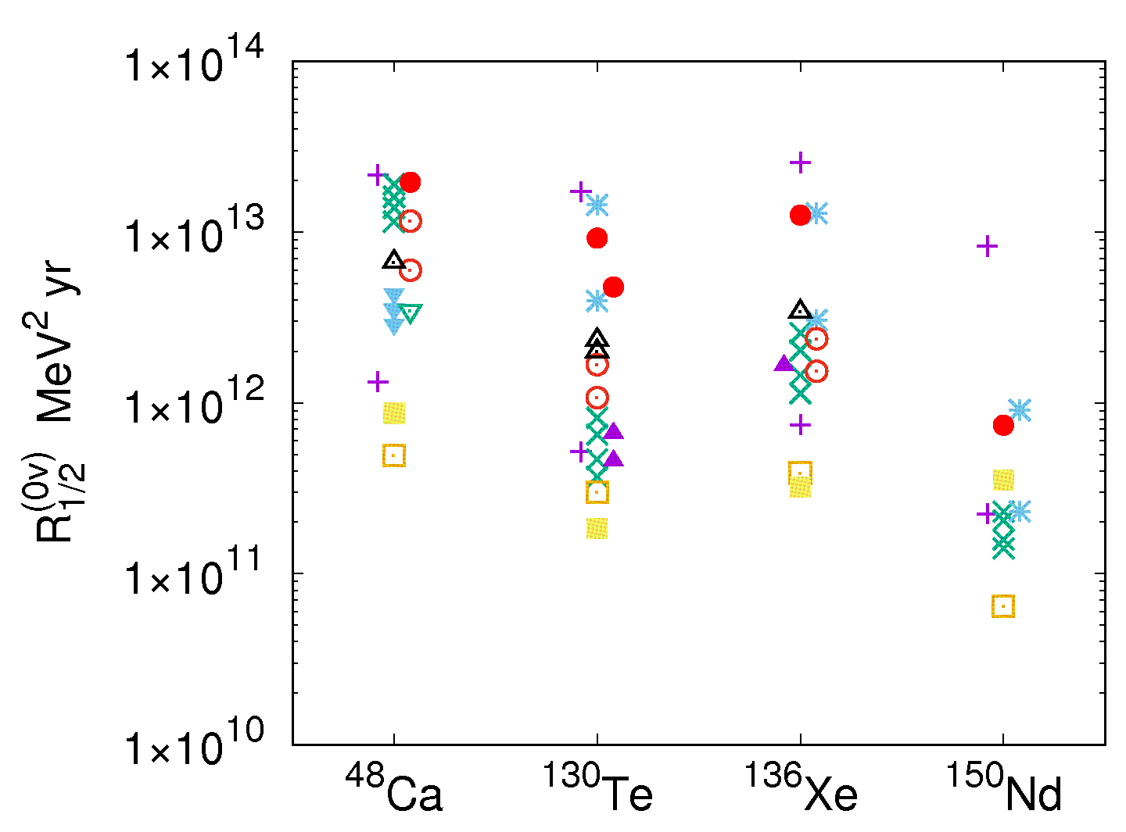
4. Reduced half-life of 0v ββ decay
$$R_{1/2}^{(0ν)}={\left(G_{0ν}^{}g_{A}^{4}\right)}^{−1}$$
$$×{\left|M^{\left(0ν\right)}\right|}^{−2}{(m_{e}c^{2})}^{2}$$
$$Half‐life$$
$$=\frac{R_{1/2}^{(0ν)}}{\text{Effective} ν \text{mass}\text{2} }$$

Slide 17
5. Summary
Our QRPA approach to the ββ decays of ¹³⁶Xe → ¹³⁶Ba has passed seven tests very well. Our approach for ¹³⁰Te → ¹³⁰Xe is not as good as the former.
Our reduced half-lives are higher than the majority of other calculations. However, our value for ¹³⁶Xe → ¹³⁶Ba cannot be ignored.

Slide 19
Supplement

Slide 20
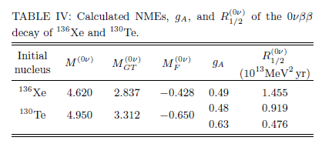

Slide 21
The overlap of QRPA states
The QRPA ground state $|0_{QRPA,i}^{+}〉$ is defined as the vacuum of the QRPA quasiboson :
$$O_{b}^{i}|0_{QRPA,i}^{+}〉=0$$
$O_{b}^{i}$ : annihilation operator of QRPA state $b$
$$|0_{QRPA,i}^{+}〉=\prod_{Kπ}{\frac{1}{𝒩_{QRPA,i}^{Kπ}}exp[v_{i}^{(Kπ)}]{|0}_{HFB,i}^{+}〉},$$
$$v_{i}^{(Kπ)}≅\sum_{μνμ^{′}ν^{′}}{\frac{1}{1+δ_{K0}}{\left(Y_{}^{i,Kπ}\frac{1}{X_{}^{i,Kπ}}\right)}_{ μν{,μ}^{′}ν^{′}}^{†}}a_{μ}^{i†}a_{ν}^{i†}a_{μ^{′}}^{i†}a_{ν^{′}}^{i†}$$
$$O_{b}^{i†}=\sum_{μνμ^{′}ν^{′}}{\left(X_{μν,b}^{i,Kπ}a_{μ}^{i†}a_{ν}^{i†}−Y_{−μ−ν,b}^{i,Kπ}a_{−ν}^{i}a_{−μ}^{i}\right)},$$
$$a_{μ}^{i}|0_{HFB,i}^{+}〉=0.$$
The overlap $〈b_{f} | b_{i}〉=〈0_{QRPA,f}^{+}|O_{b}^{f}O_{b}^{i†}|0_{QRPA,i}^{+}〉$ is calculated using that definition of the QRPA ground state.
Cf. R. Balian and E. Brezin, Nuovo Cimento 64 (1969) 37

Slide 22
Calculations of the overlap using expansion
$$〈b_{f}^{} | b_{i}^{}〉=\frac{1}{{𝒩_{f}^{}𝒩}_{i}^{}}\prod_{K_{1}π_{1}}{〈0_{HFB,f}^{+}|exp⁡[v_{f}^{(K_{1}π_{1})†}]} O_{b}^{f}O_{b}^{i†}×\exp{[v_{i}^{\left(K_{1}π_{1}\right)}]}|0_{HFB,i}^{+}〉≅\frac{1}{{𝒩_{f}^{}𝒩}_{i}^{}}\left\{〈0_{HFB,f}^{+}|O_{b}^{f}O_{b}^{i†}|0_{HFB,i}^{†}〉+\sum_{K_{1}π_{1}}{\left(〈0_{HFB,f}^{+}|v_{f}^{\left(K_{1}π_{1}\right)†}O_{b}^{f}O_{b}^{i†}|0_{HFB,i}^{+}〉+〈0_{HFB,f}^{+}|O_{b}^{f}O_{b}^{i†}v_{i}^{\left(K_{1}π_{1}\right)}|0_{HFB,i}^{+}〉\right)}+\sum_{K_{1}π_{1}}{〈0_{HFB,f}^{+}|v_{f}^{\left(K_{1}π_{1}\right)†}O_{b}^{f}O_{b}^{i†}v_{i}^{\left(K_{1}π_{1}\right)}|0_{HFB,i}^{+}〉}\right\}$$

Slide 23
Nucleus | $\prod_{i,f}{\text{normalization}}$ factors of QRPA ground state
¹⁶⁰Nd→¹⁶⁰Sm | 1.860
¹³⁶Xe→¹³⁶Ba | 1.245
¹³⁰Te→¹³⁰Xe | 1.394
⁴⁸Ca→⁴⁸Ti | 1
The many-body correlations in the QRPA ground states used for the overlap calculations are truncated so as to reproduce experimental ground-state energy – HFB ground-state energy.

Slide 24
Strengths of the pairing interactions in MeVfm³
Mother nucleus | Nn | Pp | Isoscalar
⁴⁸Ca | -224.5 | -258.4 | -180.0
¹³⁰Te | -179.9 | -219.8 | -50.0
¹³⁶Xe | -179.9 | -194.3 | -55.0
¹⁵⁰Nd | -176.4 | -218.5 | -197.4
Skyrme SkM* and contact volume-type pairing interactions are used.
Strength of the isovector pn pairing interaction = average of pp and nn pairing interactions.

Slide 25
Properties of HFB ground states
Nucleus | Δ_{p} (MeV) | Δ_{n} (MeV) | β
¹³⁶Xe | 1.341 | 0 | 0
¹³⁶Ba | 1.641 | 1.158 | 0
¹³⁰Te | 1.442 | 1.359 | 0
¹³⁰Xe | 1.692 | 1.438 | 0.112

Slide 26
Initial nucle-us | $$E_{dK}$$ | $$M^{(2ν)}$$ | $$M_{GT}^{(2ν)}$$ | $$M_{F}^{(2ν)}$$ | $$g_{A}$$ | Half-life (cal) (${10}^{21}$yr) | Half-life (exp) (${10}^{21}$yr)
¹³⁶Xe | $$E_{dK}^{i}$$ | 0.0748 | 0.0673 | -0.00181 | 0.49 | 2.164 | 2.20±0.06
 | $$E_{dK}^{f}$$ | 0.0744 | 0.0666 | -0.00188 | 0.49 | 2.188
¹³⁰Te | $$E_{dK}^{i}$$ | 0.133 | 0.132 | -0.00029 | 0.48 | 0.697 | 0.69±0.13
 | $$E_{dK}^{f}$$ | 0.0864 | 0.0856 | -0.00028 | 0.60 | 0.677
g_{A} is determined so as to reproduce the exp. half-life to 2vββ decay
A.S. Barabash, MEDEX’13.
QRPA is good for ¹³⁶Xe→¹³⁶Ba,
not very good for ¹³⁰Te→¹³⁰Xe.

Slide 27
Mixing of isovector spin-monopole operator
The transition operator is
$$στ+αr^{2}στ.$$
α: phenomenological constant determined so as to reproduce the long low strength distribution in the high-energy region
The excitation by $r^{2}στ$ is called the isovector spin monopole mode.
α = –0.03 fm^{–2}, ⁴⁸Ca→⁴⁸Sc
–0.0253 fm^{–2}, ⁴⁸Ti→⁴⁸Sc

Slide 28
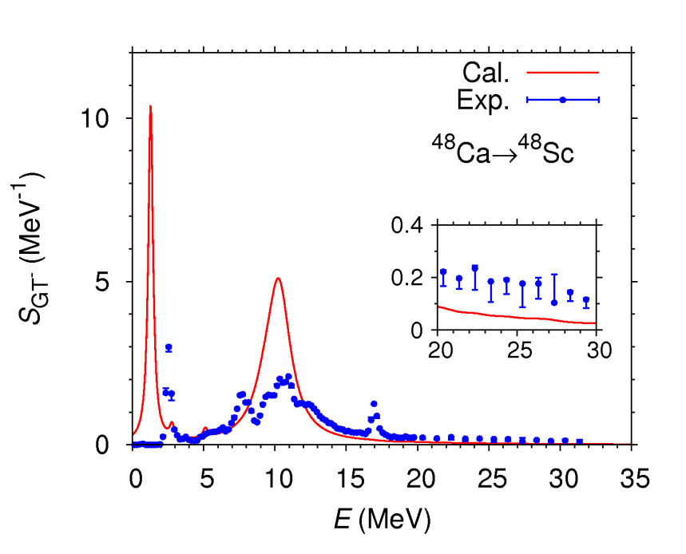
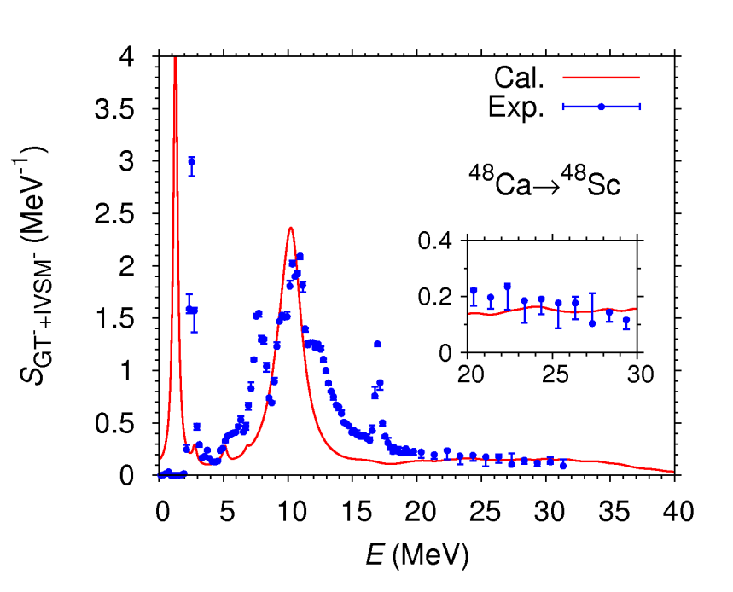
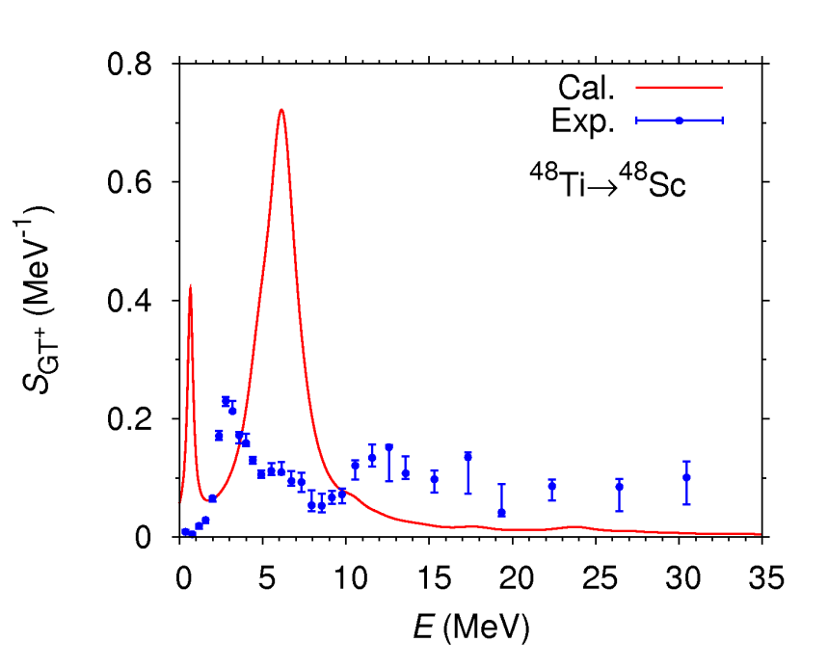
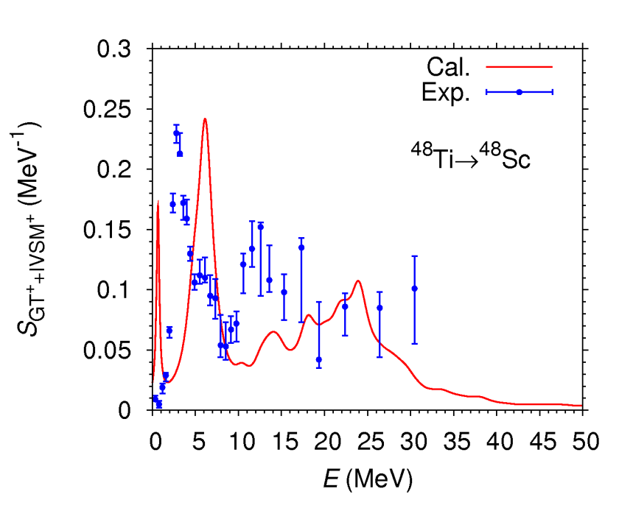
$$στ$$
$$στ+αr^{2}στ$$
4
3
2
1
0
10
5
0
⁴⁸Ca→⁴⁸Sc
⁴⁸Ca→⁴⁸Sc
S_{GT}⁻ (MeV⁻¹)
S_{GT}⁻_{+IVSM}⁻ (MeV⁻¹)
0 5 10 15 20 25 30 35
E (MeV)
0 5 10 15 20 25 30 35 40
E (MeV)
0.8
0.6
0.4
0.2
0
0.3
0.2
0.1
0
⁴⁸Ti→⁴⁸Sc
⁴⁸Ti→⁴⁸Sc
S_{GT}⁺ (MeV⁻¹)
S_{GT}⁺_{+IVSM}⁺ (MeV⁻¹)
0 5 10 15 20 25 30 35
E (MeV)
0 10 20 30 40 50
E (MeV)

Slide 29
Mechanism of improvement
Operator $r2$ has two components: 0ħω jump and 2ħω jump.
The 0ħω-jump component can be represented by
${{\text{〈}r}^{2}〉}_{s.p.}$: expectation value of $r2$ with the wave function of the
single-particle involved in the charge change
$στ+αr^{2}στ=στ+α{{\text{〈}r}^{2}〉}_{s.p.}στ$+ $α(r^{2}−{{\text{〈}r}^{2}〉}_{s.p.})στ$
0ħω jump
2ħω jump
The low-energy part
of the strength function
The high-energy part
of the strength function
α<0

Slide 30
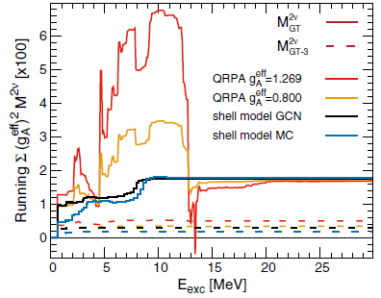
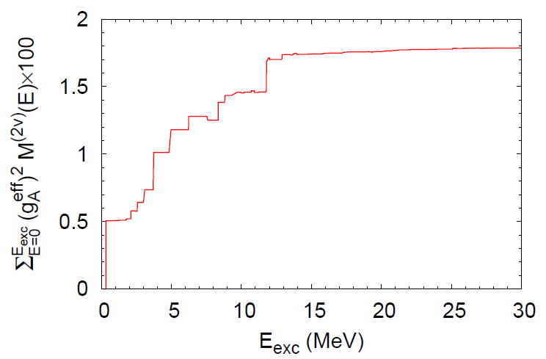
Our calculation―QRPA
A. Gando et al., PRL 122, 192501 (2019)

