Slide 1
Ab Initio Theory for Electroweak Properties of Nuclei
Jason D. Holt
with
Ragnar Stroberg
Takayuki Miyagi
Antoine Belley (undergrad)
MEDEX 2019, May 30, 2019
Notes:
`

Slide 2
Ab Initio Theory for Electroweak Properties of Nuclei
(ie, g_{A} quenching and double-beta decay)
Jason D. Holt
with
Ragnar Stroberg
Takayuki Miyagi
Antoine Belley (undergrad)
MEDEX 2019, May 30, 2019
Notes:
`

Slide 3
Results*
* from MEDEX17

Slide 4
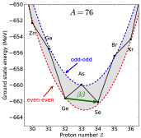
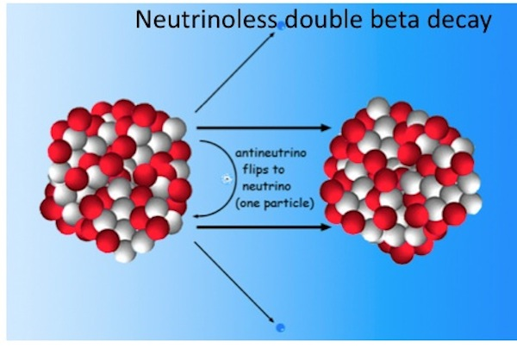
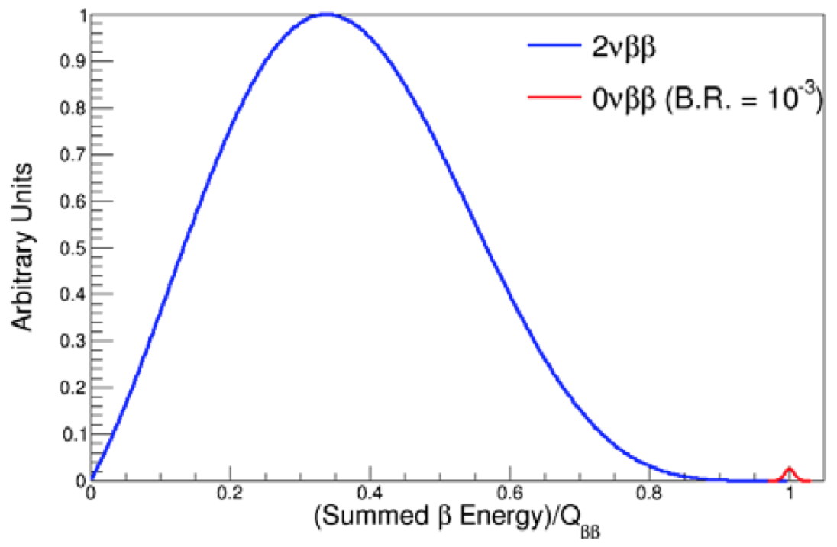
The Next Big Discovery: 0νββ-decay?
Neutrino own antiparticle 0νββ decay
Tremendous impact on BSM physics:
Lepton-number violating process
Majorana character of neutrino
Absolute neutrino mass scale

Slide 5
The Next Big Discovery: 0νββ-decay?
Neutrino own antiparticle 0νββ decay
Tremendous impact on BSM physics:
Lepton-number violating process
Majorana character of neutrino
Absolute neutrino mass scale

Slide 6
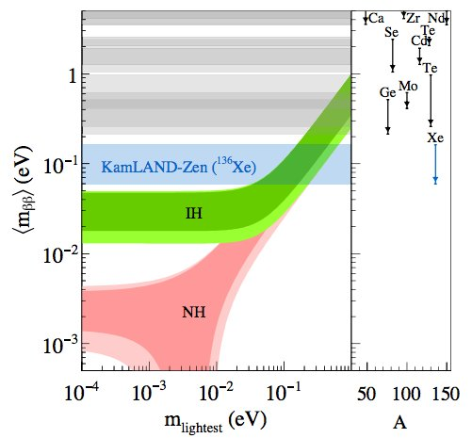
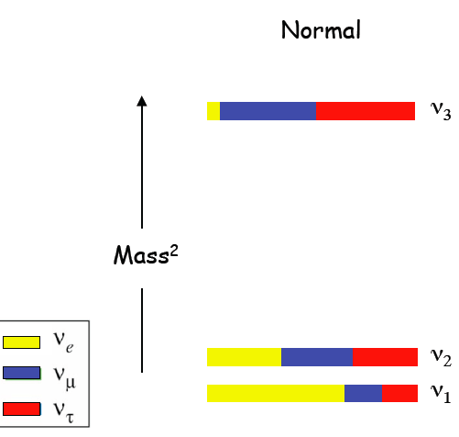
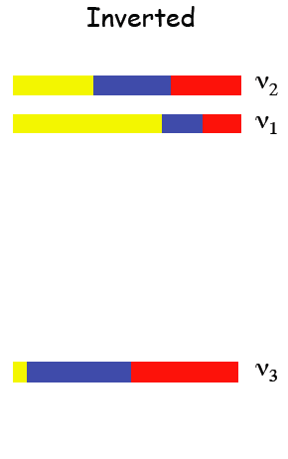
The Next Big Discovery: 0νββ-decay?
Progress in large-scale searches pushing towards IH
Cosmology
Essential ingredient:
Nuclear matrix element

Slide 7
The Next Big Discovery: 0νββ-decay?
Progress in large-scale searches pushing towards IH
Uncertainty from Nuclear Matrix Element; bands do not represent rigorous uncertainties
Cosmology
Essential ingredient:
Nuclear matrix element

Slide 8
0νββ-Decay Nuclear Matrix Element Status
All calculations to date from extrapolated phenomenological models; large spread in results
All models missing essential physics
Impossible to assign rigorous uncertainties
Engel, Menendez (2016)

Slide 9
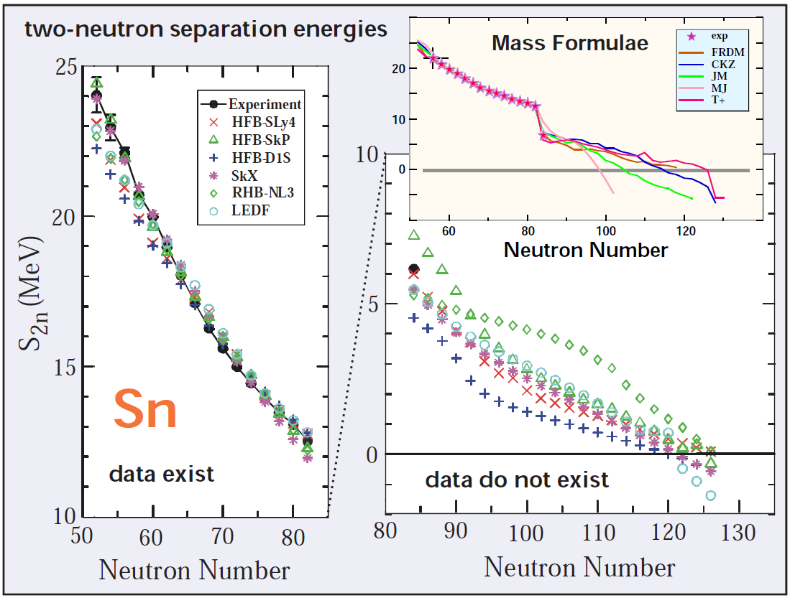
Predictions with Models
How well can nuclear models motivate experiments, predict beyond data?
Work well where informed
by data

Slide 10
Predictions with Models
How well can nuclear models motivate experiments, predict beyond data?
Double-beta decay matrix elements
Models can extrapolate unreliably
Spread in results ≠ meaningful uncertainty

Slide 11
Predictions with Models
How well can nuclear models motivate experiments, predict beyond data?
Analogous picture in 0νββ decay
Double-beta decay matrix elements
Models can extrapolate unreliably
Spread in results ≠ meaningful uncertainty
Engel, Menendez

Slide 12
0νββ-Decay Nuclear Matrix Element Status
All calculations to date from extrapolated phenomenological models; large spread in results
All models missing essential physics
Impossible to assign rigorous uncertainties Rethink approach to nuclear structure!
Engel, Menendez (2016)

Slide 13
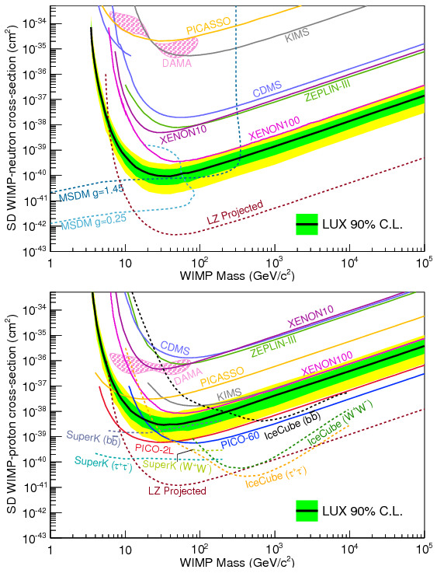
Next Big Discovery: Nature of Dark Matter?
Exclusion plots for WIMP-nucleon total cross section (spin-dependent)
Differential cross section: compare results from different target nuclei
Structure functions required from nuclear theory

Slide 14
Ab Initio Theory
Aim of modern nuclear theory: Develop unified first-principles picture of structure and reactions

Slide 15
Ab Initio Approach: Interactions
Aim of modern nuclear theory: Develop unified first-principles picture of structure and reactions
- Nuclear forces (low-energy QCD)
- Electroweak physics

Slide 16
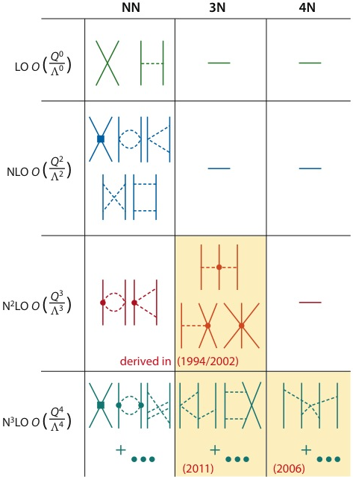
Ab Initio Approach: Interactions
Aim of modern nuclear theory: Develop unified first-principles picture of structure and reactions
- Nuclear forces (low-energy QCD)
- Electroweak physics
Chiral effective field theory: systematic expansion of nuclear interactions
Consistent NN, 3N, 4N… forces, electroweak currents
Quantifiable uncertainties possible

Slide 17
Ab Initio Approach: Many-Body Methods
Aim of modern nuclear theory: Develop unified first-principles picture of structure and reactions
- Nuclear forces, electroweak physics
- Nuclear many-body problem

Slide 18
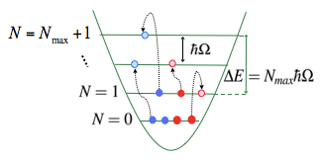
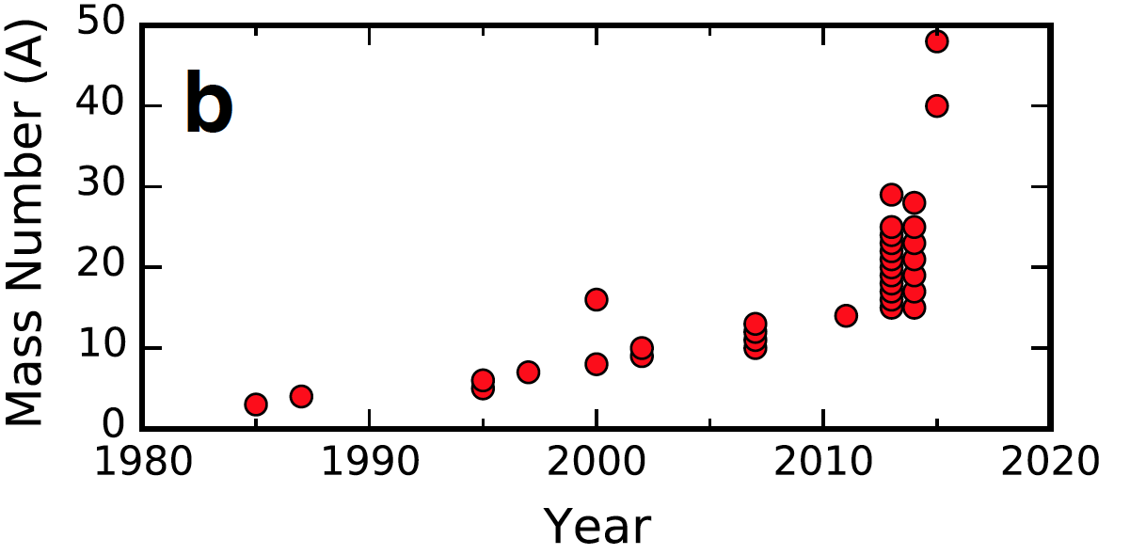

Chronological Reach of Ab Initio Many-Body Methods
Moore’s law: exponential growth in computing power
Methods for light nuclei (QMC, NCSM) scale exponentially with mass

Slide 19
Chronological Reach of Ab Initio Many-Body Methods
Moore’s law: exponential growth in computing power
Methods for light nuclei (QMC, NCSM) scale exponentially with mass
Mid 2000’s polynomial scaling methods developed (coupled cluster, in-medium SRG,…)
Explosion in reach of ab initio theory

Slide 20
Chronological Reach of Ab Initio Many-Body Methods
Moore’s law: exponential growth in computing power 2019: A>100
Methods for light nuclei (QMC, NCSM) scale exponentially with mass
Mid 2000’s polynomial scaling methods developed (coupled cluster, in-medium SRG,…)
Explosion in reach of ab initio theory

Slide 21
Breadth of Ab Initio Many-Body Methods
Aim of modern nuclear theory: Develop unified first-principles picture of structure and reactions
- Nuclear forces, electroweak physics
- Nuclear many-body problem
10-15 years ago
8-10 years ago
3-5 years ago

Slide 22
Breadth of Ab Initio Many-Body Methods
Aim of modern nuclear theory: Develop unified first-principles picture of structure and reactions
- Nuclear forces, electroweak physics
- Nuclear many-body problem
10-15 years ago
8-10 years ago
3-5 years ago
sdg?
pf?
0νββ-decay candidates
open-shell, medium/heavy-mass, deformed
⁴⁸Ca, ⁷⁶Ge, ⁸²Se, ¹³⁰Te, ¹³⁶Xe within reach
sd?

Slide 23
Valence-Space In-Medium SRG
Explicitly construct unitary transformation from sequence of rotations
All operators truncated at two-body level IMSRG(2)
IMSRG(3) in progress
Tsukiyama, Bogner, Schwenk, PRC 2012
Morris, Parzuchowski, Bogner, PRC 2015
Step 1: Decouple core
Can we achieve accuracy
of large-space methods?

Slide 24
Valence-Space In-Medium SRG
Explicitly construct unitary transformation from sequence of rotations
All operators truncated at two-body level IMSRG(2)
IMSRG(3) in progress
Tsukiyama, Bogner, Schwenk, PRC 2012
Morris, Parzuchowski, Bogner, PRC 2015
Step 1: Decouple core
Step 2: Decouple valence space
Can we achieve accuracy
of large-space methods?

Slide 25
Effective Valence-Space In-Medium SRG Operators
Explicitly construct unitary transformation from sequence of rotations
Step 1: Decouple core
Step 2: Decouple valence space
Step 3: Decouple additional operators
Careful benchmarking essential

Slide 26
Valence-Space IMSRG: From Oxygen to Nickel
New approach accesses *all* nuclei: agrees to 1% with large-space methods
Agreement with experiment deteriorates for heavy chains (due to input Hamiltonian)
Significant gain in applicability with little/no sacrifice in accuracy
Low computational cost: ~1 node-day/nucleus
Stroberg et al., PRL (2017)

Slide 27
Connection to Infinite Matter: Saturation as a Guide for Nuclei
NN+3N force with good reproduction of ground-state energies (but poor radii)
1.8/2.0 (EM) reproduces ground-state energies through ⁷⁸Ni
Slight underbinding for neutron-rich oxygen
From G. Hagen
Simonis et al., PRC (2017)

Slide 28
Forces with good saturation
Isotopic chains: dramatic improvement with respect to experimental data
Opens possibility for reliable ab initio predictions across the nuclear chart!
Accesses all properties of all nuclei:
- Ground states, excited states, radii, electroweak transitions…

Slide 29
Breadth of Ab Initio Many-Body Methods
Aim of modern nuclear theory: Develop unified first-principles picture of structure and reactions
- Nuclear forces, electroweak physics
- Nuclear many-body problem
10-15 years ago
8-10 years ago
3-5 years ago
Today
sdg
pf
0νββ-decay candidates
open-shell, medium/heavy-mass, deformed
⁴⁸Ca, ⁷⁶Ge, ⁸²Se, ¹³⁰Te, ¹³⁶Xe within reach
sd
Extends range to all nuclei to global scale: N,Z≈50

Slide 30
Global Ab Initio Calculations
Effectively takes ab initio calculations to a global scale – up to N,Z~50
B-W Mass formula: 3.1MeV Z<28
3.5MeV Z<20
DFT: 0.6-2.0 MeV
rms deviation at level of BW Mass formula (EDF models; UNEDF1 rms=1.8MeV)
Input Hamiltonians fit to A=2,3,4 – not biased towards known data
How does deviation from experiment look for separation energies (relevant for drip lines)?

Slide 31
Global Ab Initio Calculations
All corrected distributions approximately Gaussian centered at 0
Certain residuals correlated – must correct for this in probabilities
Assume unmeasured nuclei also follow this distribution
JDH, Stroberg, Schwenk, Simonis,
arXiv:1905.10475

Slide 32
Estimating Dripline Uncertainties
Determine rms deviation from experiment – extrapolate this uncertainty beyond data
Determine range of likely separation energies reaching 0
Assign probability that a particular nucleus is bound
JDH, Stroberg, Schwenk, Simonis,
arXiv:1905.10475

Slide 33
Estimating Dripline Uncertainties
First predictions of proton and neutron driplines from first principles
Known drip lines largely predicted within uncertainties (issues remain at shell closures)
Provide ab initio predictions for neutron-rich region
JDH, Stroberg, Schwenk, Simonis,
arXiv:1905.10475

Slide 34
0νββ-decay
Aim of modern nuclear theory: Develop unified first-principles picture of structure and reactions
- Nuclear forces (low-energy QCD)
- Electroweak physics
- Nuclear many-body problem
0νββ-decay candidates
open-shell, medium/heavy-mass, deformed
⁴⁸Ca, ⁷⁶Ge, ⁸²Se; ¹³⁰Te, ¹³⁶Xe within reach

Slide 35
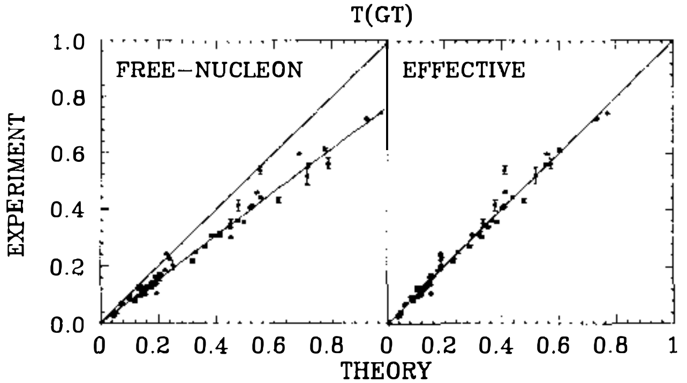
Beta-decay puzzle: “Quenching” of g_{A}
“Long-standing problem”¹ in weak decays: experimental values systematically smaller than theory
Large M_{GT}
in sd-shell
Brown, Wildenthal (1985)
¹ papers from the 1970’s

Slide 36
Beta-decay puzzle: “Quenching” of g_{A}
Long-standing problem in weak decays: experimental values systematically smaller than theory
Using agrees with data
Should g_{A} be quenched in medium?
Large M_{GT}
in sd-shell
Brown, Wildenthal (1985)

Slide 37
Beta-decay puzzle: “Quenching” of g_{A}
Long-standing problem in weak decays: experimental values systematically smaller than theory
Using agrees with data
OTHER STUFF
Should g_{A} be quenched in medium
What about all the other stuff?
Large M_{GT}
in sd-shell
Brown, Wildenthal (1985)

Slide 38
Beta-decay puzzle: “Quenching” of g_{A}
Long-standing problem in weak decays: experimental values systematically smaller than theory
Using agrees with data
Should g_{A} be quenched in medium?
Missing wavefunction correlations
Large M_{GT}
in sd-shell
Brown, Wildenthal (1985)

Slide 39
Beta-decay puzzle: “Quenching” of g_{A}
Long-standing problem in weak decays: experimental values systematically smaller than theory
Using agrees with data
O_{eff}
Should g_{A} be quenched in medium?
Missing wavefunction correlations
Renormalized VS operator?
Large M_{GT}
in sd-shell
Brown, Wildenthal (1985)

Slide 40
Beta-decay puzzle: “Quenching” of g_{A}
Long-standing problem in weak decays: experimental values systematically smaller than theory
Using agrees with data
Should g_{A} be quenched in medium?
Missing wavefunction correlations
Renormalized VS operator?
Neglected two-body currents?
Large M_{GT}
in sd-shell
Brown, Wildenthal (1985)

Slide 41
Beta-decay puzzle: “Quenching” of g_{A}
Long-standing problem in weak decays: experimental values systematically smaller than theory
Using agrees with data
Should g_{A} be quenched in medium?
Missing wavefunction correlations
Renormalized VS operator?
Neglected two-body currents?
Model-space truncations?
Explore in ab initio framework
Large M_{GT}
in sd-shell
Brown, Wildenthal (1985)

Slide 42
Large Ab Initio Effort to Calculate GT Transitions
Calculate large GT matrix elements
Light, medium, and heavy regions
Benchmark different ab initio methods
Wide range of NN+3N forces
Consistent inclusion of 2BC

Slide 43
Large Ab Initio Effort to Calculate GT Transitions
Calculate large GT matrix elements
Light, medium, and heavy regions
Benchmark different ab initio methods
Wide range of NN+3N forces
Consistent inclusion of 2BC
Coupled Cluster
VS-IMSRG
No-Core Shell Model

Slide 44
GT Transition in light and heavy nuclei
NCSM in light nuclei, CC calculations of GT transition in ¹⁰⁰Sn from different forces
Large quenching effect from correlations
Gysbers et al., Nature Phys. (2019)

Slide 45
GT Transition in light and heavy nuclei
NCSM in light nuclei, CC calculations of GT transition in ¹⁰⁰Sn from different forces
Large quenching effect from correlations
Addition of 2BC further quenches and reduces spread in results
Gysbers et al., Nature Phys. (2019)

Slide 46
GT Transition in light and heavy nuclei
NCSM in light nuclei, CC calculations of GT transition in ¹⁰⁰Sn from different forces
Large quenching effect from correlations
Addition of 2BC further quenches and reduces spread in results
Gysbers et al., Nature Phys. (2019)

Slide 47
VS-IMSRG Benchmarks
Convergence and method benchmarks of VS-IMSRG GT transitions
Well converged and good agreement with other ab initio methods

Slide 48
Ab Initio GT Decays in Medium-Mass Region
Ab initio calculations of large GT transitions in sd, pf shells
Bare operator similar to phenomenological shell model
Modest quenching from consistent ab initio wavefunctions and operators
Further modest quenching from 2BC
Gysbers et al., Nature Phys. (2019)

Slide 49
Ab Initio GT Decays in Medium-Mass Region
Comparison to standard phenomenological shell model
Ab initio calculations across the chart explain data with free-space g_{A}
Refine results with improvements in forces and many-body methods
Gysbers et al., Nature Phys. (2019)

Slide 50
Role of Correlations vs Currents
¹⁰⁰Sn examine the relative importance of correlations vs. two-body currents
Harder interactions more impact from correlations, less from currents
“Importance” is a scale/scheme-dependent notion

Slide 51
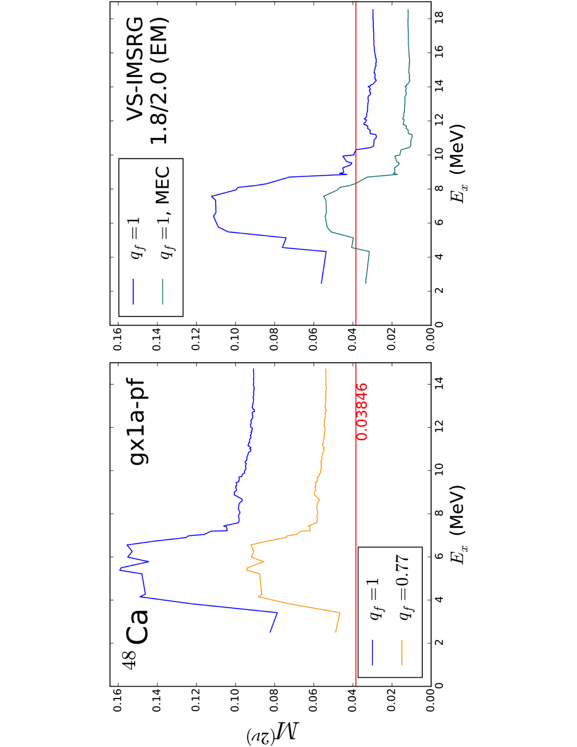
Ab Initio 2νββ-decay
Consistent many-body wfs/operators from chiral NN+3N forces (with 2b currents)
VS-IMSRG: decrease in final matrix element
Potential issues: valence-space limitations for 1+ states or missing correlations
Payne, Stroberg, JDH, et al., in prep

Slide 52
Gamow-Teller Strengths for A=48
Running GT strengths for ⁴⁸Ca(p,n)⁴⁸Sc and ⁴⁸Ti(n,p)⁴⁸Sc
Significant improvement with effects of 2BC – good agreement with experiment

Slide 53
Ab Initio 2νββ-decay: Role of Correlations?
Role of correlations addressed in CC theory
Including triples perturbatively increases value of NME
IMSRG(2) results similar to CCSD results – missing many-body correlations

Slide 54
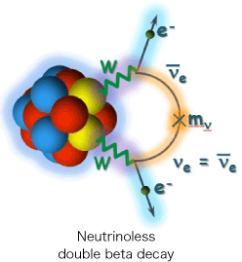
Ab Initio 0νββ-decay
Consistent many-body wfs/operators from chiral NN+3N forces (no 2b currents)
CC: Factor of 2 larger! Benchmarks underway to understand…

Slide 55
Ab Initio 0νββ-decay
Consistent many-body wfs/operators from chiral NN+3N forces (no 2b currents)
General cancellation between Fermi and Tensor contributions

Slide 56
Ab Initio 0νββ-decay
Consistent many-body wfs/operators from chiral NN+3N forces (no 2b currents)
General cancellation between Fermi and Tensor contributions

Slide 57
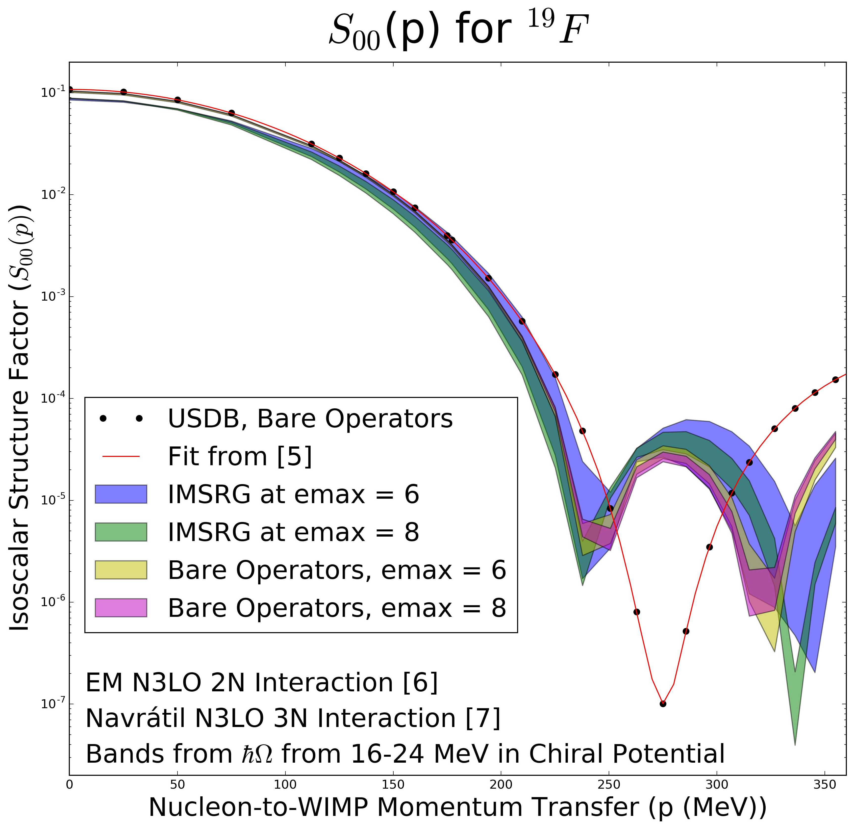
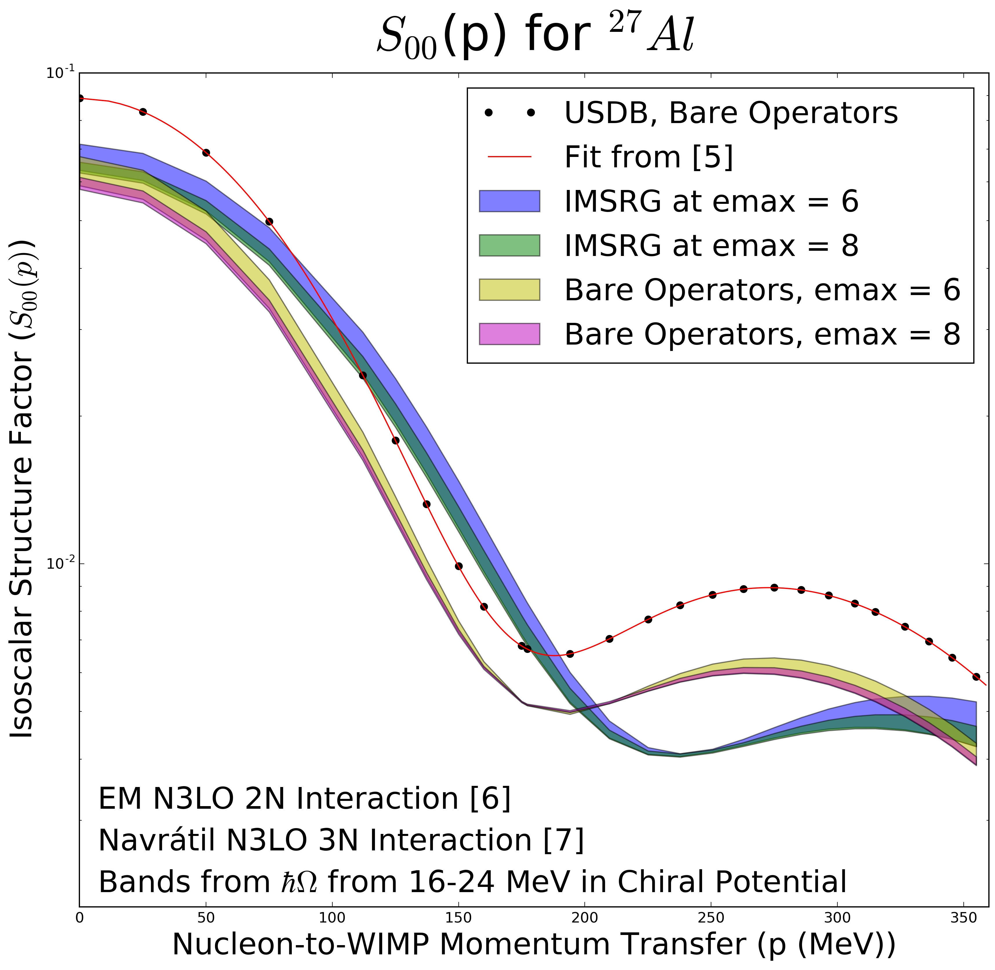
Ab Initio WIMP-Nucleus Response Functions (Isoscalar)
Ab initio: Consistent many-body wfs/operators from chiral NN+3N forces + 2b currents
Leutheusser, Stroberg, Holt

Slide 58







Outlook
Fundamental physics
Effective electroweak operators: M1, GT,…
Effective 0νββ decay operator
WIMP-Nucleus scattering
Superallowed Fermi transitions
Muon capture
Ab initio valence-shell Hamiltonians
First ab initio prediction of nuclear driplines
Multi-shell spaces: Island of inversion/forbidden decays
Outstanding issues
Controlled IMSRG(3) approximation
E2 operators/collectivity problematic
Understand discrepancies with CC
Quantify uncertainties
S. R. Stroberg
T. Miyagi
A. Belley
C. Payne
S. Leutheusser
P. Navrátil
J. Engel
H. Hergert
S. Bogner
J. Simonis
A. Schwenk
T. Morris
G. Hagen, T. Papenbrock
J. Menéndez

Slide 59
Structure of Lightest Tin Isotopes
Extend ab initio to heavy-mass region: magicity of ¹⁰⁰Sn, controversial level ordering in ¹⁰¹Sn
Predicts doubly magic nature from
2⁺ energies and B(E2) systematics Both calculations predict 5/2+ ground state
Morris et al., PRL (2018)

Slide 60
GT Transition in light and heavy nuclei
NCSM in light nuclei, CC calculations of GT transition in ¹⁰⁰Sn from different forces
Large quenching effect from correlations
Addition of 2BC further quenches and reduces spread in results
Gysbers et al., Nature Phys. (2019)

Slide 61
GT Transition in light and heavy nuclei
NCSM in light nuclei, CC calculations of GT transition in ¹⁰⁰Sn from different forces
Large quenching effect from correlations
Addition of 2BC further quenches and reduces spread in results
Gysbers et al., Nature Phys. (2019)

Slide 62
Ab Initio GT Decays in Medium-Mass Region
Ab initio calculations of large GT transitions in sd, pf shells
Bare operator similar to phenomenological shell model
Modest quenching from consistent ab initio wavefunctions and operators
Further modest quenching from 2BC
Gysbers et al., submitted
Gysbers et al., Nature Phys. (2019)

Slide 63
Ab Initio GT Decays in Medium-Mass Region
Comparison to standard phenomenological shell model
Ab initio calculations across the chart explain data with free-space g_{A}
Refine results with improvements in forces and many-body methods
Gysbers et al., Nature Phys. (2019)

Slide 64
Global Ab Initio Calculations
Potential errors at shell closures from changing valence spaces
Differentiate between “closure” and “no closure” cases
Distributions approximately Gaussian
Non closed shells approximately centered at 0; rms approximately 1MeV
JDH, Stroberg, Schwenk in prep

Slide 65
Distribution of Separation Energies
Defect 2: Incomplete infrared convergence near threshold – clear trend in residuals
Separate trends for VS change and no change
Correct VS-IMSRG results with linear fit of residuals
JDH, Stroberg, Schwenk in prep

Slide 66
Global Ab Initio Calculations
All corrected distributions approximately Gaussian centered at 0
JDH, Stroberg, Schwenk in prep

Slide 67
Ab Initio 0νββ-Decay Predictions from Valence-Space IMSRG
Conventional SM: phenomenological wavefunctions
Ab initio SM: wavefunctions from chiral NN+3N forces
Ab initio energies in medium/heavy-mass region
  Valence-space IM-SRG for all medium-mass nuclei
  Deformation challenging for large-space methods

Slide 68
Ab Initio 0νββ-Decay Predictions from Valence-Space IMSRG
Conventional SM: phenomenological wavefunctions
Ab initio SM: wavefunctions from chiral NN+3N forces
Ab initio energies in medium/heavy-mass region
  Valence-space IM-SRG for all medium-mass nuclei
  Deformation challenging for large-space methods
  First ab initio calculation of ⁷⁶Ge/⁷⁶Se
✓

Slide 69
Towards big questions: WIMP-Nucleus Scattering
Aim of modern nuclear theory: Develop unified first-principles picture of structure and reactions
- Nuclear forces (low-energy QCD)
- Electroweak physics
- Nuclear many-body problem
WIMP-nucleus direct detection candidates
open-shell, medium/heavy-mass, deformed
¹⁹F,²³Na,²⁷Al,²⁹Si,⁷³Ge; ¹²⁷I,^{129,131}Xe within reach

Slide 70
Comparison with DFT Dripline Predictions
Recent DFT analysis from Si-Ti based on Bayesian machine learning
Largely consistent prediction of drip line

Slide 71
Shell Closures in Neutron-Rich Ni
Clear artifacts when changing valence spaces
fp-shell
sdg-shell
sdg-shell
fp-shell

Slide 72
Shell Closures in Neutron-Rich Ni
Clear artifacts when changing valence spaces: can we decouple a cross-shell space?
fp-shell
sdg-shell
sdg-shell
fp-shell

Slide 73
Exploring Cross-Shell Valence Spaces
First try: extend pf to include g9/2, etc
IMSRG fails to decouple such valence spaces
50
50
0g_{9/2}
0g_{9/2}
0f_{5/2}
0f_{5/2}
1p_{1/2}
1p_{1/2}
28
1p_{3/2}
28
1p_{3/2}
0f_{7/2}
0f_{7/2}
20
20
0d_{3/2}
0d_{3/2}
1s_{1/2}
1s_{1/2}
0d_{5/2}
0d_{5/2}

Slide 74
Exploring Cross-Shell Valence Spaces
Next try: extend to include g9/2, but exclude f7/2
50
50
50
0g_{9/2}
0g_{9/2}
0g_{9/2}
0f_{5/2}
0f_{5/2}
0f_{5/2}
1p_{1/2}
1p_{1/2}
1p_{1/2}
28
1p_{3/2}
28
1p_{3/2}
1p_{3/2}
0f_{7/2}
0f_{7/2}
0f_{7/2}
20
20
20
0d_{3/2}
0d_{3/2}
0d_{3/2}
1s_{1/2}
1s_{1/2}
1s_{1/2}
0d_{5/2}
0d_{5/2}
0d_{5/2}

Slide 75
Exploring Cross-Shell Valence Spaces
Next try: extend to include g9/2, but exclude f7/2
IMSRG successfully decouples (usually) such valence spaces!
50
50
50
0g_{9/2}
0g_{9/2}
0g_{9/2}
0f_{5/2}
0f_{5/2}
0f_{5/2}
1p_{1/2}
1p_{1/2}
1p_{1/2}
28
1p_{3/2}
28
1p_{3/2}
1p_{3/2}
0f_{7/2}
0f_{7/2}
0f_{7/2}
20
20
20
0d_{3/2}
0d_{3/2}
0d_{3/2}
1s_{1/2}
1s_{1/2}
1s_{1/2}
0d_{5/2}
0d_{5/2}
0d_{5/2}

Slide 76
Shell Closures in Neutron-Rich Ni
Clear artifacts when changing valence spaces
fp-shell
sdg-shell
sdg-shell
fp-shell

Slide 77
Shell Closures in Neutron-Rich Ni
Cross-shell valence space interpolates smoothly through pf/sdg spaces
fp-shell
sdg-shell
pf₅g₉-shell
sdg-shell
fp-shell
pf₅g₉-shell

Slide 78
Towards Multi-Shell Hamiltonians

Slide 80
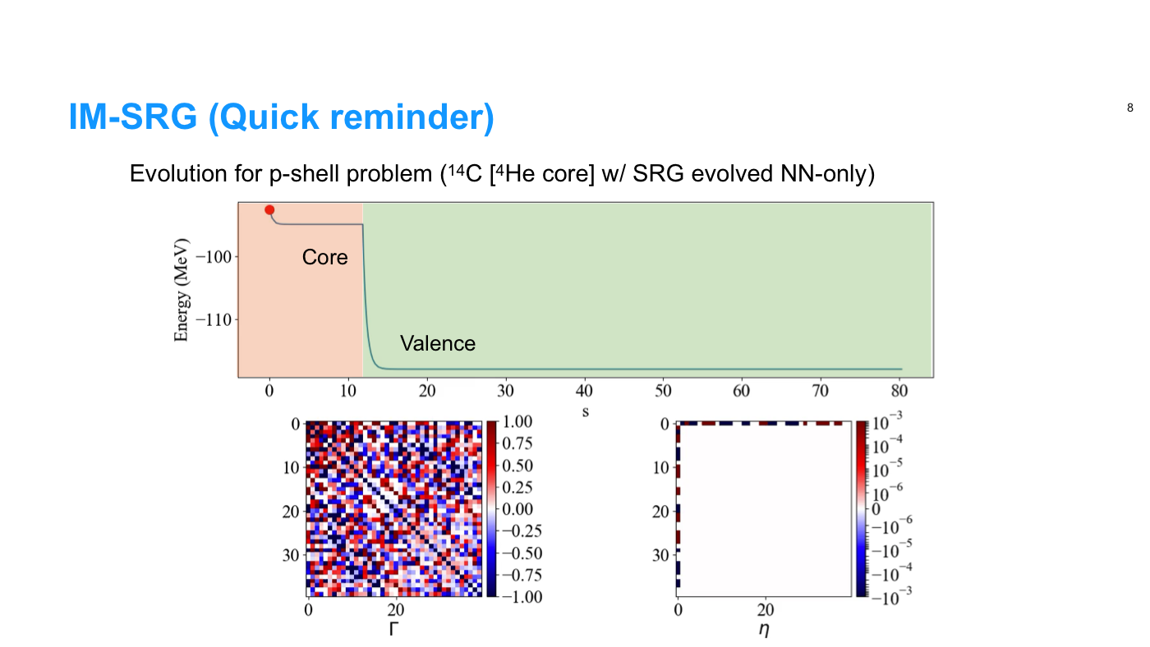

Slide 81
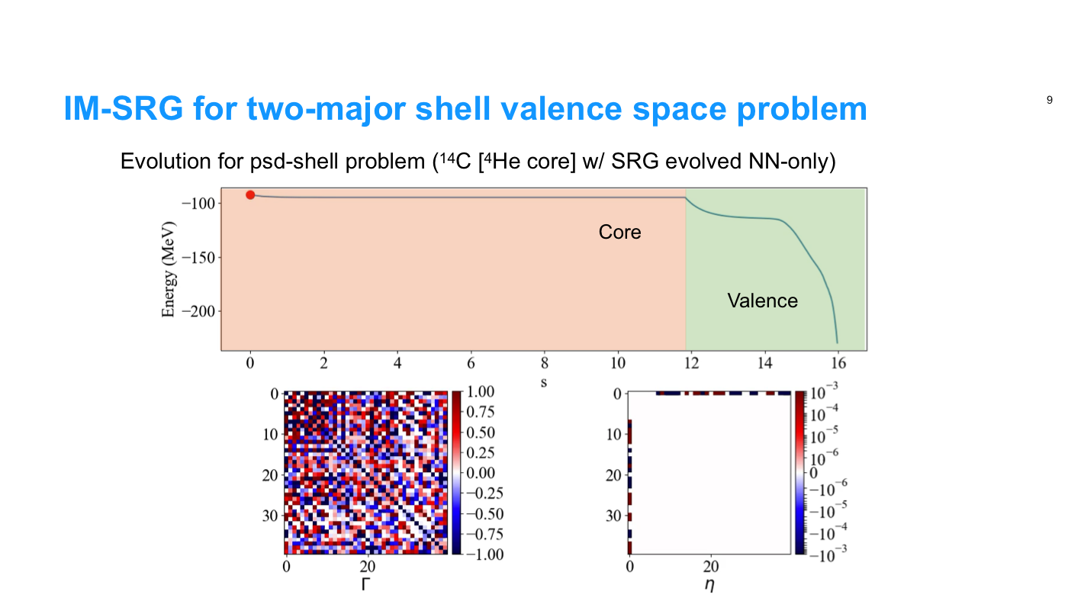

Slide 82
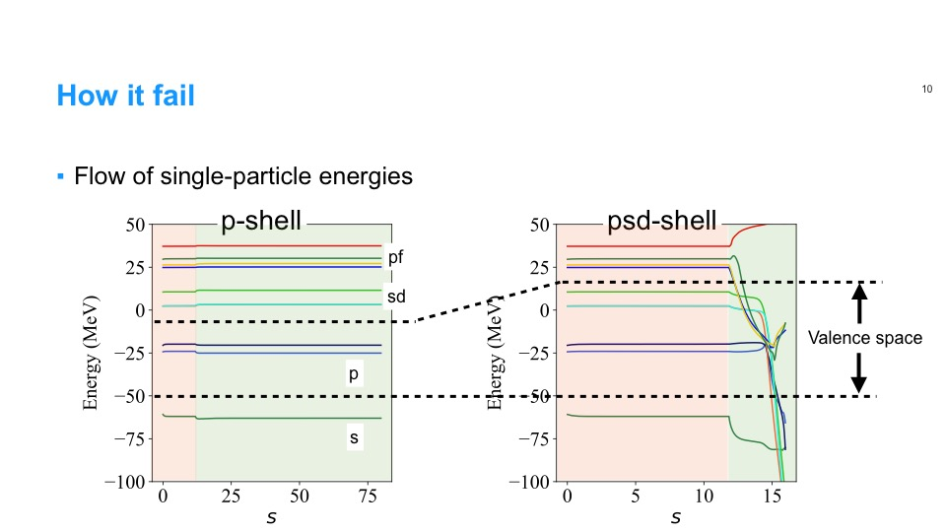

Slide 83
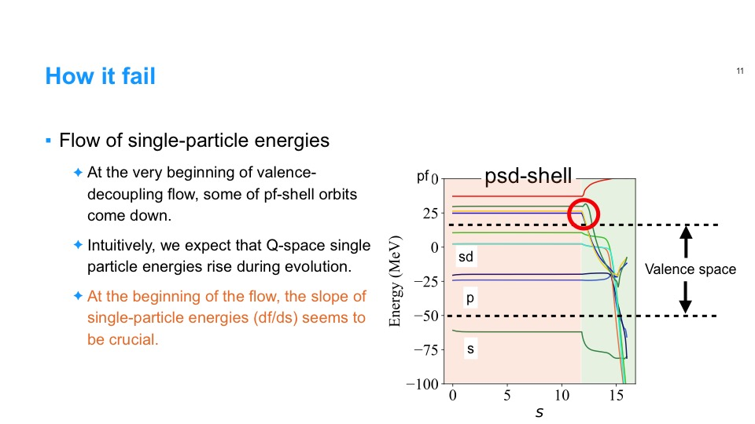

Slide 86
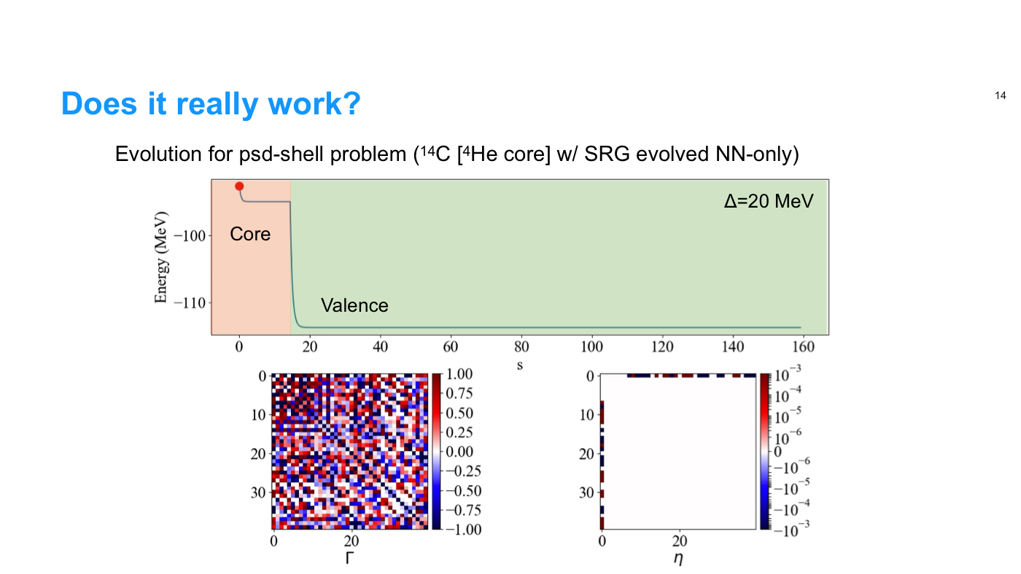

Slide 87
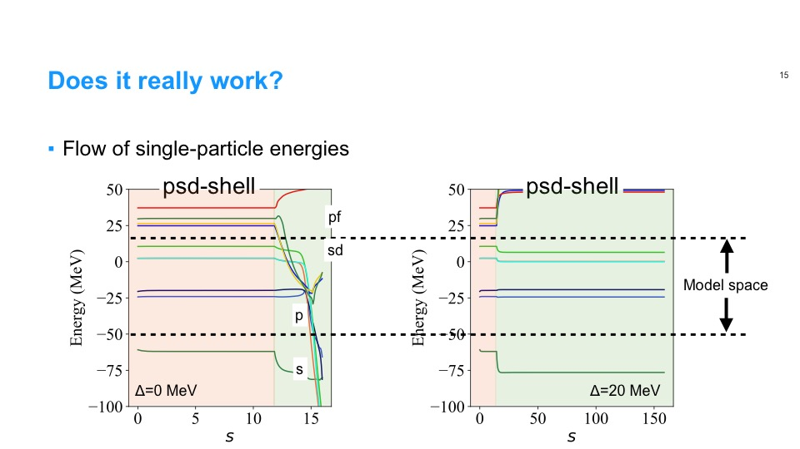

Slide 88
Miyagi, JDH, Stroberg in prep

Slide 89
Miyagi, JDH, Stroberg in prep

Slide 90
Miyagi, JDH, Stroberg in prep

Slide 91
Miyagi, JDH, Stroberg in prep

Slide 92
The Next Big Discovery: 0νββ-decay?
Neutrino own antiparticle 0νββ decay
Tremendous impact on BSM physics:
Lepton-number violating process
Majorana character of neutrino
Absolute neutrino mass scale

Slide 93
The Next Big Discovery: 0νββ-decay?
Progress in large-scale searches pushing towards IH
Uncertainty from Nuclear Matrix Element; bands do not represent rigorous uncertainties
Essential ingredient:
Nuclear matrix element

Slide 94
0νββ-Decay Nuclear Matrix Element Status
All calculations to date from extrapolated phenomenological models; large spread in results
All models missing essential physics
Impossible to assign rigorous uncertainties
Engel, Menendez (2016)

Slide 95
Shell Closures in Neutron-Rich Ni
Defect 1: Clear artifacts when changing valence spaces
fp-shell
sdg-shell
sdg-shell
fp-shell

Slide 96
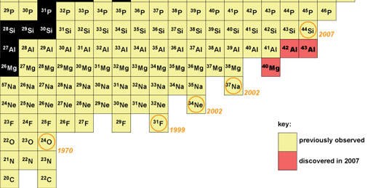
I: Global Calculations and the Nuclear Driplines
Where (and what) is the nuclear dripline?
Limits defined as last isotope with positive neutron separation energy
- Nucleons “drip” out of nucleus
Neutron dripline experimentally established to Z=8
Ab initio prediction
(2016)
Same result from same input NN+3N forces
Already well beyond where fit to data!

Slide 97
Shell Closures in Neutron-Rich Ni
Defect 1: Clear artifacts when changing valence spaces
Introduces errors for separation energies near HO shell closures
fp-shell
sdg-shell
sdg-shell
fp-shell

Slide 98
Ab Initio Approach: Interactions
Aim of modern nuclear theory: Develop unified first-principles picture of structure and reactions
- Nuclear forces (low-energy QCD)
- Electroweak physics
Chiral effective field theory, in principle
Systematic expansion of nuclear interactions
Consistent 3N forces, electroweak currents
Quantifiable uncertainties possible
In practice, use EFT as guidance - all available Hamiltonians exhibit some deficiencies

Slide 99
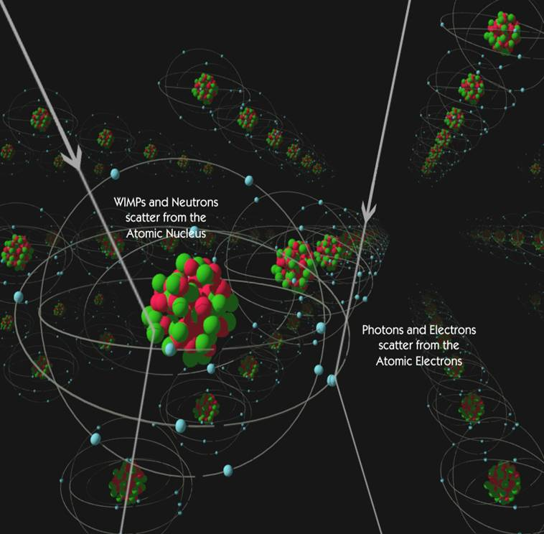
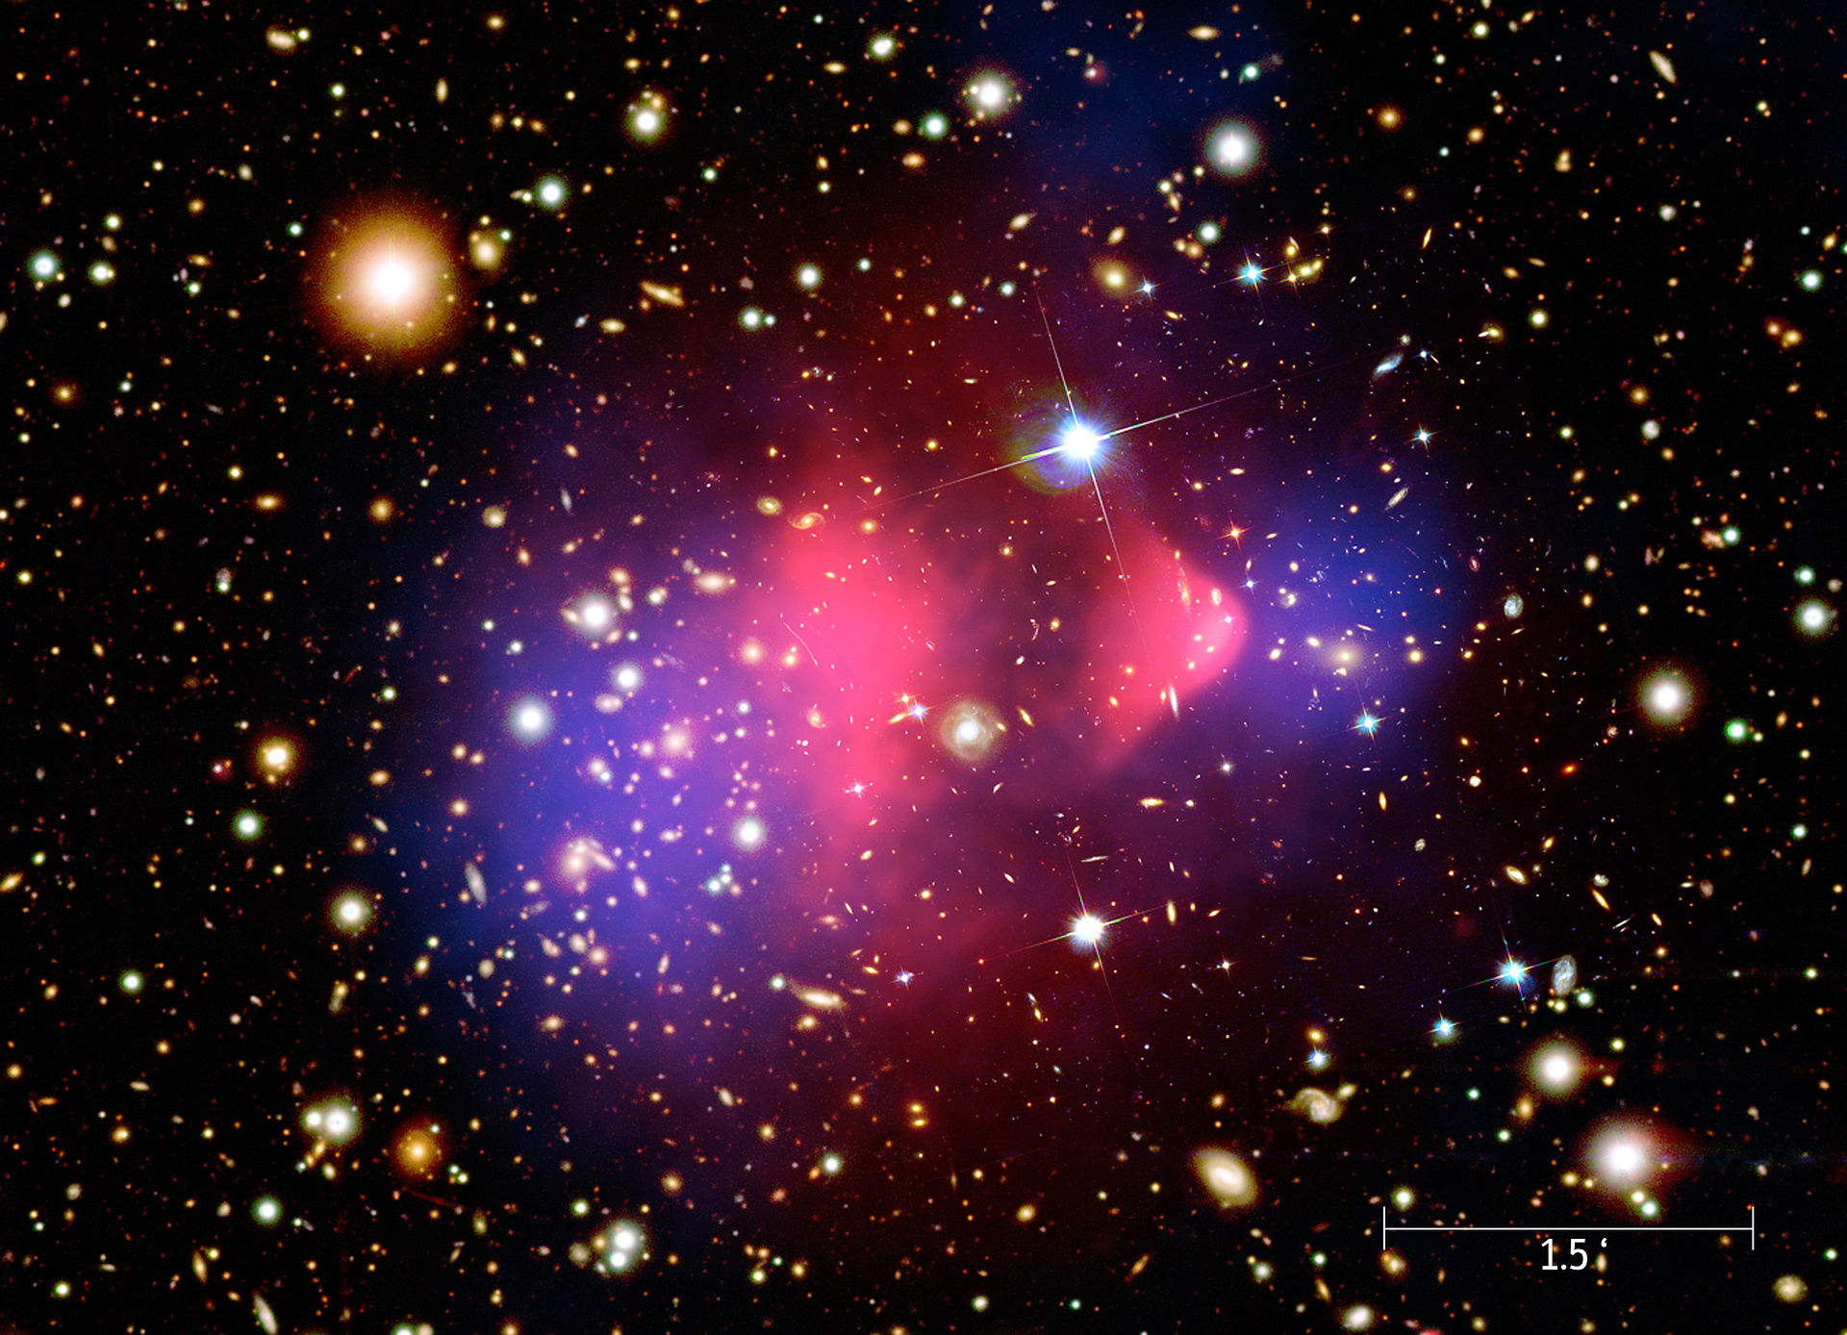
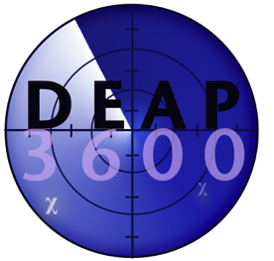

Next Big Discovery: Nature of Dark Matter?
Many direct-detection searches underway worldwide
Direct detection:
Leading candidates: neutralinos
Couples primarily to scalar and axial-vector currents in atomic nuclei
From CDMS collaboration
Wikipedia Commons
Observation of nuclear recoil

Slide 100
Next Big Discovery: Nature of Dark Matter?
Exclusion plots for WIMP-nucleon total cross section (spin-dependent)
Differential cross section: compare results from different target nuclei

Slide 101
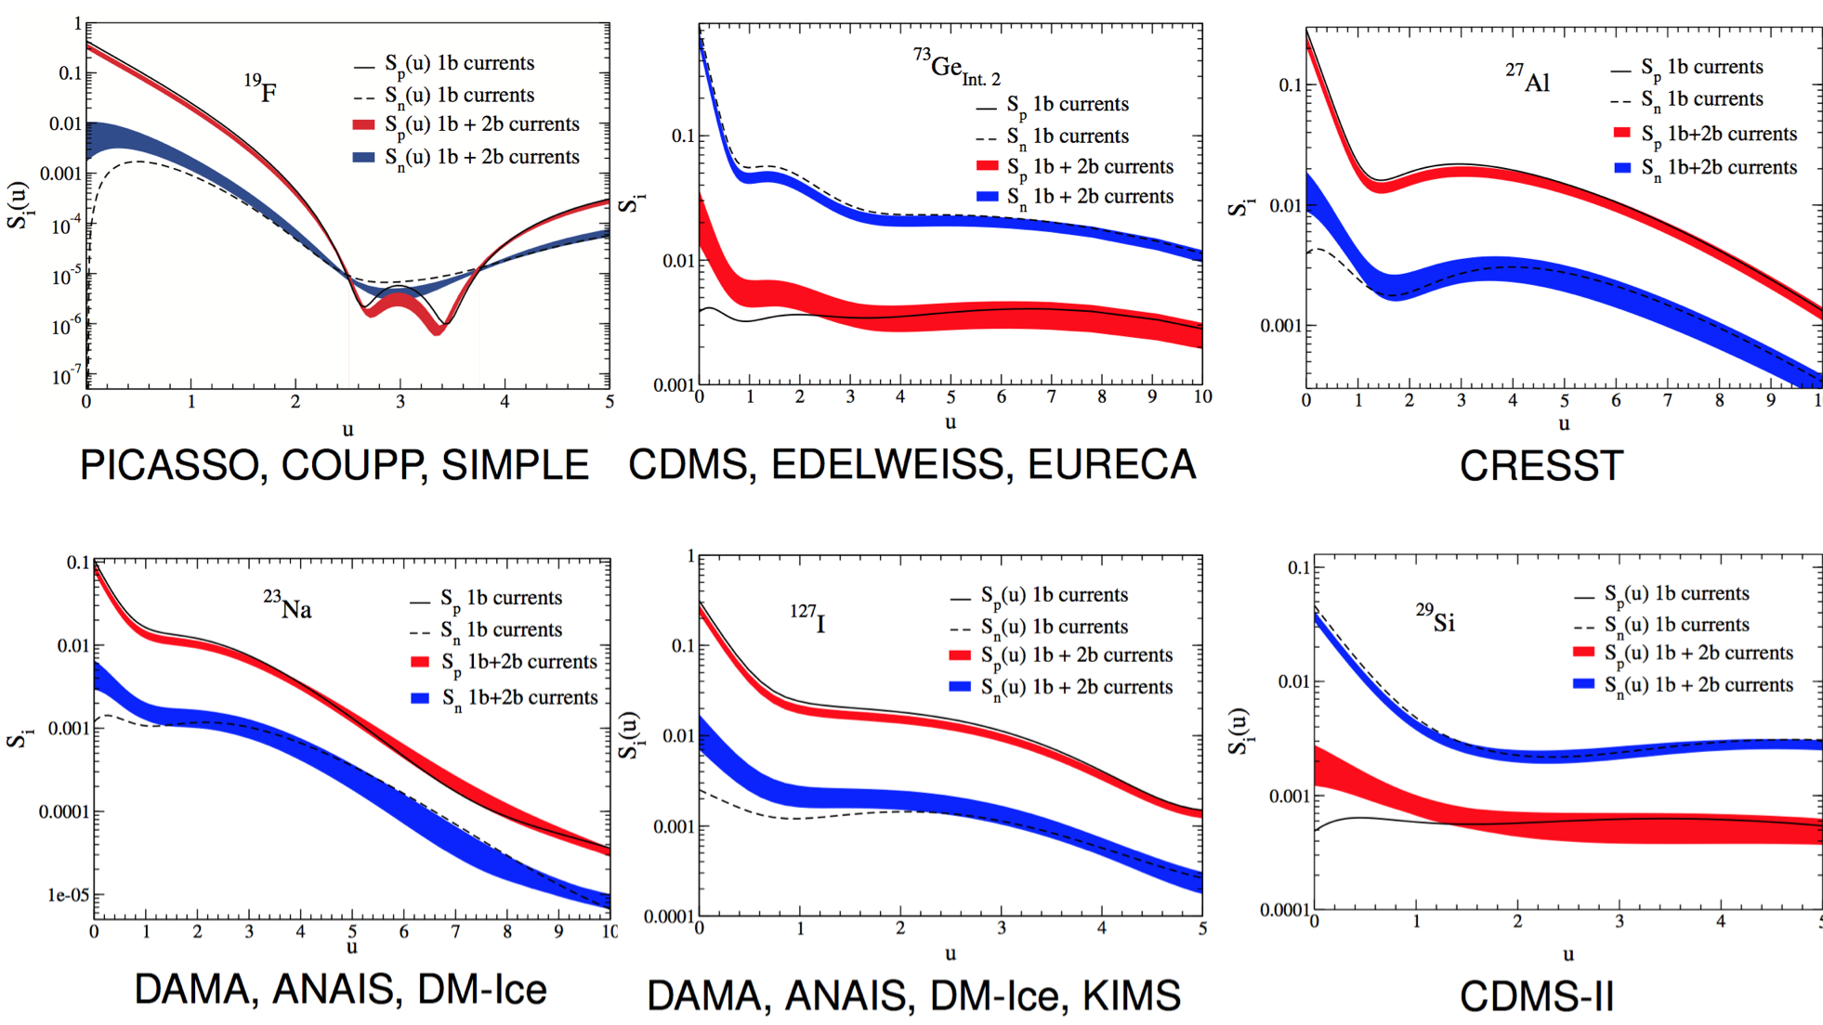

Spin-Dependent Structure Factors
Phenomenological wfs + inconsistent bare operator (with two-body currents)
✓
Klos et al, PRD (2013)

