Slide 1
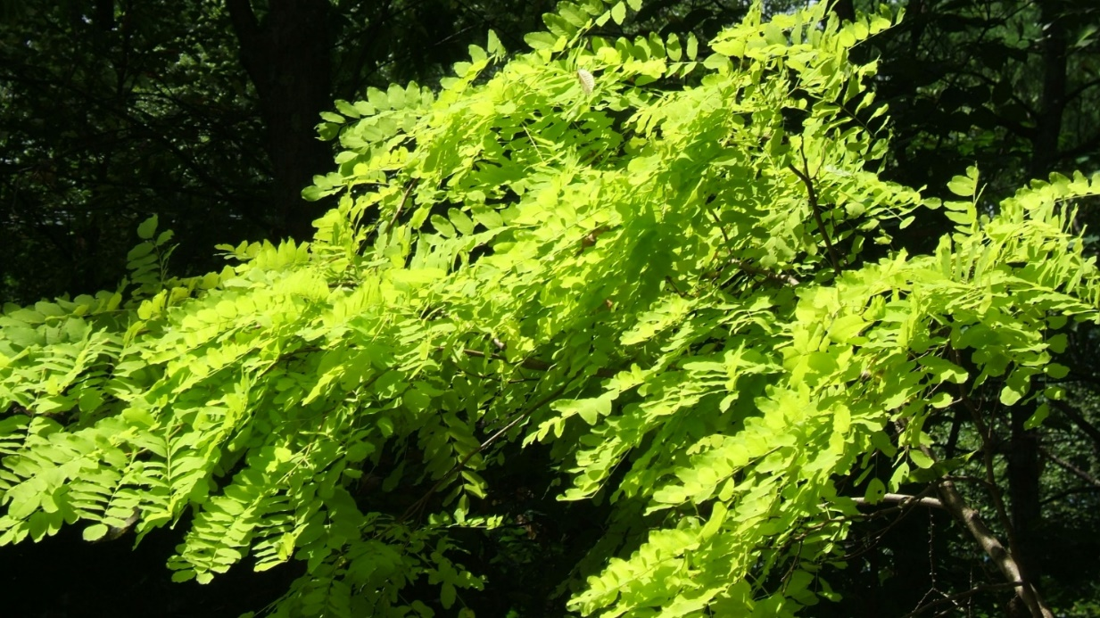
Experimental aspects
Neutrino-nuclear responses and effective
weak couplings for astro neutrinos & DBD
Hiro Ejiri RCNP Osaka
Thanks organizers for invitation
Thanks: The organizers for the invitation

Slide 2
1. Neutrino nuclear responses and g_{A} quenching
2. Experimental studies for ν nuclear responses
3. Low multipole low momentum responses
4. Medium momentum responses for DBD and SN.
5. Neutrino responses for astro neutrinos and DBD
H.Ejiri J.I. Fujita Phys. Rep 38 1978 85
H. Ejiri Phys. Rep. 338 2000 265
H. Ejiri J. Suhonen K. Zuber Phys. Rep. 797 1 2019
H. Ejiri Frontiers 10.3389/fyhs. 2019. 00030
H. Ejiri NNR19 May 2019 Neutrino Response Workshop 2019

Slide 3
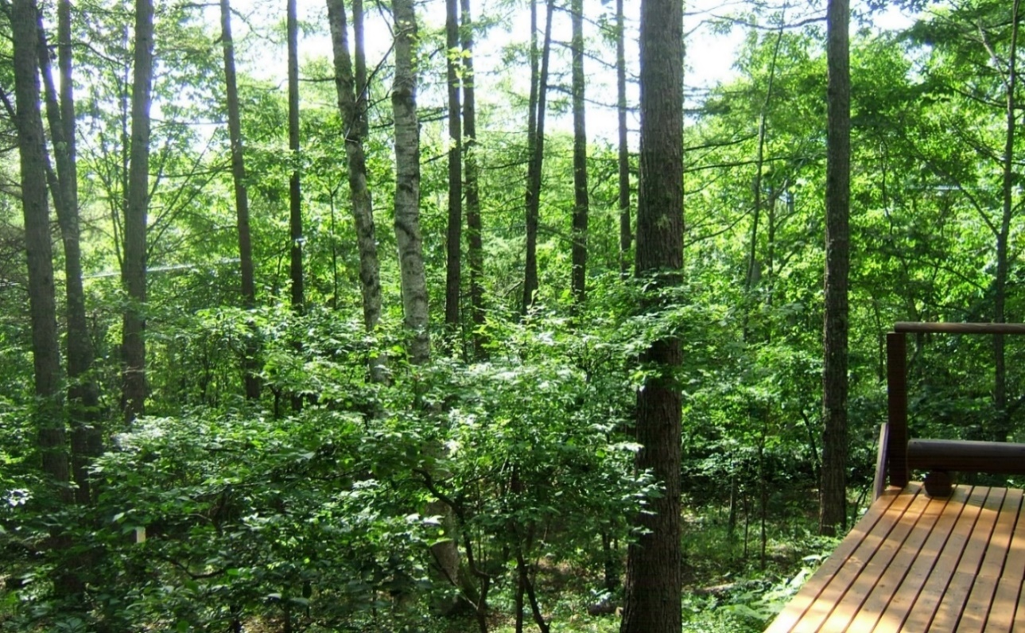
1. 1. Weak responses and g_{A}^{eff}
Ejiri’s log cabin in Tateshina 1450m

Slide 4
Nuclear Response = M : M=NMEs
e
ν
τσ
T = G [ M （m_{ν} )/ A_{ν} ]^{２}
Nuclear phys Particle/astro phys.
W
n
p
τσ
A. DBD Neutrino-less ββ Μ
M=g²_{A}M_{A} - g²_{V}M_{V} + g²_{A}M_{T} with bare g_{A、V} for free N.
M_{A}=k_{A}² M_{A}(model), M_{V}=k_{V}² M_{V}(model),
k_{A} = g_{A}^{eff}/g_{A} : Effects which are not in M_{A}(model)
M_{A}
Astro ν and anti-ν response
M_{A}=k_{A} M_{A}(model), k_{A} = g_{A}^{eff}/g_{A} :
DBD ν and Astro ν are q=5-150 MeV/c, J± with J=0-5

Slide 5
Effective couplings k_{A} = g^{eff}/g
M_{A}=k_{A} M_{A}(model) k=g^{eff}/g Deviation of model NME
from Exp. ＝True MNE since Model is NOT perfect
τσ Y
Dress / core
change i-f
Since 1960 for μ GT as e^{eff}/e .
A : Theoretical way ab initio NME k_{A} = g^{eff}/g=1
Cal. for g^{eff}/g for meson isobar , many body, medium
B: Experimental way : present
Exp g^{eff}/g = Exp NME/Model NME and
Use Exp. g^{eff}/g and Model QP, QRPA to get NME

Slide 6
Weak int.: spin isospin τσ N⁻¹N GR and N⁻¹Δ GR
Nuclear medium
τσ polarization
GR= σ τ flip
Σ [N_{i}⁻¹ Δ_{j}＋]]
ν β⁻
σ τ Ν
Nucleus
nucleon σ τ N
quark τσ Δ_{j}
GR=
Σ [N_{i}⁻¹ P_{j}]
ν
τ⁻ σ
[N₁⁻¹ P₁] [
0⁺
1. H. Ejiri PRC 26 ‘82 2628
Nuclear core change ,
|I> = |NP> - ε |GRn> - δ |GR Δ>
M^{β}~ k^{eff} M₀ k^{eff} (τσ)~ 1/(1+ χ_{τσ}) = 0.4
k^{eff} (Δ)~ 0.6 χ_{τσ}: susceptibility
1⁺
2⁻
Bohr Mottelson
PL B 10 ‘81 10 Isobar

Slide 7
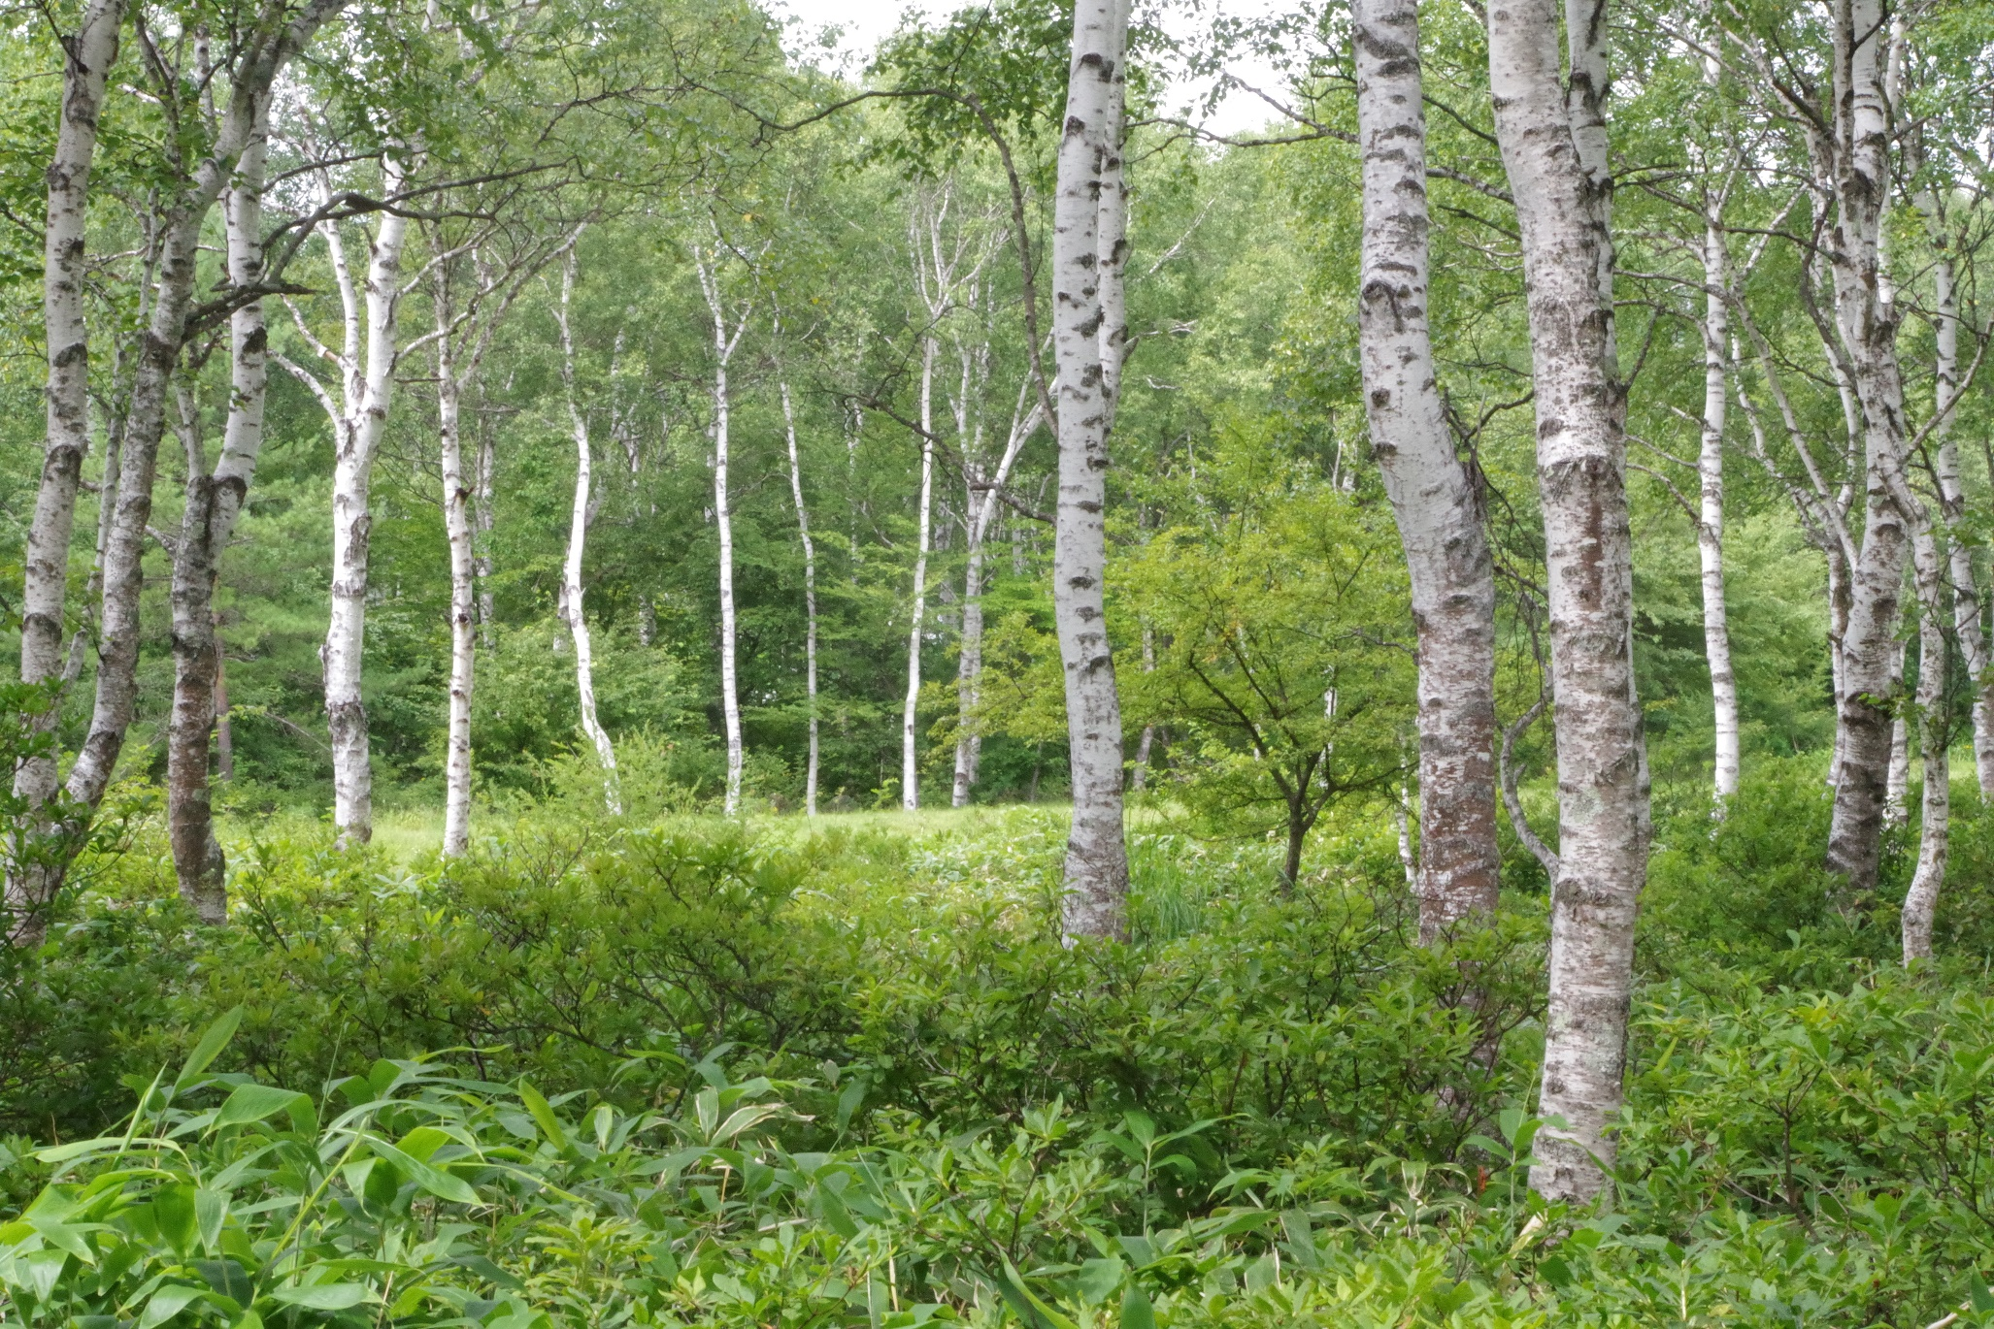
Experimental studies of neutrino responses by
charge exchange nuclear and lepton reactions
Tateshina view

Slide 8
CERs for CC
e
M=g²_{A}M_{DA} - g²_{F}M_{D}
Sensitive to NN, NΔ/π
nuclear medium effects
τ−
τ+
n
p
τ, τσ
e
ν
n
e
p
τ,τσ
M(EXP) =g_{A}M, g_{F}M by
lepton and nuclear CERs
to help calculations which are
sensitive to nn & medium.

Slide 9
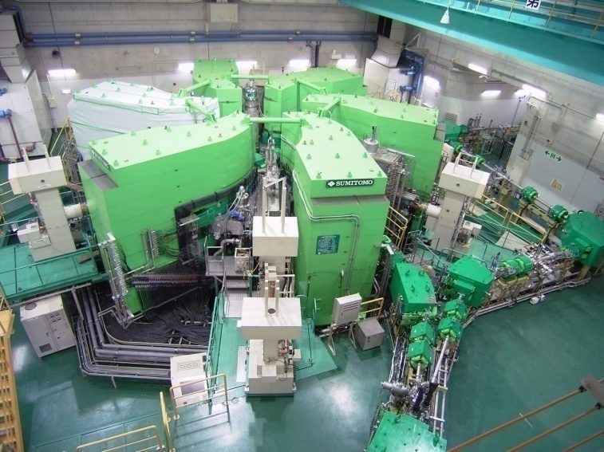
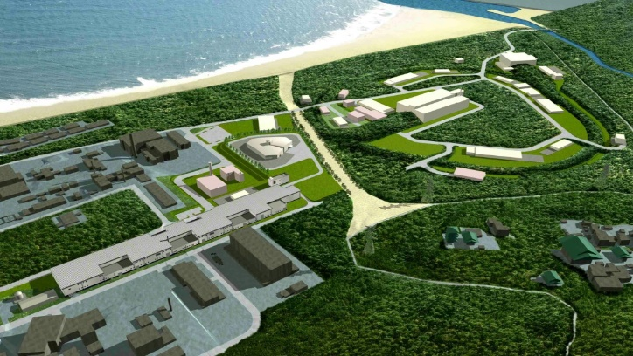
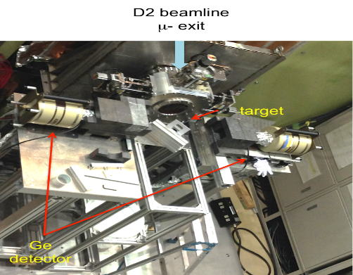
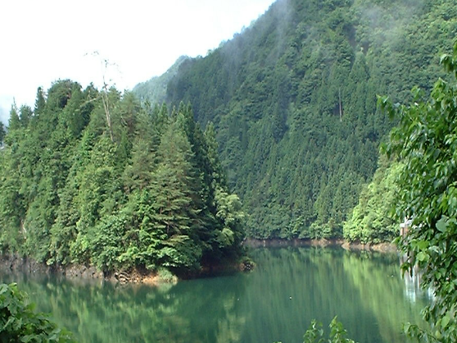
Response experiments by RCNP/Osaka
RCNP Osaka p,He, μ
J-PARC 3-50 GeV p, ν, μ
MLF MUSE μ
MuSIC μ
Spring-8 GeV- MeV pol. γ
Oto under gr. ββ−ν,

Slide 10
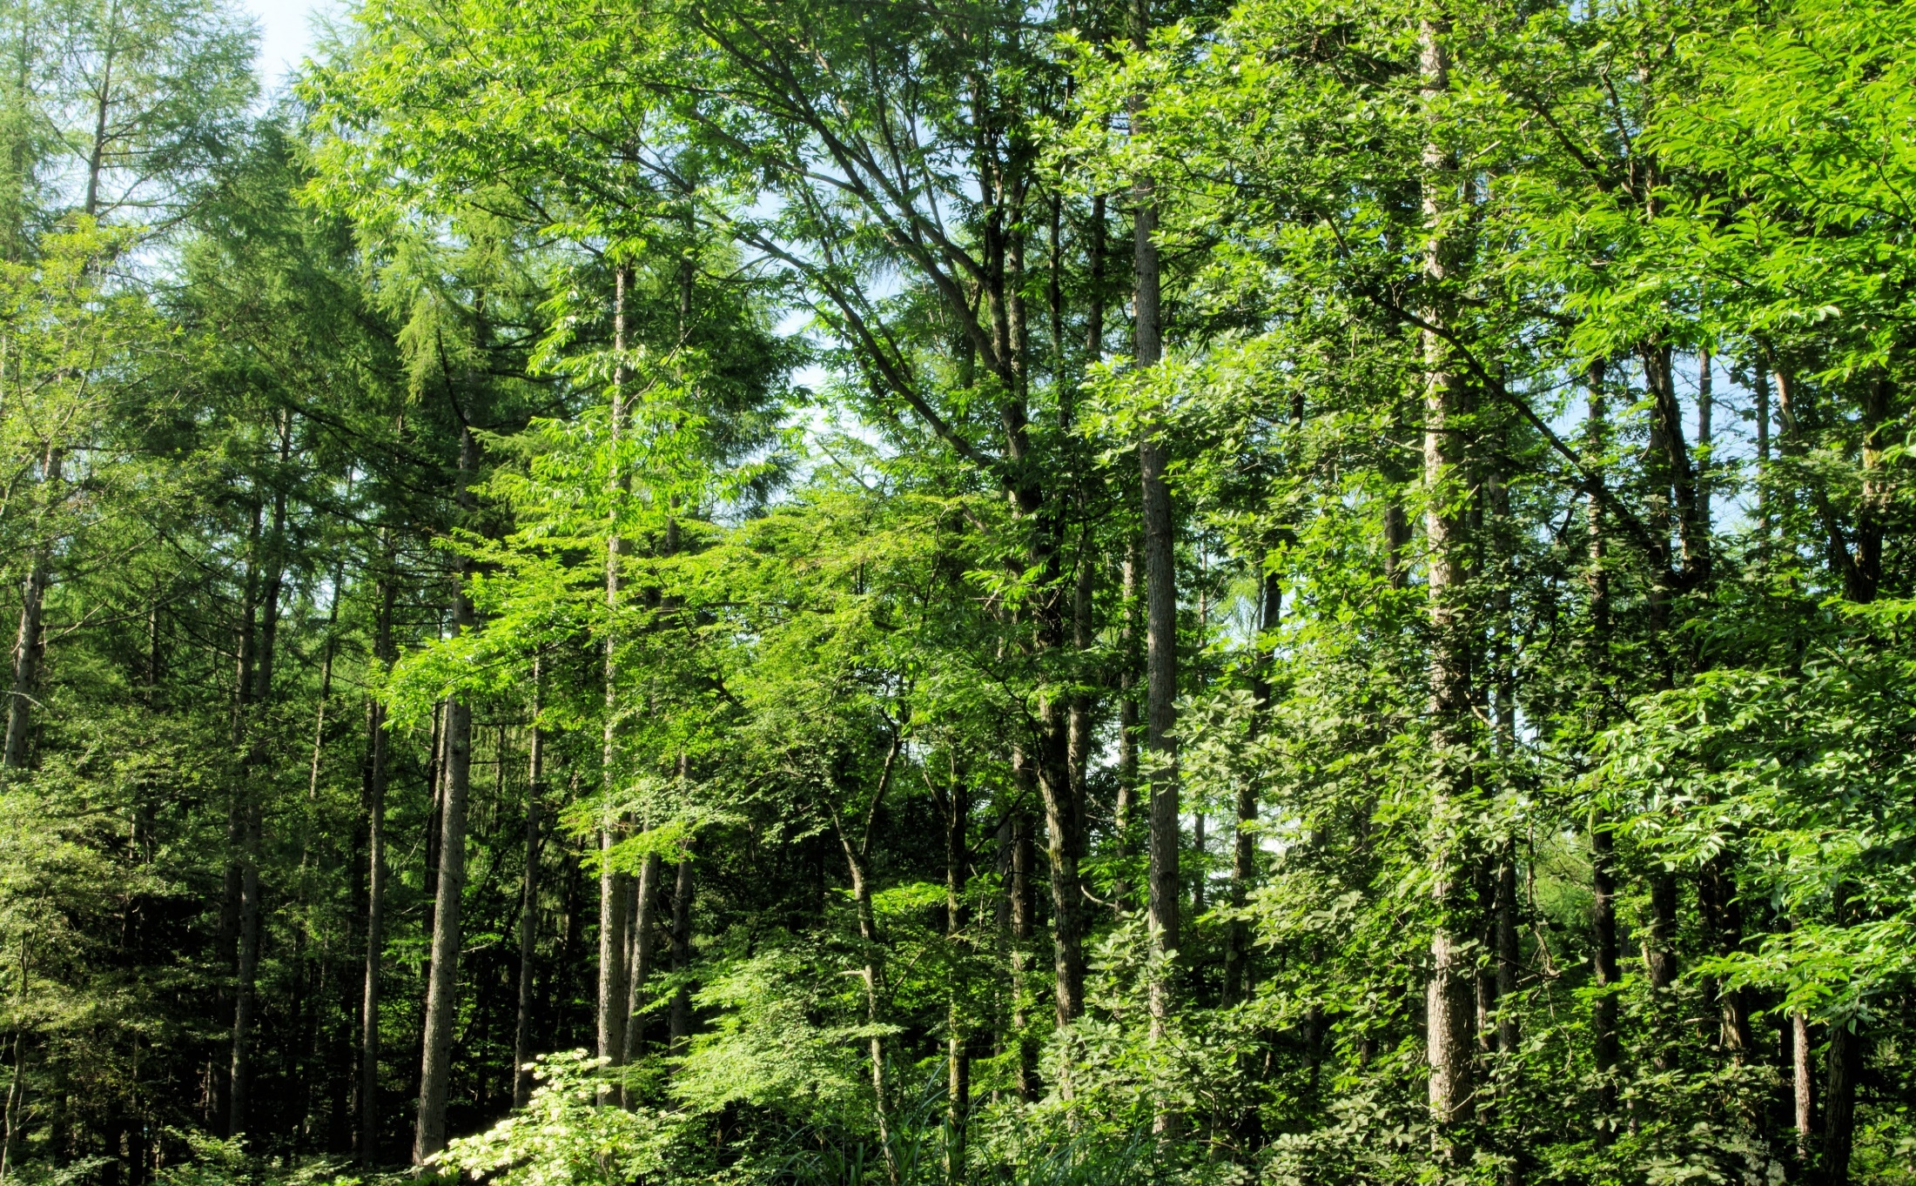
3. Low momentum β -e (β,e→ν_{e} CER)

Slide 11
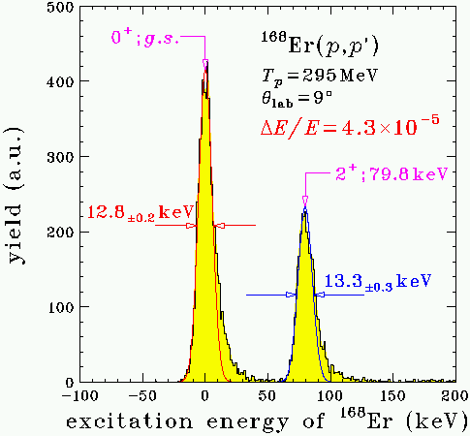
High E resolution (³He,t) CERs at RCNP Osaka
ΔE/E ~ 2 10⁻⁵
t
³He
q~ 20-200 MeV/c

Slide 12
H. Akimune, H. Ejiri, RCNP Catania, KVI , Munster・・

Slide 13
M(SD 2⁻)EXP = k M(SD QP)
Ejiri D. Frekers
J. Physics G. 43 11L01
 | M(CER) | M (FSQP)
⁷⁶Ge (SD) | 2.0 | 2.1
¹²⁸Te (SD) | 3.55 | 3.4
¹³⁰Te (SD) | 4.05 | 3.7
SD NMEs with k~0.25 from
ft data in neighboring nuclei.
H. Ejiri D. Frekers J. Physics G. Letters Sept.
k=M/M(QP) = QRPA ~0.5
and medium(g_{A}) effect 0.5

Slide 14
M(SD 2⁻)EXP = k M(SD QP)
B(SD)=[σ(SD)/σ(IAS)]B(IAS) K, B(SD)=M(SD)²
σ(SD)/σ(IAS) for ⁷⁶Ge, B(IAS) =N- Z, and K is from the
measured cross section ratio for ⁷⁴Ge with B(SD) from ft
 | M(CER) | M (FSQP)
⁷⁶Ge (SD) | 1.57 ±0,24 | 2.1
¹²⁸Te (SD) | 2.82 ±0.48 | 3.4
¹³⁰Te (SD) | 3,33±0.59 | 3.7
M(ESQP) with k~0.25 from ft data in neighboring nuclei.
H. Ejiri D. Frekers J. Physics G. Letters Sept.
k~0.25, with 0.5 from τσ and medium(g_{A}) effect 0.5
SD RCNP H. Akimune, H. Ejiri, RCNP Catania, Munster, KVI ,・・

Slide 15
Universal reductions of axial vector β & γ in low p
Ejiri Fujita
PR 34 85 1978
γ
γ
β
β
k=k(τσ) k(NM)~0.25 with respect to QP
k=k(τσ)~0.5 : Nucleonic long range τσ GR
k(NM)~ g^{eff}_{A}/g_{A}~0.6 : Short range nucl. medium Δ π
H, Ejiri J. Suhonen J. Phys. G. 42 2015
H. Ejiri N. Soucouti, J. Suhonen PL B 729 2014 .
L. Jokiniemi J. Suhonen H. Ejiri AHEP2016 ID8417598

Slide 16
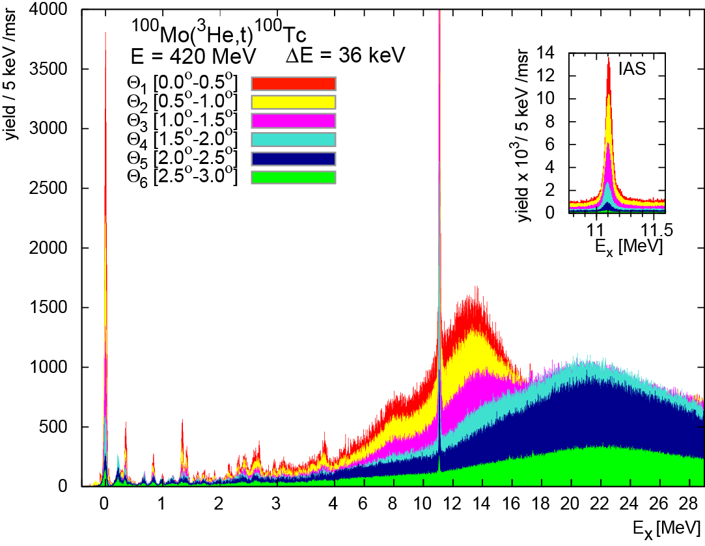
B(GT) sum strength
F ０＋
GT
B(GT):all
B(GT):low
GT １＋
SD ２－
Thies et al., PR C 86 2012
Quasi-free = No GT
GT
SD
(N-Z) [B(σ)=3]
0.55 Sum
n p
GT
GT
C. Douma 116 122 Sn
F
B(GT)/B(σ) = 0.55 (N-Z)
Note : Nucleon in nucleus
is 0.55 free nucleon

Slide 17
⁷¹Ga neutrino response for ⁵¹Cr and sterile ν ?
SAGE Galex ⁵¹Cr ³⁷Ar
PL B 706 134
2011 Frekers,
Ejiri,Akimune
Harakeh et al.
Gr 0 GT 92% B(GT) =8.52 10⁻² Ratio 1.00
1 st 175 40% 0.34 0.027 (~0.01 )
2nd 500 87% 1.76 0.045
Exp. /Ga response 0.92 ±0.05 (ground state)
0.87 ±0.05 (excited state theory) 0.86 ±0.05 (excited state exp.)
Missing suggests Exp. efficiency or Sterile mentrinos.

Slide 18
Ga isotope σ and [ σxY₂]₁
B(110) = (M(σ) + k [ σxY₂]₁)²/(2J+1) k = GT/T =0.1
＊ assuming the same ratio of M(s)/M(sY2) for ⁶⁹Ga
M(σ) =0.08 -0.07 =small . M [ σxY₂]₁= 0.7 large due to p3/2 – f 5/2

Slide 19
Double charge exchange reaction＊
⁵⁶Fe
¹¹B, ¹¹Li
D GR
Takahisa Ejiri E/A=0.8 GeV
arXiv 170308265
H.Ejiri et al JPSJ 65 (1996),
No GT GR in case of 2νββ
Y(0-10MeV) /Y(20-30 MeV)=0.03
Cappuzzello et al Eur. Phys. J. A 51 145
Cappuzzello et al Eur. Phys. J. A 51 145
E/A=15 MeV Various kinds of V(τσ q )
Notes:
DGT

Slide 20
4 . Neutrino nuclear responses in medium
momentum region

Slide 21
CER. F, GT &SD q-dependence
t
θ ∼q
³He
τ, τσ
W
n
p
τ, τσ
M_{W}~1 GeV g_{W}~ const
over 0-100 MeV/c of SN DBD
e
dσ(q) = C |f_{a}(qr)|² M_{α}(q) ²
f_{a}(qr)~ DWBA ~ j_{a}(qr) : kinematical q dependence
M_{α}(q)=k^{eff}(q) M_{α}(QP)
j₀ for IAS, GT, j₁ for SD
k^{eff}(q)= g_{A}^{eff}(q)~ constant q=20 – 100 MeV/c

Slide 22
¹³⁰Te
¹³⁰Te F
0⁺
1⁺
¹³⁰Te SD
2⁻
g_{A}^{eff}~const over q=0-100 MeV/c

Slide 23
CER (μ,ν_{μ}, xn γ) ν−β⁺
Responses q~80 MeV/c
J PARC 3 GeV p
(μ, ν_{μ} )
⁹⁷Nb
β,γ
μ⁻
β,γ
⁹⁹Nb
¹⁰⁰Nb
¹⁰⁰Mo
γ_{i} from ^{100-i}Nb: relative strength Life time : the absolute strength
H. Ejiri Proc. e-γ conference Sendai 1972, H. Ejiri et al., JPSJ 2014
NNR19:I. Hashim , Hashim H. Ejiri et al., PRC 97 (2018) 014617

Slide 24
μ GR
γ GR
μ GR
N
Z
I. Hashim PhD Thesis Osaka 2015I.
I. Hashim H. Ejiri , MXG16, PR C 97 2018

Slide 25
Muon capture rate on ¹⁰⁰Mo
Ejiri Hashim 2019
Rate Exp. ~ 6.6 M/sec ~ Primakoff 7.5 M/sec
Comparison with pnQRPA (Jokimiemi) shows k~0.4
and more rate at higher excitation region

Slide 26
Muon capture strength as a function of E
Rate: R=k G(E) S(E)
G(E)=kP(E)²
Phase space
P=Momentum
S(E)=Σ M_{i}²(E)
Strength M: NME
k S(E) in 10 /MeV²/sec

Slide 27
5．DBD NMEs and DBD rates

Slide 28
DBD 2νββ and 0νββ NMEs
QRPA 0νββ NMEs (Engel et al. PRC 89 (2014) 064308
^{ｓｓ}G I
^{ｓｓ}G III
⁷⁶Ge
⁸²Se
Triangle =exp, Squares=FSQP(Ejiri) J. Phys. 2017
M^{2νββ} = Σ_{k} M⁻_{k}M⁺_{k} /Δ_{k}
M⁻_{k} = (k^{eff}_{i}) m_{ij}V_{n}U_{p} , M⁺_{k} = (k^{eff}_{f}) m_{ij}U_{n}V_{p} , (k^{eff}_{A})² ~ (0.23)² = 0.05
Shell closure makes U or V small, and thus UV small .

Slide 29
M(α) Model
pnQRPA
⁷⁶Ge
M(GT)=5.4,
M(T)=-0.36
M(F)=1.76
Jokiniemi,
Ejir, Suhonen PR C 98 2018
g_{A}^{eff} /g_{A}= 0.6 leads to reductions 0.35 for M(GT),
0.5 for M^{0ν} , 0.25 for DBD rate, ~ 10 for DBD detector mass
H. Ejiri Frontiers 10.3389/fyhs.2019.00030
L. Jokiniemi, H. Ejiri, D. Frekers, J. Suhonen 2018 PR C 98 024608

Slide 30
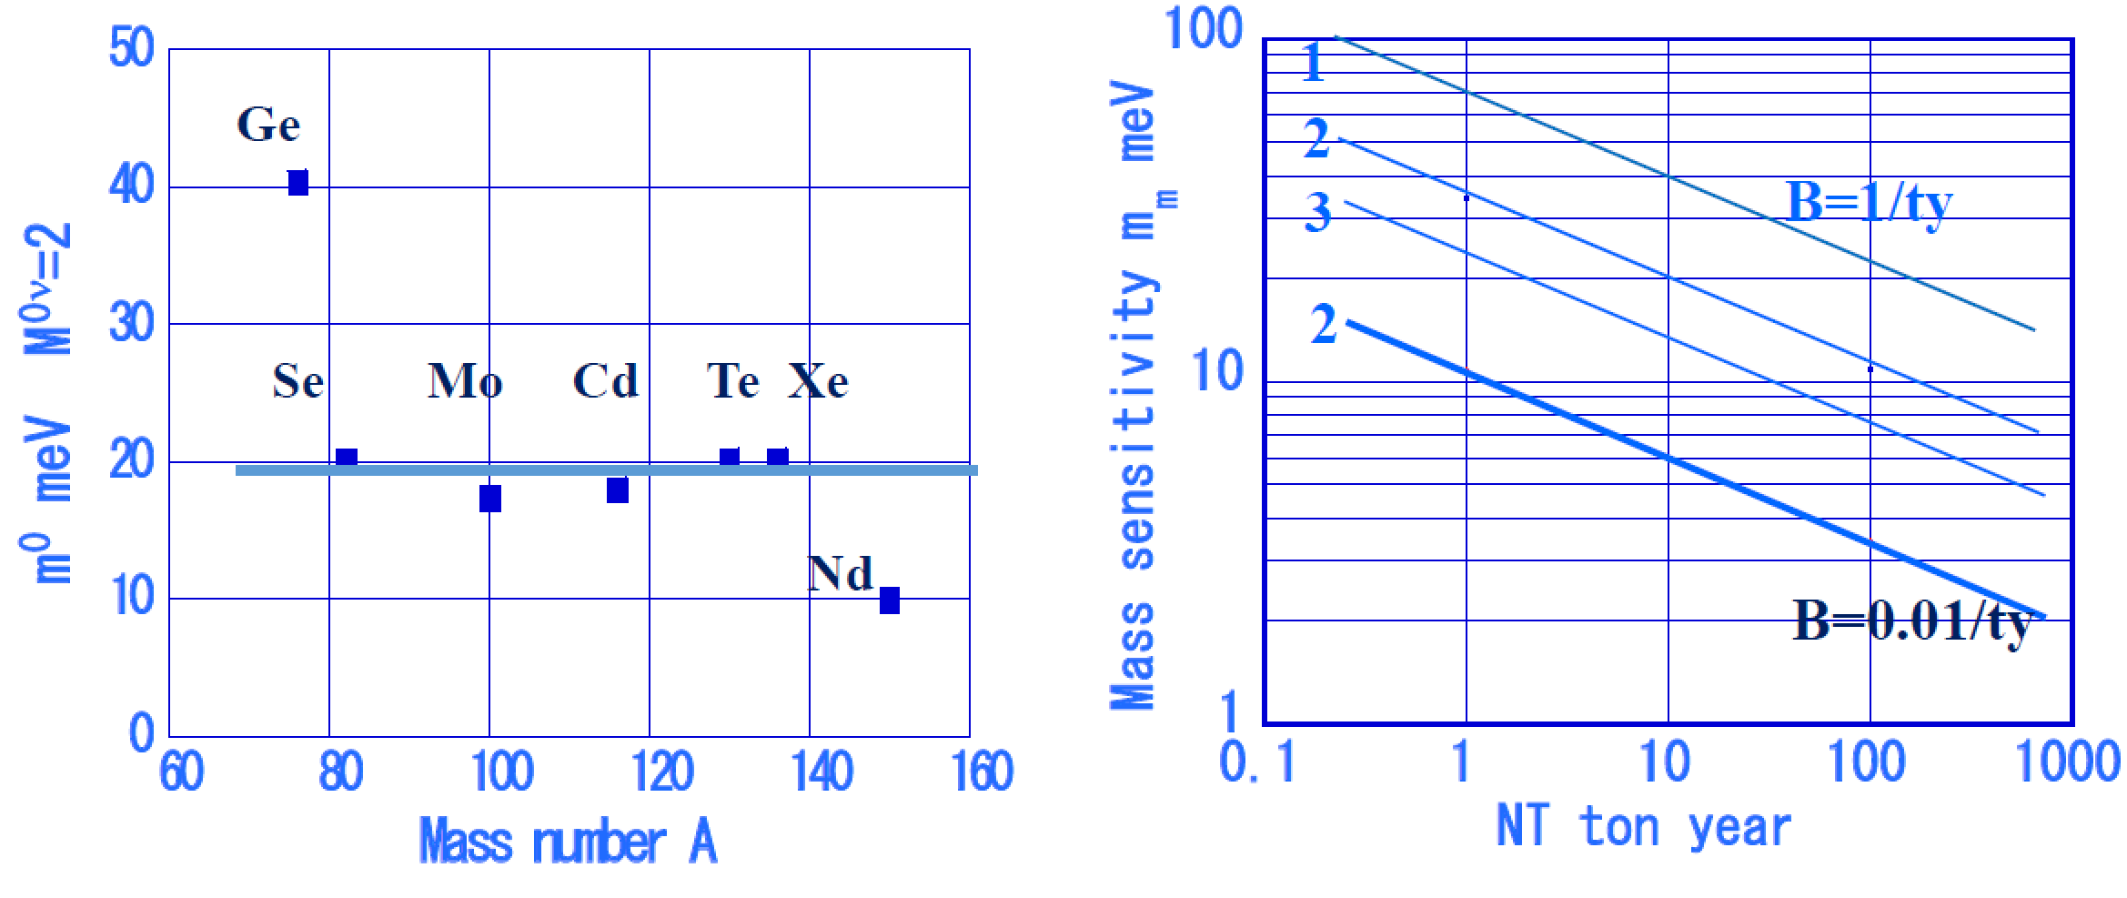
DBD 0νββ NMEs and DBD mass sensitivity
Nuclear sensitivity m⁰= mass for 1/t y
Mass sensitivity mass to be detected m_{m}= m⁰ D
M^{0ν}=k² M(QRPA) ~ 2 , k=(g^{eff}/g)~0.6 - 0.7
IH 20 meV

Slide 31
6. Remarks

Slide 32
Remarks
CER: (³He,t) provides NMEs J= 0-2, p=5-100 MeV/c used for evaluating β⁻, ν astro ν and DBD responses.
2. CER: (μ,ν_{μ}) shows MGR (giant resonance) at 12 MeV
provides NMEs J= 0-3, p=50-100 MeV/c
used for evaluating β⁺, ν astro ν and DBD responses.
3. M_{EXP} (GT,SD) are reduced from M_{QP} by k^{eff}~ 0.2-0.25,
k_{ts} ~ 0.4-0.5 by nucl. τσ, k_{m} ~ 0.5-0.6 = (g_{A}^{eff}/g_{A}).
4. DBD NMEs ~ 0.5 NMEs(QRPA), and 10 t y for IH.
5. ⁷¹Ga anomaly is not due to nuclear responses.

Slide 33
Thanks for your attention Greenary Nimph 翠の精

