Slide 1


Recent results on heavy-ion induced reactions of interest for neutrinoless double beta decay
F. Cappuzzello
Università di Catania and INFN LNS

Slide 2
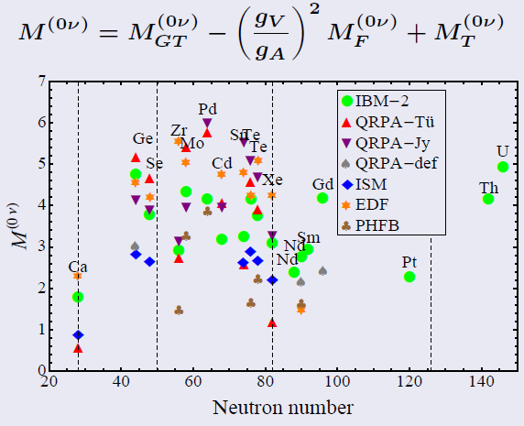
0υββ Nuclear Matrix Element
A challenging problem in nuclear physics
Still tension in NME calculations
Calculations (still sizeable uncertainties): QRPA, Large scale shell model, IBM, EDF, ab-initio …..

Slide 3
Support from the experiments
Measurements (still not conclusive for 0νββ NME):
β-decay and 2νββ decay
(π⁺, π⁻)
single charge exchange (³He,t), (d,²He), electron capture, transfer reactions, HI-CEX (see H.Lenske et al., PRC 98 (2018) 044620 and review from H.Lenske, F.C. et al. PPNP, submitted)
μ-capture, γγ-decay …
A recent experimental tool: Heavy-Ion Double Charge-Exchange (DCE)
1st order isospin probes
2nd order isospin probes

Slide 4

Heavy-ion DCE as surrogate processes
Induced by strong interaction
Sequential nucleon transfer mechanism 4th order: Kinematical matching conditions
Meson exchange mechanism 1st or 2nd order
Possibility to go in both directions
Low cross section
(¹⁸O,¹⁶O)
⁷⁶Se
⁷⁷Se
⁷⁸Se
3
(¹⁸O,¹⁸F)
Tiny amount of DGT strenght in low lying states
⁷⁶As
(¹⁸O,²⁰Ne)
⁷⁵As
⁷⁷As
(²⁰Ne,¹⁸O)
(π⁺,π⁻), (²⁰Ne,²⁰O), ββ decay
(¹⁸O,¹⁸Ne)
(²⁰Ne,²⁰F)
RIKEN
RCNP
In principle, sum rule almost exhausted by DGT Giant Mode
⁷⁴Ge
⁷⁵Ge
⁷⁶Ge
(²⁰Ne,²²Ne)

Slide 5

0νββ vs DCE
Differences
DCE mediated by strong interaction, 0νββ by weak interaction
Decay vs reaction dynamics
DCE includes sequential transfer mechanism
Similarities
Same initial and final states: Parent/daughter states of the 0νββ decay are the same as those of the target/residual nuclei in the DCE
Similar operator: Short-range Fermi, Gamow-Teller and rank-2 tensor components are present in both the transition operators, with tunable weight in DCE
Large linear momentum (~100 MeV/c) available in the virtual intermediate channel
Non-local processes: characterized by two vertices localized in a pair of nucleons
Same nuclear medium: Constraint on the theoretical determination of quenching phenomena on 0νββ
Off-shell propagation through virtual intermediate channels

Slide 6
A fundamental property
The complicated many-body heavy-ion scattering problem is largely simplified for direct quasi-elastic reactions
V_{α} (r_{α} ,χ_{α}) = U_{α} (r_{α}) + W_{α}(r_{α} ,χ_{α})
Optical potential (ISI-FSI)
Residual interaction
For charge exchange reactions the W_{α}(r_{α} ,χ_{α}) is ‘small’ and can be treated perturbatively
In addition the reactions are strongly localized at the surface of the colliding systems and consequently large overlap of nuclear densities are avoided
Accurate description in fully quantum approach, eg. Distorted Wave techniques
Microscopic derived double folding potentials are good choices for U_{α} (r_{α})
Microscopic form factors work for charge exchange reactions

Slide 7
HI-DCE reaction mechanism
Cross section as coherent sum of three different kinds of reaction dynamics
1. Multi-nucleon transfer (two proton pick-up/stripping followed by two neutron stripping/pick-up
(¹⁸O,¹⁶O)
Probing at least twice nucleus nucleus Initial (ISI) and Final (FSI) State interaction
4th order processes probing nuclear mean field felt by the transferred nucleons
Typically not relevant for 0υββ decay
Instead transfer or 2p/2n pair followed by 2n/2p pair could be of interest for 0υββ NME B.A.Brown et al. PRL 113, 262501 (2014)
⁷⁶Se
⁷⁷Se
⁷⁸Se
⁷⁶As
(¹⁸O,²⁰Ne)
⁷⁵As
⁷⁷As
(²⁰Ne,¹⁸O)
⁷⁴Ge
⁷⁵Ge
⁷⁶Ge
(²⁰Ne,²²Ne)

Slide 8
HI-DCE reaction mechanism
Cross section as coherent sum of three different kinds of reaction dynamics
2. Double Single Charge Exchange (DSCE)
⁷⁶Se
⁷⁷Se
⁷⁸Se
Probing twice nucleus nucleus Initial (ISI) and Final (FSI) State interaction
Probing twice isovector nucleon-nucleon interaction between a pair of uncorrelated nucleon in the target and projectile
Similar to 2νββ but with more momentum transfer
Hints for closure of states in the intermediate channel
(²⁰F,²⁰O)
⁷⁶As
(¹⁸O,¹⁸F)
⁷⁵As
⁷⁷As
(²⁰Ne,²⁰F)
(¹⁸F,¹⁸Ne)
⁷⁴Ge
⁷⁵Ge
⁷⁶Ge

Slide 9
HI-DCE reaction mechanism
Cross section as coherent sum of three different kinds of reaction dynamics
3. Correlated Double Charge Exchange (‘Majorana’ mechanism MDCE)
⁷⁶Se
⁷⁷Se
⁷⁸Se
Probing once nucleus nucleus Initial (ISI) and Final (FSI) State interaction
Probing short range correlations in the target and projectile
Similar to 0νββ
⁷⁶As
⁷⁵As
(²⁰Ne,²⁰O), ββ decay
⁷⁷As
(¹⁸O,¹⁸Ne)
⁷⁴Ge
⁷⁵Ge
⁷⁶Ge

Slide 10
New Theoretical Developments for HI-DCE
In E. Santopinto et al. PRC98, 061601(R) (2018) the factorization of DCE cross section as the product of a NME times a reaction factor is demonstrated for a simplified reaction model, assuming closure approximation
In Bellone, Colonna, Lenske, Lay J. Phys. Conf. Ser. 1056 (2018) 012004, the factorization is shown to survive for momentum transfer lower than 50 MeV/c, with a microscopic quantum description of DCE as two step DSCE mechanism
In H. Lenske, Theory of heavy ion single and double charge exchange reactions, CERN Proceedings
2019-001 (2019) [49] and review H. Lenske, F.C. et al PPNP (submitted), the DCE is modeled as two-step DSCE and as a one step Majorana type reaction mechanism, this latter being a new introduced reaction promisingly probing a similar nuclear response as 0νββ decay

Slide 11
The “Majorana” hadron mechanism for HI-DCE
From H. Lenske, CERN Proceedings 2019-001 (2019) [49]
Elementary weak interaction process mediating 0νββ
Elementary strong interaction process mediating 1-step DCE
Requires a reaction partner to manifest in a visible signal
Can occur, in principle, on an isolated nucleus
Two kind of Majorana MDCE isotensor interactions
Universal because of generic SRC NN dynamics
Universal because of generic meson dynamics

Slide 12
The “Majorana” mechanism for HI-DCE
From H. Lenske, CERN Proceedings 2019-001 (2019) [49]
ISI and FSI ion-ion interaction from double folding
QRPA transition densities for microscopic form factors
⁴⁰Ca(¹⁸O,¹⁸Ne)⁴⁰Ar @ 270 MeV
⁴⁰Ca(¹⁸O,¹⁸Ne)⁴⁰Ar @ 270 MeV
MDCE calculations scaled at forward angles
Consistency between DSCE and MDCE
Caveat:
Only π-correlations included
Off shell momentum structure approximated with on-shell component
Encouraging results, but still room for refinements

Slide 13
Heavy-ion DCE and Double Gamow-Teller resonance
Experiments
Nuclear structure Theory
Pioneering search at RIKEN via the (¹²C,¹²Be0⁺₂)
Results not yet published
Possible connection with 0νββ
N. Shimizu et al., PRL 120 (2018) 142502
(¹¹B,¹¹Li)@80 A MeV @ RCNP
Takahisa, Ejiri et al., arXiv:1703.08264 (2017)
Identifying DIAS, and finding structures, maybe not the DGT
See also
E. Santopinto et al. PRC98, 061601(R) (2018) and
N. Auerbach and B. Minh Loc PRC98, 064301 (2018)

Slide 14
DCE @ INFN-LNS

Slide 15
The NUMEN project
https://web.infn.it/NUMEN/index.php/it/
F. Cappuzzello et al., Eur. Phys. J. A (2018) 54: 72
Spokespersons: F. Cappuzzello (cappuzzello@lns.infn.it) and C. Agodi (agodi@lns.infn.it)
Proponents: C. Agodi, J. Bellone, D. Bonanno, V. Branchina, S. Brasolin, G. Brischetto, O. Brunasso, S. Burrello, S. Calabrese, L. Calabretta, D. Calvo, V. Capirossi, F. Cappuzzello, D. Carbone, M. Cavallaro, I. Ciraldo, M. Colonna, G. D’Agostino, N. Deshmukh, C. Ferraresi, J. Ferretti, P. Finocchiaro, M. Fisichella, A. Foti, G. Gallo, H. Garcia-Tecocoatzi, F. Iazzi, G. Lanzalone, F. La Via, F. Longhitano, D. Lo Presti, P. Mereu, L. Pandola, F. Pinna, S. Reito, A.D. Russo, G. Russo, E. Santopinto, O. Sgouros, V. Soukeras, A. Spatafora, D. Torresi, S. Tudisco, R.I.M. Vsevolodovna
Istituto Nazionale di Fisica Nucleare, Laboratori Nazionali del Sud, Catania, Italy
Istituto Nazionale di Fisica Nucleare, Sezione di Catania, Italy
Istituto Nazionale di Fisica Nucleare, Sezione di Torino, Italy
Istituto Nazionale di Fisica Nucleare, Sezione di Genova, Italy
Dipartimento di Fisica e Astronomia, Università di Catania, Italy
Dipartimento di Fisica, Università di Genova, Italy
DISAT, Politecnico di Torino, Italy
Università degli Studi di Enna "Kore", Enna, Italy
CNR-IMM, Sezione di Catania, Italy
A. Pakou, G. Souliotis
Department of Physics, University of Ioannina, Greece
Department of Chemistry, National and Kapodistrian University of Athens, Greece
H. Lenske, P. Ries, N. Pietralla, V. Werner
Department of Physics, University of Giessen, Germany
Institut fur Kernphysik, Technische Universitat Darmstadt, Germany
N. Auerbach
School of Physics and Astronomy Tel Aviv University, Israel
H. Petrascu, L. Serbina
IFIN-HH, Bucarest, Romania
J.A. Lay
Departamento de FAMN, University of Seville, Spain
F. Delaunay,
LPC Caen, Normandie Université, ENSICAEN, UNICAEN, CNRS/IN2P3, France
Z.J. Kotila,
University of Jyväskylä, Jyväskylä, Finland
G. De Geronimo
Stony Brook University, US
J. Barea
Universidad de Conception, Chile
R. Chen, J. Ma, J.S. Wang, Y.Y. Yang
Institute of Modern Physics, Chinese Academy of Sciences, Lanzhou, China
A. Khouaja, J. Inchaou, M.L.Bouhssa
Université Hassan II – Casablanca, Morocco
T. Borello-Lewin, P.N. de Faria, J.L. Ferreira, R. Linares, J. Lubian, N.H. Medina, D.R. Mendes, M. Moralles, J.R.B. Oliveira, M.R.D. Rodrigues, R.B.B. Santos, M.A.G. da Silveira, V.A.B. Zagatto
Instituto de Fisica, Universidade de Sao Paulo, Brazil
Instituto de Fisica, Universidade Federal Fluminense, Niteroi, Brazil
Instituto de Pesquisas Energeticas e Nucleares IPEN/CNEN, Brazil
Centro Universitario FEI Sao Bernardo do Brazil, Brazil
I. Boztosun, H. Djapo, S. Firat, A. Hacisalihoglu, Y. Kucuck, S.O. Solakcı, A. Yildirin
Akdeniz University, Antalya, Turkey
Institute of Natural Sciences, Karadeniz Teknik University, Turkey
L. Acosta, P. Amador, R. Bijker, E.R. Chávez Lomelí, R. Espejel, A. Huerta, H. Vargas, A. Flores, S. Martínez, C. Ordoñez, D. Marín-Lámbarri, B. Góngora, G. Reza, J. Mas, G. Vega, D. Belmont, S. Sandoval
Instituto de Fìsica, Universidad Nacional Autónoma de México, México
Instituto de Ciencias Nucleares, Universidad Nacional Autónoma de México, México Instituto Nacional de Investigaciones Nucleares, México

Slide 16
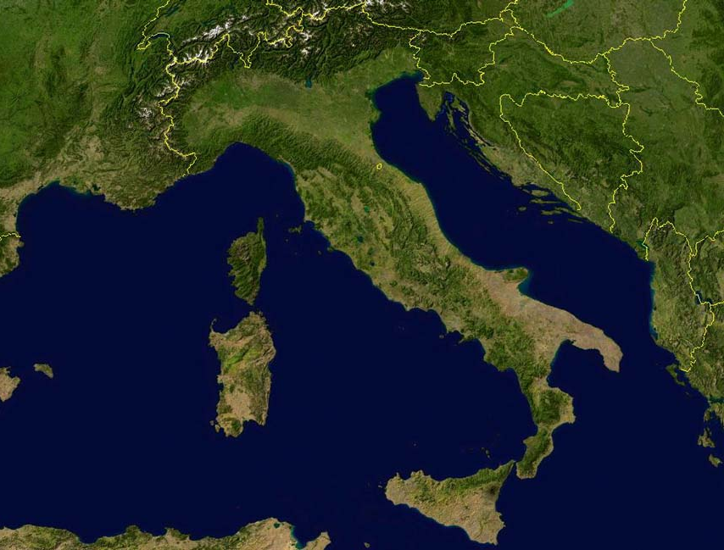

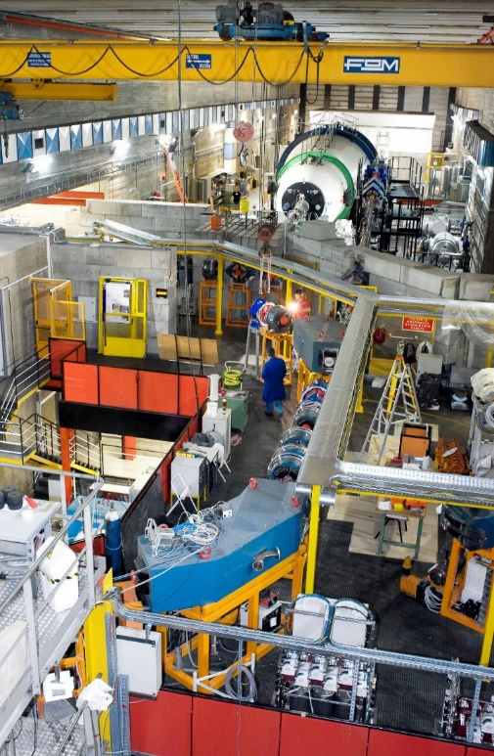
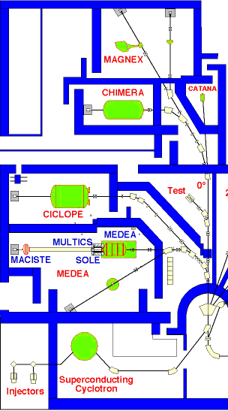
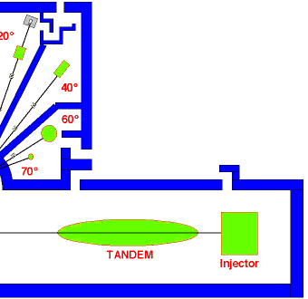
The LNS laboratory in Catania
INFN Laboratori Nazionali del Sud
Catania

Slide 17
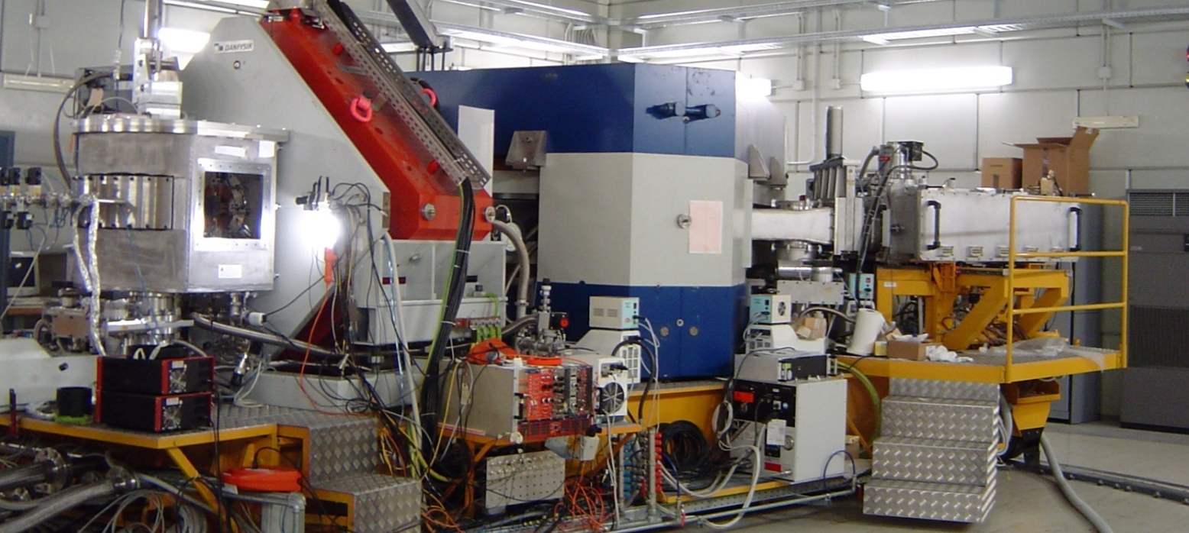
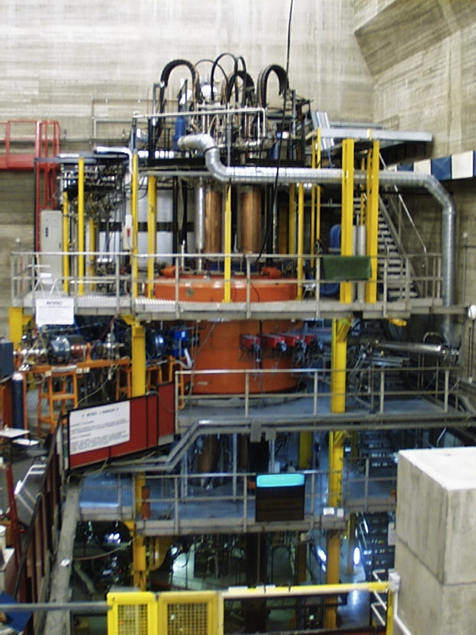
Superconducting Cyclotron and MAGNEX spectrometer @ LNS
Crucial for the experimental challenges
F. Cappuzzello et al., Eur. Phys. J. A (2016) 52: 167
In operation since 1996.
Accelerates from H to U ions
Maximum energy 80 MeV/u.
Optical characteristics | Current values
Maximum magnetic rigidity (Tm) | 1.8
Solid angle (msr) | 50
Momentum acceptance | -14%, +10%
Momentum dispersion (cm/%) | 3.68
Good compensation of
the aberrations:
Trajectory reconstruction
Measured resolutions:
Energy ΔE/E ∼ 1/1000
Angle Δθ ∼ 0.2°
Mass Δm/m ∼ 1/160

Slide 18
The Phases of NUMEN project
Phase1: The experimental feasibility
Phase2: “hot” cases optimizing the experimental conditions, getting first results and developing reliable R&D for the upgrade (approved)
Phase3: The facility upgrade (Cyclotron, MAGNEX, beam lines, …..) (approved)
Phase4 : The systematic experimental campaign
Time table
year | 2013 | 2014 | 2015 | 2016 | 2017 | 2018 | 2019 | 2020 | 2021 | 2022
Phase1 | done
Phase2 |  |  |  | Approved
Phase3 |  |  |  |  |  |  | Approved (20 M€)
Phase4

Slide 19
Numen experimental runs of Phase 2

Slide 20
Recent NUMEN experimental results

Slide 21


NUMEN runs – Phase 2
¹¹⁶Cd - ¹¹⁶Sn case
(¹⁸O,¹⁶O)
¹¹⁶Sn | ¹¹⁷Sn | ¹¹⁸Sn
¹¹⁵In | ¹¹⁶In | ¹¹⁷In
¹¹⁴Cd | ¹¹⁵Cd | ¹¹⁶Cd
Experiments @ 15 MeV/A
¹⁸O + ¹¹⁶Sn
²⁰Ne + ¹¹⁶Cd
(¹⁸O,¹⁸O)
¹¹⁶Sn | ¹¹⁷Sn | ¹¹⁸Sn
¹¹⁵In | ¹¹⁶In | ¹¹⁷In
¹¹⁴Cd | ¹¹⁵Cd | ¹¹⁶Cd
(¹⁸O,¹⁷O)
(¹⁸O,¹⁹F)
(¹⁸O,¹⁸F)
¹³⁰Te – ¹³⁰Xe case
Z
Z
(²⁰Ne,²⁰O) and ββ-
(²⁰Ne,¹⁸O)
(¹⁸O,²⁰Ne)
(¹⁸O,¹⁸Ne) and ββ+
(²⁰Ne,²⁰F)
(²⁰Ne,¹⁹F)
¹³⁰Xe | ¹³¹Xe | ¹³²Xe
¹²⁹I | ¹³⁰I | ¹³¹I
¹²⁸Te | ¹²⁹Te | ¹³⁰Te
(²⁰Ne,²¹Ne)
(²⁰Ne,²⁰Ne)
(²⁰Ne,²²Ne)
N
N
Z
(²⁰Ne,²⁰O) and ββ-
(²⁰Ne,¹⁸O)
⁷⁶Ge – ⁷⁶Se case
(²⁰Ne,²⁰F)
(²⁰Ne,¹⁹F)
(¹⁸O,¹⁶O)
Experiments @ 15 MeV/A
²⁰Ne + ⁷⁶Ge
¹⁸O + ⁷⁶Se (end of 2018)
⁷⁶Se | ⁷⁷Se | ⁷⁸Se
⁷⁵As | ⁷⁶As | ⁷⁷As
⁷⁴Ge | ⁷⁵Ge | ⁷⁶Ge
⁷⁶Se | ⁷⁷Se | ⁷⁸Se
⁷⁵As | ⁷⁶As | ⁷⁷As
⁷⁴Ge | ⁷⁵Ge | ⁷⁶Ge
(²⁰Ne,²¹Ne)
(²⁰Ne,²⁰Ne)
(¹⁸O,¹⁸O)
(¹⁸O,¹⁷O)
(²⁰Ne,²²Ne)
N
(¹⁸O,¹⁹F)
(¹⁸O,¹⁸F)
One experiment @ 15 MeV/A
²⁰Ne + ¹³⁰Te
Z
Z
(²⁰Ne,²⁰O) and ββ-
(²⁰Ne,¹⁸O)
(¹⁸O,²⁰Ne)
(¹⁸O,¹⁸Ne) and ββ+
(²⁰Ne,²⁰F)
(²⁰Ne,¹⁹F)
(²⁰Ne,²¹Ne)
(²⁰Ne,²⁰Ne)
(²⁰Ne,²²Ne)
N
N

Slide 22
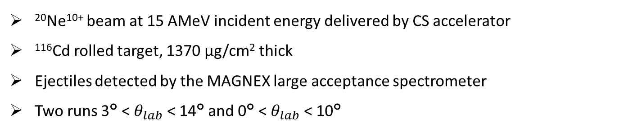
The ¹¹⁶Cd(²⁰Ne,²⁰O)¹¹⁶Sn reaction
²⁰Ne¹⁰⁺ beam at 15 AMeV incident energy delivered by CS accelerator
¹¹⁶Cd rolled target, 1370 μg/cm² thick
Ejectiles detected by the MAGNEX large acceptance spectrometer
Two runs 3° < $θ_{lab}$ < 14° and 0° < $θ_{lab}$ < 10°
Measured channels
DCE reaction ¹¹⁶Cd(²⁰Ne,²⁰O)¹¹⁶Sn
SCE reaction ¹¹⁶Cd(²⁰Ne,²⁰F)¹¹⁶In
2p-transfer ¹¹⁶Cd(²⁰Ne,¹⁸O)¹¹⁸Sn
2n-transfer ¹¹⁶Cd(²⁰Ne,²²Ne)¹¹⁴Cd
1p-transfer ¹¹⁶Cd(²⁰Ne,¹⁹F)¹¹⁷In
1n-transfer ¹¹⁶Cd(²⁰Ne,²¹Ne)¹¹⁵Cd
Elastic ¹¹⁶Cd(²⁰Ne,²⁰Ne)¹¹⁶Cd
¹¹⁶Sn | ¹¹⁷Sn | ¹¹⁸Sn
¹¹⁵In | ¹¹⁶In | ¹¹⁷In
¹¹⁴Cd | ¹¹⁵Cd | ¹¹⁶Cd
(²⁰Ne,²⁰O) and ββ-
(²⁰Ne,¹⁸O)
(²⁰Ne,²⁰F)
(²⁰Ne,¹⁹F)
Z
(²⁰Ne,²¹Ne)
(²⁰Ne,²⁰Ne)
(²⁰Ne,²²Ne)
N

Slide 23
Conclusions and Outlooks
Second order isospin excitations of nuclei are key information bridging the gap between nuclear and neutrino physics
Challenging projects on HI-DCE have started in Italy and Japan
New results coming out for different systems
A big challenge for nuclear technology and nuclear theory
NUMEN represents a central perspective for the future of LNS in nuclear science

Slide 24
Announcment
2° edition of CNNP will be held in Cape Town on 24-28 february 2020
Successful 1st edition in Catania with more than 200 participants and very lively discussions
Please take note on your agenda and have a look on it
https://indico.tlabs.ac.za/event/85/

