Slide 1
Various aspects and results on beta decay, DBD, COBRA and LFV Kai Zuber Institut für Kern- und Teilchenphysik
Fakultät Mathematik und Naturwissenschaften, Institut für Kern- und Teilchenphysik
29.5. 2019, MEDEX 2019

Slide 2
Contents
A kind of update from MEDEX 17
Highly forbidden beta decays
Double EC captures
Various double beta decays
Status of the COBRA experiment
Quenching of g_{A}
Charged lepton number violation
Summary

Slide 3
Highly forbidden beta decays
Highly forbidden beta decays have different energy spectra, a lot of operators
3-fold forbidden: ^{180m}Ta,.....nothing new
4-fold forbidden non-unique^{: 50}V,¹¹³Cd,¹¹⁵In
5-fold forbidden: ⁹⁶Zr, ⁴⁸Ca (in the range of double beta decay) nothing new
Cd-113
In-115
5-fold forbidden
Zr 96
Ca48

Slide 4
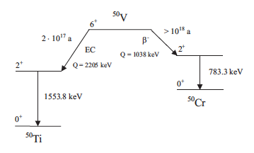
The case of V-50
The search for V-50 has a long history...started 1955
T_{1/2} > 1.7 x 10¹⁸ yrs
Measurement at PTB Braunschweig (ASSE)

Slide 5
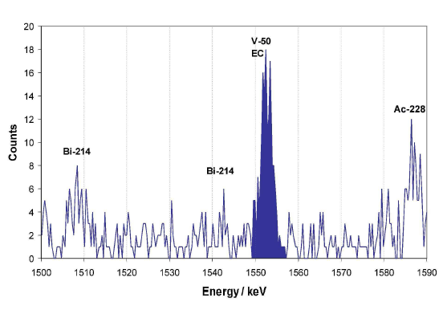
The case of V-50
H. Dombrowski, S. Neumaier, K. Zuber,
PRC 83, 054322 (2011)
What about beta- branch?
Theoretical prediction (shell model) for beta- branch:
M. Haaranen, P. Srivastava, J. Suhonen, K. Zuber, PRC 90, 044314 (2014)
New measurement at LNGS: M. Laubenstein, S. Nagorny,S. Nisi, K. Zuber

Slide 6
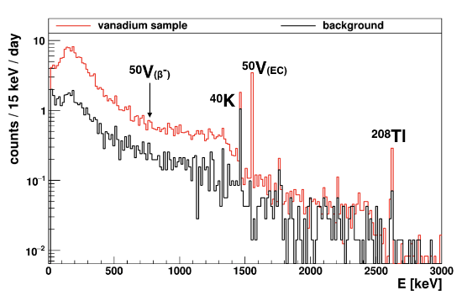
The case of V-50
M. Laubenstein et al., PRC 99, 045501 (2019)
One order improvement in beta channel, just touching theory region

Slide 7
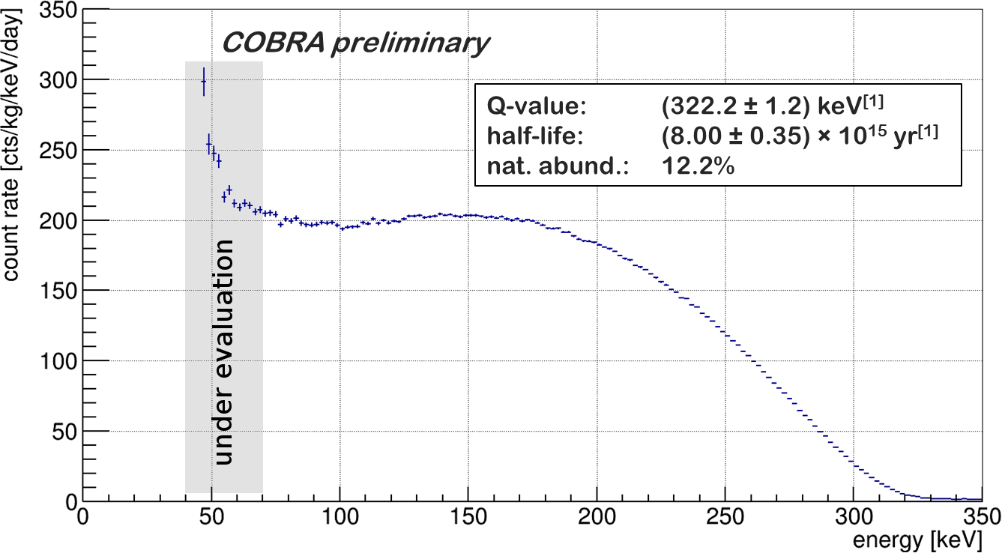
The case of ¹¹³Cd
4-fold forbidden non-unique beta decay (1/2⁺→9/2⁺)
COBRA experiment (CdZnTe Semiconductor detectors)
Q-value:
113Cd
Preliminary
J. V. Dawson et al., Nucl. Phys. A 818,264 (2009)
AME 2012 value: 322.6 0.8 keV
Penning trap value: 323.89 (27) keV
N. D. Gamage et al., Phys. Rev. C 94,025505 (2016)
Shape depends on g_{A}
M. T. Mustonen, M. Aunola, J. Suhonen , PRC 73,054301 (2006)
M. T. Mustonen, J. Suhonen,, PLB 657,38 (2007)
Half-life:

Slide 8
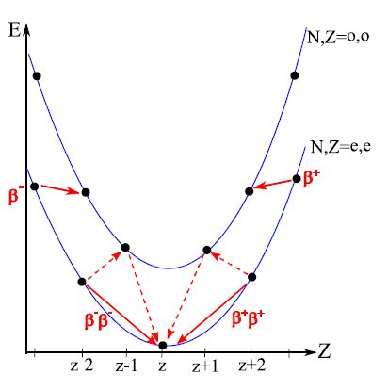
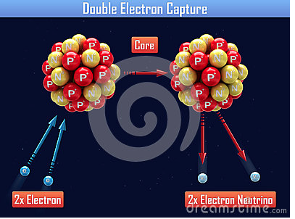
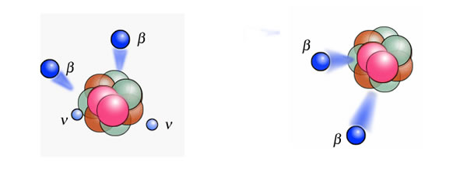
Double EC and DBD
Mass parabola (isobar)
There are 35 double beta
(and ECEC) emitters out of
which are 6 double positron emitters
Depending on Q-value competing with double positron
and EC/positron decay
Both modes can occur with/without neutrinos
Also transitions into excited states possible

Slide 9
Excited state transitions
First excited 0⁺ states have only been seen in Mo-100 and Nd-150
GERDA -results
Notes:
Die blauen Baender sind Seitenbaender fuer die Background estimation T^

Slide 10
Excited state transitions
More measurements : Excited state transition of Mo-94
3 running periods
J. Phys. G 43,115201 (2016)
T_{1/2} > 5.2 x 10¹⁹ years (90 % C.I.)
N. Dokania et al., JPG 45, 075104 (2018)

Slide 11
Double EC and DPD
Theory prediction lacking for neutrinoless double EC:
- Internal bremsstrahlungs gamma (monoenergetic)
Pair production in nuclear field
Internal conversion
M. Doi, T. Kotani, Prog. Theo. Phys. 89,130 (1993)
(GERDA and „our“ measurements)
Eur. Phys. J C 76, 652 (2016)
Again more measurements exist

Slide 12
Double EC
Suggestion: Use LXe dark matter detectors for search (^{124,126}Xe)
N. Barros, J.Thurn, K. Zuber, J. Phys. G 41, 115105 (2014)
Xenon-collab: T > 6.5 10²⁰ years, (124Xe) Phys. Rev. C 95, 024605 (2017)
XMASS-collab.: T > 2.1 10²² years (124Xe), PTEP, 053 (2018)
Russian-collab.: T > 7.7 10²¹ years (124Xe), Phys. Part. Nucl. 49, 563 (2018)
Discovery of 2ν ECEC by Xenon coll., Nature 568, 532(2019)
Xenon-collab: T = 1.8 10²² 0.5 (stat.) (sys.) years (124Xe)
More to come - more data, larger detectors like XenonNT , DARWIN and others

Slide 13
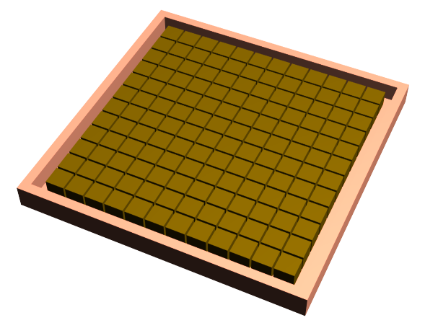
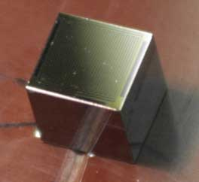
COBRA
Use large amount of
CdZnTe Room Temp
Semiconductor Detectors
Large array of
CdZnTe detectors
Q-value is 2.814 MeV
Beyond Tl-208 line!!!
Allows for searches of Te-130, Te-128, Zn-70, Cd-114, Cd-116 (two electrons)
Allows for searches of Zn-64, Cd-106, Cd-108, Te-120 (positron/EC)
K. Zuber, Phys. Lett. B 519,1 (2001)

Slide 14
COBRA
Courtesy of Stefan Zatschler

Slide 15
COBRA

Slide 16
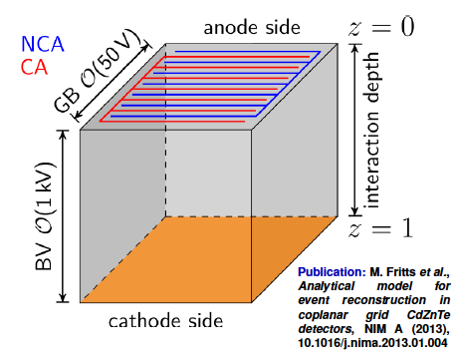
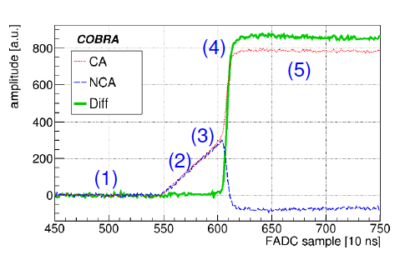
COBRA
Similar to a Frisch grid ionisation chamber
This allows:
Interaction depth determination
Discrimination of single site
vs. multiple site
A/E ratio (same analysis like GERDA)

Slide 17
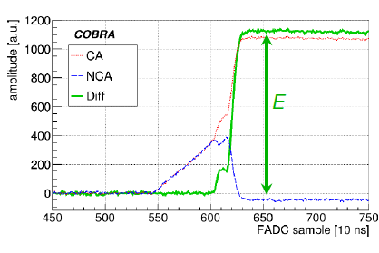
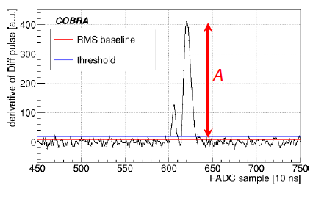
COBRA
Pulse shape analysis like GERDA A/E ratio

Slide 18
COBRA

Slide 19
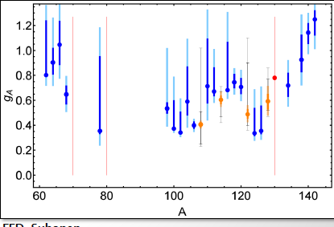
Quenching of g_{A}
F. Deppisch, J. Suhonen, Phys. Rev. C 94, 055501 (2016)

Slide 20
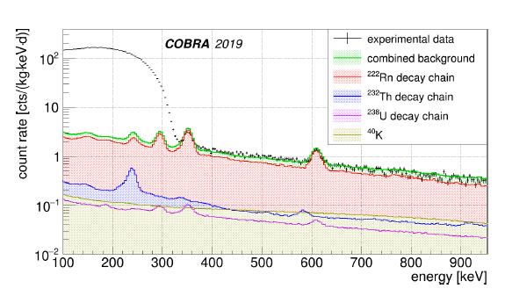
Quenching of g_{A} – (electrons)
Spectral shapes of highly forbidden beta decays are very sensitive on g_{A}
J. Suhonen, Phys. Rev. C, 96:055501 (2017)
H. Ejjri, J. Suhonen, K. Zuber, Phys. Rep. 797,1 (2019)
Here: Cd-113 (about 10¹⁵ yrs):
transition
COBRA double beta experiment is running 64 CdZnTe semiconductor detectors
Lucas Bodenstein-Dresler et al., COBRA collaboration, arXiv:1806.02254v2

Slide 21
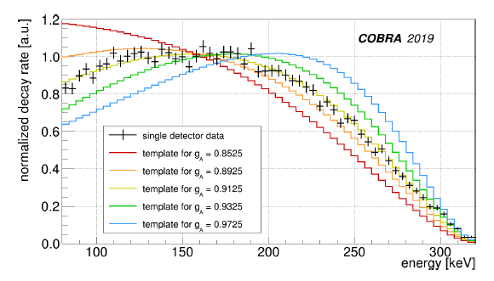
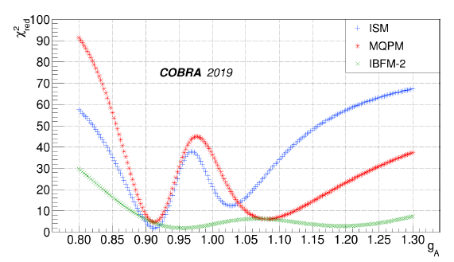
Quenching of g_{A} – (electrons)
Three models: ISM, MQPM, IBFM-2
Fine grained templates over a wide range of g_{A}
We have 45 independent detectors and thus 45 masurements

Slide 22
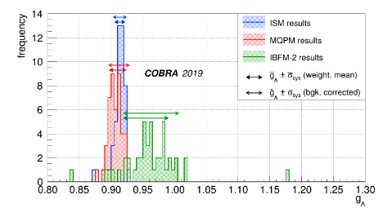
Quenching of g_{A} – (electrons)
Three models: ISM, MQPM, IBFM-2
Fine grained templates over a wide range of g_{A}
Lucas Bodenstein-Dresler et al., COBRA collaboration, arXiv:1806.02254v2

Slide 23
COBRA
Status: 9 detectors running (doubles mass)

Slide 24
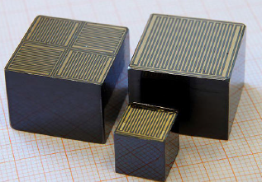
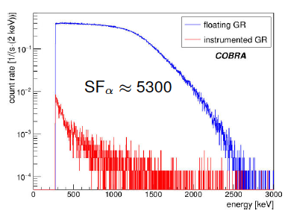
X-DEM
A bit of a technical slide
Guard ring
Massive background reduction by instrument guard ring

Slide 25
Total lepton number violation
•
Neutrino-less double beta decay
•
μ- - e+ conversion on nuclei (²⁷Al)
T. Geib, A. Merle, K. Zuber, PLB 764,157 (2017)
B. Yeo, Y. Kuno, M. Lee, K. Zuber, PRD 96,075027 (2017)
Neutrino-less double muon decay of the pion
•
(< 8.6 x 10⁻¹¹)
K. Zuber, Phys. Lett. B 479,33 (2000) J. Barley et al., Phys. Lett. B 769, 67 (2017)
In general: BSM physics

Slide 26
Charged lepton flavour violation (CLFV)
DBD limits have improve by about a factor 10 in 15 years (optimistic)
If you want to have fun: Factor 10000 in 7 years
Mu2e
Focus: Coherent muon – electron conversion on nuclei (coherent = via ground state)

Slide 27
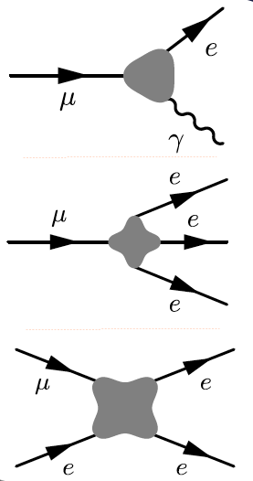
CLFV
MEG
Mu3e
COMET, Mu2e
Aim: R about 10⁻¹⁷

Slide 28
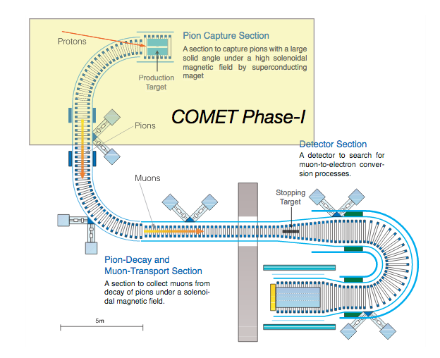
CLFV
TDR
arXiv:1812.09018
Experiment at J-PARC

Slide 29
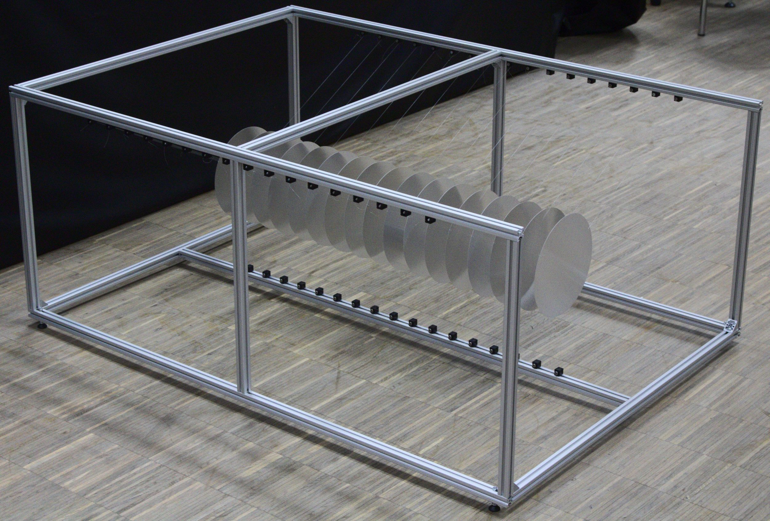
Comet

Slide 30
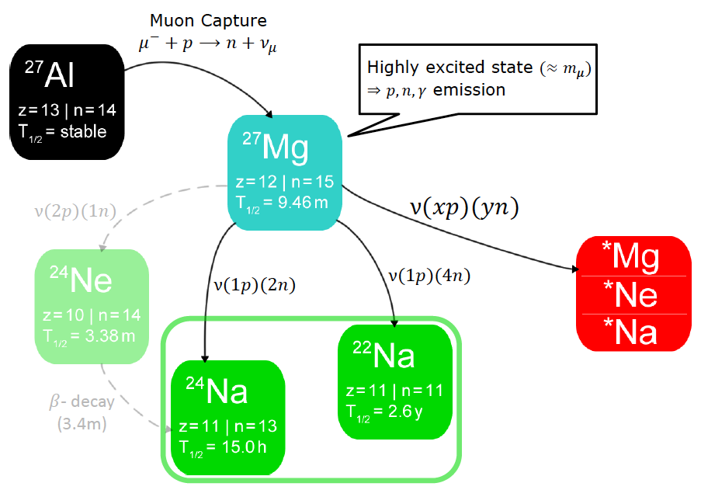
Muon-Stopping targets – The nuclear part
J. Kostensalo, J. Suhonen, O.Civitarese , PRC 98, 065504 (2018)

Slide 31
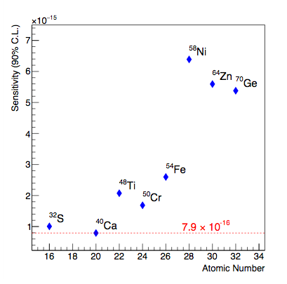
COMET
•
Muon –positron conversion on Aluminum?
•
•
If you want μ⁻ -> e⁺
Al not that good, because
of radiative muon capture
•
•
B. Yeo, Y. Kuno, M. Lee, K. Zuber,
PRD 96,075027 (2017)

Slide 32
Summary
Measurement of half-lives of long living nuclides is still very interesting as some
values are not as good as they look at first glance
The EC-branch half-life of V-50 has been measured, beta branch improved by an
an order of magnitude, but is blocked by V-50 itself
Spectral shape studies on highly forbidden beta decay of Cd-113 has
been performed by 45 detectors on 3 different models. All point towards to g_{A} <1
Various new limits on excited states searches in double beta decay and in
radiative double EC have been obtained, first detecion of 2νECEC
• Big progess expected in the next years in charged lepton number violation processes, especially muon-electron conversion

